Slide 1
Libra:
Methodology Development Library
Alexey Akimov
MolSSI workshop “Modular Software Infrastructure
for Excited State Dynamics” University at Buffalo, Buffalo, June 9, 2018
Notes:
One of the motivations for the development of this package has been my continued interest in studying methodological aspects of chemical dynamics.

Slide 2
Outline
Introduction to Quantum Dynamics Hub and Libra
Even closer marriage of C++ and Python
nHamiltonian – dynamics workflow organizer, shared access
Hierarchy of Hamiltonians – handling coupled trajectories

Slide 3
An overview of the Quantum Dynamics Hub
A platform for development of codes for quantum dynamics
Is a Github organization, not a personal repository
Code dissemination and “backup”
Version control – the history of all revisions, contributions
Quality control – Travis CI, peer-review
Learning, Discussions, and Collaboration
GitHub - version control system:
Source Codes
Web Sites
User Forum

Slide 4
Codes overview: Status, Plans, etc.
Libra
(later in this presentation)
Akimov JCC, 2016, 37, 1626
New: David Turner (Kansas State U)
parallelized version of Pyxaid, to be added soon
Pyxaid
Website: is still on the UB server, to be moved to GitHub
Akimov, Prezhdo, JCTC, 2013, 9, 4959.
Akimov, Prezhdo, JCTC, 2014, 10, 789
More: Oleg Prezhdo
Libra-X
Libra-GAMESS, Libra-QE, Libra-Gaussian
$ΔSCF−NAMD$ using QE
Pyxaid2 (no logo yet ☺)
Better modularization
SOC, multiple k-points, etc.
Both are being further modularized: to be split into: core Libra, libra_py, libra/workflows
Forked codes:
QTES code (Sophya Garshchuk group); IETSim code (Victor Batista group); SC-IVR (Nandini Ananth group)
Are being integrated into Libra… despacito… help is needed…

Slide 5
GitHub for Quantum Chemists
Central Repository
fork
Developer
Remote repo
(GitHub)
Master
Devel
Master
Devel
pull-request
git merge
git pull
git clone
git push
Merge/Revise/Decline
Local repo
(computer)
Master
Devel
Admin
More on the quality control – Matthew Chan
Developer

Slide 6
Libra overview
modular
Maximize and simplify the re-use
linear algebra, integrals,
quantum and classical mechanics/dynamics,
nonadiabatic methods, surface hopping,
IO utilities, model preparation and analysis
versatile
polymorphism
task-diversified API & UI
focus on methods
Heavily use Python, but don’t forget about C++
Present use:
[1] ETHD methodology:
Smith, B. A.; Akimov, A. V. J. Chem. Phys. 2018 148, 144106
[2] quasi-stochastic Hamiltonian approach to NA-MD
Akimov, A. V. J. Phys. Chem. Lett. 2017 8, 5190-5195
[3] Tight-binding FMO-based NA-MD
Akimov, A. V. J. Chem. Theory Comput. 2016 12, 5719-5736
Notes:
So that is what Libra is essentially about..
To give you a more practical idea of how these design principles are implemented, lets discuss several modules..

Slide 7
Modularity
Common practice
Our vision
Developer 1
Developer 2
Developer 1
Developer 2
Code 1
Code 2
Library
Method/Utility
Method/Utility
Method/Utility
Method/Utility
Method/Utility
Method/Utility
Code 1
Code 2
…
…
User
community 1
User
community 2
User
community 1
User
community 2

Slide 8
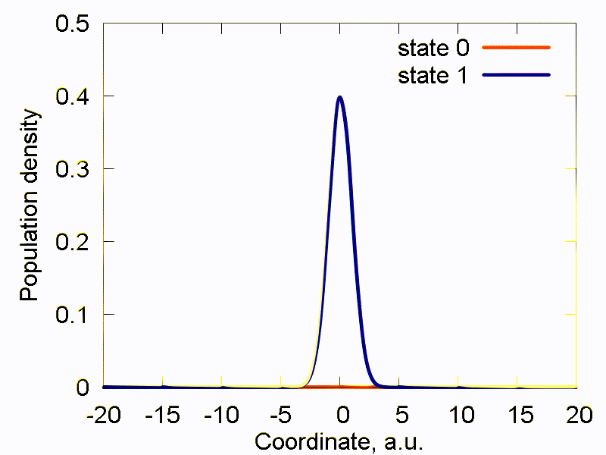
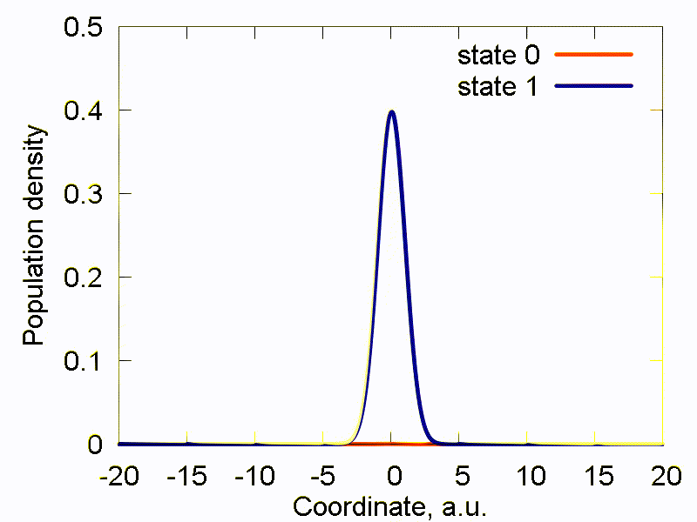
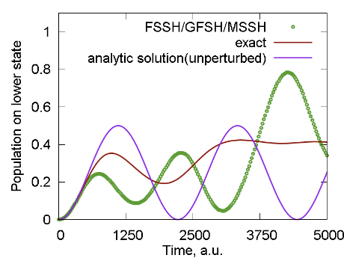
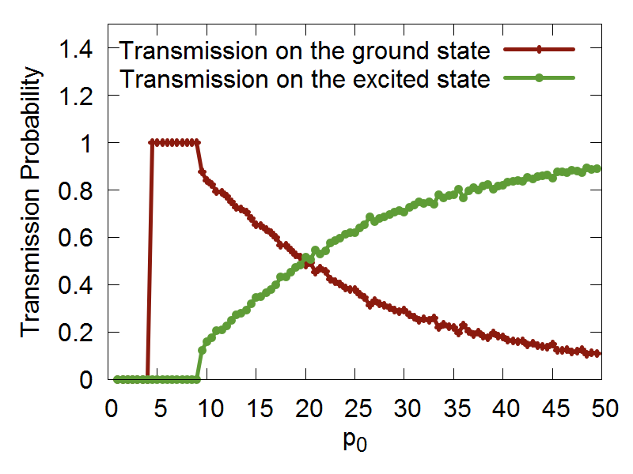
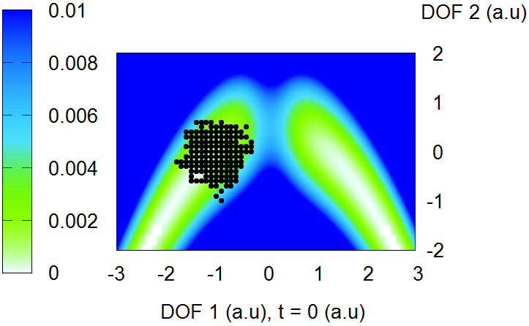
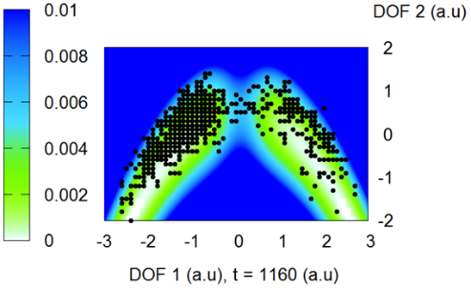
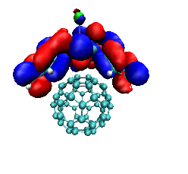
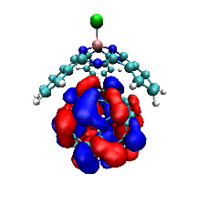
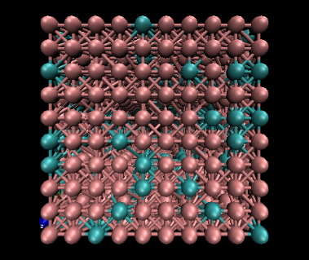
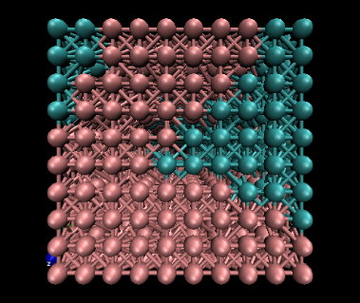
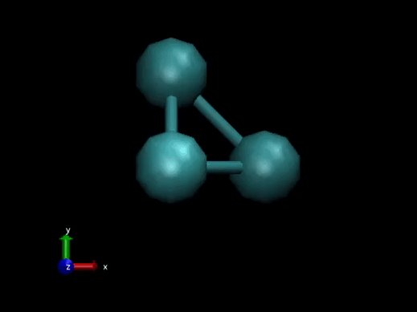
Libra versatility
Exact TD-SE integration
Ehrenfest & TSH methods
Build-in electronic structure & TSH
Entangled trajectories methods
Rigid body rotations
(e.g. PES scans)
Classical MD,
build in force fields
Lattice Monte Carlo

Slide 9
A deeper look into Libra
Nuclear dynamics: Verlet (atomistic), a family of RB-MD integrators
Coupled nuclear trajectories: ETHD/LQF
To be added: Bohmian/Liouville-based formulations (Garshchuk, Martens)
To be added: RPMD-based approaches, including NA-MD (Huo, Ananth)
Electronic dynamics: MMTS variables, Trotter-based scheme with rotations, unitary
To be added: MInt (according to Church & Ananth)
Bath: Nose, Nose-Hoover Chain
Ehrenfest dynamics: both diabatic & adiabatic representations
Surface hopping: FSSH, MSSH, GFSH
To be added: collective surface hopping approaches (e.g. Martens, Bastida, etc.)
Decoherence corrections: DISH, SDM, ID-A
Phase corrections & state reordering

Slide 10
Polymorphism
The goal is to suite the needs of the users of various levels
Find a balance between simplicity and flexibility
For C++
double gaussian_overlap( AO* AOa, AO* AOb,int is_normalize, int is_derivs, VECTOR& dIdA, VECTOR& dIdB, vector<double*>& auxd,int n_aux);
double gaussian_overlap( AO* AOa, AO* AOb,int is_normalize, int is_derivs, VECTOR& dIdA, VECTOR& dIdB );
double gaussian_overlap(AO* AOa, AO* AOb,int is_normalize);
double gaussian_overlap(AO* AOa, AO* AOb);
For Python
double gaussian_overlap( AO& AOa, AO& AOb,int is_normalize, int is_derivs, VECTOR& dIdA, VECTOR& dIdB, vector<double*>& auxd,int n_aux);
double gaussian_overlap( AO& AOa, AO& AOb,int is_normalize, int is_derivs, VECTOR& dIdA, VECTOR& dIdB );
boost::python::list gaussian_overlap( AO& AOa, AO& AOb,int is_normalize, int is_derivs);double gaussian_overlap(AO& AOa, AO& AOb,int is_normalize);
double gaussian_overlap(AO& AOa, AO& AOb);

Slide 11
C++/Python Interoperability
C++ layer
Python layer
Expose to Python
using
Boost.Python
User-Customized & Library
Python functions
Call by C++
libra_py
Prototype and
Test (Discover)
Translate code
Use in C++ codes
Use in Python codes

Slide 12
External dependencies & Plans
Eigen 3
Linear algebra (eigensolvers, etc)
Python (interface to Python)
Property tree (XML handling)
Regex
Special functions
An internal library of
molecular integrals
Further Options: PySCF, libint, PyQuante
Tighter interfacing with electronic other structure packages
Simple codes – include within Libra
Complex codes – interface within Libra
Any easy to integrate packages?
What would be useful to you?

Slide 13
Shared C++/Python Data Access
C++
Python
class CMATRIX
ham_dia = CMATRIX(2,2)
ham_adi = CMATRIX(2,2)
class nHamiltonian{
CMATRIX* ham_dia;
CMATRIX* ham_adi;
}
ham = nHamiltonian(2,2,1)
ham.set_ham_dia_by_ref(ham_dia)
ham_dia
Implementation
of all the
transformations
ham
ham.compute_adiabatic()
ham_adi
ham.set_ham_adi_by_ref(ham_adi)

Slide 14
Closer marriage of C++ & Python: Part I
vector<MATRIX> metropolis_gau
(Random& rnd,
bp::object target_distribution,
MATRIX& dof,
bp::object distribution_params,
int sample_size, int start_sampling,
double gau_var){
Implementation of the Metropolis algorithm
double p_old =
bp::extract<double>( target_distribution(s_old, distribution_params) );
…
}
def test():
q = MATRIX(ndof, 1)
output = metropolis_gau( piab, q, params, ...)
User defines how to
run the MC sampling
Sampling
def piab(q, params):
User defines what probability distribution function is to be sampled
return p # float
C++
Python

Slide 15
Example
q = MATRIX(1,1); q.set(0, 0.5)
params = {"k":1.0, "m":2000.0, "states":[0], "coeffs":[1.0]}
Nsamp = 1000000; Nstart = 50000
sampling = metropolis_gau(rnd, HO_sup, q, params, Nsamp,Nstart, 0.05)
bin(sampling, -1.5, 2.0, 0.01, 0, 0, "_distrib-1.txt")
User defines how to
run the MC sampling
def HO_sup(q, params):
k = params["k"]; m = params["m"];
states = params["states"]; coeffs = params["coeffs"]
x = q.get(0)
sz = len(states)
p = 0.0
for n in xrange(sz):
p = p + coeffs[n] * ket_n(x, states[n], k, m)
p = p * p
return p
User defines what
probability distribution
function is to be sampled

Slide 16
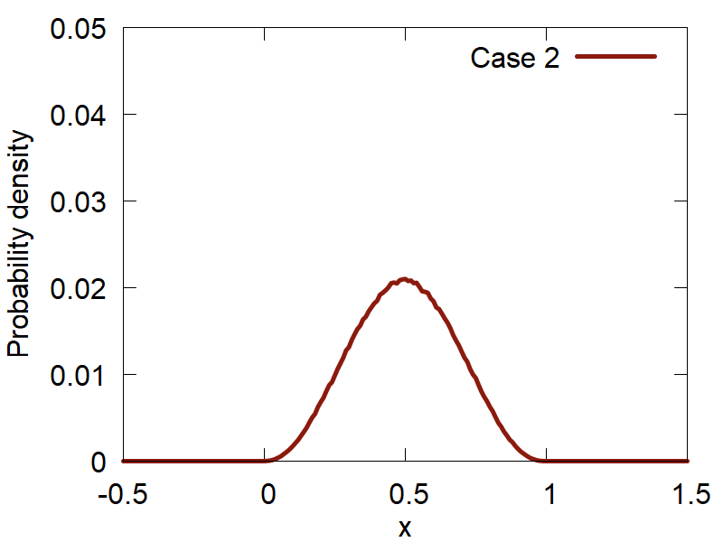
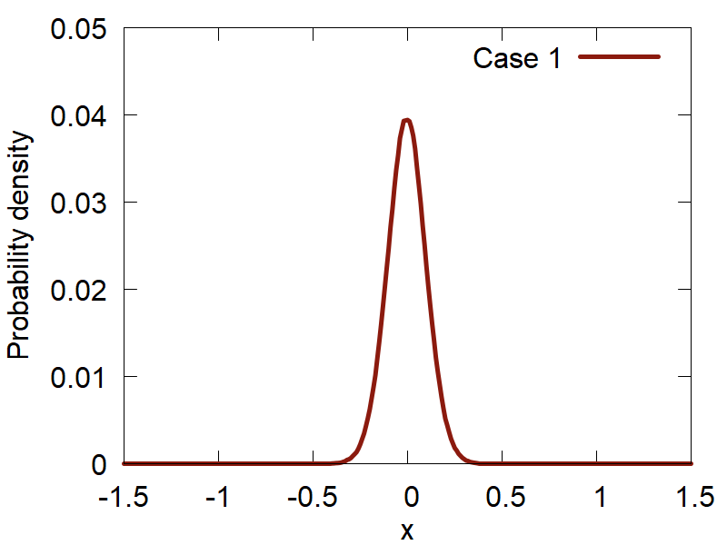
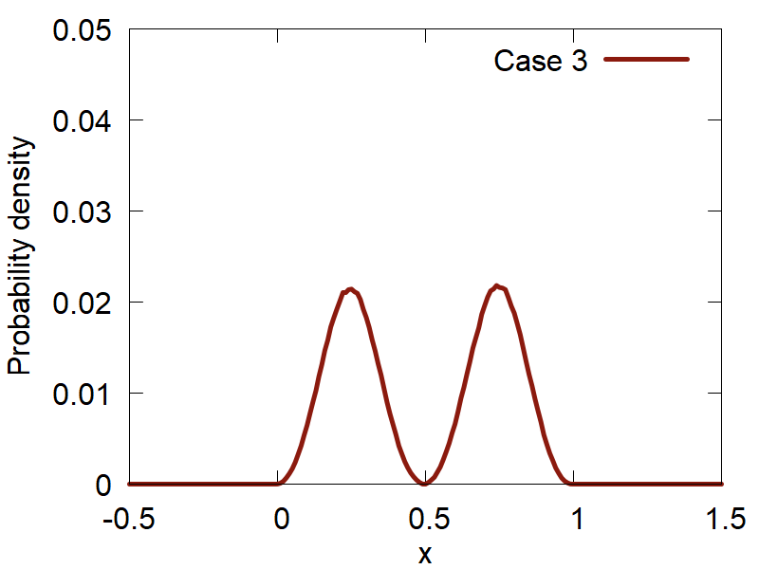
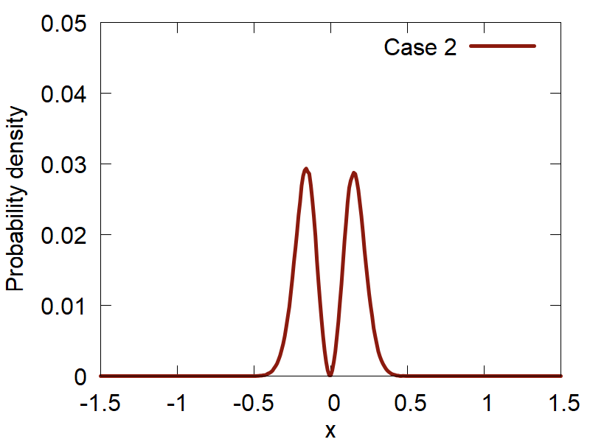
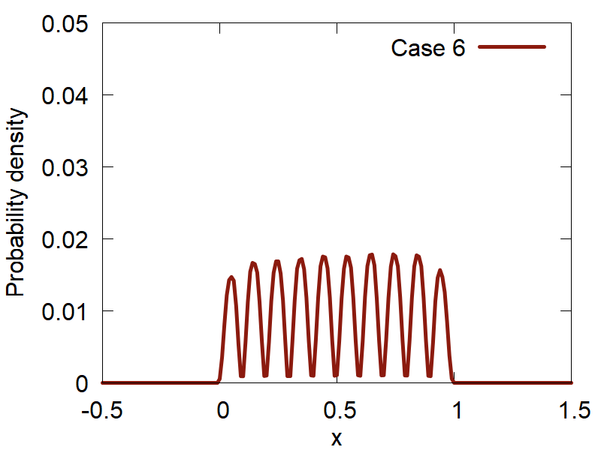
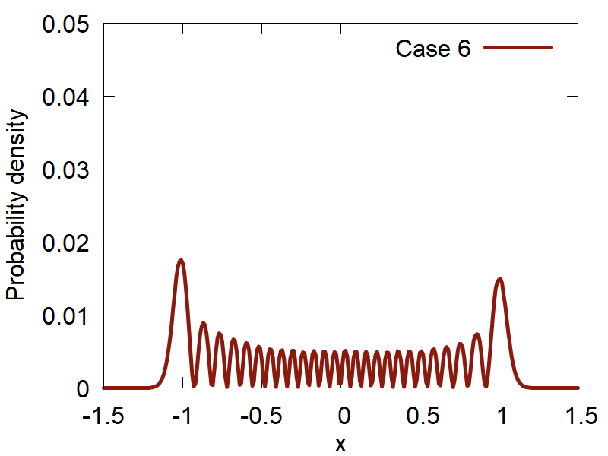
Metropolis Sampling
Particle in a box
Harmonic oscillator
$$ψ_{n}\left(q\right)\sim \sin\left(\frac{πnq}{L}\right)$$
$$ψ_{n}\left(q\right)\sim H_{n}\left(q\sqrt{α}\right)\exp\left(−\frac{αq^{2}}{2}\right)$$
$$\left.|1\right\rangle$$
$$\left.|0\right\rangle$$
$$\left.|2\right\rangle$$
$$\left.|1\right\rangle$$
$$\left.|10\right\rangle$$
$$\left.|25\right\rangle$$

Slide 17
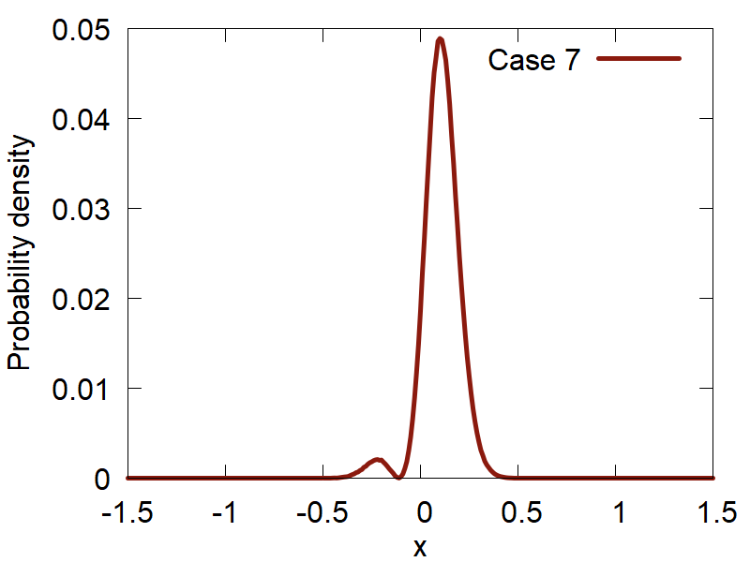
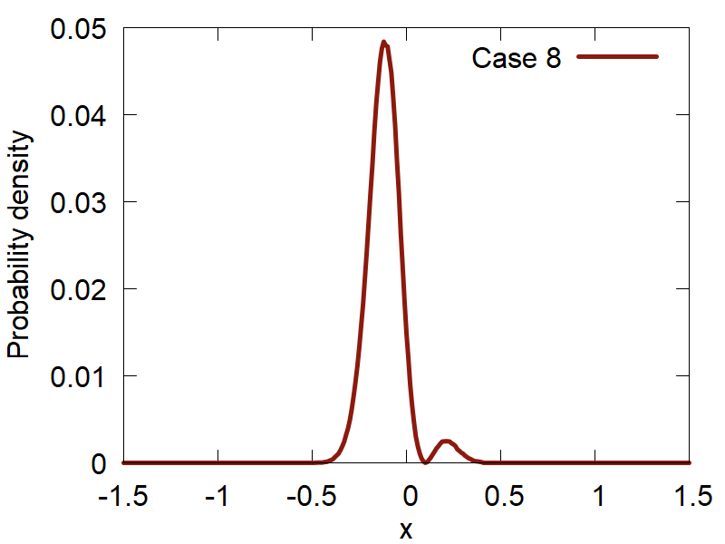
Metropolis Sampling: Superposition
$$\left.|0\right\rangle +\left.|1\right\rangle$$
$$\left.|0\right\rangle −\left.|1\right\rangle$$

Slide 18
Closer marriage of C++ & Python: Part II
nHamiltonian
def py_funct(bp::object q,
bp::object params)
Ham_adi
Ham_dia
Compute the diabatic
properties and
place the results directly
to the allocated matrices
d1Ham_adi
d1Ham_dia
…
…
Verlet(bp::object q, bp::object p, bp::object f,
bp::object py_funct, ham, bp::object py_funct params)
$$p←p+f\frac{dt}{2}$$
$$q←q+\frac{p}{m}dt$$
ham.compute_diabatic(bp::object py_funct, bp::object q, bp::object params)
ham.compute_adiabatic(int lvl)
$$p←p+f\frac{dt}{2}$$

Slide 19
Example
for i in xrange(500):
propagate_el(Cdia, Cadi, Hvib, Sdia, 0.5*dt, rep)
p = p + 0.5*f*dt
q = q + dt*p/m
compute_model(model, Hdia, Sdia, d1ham_dia, dc1_dia, q, params)
ham.compute_adiabatic(1);
f = compute_frc(ham, Cdia, Cadi, rep)
p = p + 0.5*f*dt
Hvib = compute_Hvib(Hdia, Hadi, dc1_dia, dc1_adi, p, m, rep)
propagate_el(Cdia, Cadi, Hvib, Sdia, 0.5*dt, rep)
Etot = compute_etot(ham, p, Cdia, Cadi, m, rep)
User defines how to
run the dynamical simulation
User defines what
function to use to compute entries in the
Hamiltonian object (diabatic/adiabatic Ham, overlap matrix, derivatives, etc.) - NEXT

Slide 20
Example: Model Calculations
def model2(q, params):
obj = tmp()
obj.ham_dia = CMATRIX(2,2); obj.ovlp_dia = CMATRIX(2,2);
obj.d1ham_dia = CMATRIXList(); obj.d1ham_dia.append( CMATRIX(2,2))
obj.dc1_dia = CMATRIXList(); obj.dc1_dia.append( CMATRIX(2,2))
x = q.get(0)
x0,k,D,V = params["x0"], params["k"], params["D"], params["V"]
obj.ovlp_dia.set(0,0, 1.0+0.0j); obj.ovlp_dia.set(0,1, 0.0+0.0j);
obj.ovlp_dia.set(1,0, 0.0+0.0j); obj.ovlp_dia.set(1,1, 1.0+0.0j);
obj.ham_dia.set(0,0, k*x*x*(1.0+0.0j) ); obj.ham_dia.set(0,1, V*(1.0+0.0j));
obj.ham_dia.set(1,0, V*(1.0+0.0j)); obj.ham_dia.set(1,1, (k*(x-x0)**2 + D)*(1.0+0.0j));
for i in [0]:
obj.d1ham_dia[i].set(0,0, 2.0*k*x*(1.0+0.0j) ); obj.d1ham_dia[i].set(0,1, 0.0+0.0j);
obj.d1ham_dia[i].set(1,0, 0.0+0.0j); obj.d1ham_dia[i].set(1,1,2.0*k*(x-x0)*(1.0+0.0j));
obj.dc1_dia[i].set(0,0, 0.0+0.0j); obj.dc1_dia[i].set(0,1,-0.1+0.0j);
obj.dc1_dia[i].set(1,0, 0.1+0.0j); obj.dc1_dia[i].set(1,1, 0.0+0.0j);
return obj

Slide 21
Example: Atomistic Calculations
def model_atomistic(q, params, indx):
natoms = params["natoms"]; ndof = q.num_of_rows; ndia = params[ "ndia" ]
params[ "output_filename" ] = "detailed.out“
obj = tmp()
obj.ham_dia = CMATRIX(1,1);
obj.ovlp_dia = CMATRIX(1,1); obj.ovlp_dia.set(0,0, 1.0+0.0j)
obj.d1ham_dia = CMATRIXList();
for i in xrange(ndof):
obj.d1ham_dia.append( CMATRIX(1,1) )
os.system("mkdir wd/job_"+str(indx))
os.system("cp dftb_in.hsd wd/job_"+str(indx)) #+"/dftb_in.hsd")
os.chdir("wd/job_"+str(indx))
create_input.update_coordinates(q, params)
os.system("srun %s < dftb_in.hsd > out" % (exe_name) ) # DFTB calculations are run here!
dftb_forces = parse_output.get_forces(params)
os.chdir("../../")
for i in xrange(ndof):
obj.d1ham_dia[i].set(0,0, dftb_forces[i]*(-1.0+0.0j) )
obj.dc1_dia[i].set(0, 0, 0.0+0.0j)
return obj

Slide 22
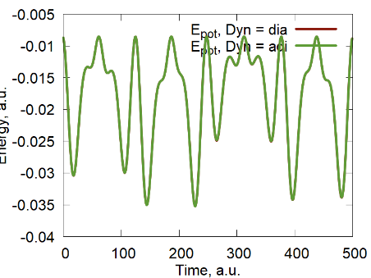
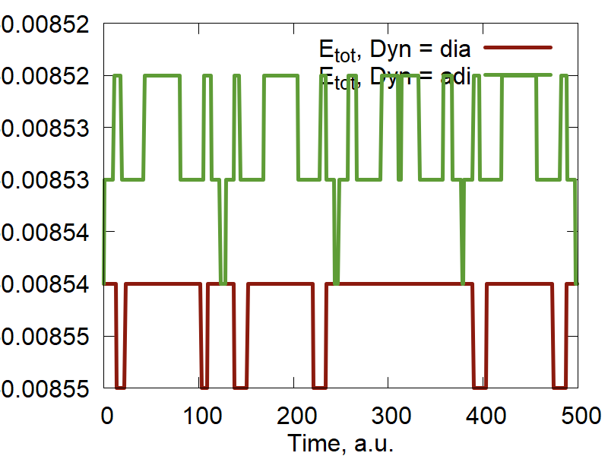
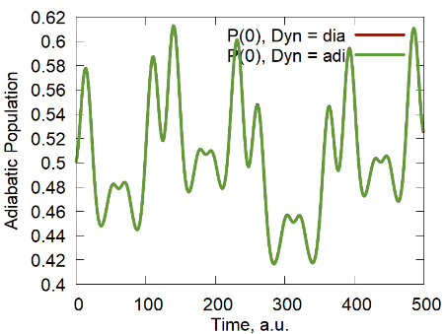
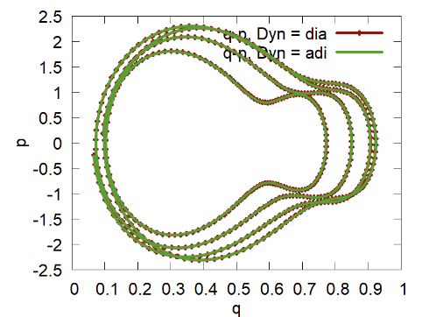
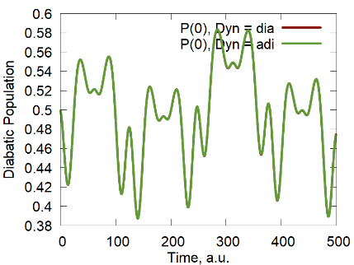
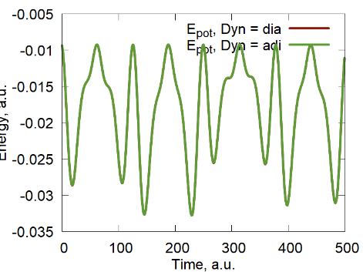
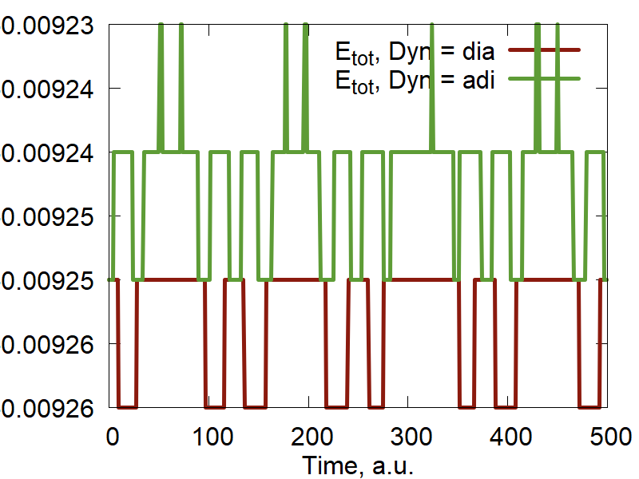
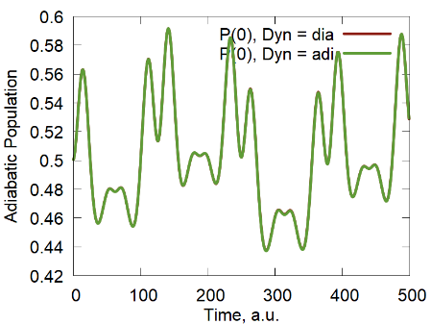
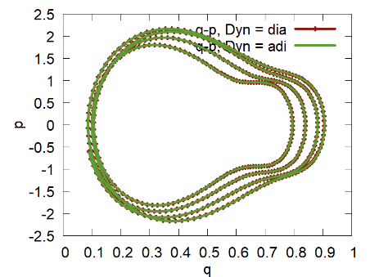
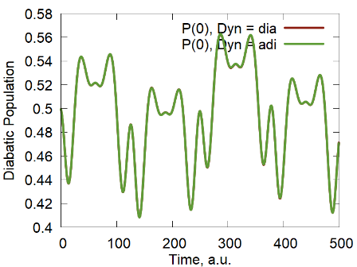
Ehrenfest Dynamics
$$H=\left(\begin{matrix}kq^{2} & V \\ V & k{\left(q−q_{0}\right)}^{2}+D\end{matrix}\right)$$
$$S=\left(\begin{matrix}1 & 0 \\ 0 & 1\end{matrix}\right)$$
$$D=\left(\begin{matrix}0 & 0 \\ 0 & 0\end{matrix}\right)$$
Model 1
$$H=\left(\begin{matrix}kq^{2} & V \\ V & k{\left(q−q_{0}\right)}^{2} +D\end{matrix}\right)$$
$$S=\left(\begin{matrix}1 & 0 \\ 0 & 1\end{matrix}\right)$$
$$D=\left(\begin{matrix}0 & −0.1 \\ 0.1 & 0\end{matrix}\right)$$
Model 2

Slide 23
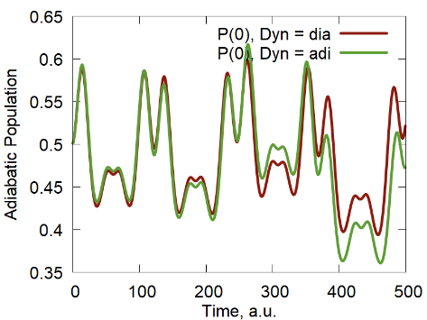
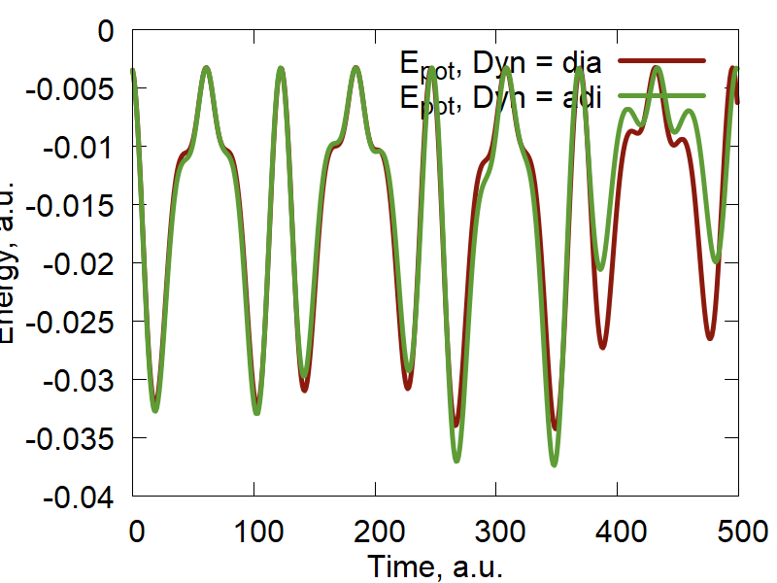
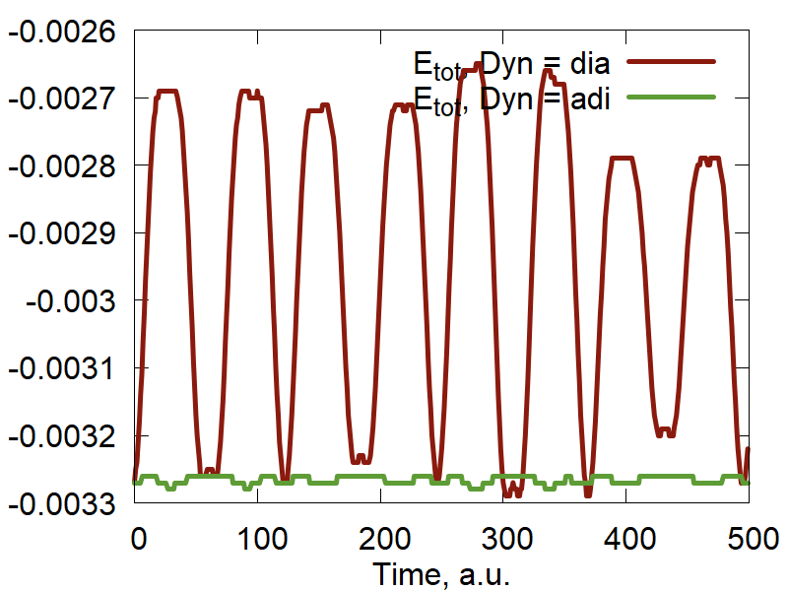
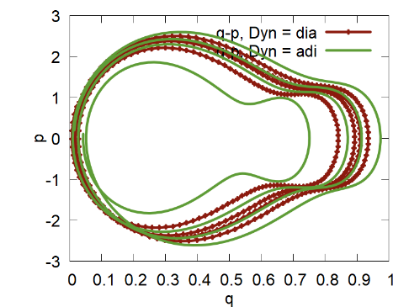
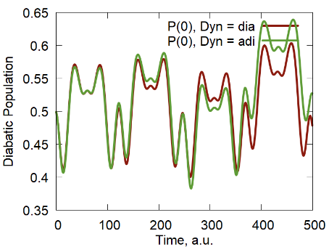
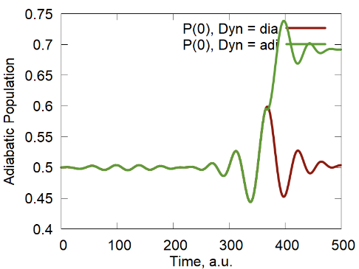
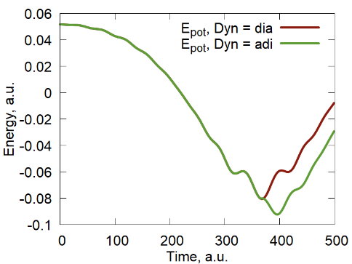
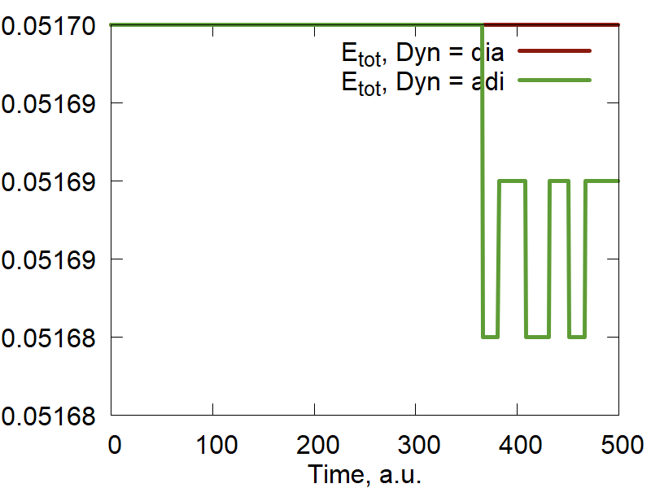
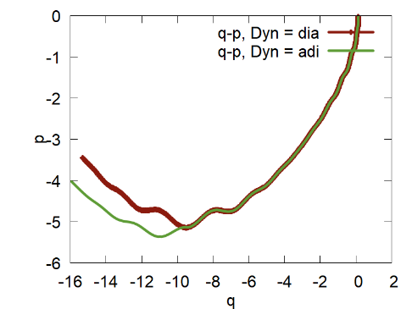
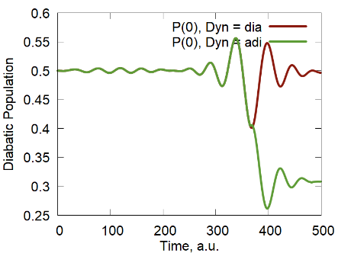
Ehrenfest Dynamics
$$S=\left(\begin{matrix}1 & 0.05e^{−{\left(q−\frac{1}{2}q_{0}\right)}^{2}} \\ 0.05e^{−{\left(q−\frac{1}{2}q_{0}\right)}^{2}} & 1\end{matrix}\right)$$
$$D=\left(\begin{matrix}0 & d \\ d & 0\end{matrix}\right)$$
Model 3
$$H=\left(\begin{matrix}kq^{2} & V \\ V & k{\left(q−q_{0}\right)}^{2}+D\end{matrix}\right)$$
$$d=\frac{1}{2}\frac{dS}{dq}$$
Model 4
$$H=\left(\begin{matrix}kcos(ωq) & V \\ V & ksin\left(ωq\right)+D\end{matrix}\right)$$
$$S=\left(\begin{matrix}1 & 0 \\ 0 & 1\end{matrix}\right)$$
$$D=\left(\begin{matrix}0 & 0 \\ 0 & 0\end{matrix}\right)$$

Slide 24
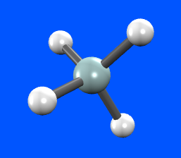
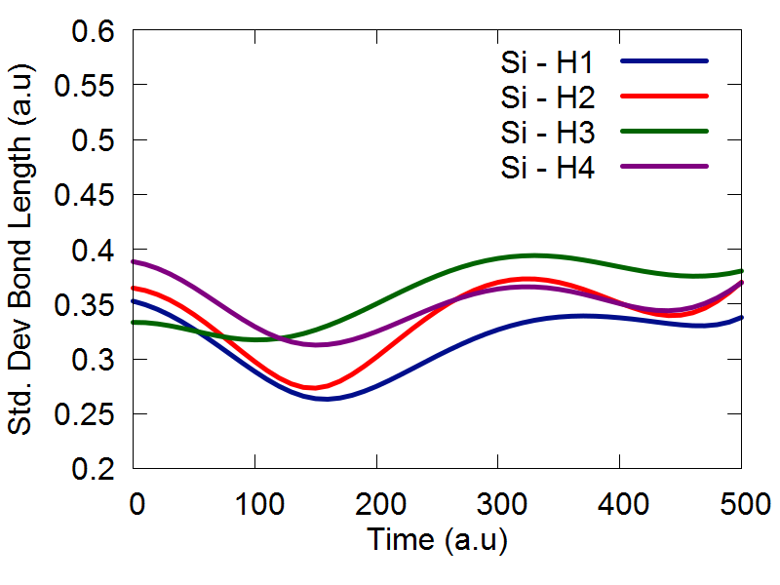
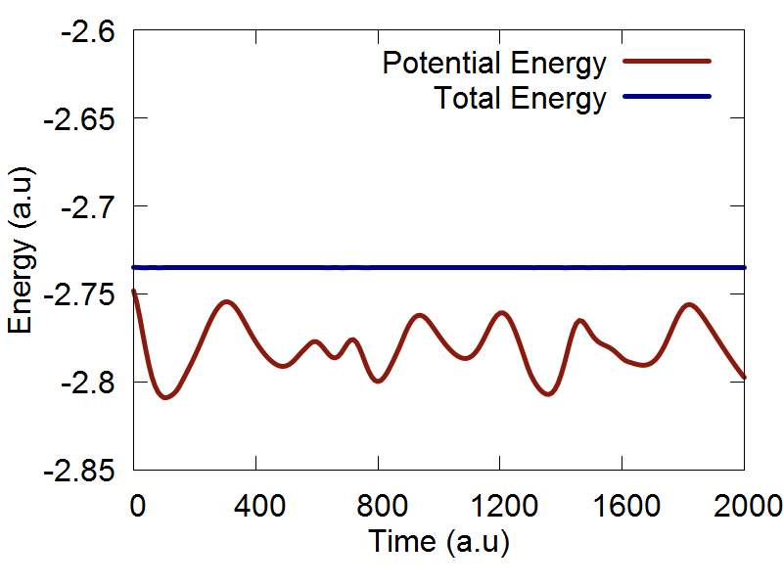
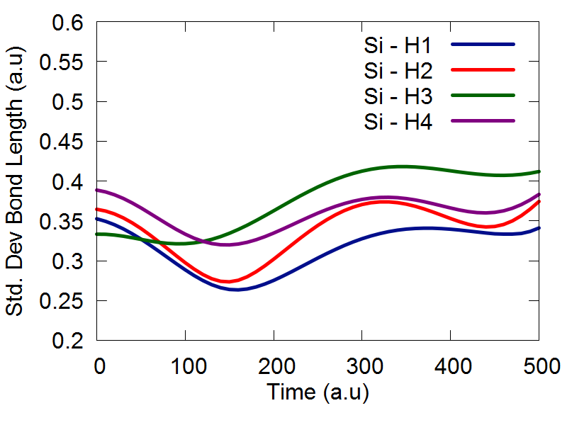
Nuclear Dynamics
Interface
with
DFTB+
Classical
ETHD

Slide 25
States reordering
$$X\left(t,t^{′}\right)=U^{+}\left(t\right)U\left(t^{′}\right)=\left(\begin{matrix}\left.u_{0}^{+}\left(t\right)u_{0}(t′\right) & \left.u_{0}^{+}\left(t\right)u_{1}(t′\right) & \begin{matrix}… & \left.u_{0}^{+}\left(t\right)u_{N−1}(t′\right)\end{matrix} \\ \left.u_{1}^{+}\left(t\right)u_{0}(t′\right) & \left.u_{1}^{+}\left(t\right)u_{1}(t′\right) & \begin{matrix}… & \left.u_{1}^{+}\left(t\right)u_{N−1}(t′\right)\end{matrix} \\ \begin{matrix}… \\ \left.u_{N−1}^{+}\left(t\right)u_{0}(t′\right)\end{matrix} & \begin{matrix}… \\ \left.u_{N−1}^{+}\left(t\right)u_{1}(t′\right)\end{matrix} & \begin{matrix}\begin{matrix}… \\ …\end{matrix} & \begin{matrix}… \\ \left.u_{N−1}^{+}\left(t\right)u_{N−1}(t′\right)\end{matrix}\end{matrix}\end{matrix}\right)$$
$$\left(\begin{matrix}… & … & \begin{matrix}… & … & …\end{matrix} \\ … & u_{i}^{+}\left(t\right)u_{i}\left(t^{′}\right)≈1 & \begin{matrix}… & u_{i}^{+}\left(t\right)u_{j}\left(t^{′}\right)≈0 & …\end{matrix} \\ \begin{matrix}… \\ … \\ …\end{matrix} & \begin{matrix}… \\ u_{j}^{+}\left(t\right)u_{i}\left(t^{′}\right)≈0 \\ …\end{matrix} & \begin{matrix}\begin{matrix}… \\ … \\ …\end{matrix} & \begin{matrix}… \\ u_{j}^{+}\left(t\right)u_{j}\left(t^{′}\right)≈1 \\ …\end{matrix} & \begin{matrix}… \\ … \\ …\end{matrix}\end{matrix}\end{matrix}\right)→\left(\begin{matrix}… & … & \begin{matrix}… & … & …\end{matrix} \\ … & u_{i}^{+}\left(t\right)u_{j}\left(t^{′}\right)≈0 & \begin{matrix}… & u_{i}^{+}\left(t\right)u_{i}\left(t^{′}\right)≈1 & …\end{matrix} \\ \begin{matrix}… \\ … \\ …\end{matrix} & \begin{matrix}… \\ u_{j}^{+}\left(t\right)u_{j}\left(t^{′}\right)≈1 \\ …\end{matrix} & \begin{matrix}\begin{matrix}… \\ … \\ …\end{matrix} & \begin{matrix}… \\ u_{j}^{+}\left(t\right)u_{i}\left(t^{′}\right)≈0 \\ …\end{matrix} & \begin{matrix}… \\ … \\ …\end{matrix}\end{matrix}\end{matrix}\right)$$
$$P_{N}^{i,j}=\left(\begin{matrix}0 & … & \begin{matrix}i & … & \begin{matrix}j & … & N−1\end{matrix}\end{matrix} \\ 0 & … & \begin{matrix}j & … & \begin{matrix}i & … & N−1\end{matrix}\end{matrix}\end{matrix}\right)$$
Indices of the eigenvectors’ columns at time $t$
Indices of the eigenvectors’ columns at time $t′$
$$P_{N}\left(t^{′}\right)=\prod_{k}{P_{N}^{i_{k},j_{k}}(t^{′})}$$
Passing over all the columns
$$M\left(t\right)=\prod_{t^{′}=0}^{t}{\left.P_{N}(t′\right)}=P_{N}\left(t\right)P_{N}\left(t−dt\right)…P_{N}\left(dt\right)P_{N}\left(0\right)$$
Keeping track of the states’
Identities over all timesteps

Slide 26
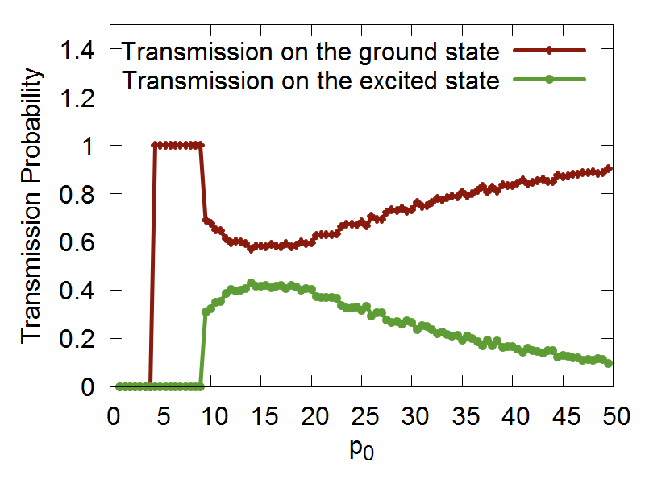
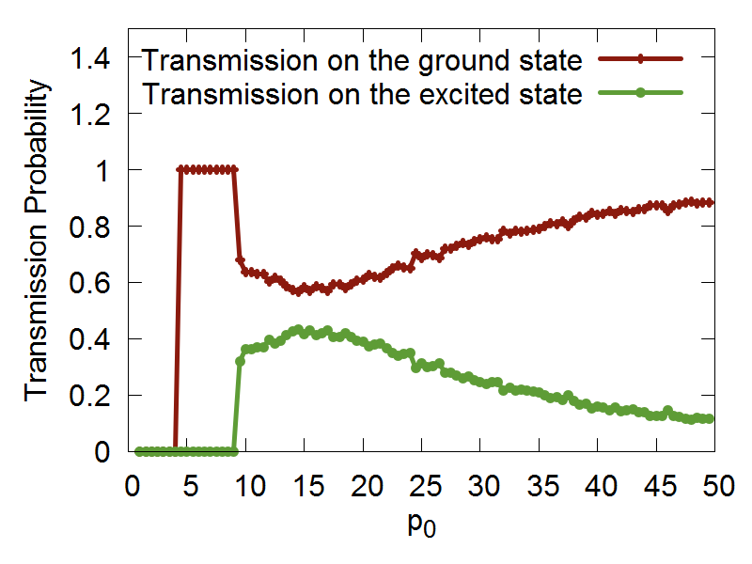
States phase correction
$$f_{i}=\frac{\left\langle \left.ψ_{i}(t\right) | \left.ψ_{i}(t′\right)\right\rangle }{\sqrt{\left|\left\langle \left.ψ_{i}(t\right) | \left.ψ_{i}(t′\right)\right\rangle \right|}}$$
$\left.|{\tilde{ψ}}_{i}(t′)\right\rangle =f_{i}^{∗}\left.|ψ_{i}(t′)\right\rangle$
Indeed:
$$\left.\left.|ψ_{i}(t\right)\right\rangle =e^{\left.iφ(t\right)}\left.\left.|χ_{i}(t\right)\right\rangle$$
$\left.|{\tilde{ψ}}_{i}(t′)\right\rangle =f_{i}^{∗}\left.|ψ_{i}(t′)\right\rangle =e^{−i\left[φ\left(t′\right)−φ(t)\right]}e^{iφ(t′)}\left.|χ_{i}(t′)\right\rangle =e^{iφ(t)}\left.|χ_{i}(t′)\right\rangle$
$$\left.\left.|ψ_{i}(t′\right)\right\rangle =e^{\left.iφ(t′\right)}\left.\left.|χ_{i}(t′\right)\right\rangle$$
Phase-correct other properties:
$$d_{ij}^{α}=\left\langle ψ_{i} | ∇_{α} | ψ_{j}\right\rangle →f_{i}\left\langle ψ_{i} | ∇_{α} | ψ_{j}\right\rangle f_{j}^{∗}$$
Reordering = 0
Phase = 0
Reordering = 1
Phase = 0
Reordering = 1
Phase = 1

Slide 27
States reordering/phase correction
Fabiano, Keal, Thiel Chem. Phys. 2008, 349, 334.
Implemented in the MNDO package
Not an open source? Phase corrections?
Modularity?
Mincost:
Fernandez-Alberti, Roitberg, Nelson, Tretiak
J. Chem. Phys. 2012, 137, 014512.
Implemented in NA-ESMD
A modular code? Possible C++ interoperability?
Python wrapping? Tutorials?
Ryabinkin, Nagesh, Izmaylov
J. Phys. Chem. Lett., 2015, 6, 4200
$\left.|{\tilde{ψ}}_{i}(t′)\right\rangle =O^{T}\left.|ψ_{i}(t′)\right\rangle$
$$O=round[X\left(t,t^{′}\right)]$$
Implemented in Newton-X
Further suggestions? Opinions? Ideas?

Slide 28
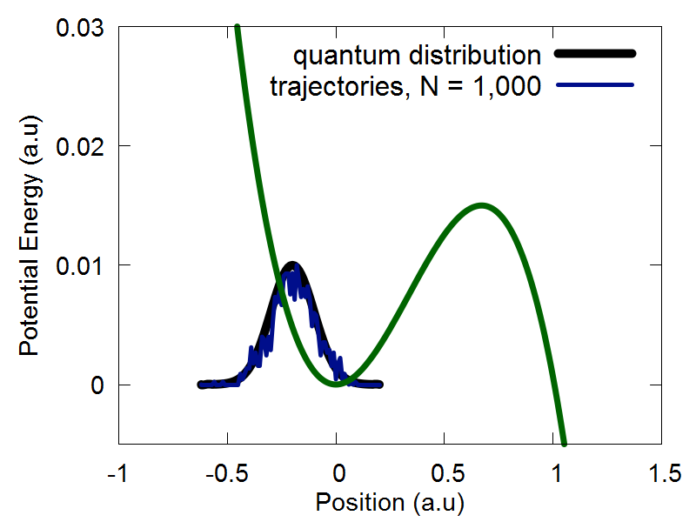
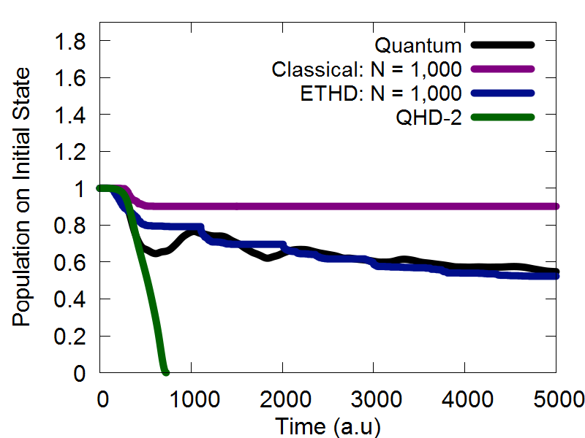
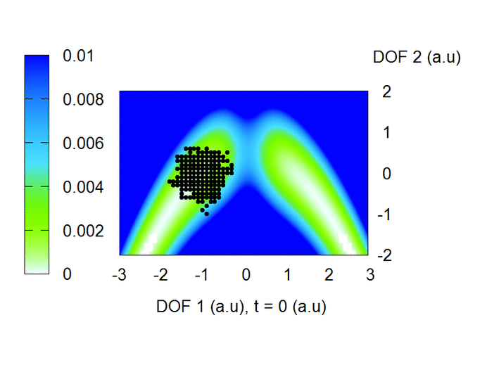
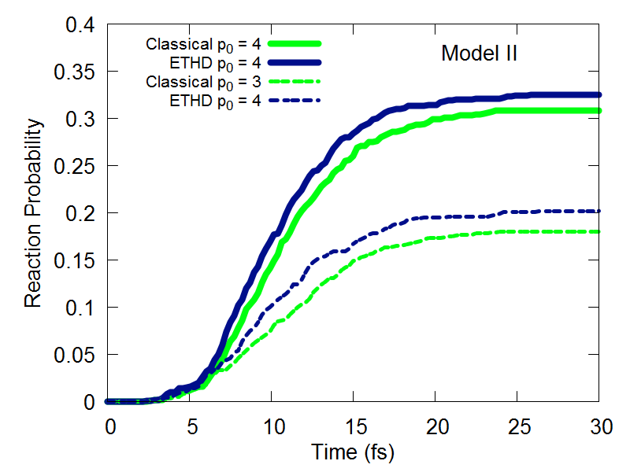
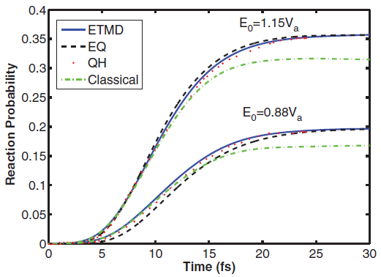
Entangled Trajectories Dynamics
$$H=\sum_{i}^{N_{traj}}{H_{class,i}}+\sum_{i=1}^{M_{group}}{\frac{Nℏ^{2}}{8m_{i}}\sum_{j=1}^{M_{DOF_{i}}}{\frac{1}{\left.s_{ij}^{2}\{q\right\}}}}$$

Slide 29
Velocity Verlet algorithm
$$p←p+f\frac{Δt}{2}$$
$$←$$
+
$$q←q+M^{−1}pΔt$$
$$←$$
+
Forces update
$$p←p+f\frac{Δt}{2}$$
$$←$$
+

Slide 30
vVerlet for multiple trajectories
$$←$$
+
$$←$$
+
Independent
Trajectories
$$H=\sum_{i}^{N_{traj}}{H_{class,i}}$$
$$←$$
+

Slide 31
vVerlet for multiple trajectories
$$←$$
+
$$←$$
+
Coupled
Trajectories
$$H′=\sum_{i=1}^{M_{group}}{\frac{Nℏ^{2}}{8m_{i}}\sum_{j=1}^{M_{DOF_{i}}}{\frac{1}{\left.s_{ij}^{2}\{q\right\}}}}$$
$$←$$
+

Slide 32
Handling multiple trajectories
$$q=$$
$N_{dof}$ the number of degrees of freedom
Options to generalize this to multiple trajectories
Extend the dimensionality
Form a supermatrix
Compact in terms of memory
Generalize the nHam
class to handle the objects
of different shape
A lot of re-coding
Re-use the existing
functionality of
the nHamiltonian
Keep UI simple
Hierarchy of Hamiltonians
Preserves the algorithm
Extends the memory requirements

Slide 33
Hierarchy of Hamiltonians
class nHamiltonian{
vector<nHamiltonian*> children;
}
Hamiltonian for
entanglement effects
Independent trajectories
All-system adiabatic states
Fragment, many-electron
orbitals
1-electron
orbitals

Slide 34
Acknowledgements
People:
Mr. Brendan Smith
Mr. Kosuke Sato
Dr. Ekadashi Pradhan
Mr. Wei Li
Special thanks to: Kortni Lindsay, Jeneen Preston, Daniel Crawford
Brendan Smith, Mahsa Jabbar
Computing resources:
Funds:
UB startup

