Slide 1


X-ray Circular Dichroism
A window to local chirality in molecules
Victor M. Freixas (vfreixas@uci.edu)

Slide 2
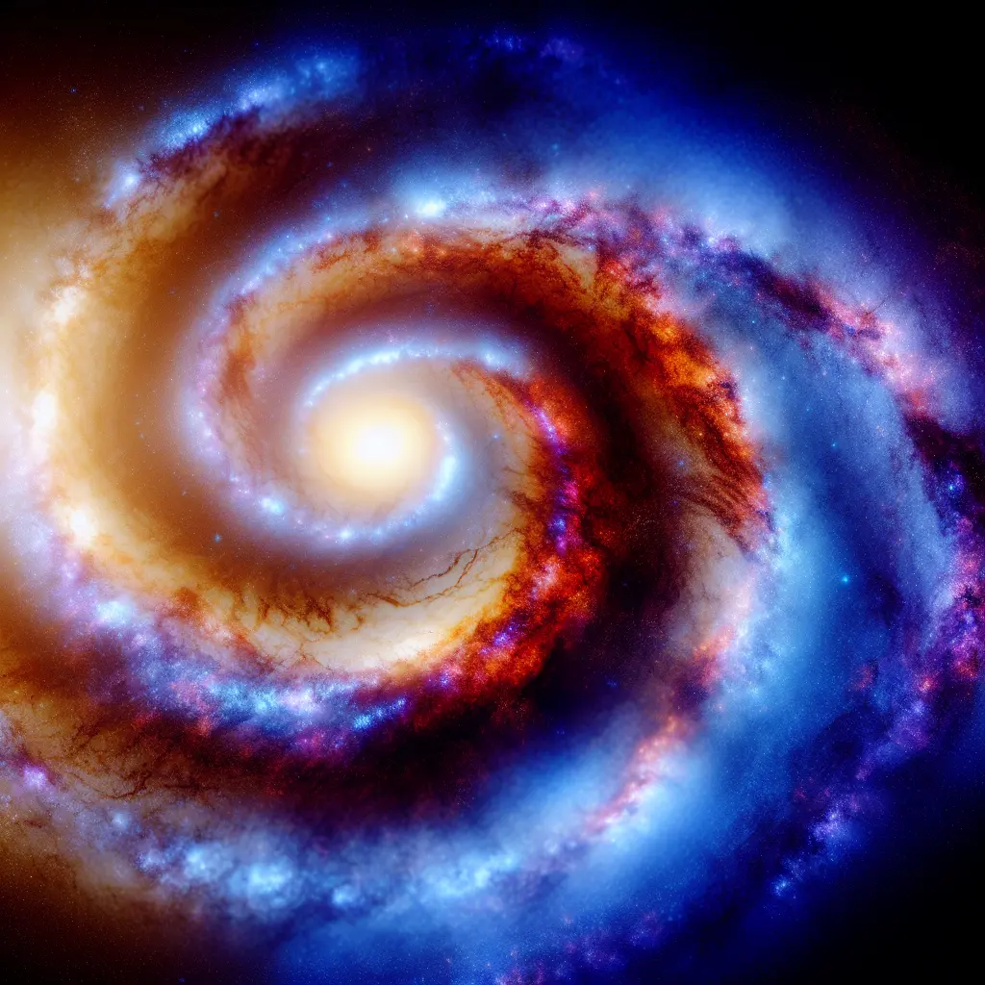

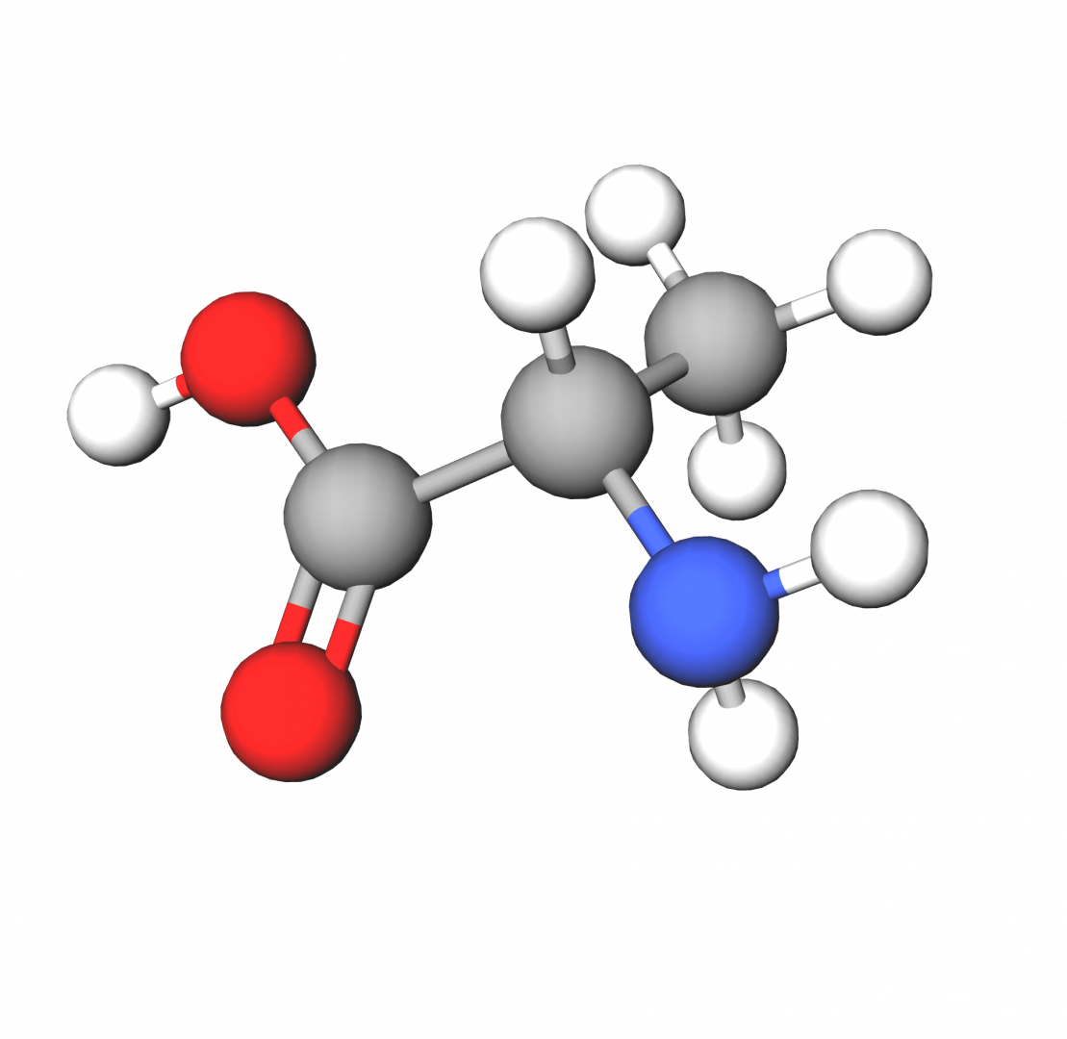

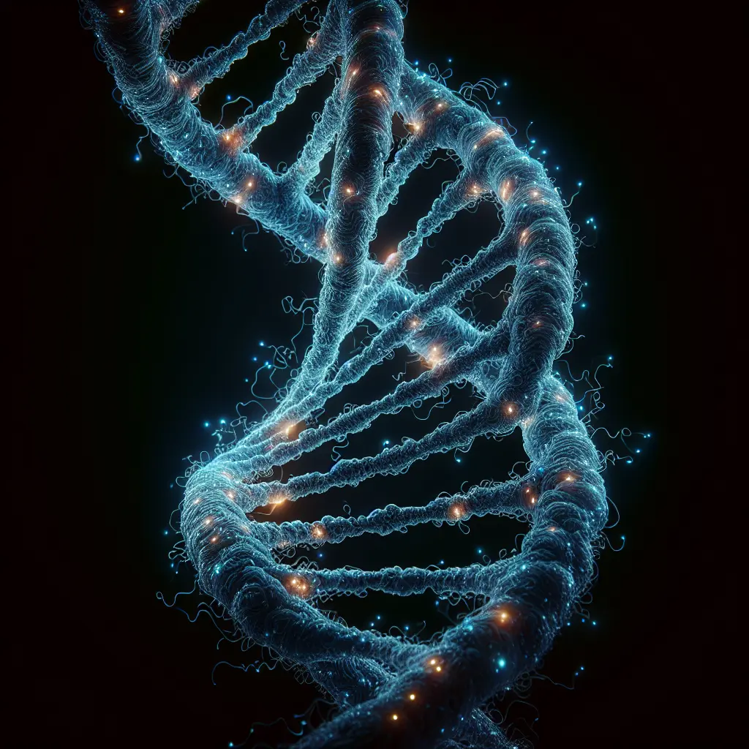
Chirality
A geometrical property characterizing those objects that can not overlap with their mirror image
10⁵ m
10⁻⁹ m
10²¹ m
10⁻¹ m
10⁻¹⁰ m

Slide 3

Molecular chirality
- Molecular chirality:
It is highly relevant in living organisms
It impacts chemical and biological function
It is essential for drug design
The wrong enantiomer can be inert or even harmful
Light can also be shaped into a chiral object
Molecular chirality is detected by circular dichroism (CD) signals
CD signals measure the difference in absorption between right and left circularly polarized light

Slide 4

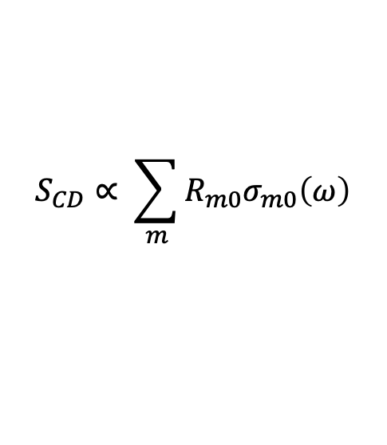

Rotatory strengths
- Rotatory strength:
After averaging over all the possible molecular orientations, CD signals become proportional to the rotatory strength:
$$S_{CD}\left(ω\right)=A^{L}\left(ω\right)−A^{R}\left(ω\right)$$
$$S_{CD}∝ \sum_{m}{R_{m0}σ_{m0}\left(ω\right)}$$
Rotatory strength is given by the inner product between the electric and magnetic transition dipoles:
$$R_{m0}=Im\left(μ_{m0}⋅m_{m0}\right)$$

Slide 5
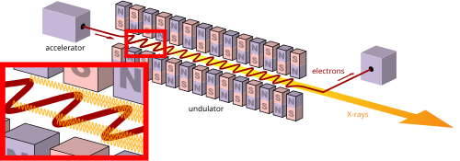
X-ray sources
- X-ray laser sources:
Provide a better time resolution allowing to probe transient process
Can be tuned to be resonant with specific X-ray chromophores electronic core transitions
Allow to probe local information
Recent advances in the control of the polarization and spatial structure of X-ray beams have paved the way for extending CD to the X-ray range (XCD)
XCD can probe the local chirality of molecules and provides the time resolution required to probe transient chiral changes

Slide 6
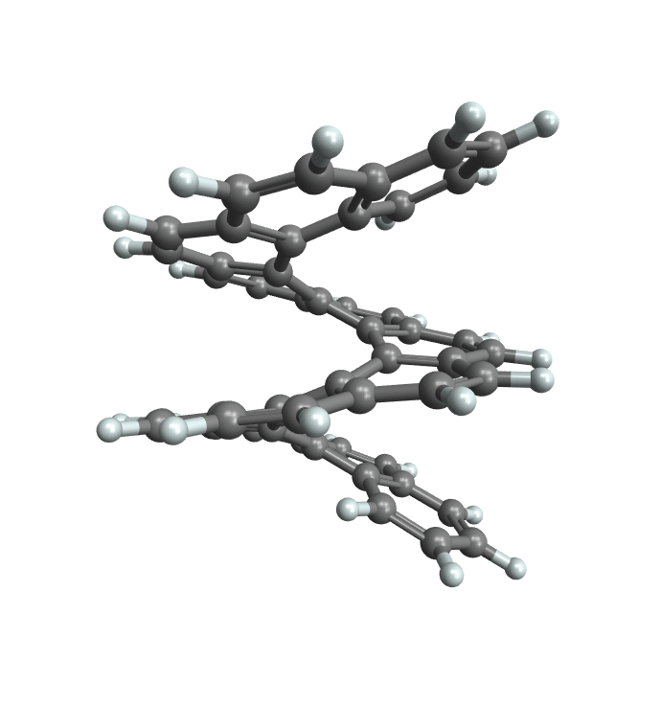
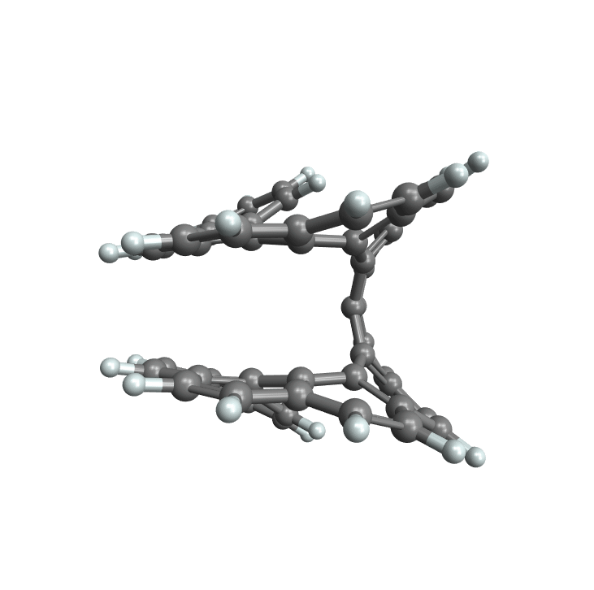
Proof of concept example

Slide 7
About Helicenes
Helix shape (HS)
- Helicene molecules:
Helicenes are twisted molecules usually having a Helix Shape (HS) conformation with a well defined global chirality
While investigating helicenes melting point, it was discovered that they can racemize at high temperatures, going from one helix orientation to the opposite
The racemization mechanism was determined to follow a conformational pathway, where a Transition State (TS) is located in the middle
In the TS, helicene becomes globally achiral while retaining two opposite local chiralities
Transition State (TS)

Slide 8
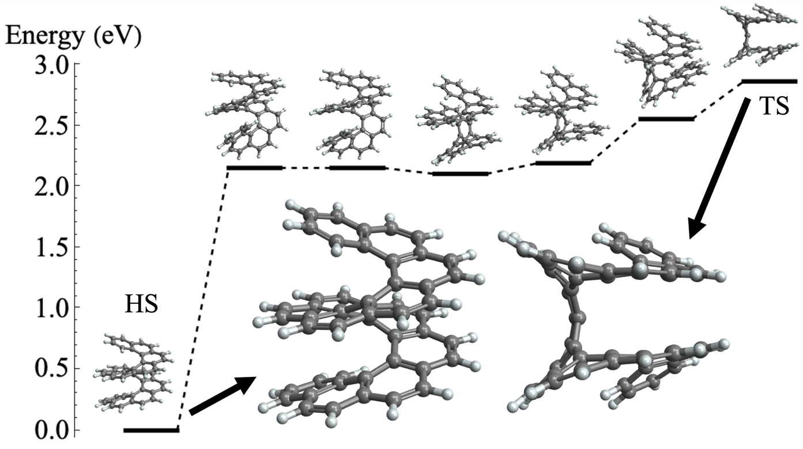
[12]Helicene half racemization pathway
- Racemization pathway:
Racemization of helicenes follows a conformational pathway ^{[12]} that is thermally activated
[12] Jorge Barroso et al., Chem. Comm. 2018, 54(2), 188-191.

Slide 9
OCD for the HS and TS configurations
- OCD signals:
OCD probes the global chirality of helicene
The HS is globally chiral as probed by OCD
The TS is globally achiral as probed by OCD

Slide 10
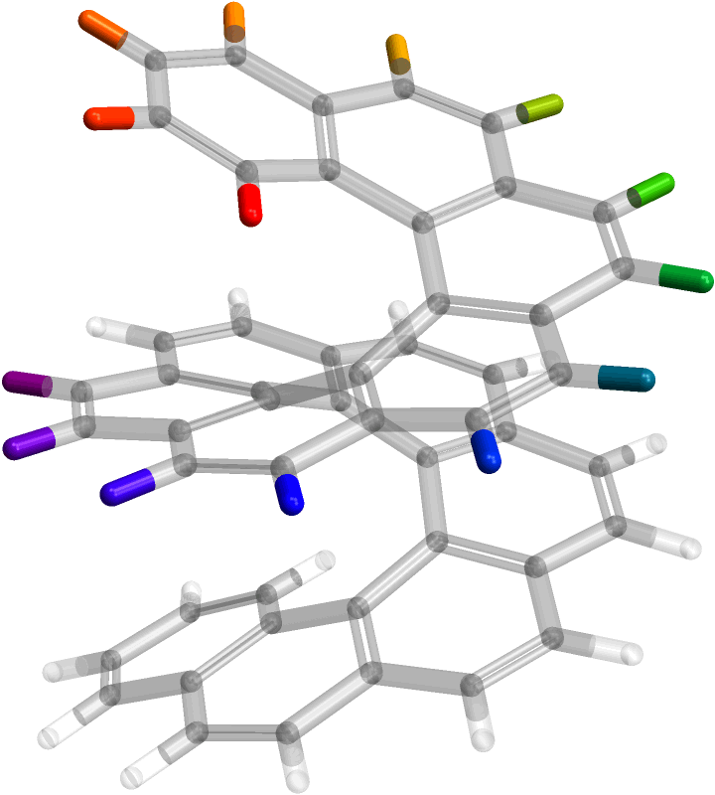
How to probe local chirality?
3
4
5
6
2
- XCD signals:
XCD can be tailored for transitions that are well localized
Carbon atoms have a small chemical shift for [12]helicene
We can perform X-ray chromophore substitutions (e.g. F) to probe the local chirality at different substitution sites (as numbered in the sketch)^{[13]}
7
1
8
14
9
13
10
12
11
1’
[13] Freixas, V. M. et al., JACS. 2023, 145(38), 21012-21019.

Slide 11
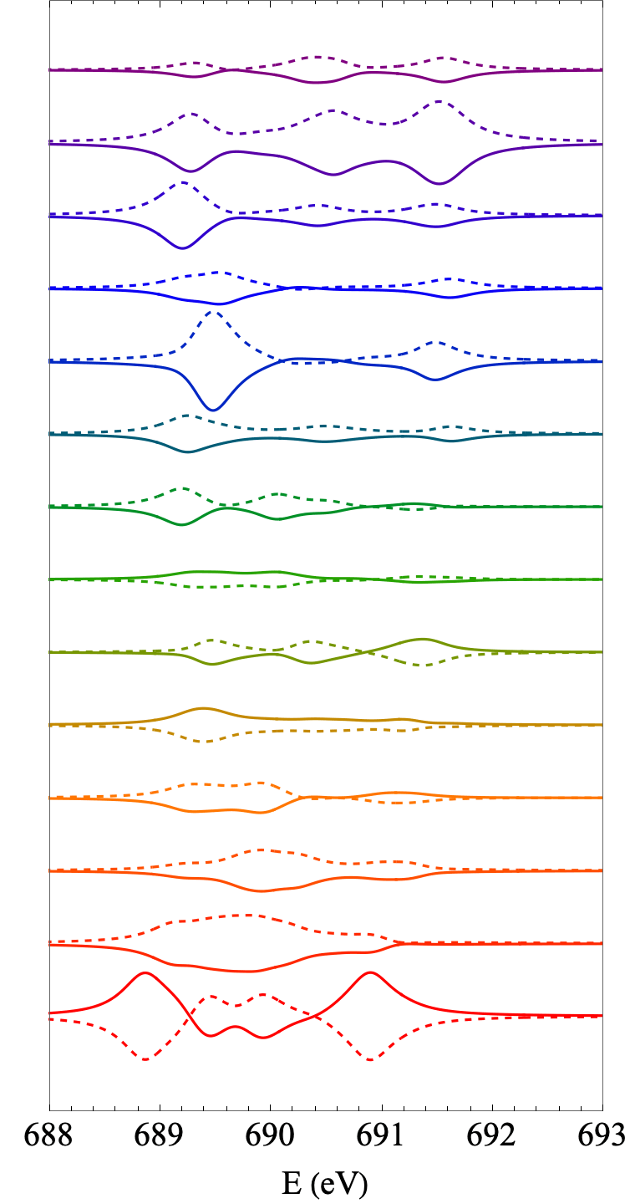
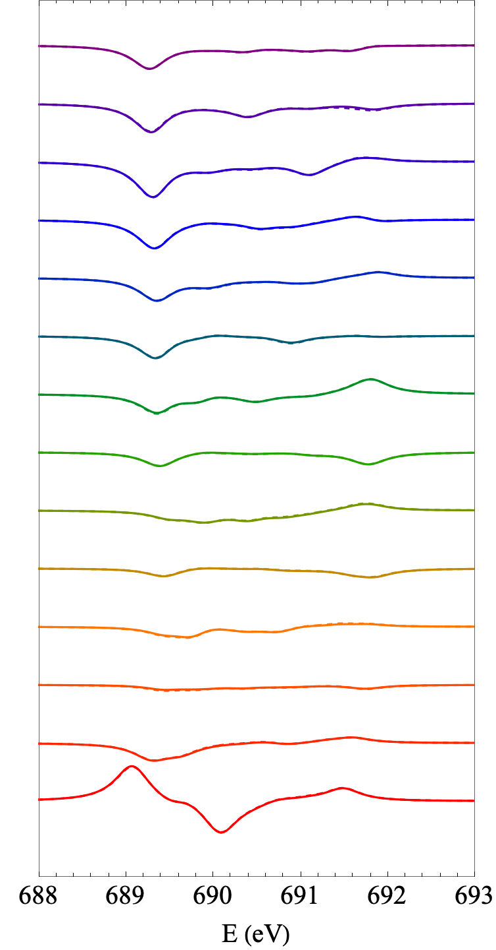
XCD for the F K-edge at different substitution sites
TS
HS
14
14
13
13
12
12
11
11
- XCD signals:
For the TS conformation XCD detects the opposite local chirality on each side of the molecule
For the HS conformation XCD detects the same local chirality on each side of the molecule
10
10
9
9
8
8
7
7
6
6
5
5
4
4
3
3
2
2
1
1

Slide 12
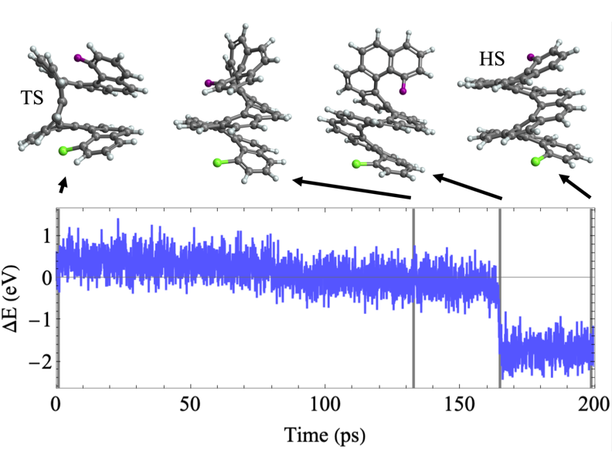
Molecular dynamics of the racemization pathway
- Molecular dynamics simulation:
Double substitutions were performed with different X-ray chromophores (F and Cl)
Ground state molecular dynamics with the Langevin thermostat at 300 K starts from the TS conformation and evolves toward the HS conformation
The potential energy drop (~165 ps) reflects the final transition to the HS conformation
F atom
Cl atom

Slide 13
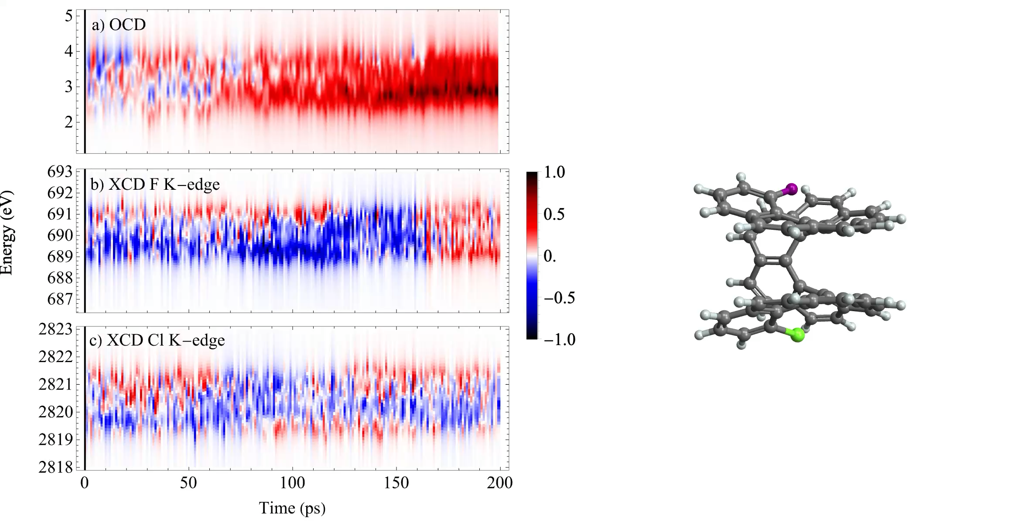
OCD vs. XCD at F and Cl K-edges
Globally chirality probed by OCD
Local chirality on the F side probed by XCD
- Molecular dynamics simulation:
The CD signal signs are represented by red vs. blue contributions
a) OCD captures the global chirality as it grows from the globally achiral TS to the globally chiral HS
b) The XCD signal on the F side shows a sudden sign flip at the local chirality transition (~165 ps)
c) The chiral transition is not detected by the XCD signal on the Cl side
F atom
Cl atom
Local chirality on the Cl side probed by XCD

Slide 14
Can we connect chiral response to the atomic orbital picture in a systematic way?
🤔

Slide 15
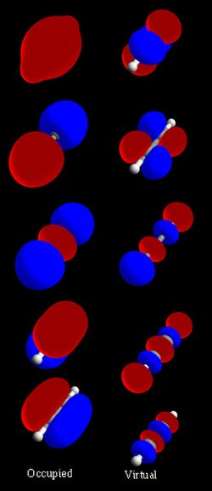
Inspiration from traditional AO plots
- Isosurface plots:
A 3D function is calculated by adding all atomic orbital (AO) contributions for a given point in space
The AO are weighted according to the specific object represented
Examples:
Molecular Orbitals (MOs) are given by linear combinations of AOs and these coefficients are used directly as the weights (see acetylene MOs on the right)
For excitonic states, diagonal elements of the transitioin density matrix (TDM), representing the transition charge density, can be used as the weights
For charge transfer states, a SVD of the TDM can be performed to get hole and particle components

Slide 16
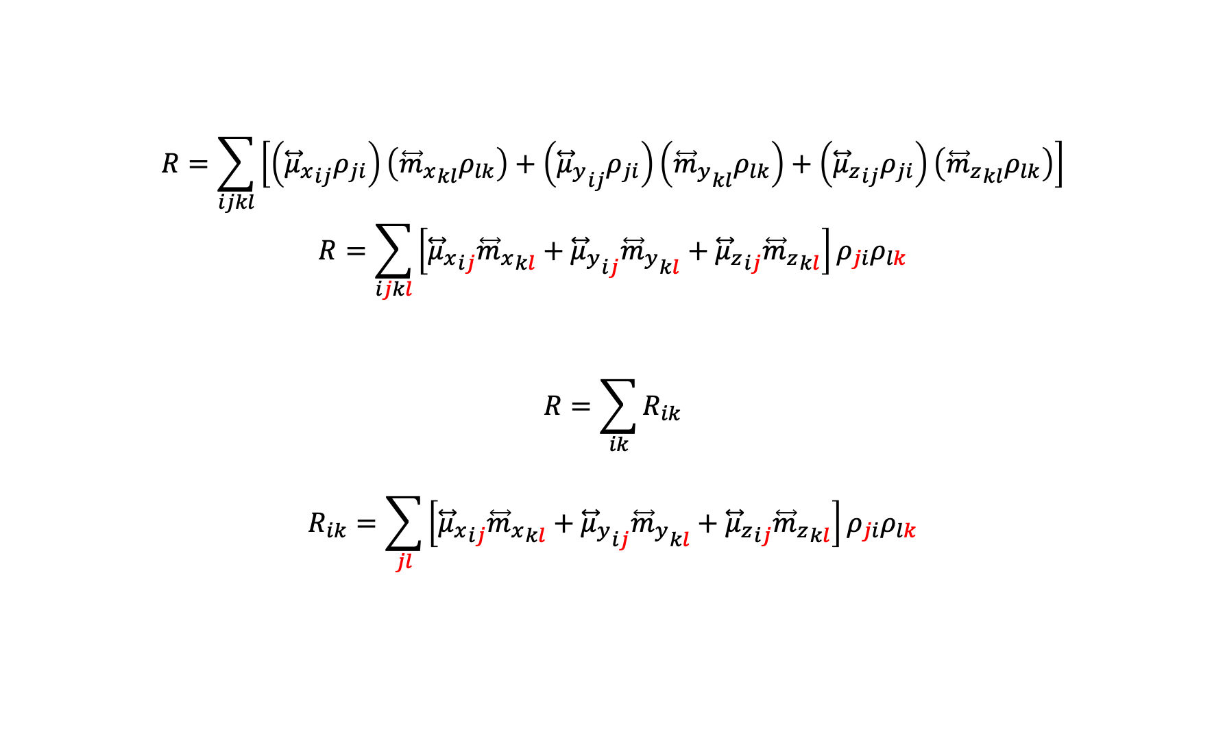
Dissecting the rotatory strength
$$R=\sum_{ijkl}{\left[\left({{\overset{⃡}{μ}}_{x}}_{ij}ρ_{ji}\right)\left({{\overset{⃡}{m}}_{x}}_{kl}ρ_{lk}\right)+\left({{\overset{⃡}{μ}}_{y}}_{ij}ρ_{ji}\right)\left({{\overset{⃡}{m}}_{y}}_{kl}ρ_{lk}\right)+\left({{\overset{⃡}{μ}}_{z}}_{ij}ρ_{ji}\right)\left({{\overset{⃡}{m}}_{z}}_{kl}ρ_{lk}\right)\right]}$$
$$R=\sum_{ijkl}{\left[{{\overset{⃡}{μ}}_{x}}_{ij}{{\overset{⃡}{m}}_{x}}_{kl}+{{\overset{⃡}{μ}}_{y}}_{ij}{{\overset{⃡}{m}}_{y}}_{kl}+{{\overset{⃡}{μ}}_{z}}_{ij}{{\overset{⃡}{m}}_{z}}_{kl}\right]}ρ_{ji}ρ_{lk}$$
$$R=\sum_{ik}{R_{ik}}$$
$$R_{ik}=\sum_{jl}{\left[{{\overset{⃡}{μ}}_{x}}_{ij}{{\overset{⃡}{m}}_{x}}_{kl}+{{\overset{⃡}{μ}}_{y}}_{ij}{{\overset{⃡}{m}}_{y}}_{kl}+{{\overset{⃡}{μ}}_{z}}_{ij}{{\overset{⃡}{m}}_{z}}_{kl}\right]ρ_{ji}ρ_{lk}}$$
$R_{ik}$ represents contributions to the chiral response of electric dipole from AO $i$ and magnetic dipole from AO $k$

Slide 17
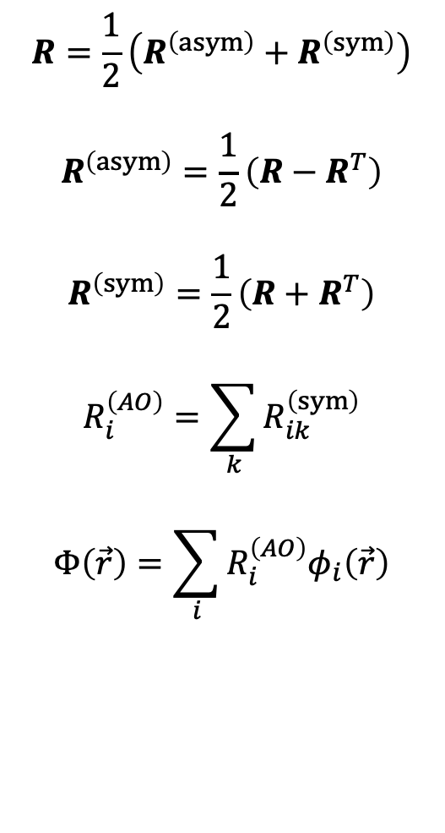
Chiral population analysis
$$R=\frac{1}{2}\left(R^{\left(asym\right)}+R^{\left(sym\right)}\right)$$
$$R^{\left(asym\right)}=\frac{1}{2}\left(R−R^{T}\right)$$
$$R^{\left(sym\right)}=\frac{1}{2}\left(R+R^{T}\right)$$
$$R_{i}^{\left(AO\right)}=\sum_{k}{R_{ik}^{\left(sym\right)}}$$
$$Φ\left(\vec{r}\right)=\sum_{i}{R_{i}^{\left(AO\right)}φ_{i}\left(\vec{r}\right)}$$
Has no contributions to the rotatory strength
Retains the physically meaningful constructive contributions to the rotatory strength
Chiral populations^{[14]} analogous to Mulliken charges
Chiral population orbitals
[14] Freixas, V. M. et al., Chem. Sci. 2025 (under revision)

Slide 18
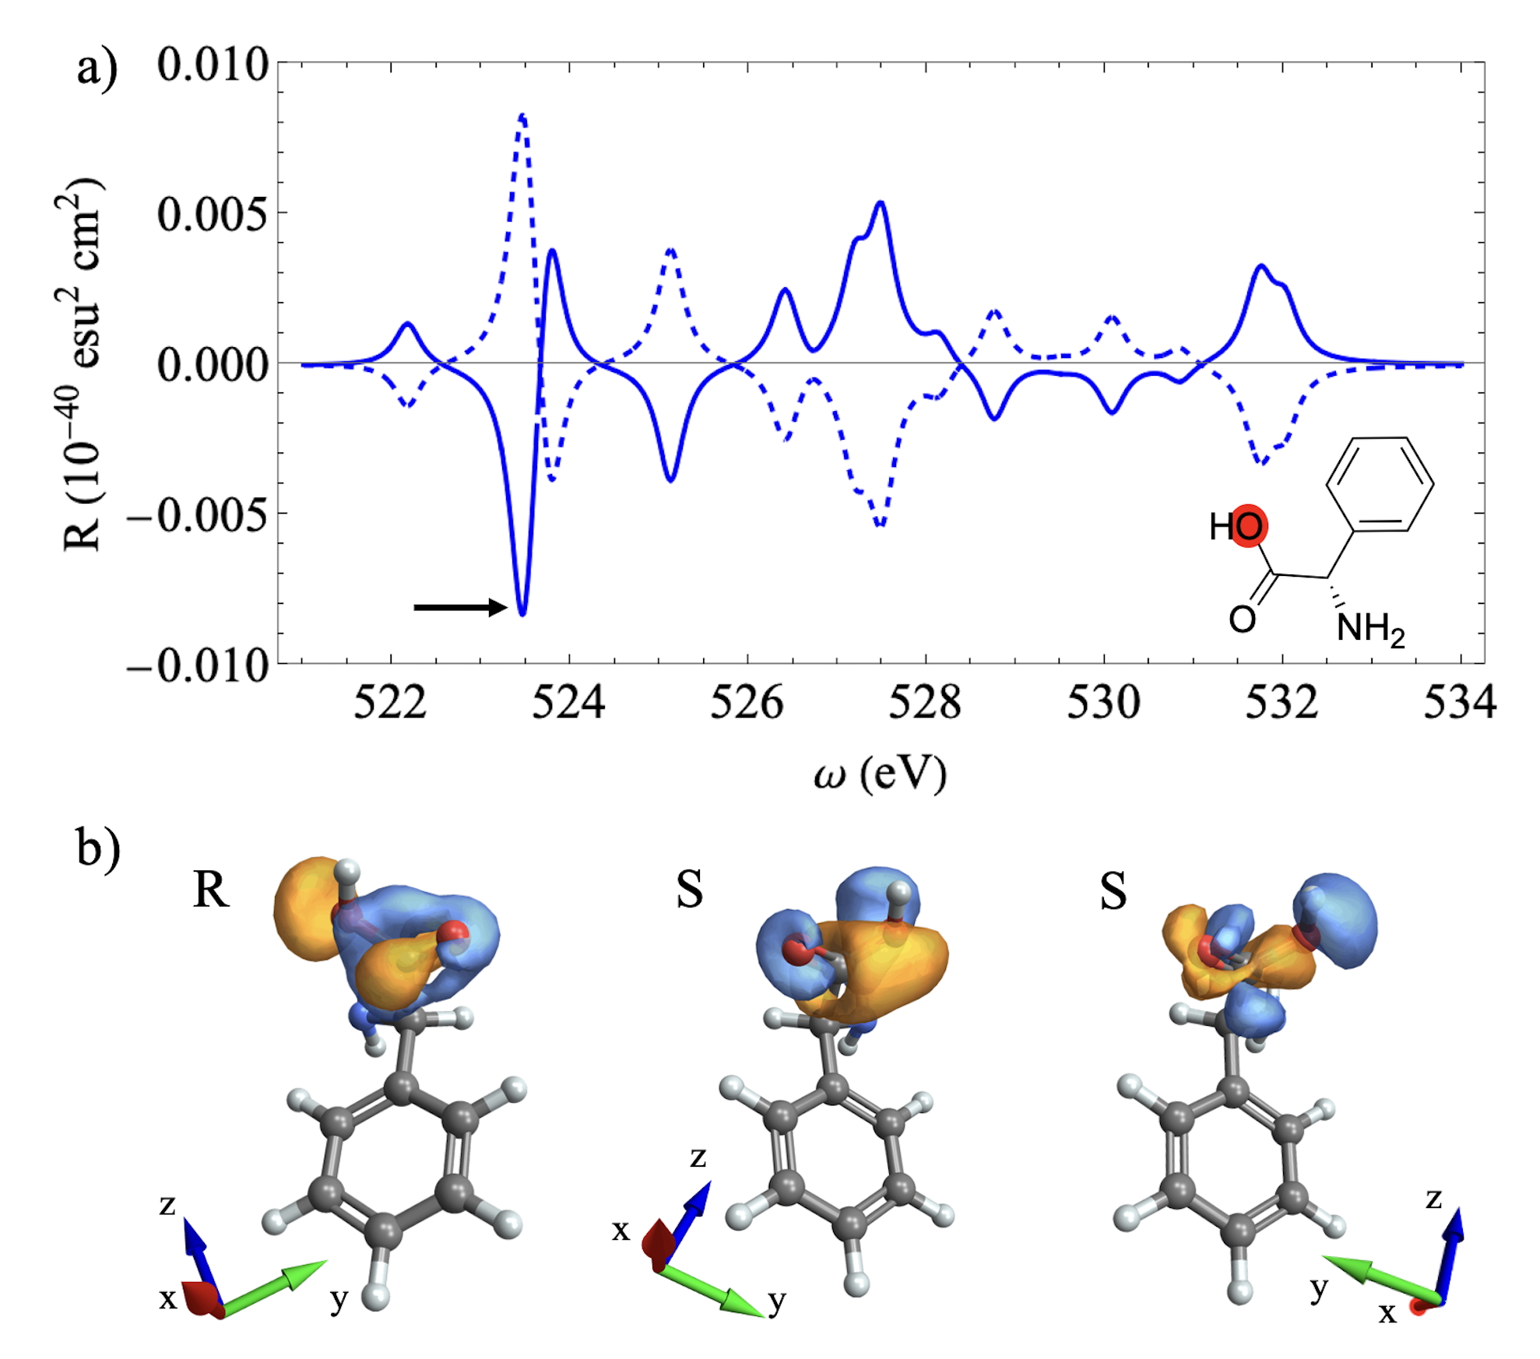
Example of application: Phenylglycine
- Chiral Population Analysis:
XCD of the hydroxyl oxygen K-edge is shown in the top panel
Chiral population orbitals corresponding to the second excitation of the manifold is shown in the lower panel
Electric dipole induced displacements contributing to the chiral response appear as lobe features
Magnetic dipole induced circulations contributing to the chiral response appear as loop features
Spiral patterns emerge in regions where both electric and magnetic dipoles are relevant

Slide 19
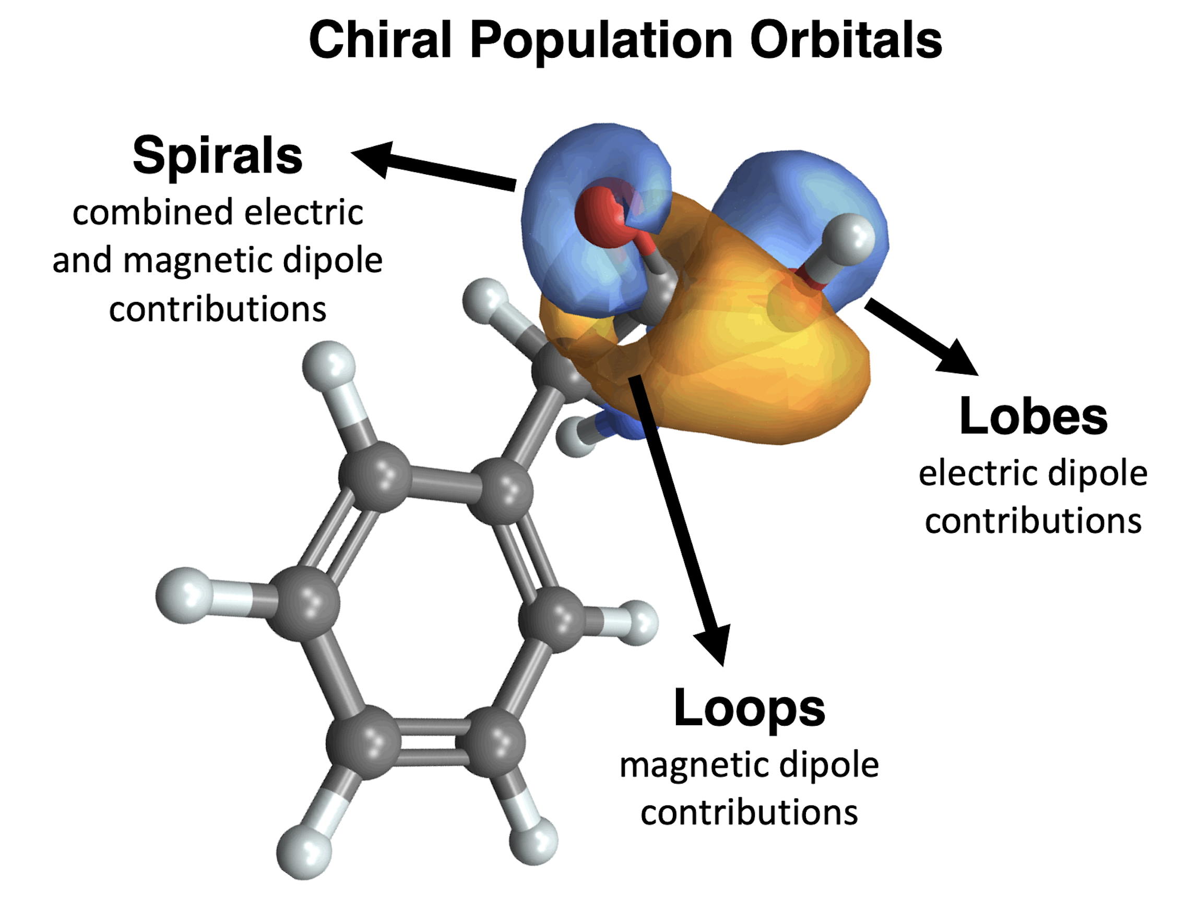
Example of application: Phenylglycine

Slide 20
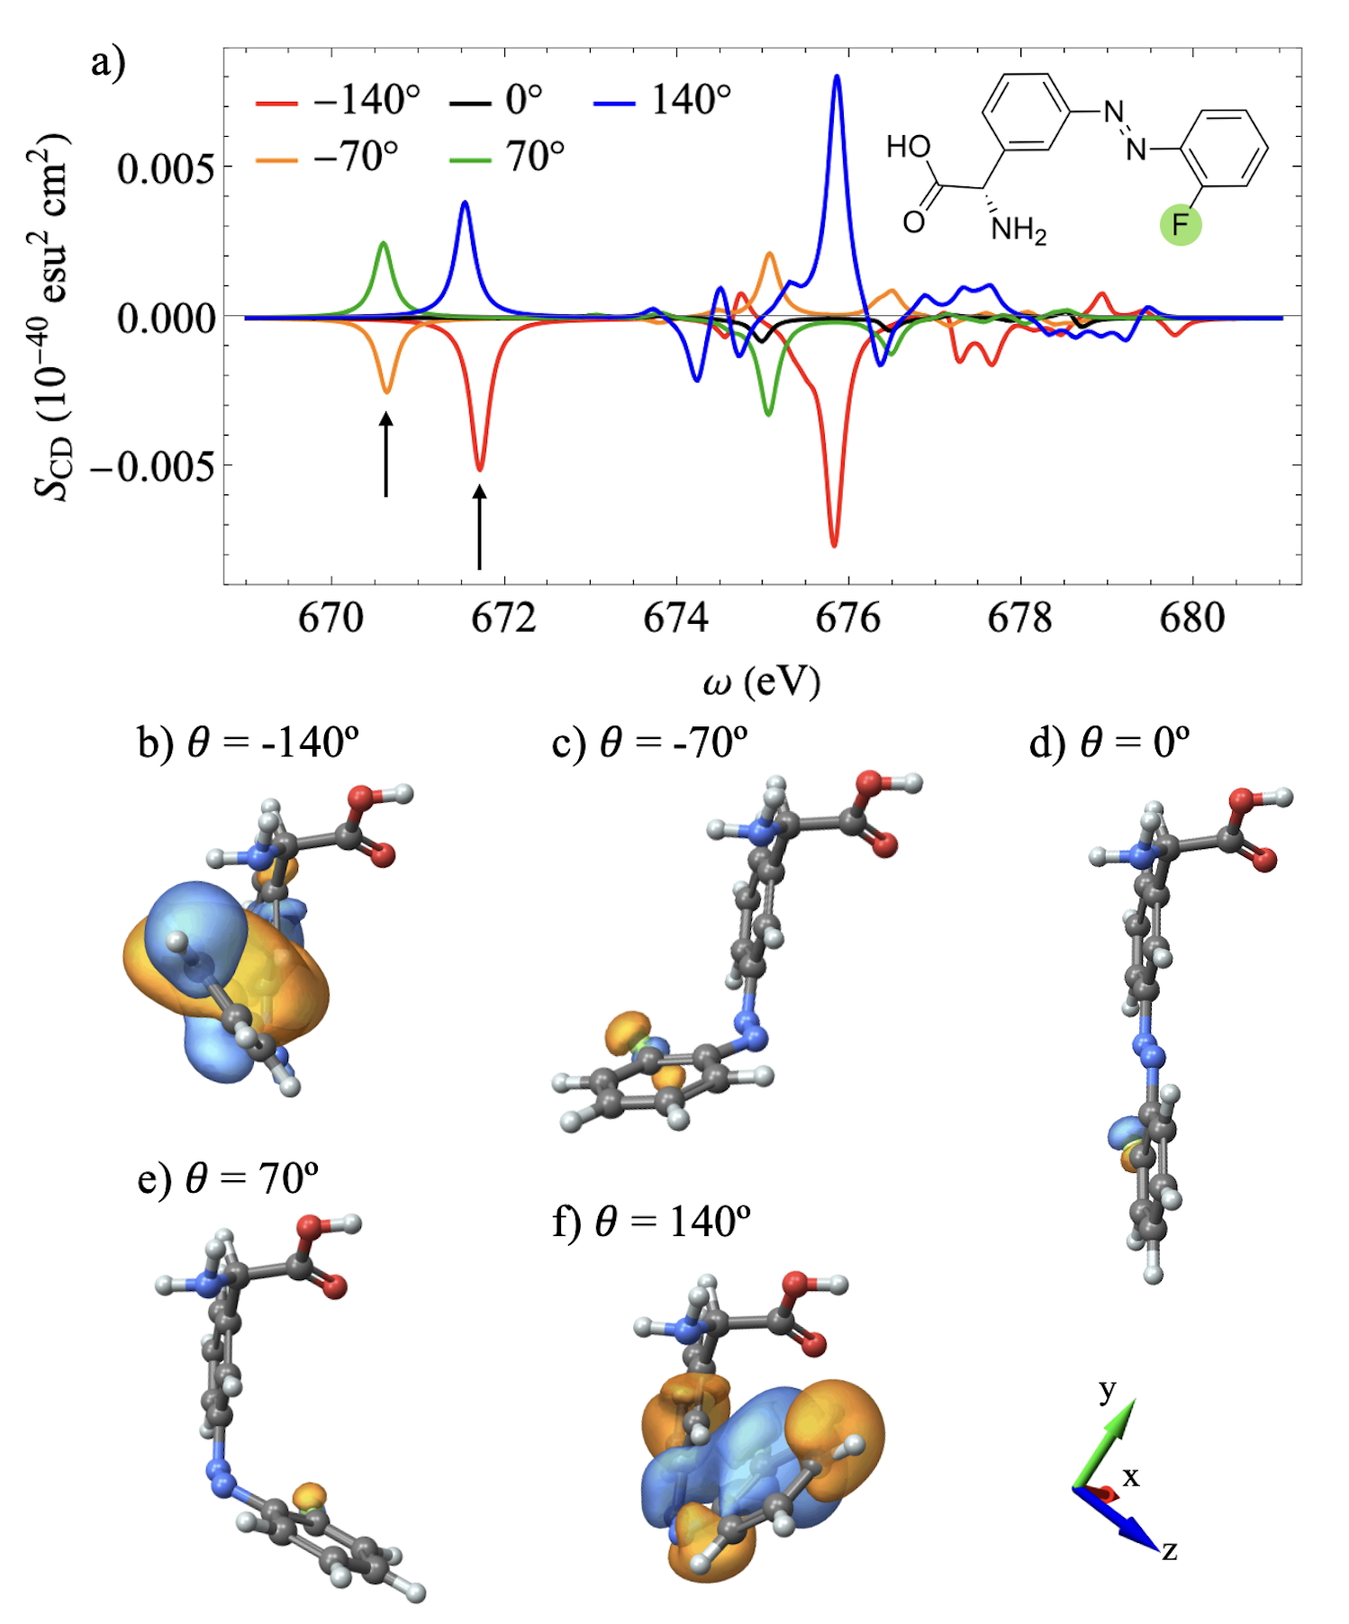
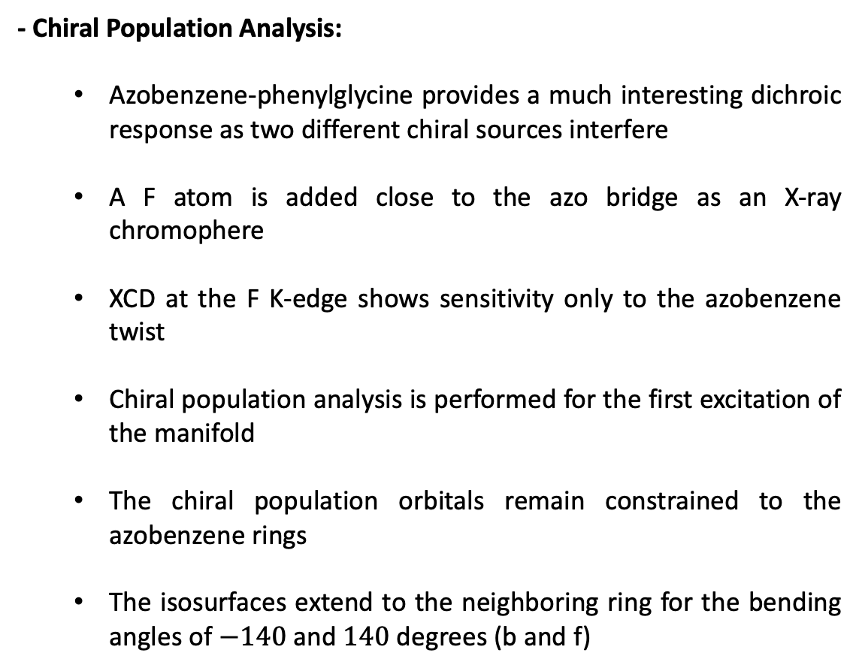
Example of application: Azobenzene-Phenylglycine
- Chiral Population Analysis:
Azobenzene-phenylglycine provides a much interesting dichroic response as two different chiral sources interfere
A F atom is added close to the azo bridge as an X-ray chromophere
XCD at the F K-edge shows sensitivity only to the azobenzene twist
Chiral population analysis is performed for the first excitation of the manifold
The chiral population orbitals remain constrained to the azobenzene rings
The isosurfaces extend to the neighboring ring for the bending angles of $−140$ and $140$ degrees (b and f)

Slide 21
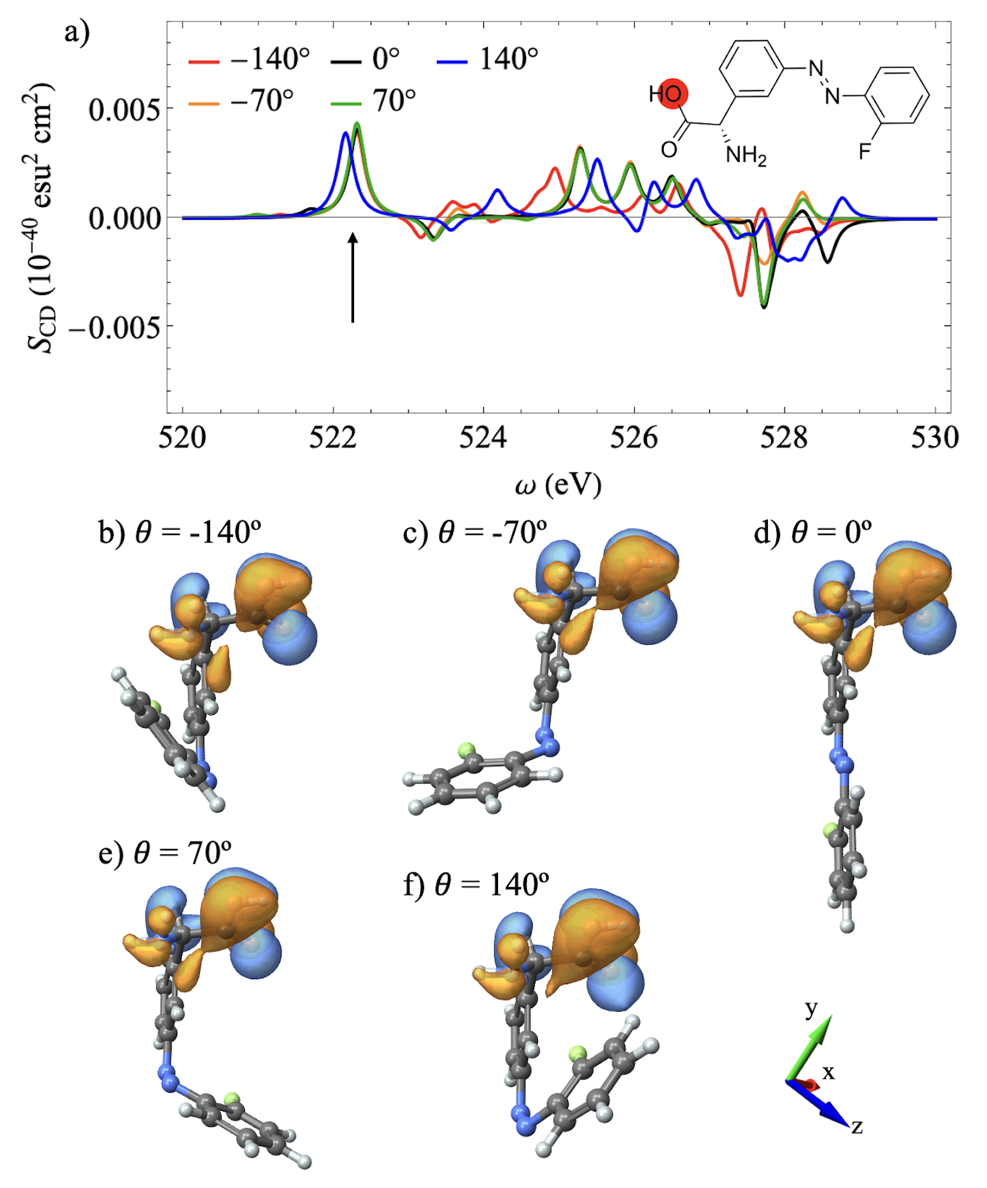
Example of application: Azobenzene-Phenylglycine
- Chiral Population Analysis:
XCD at the hydroxyl oxygen K-edge
Chiral population analysis is performed to the second transition of the manifold
XCD in this range is independent of the azobenzene twist
Chiral population analysis show similar orbitals located in the glycine moiety

Slide 22
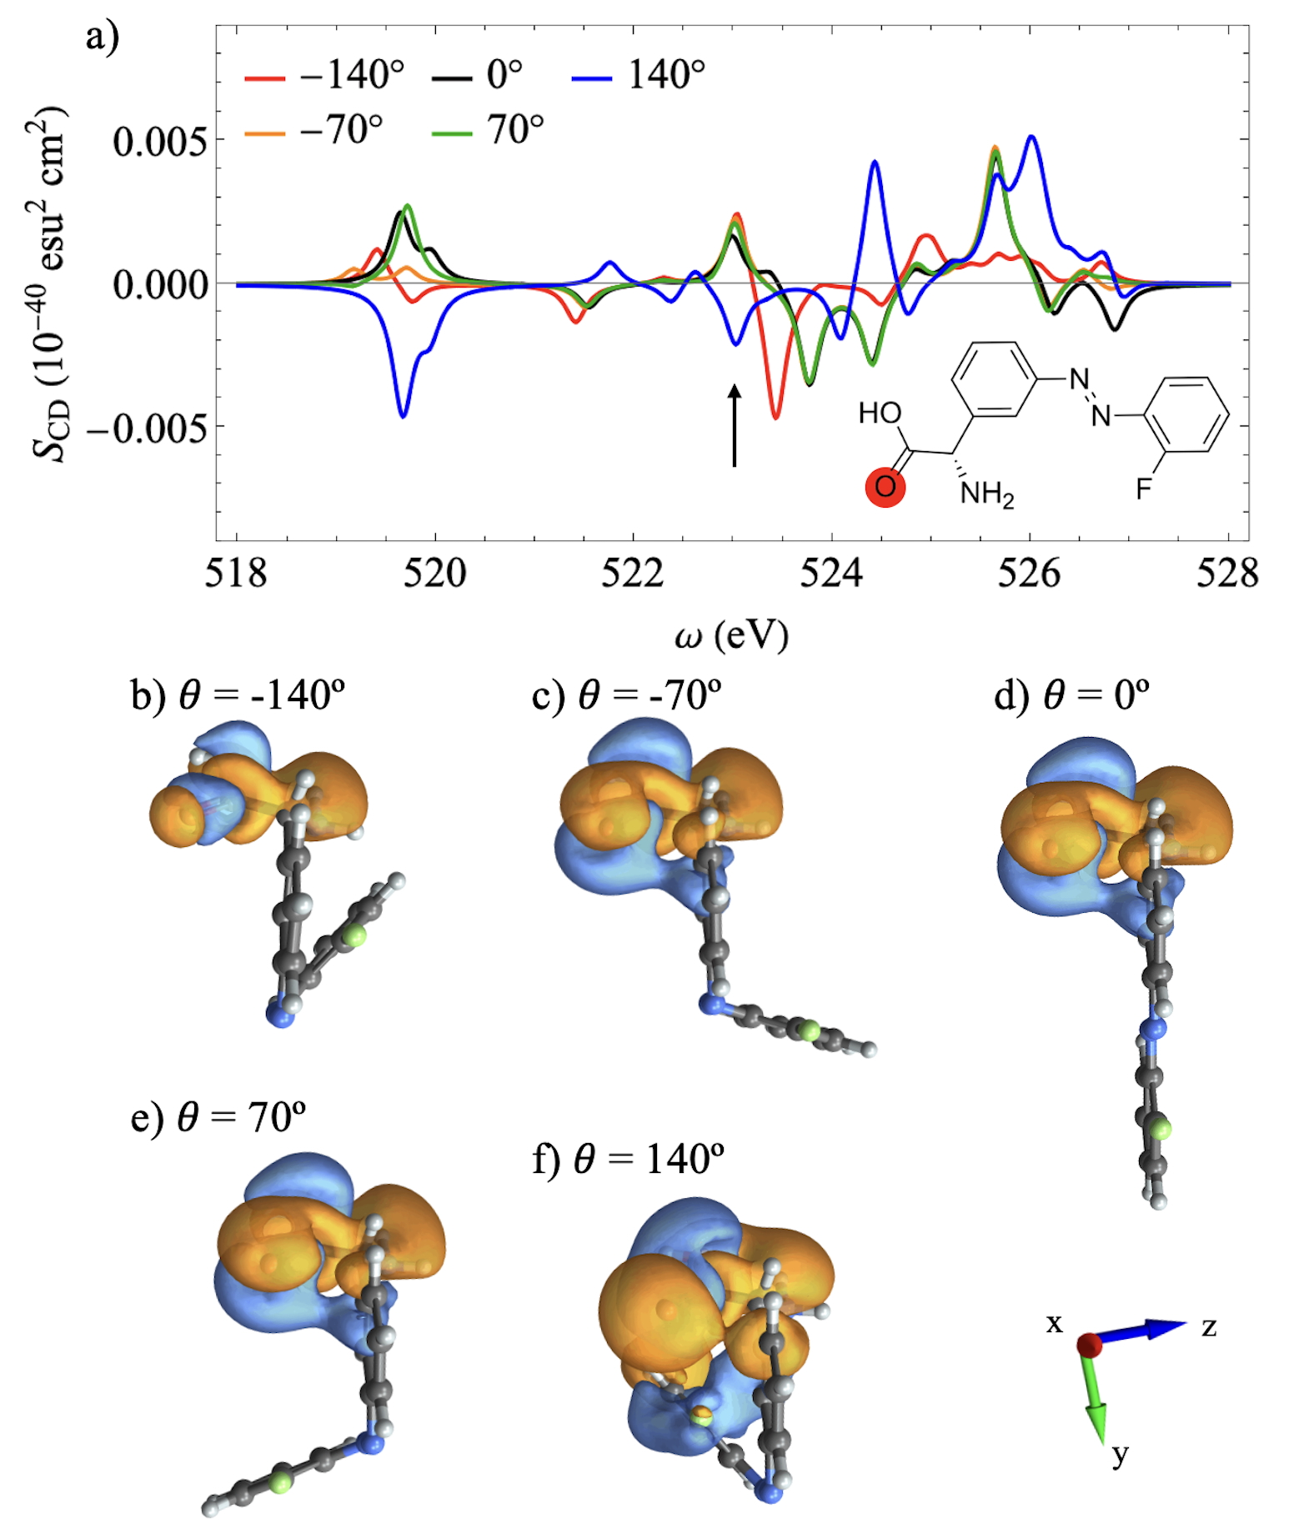
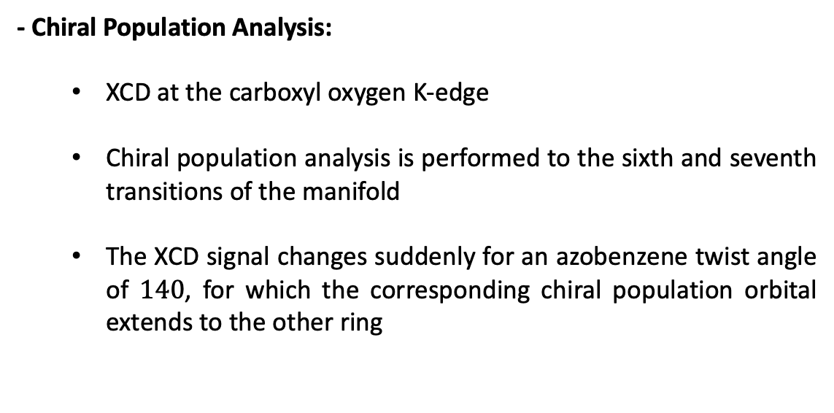
Example of application: Azobenzene-Phenylglycine
- Chiral Population Analysis:
XCD at the carboxyl oxygen K-edge
Chiral population analysis is performed to the sixth and seventh transitions of the manifold
The XCD signal changes suddenly for an azobenzene twist angle of $140$, for which the corresponding chiral population orbital extends to the other ring

Slide 23
Conclusions
X-ray circular dichroism is a promising candidate to obtain information about local chiral features within molecules
X-ray circular dichroism also provides the time resolution required to probe ultrafast time-dependent chiral transitions
Chiral population analysis is a promising tool for dissecting atomic orbital contributions to chiral response in a visually intuitive way

Slide 24




Aknowledgements
Niranjan Govind
Xu Lei
Jeremy Rouxel
Yeonsig Nam
Sergei Tretiak
Ajay Khanna
Shaul Mukamel

