Slide 1

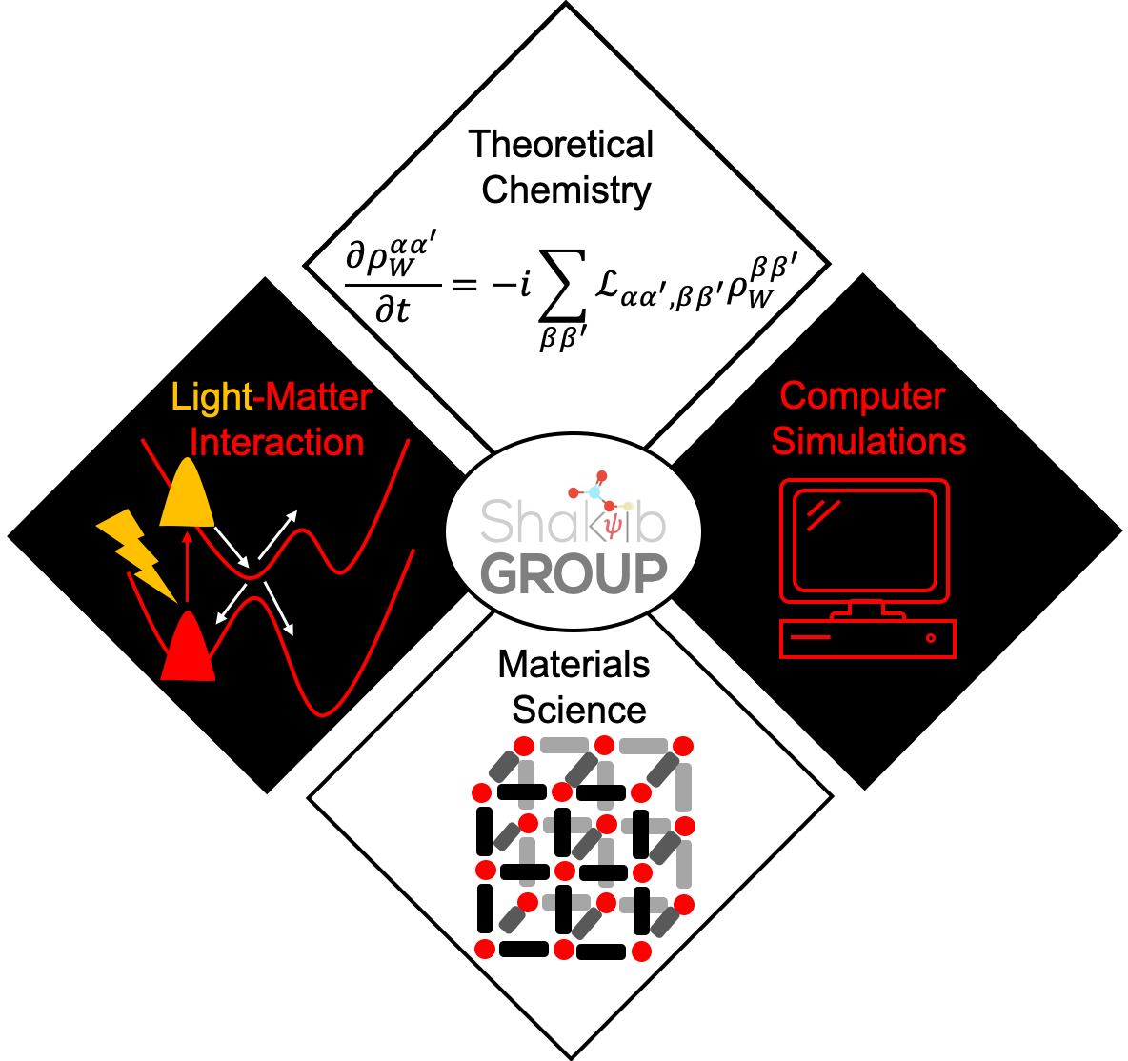
Development of methods and software for non-adiabatic quantum dynamics simulations subject to nuclear quantum effects
Farnaz A. Shakib
Method Development and Materials Simulations Lab
VISTA seminar series
March 12, 2025

Slide 2

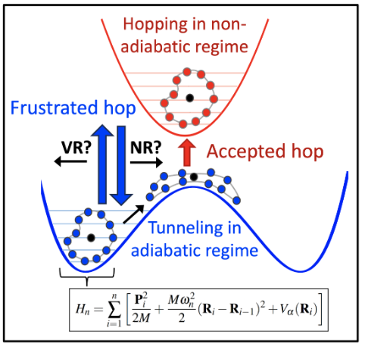
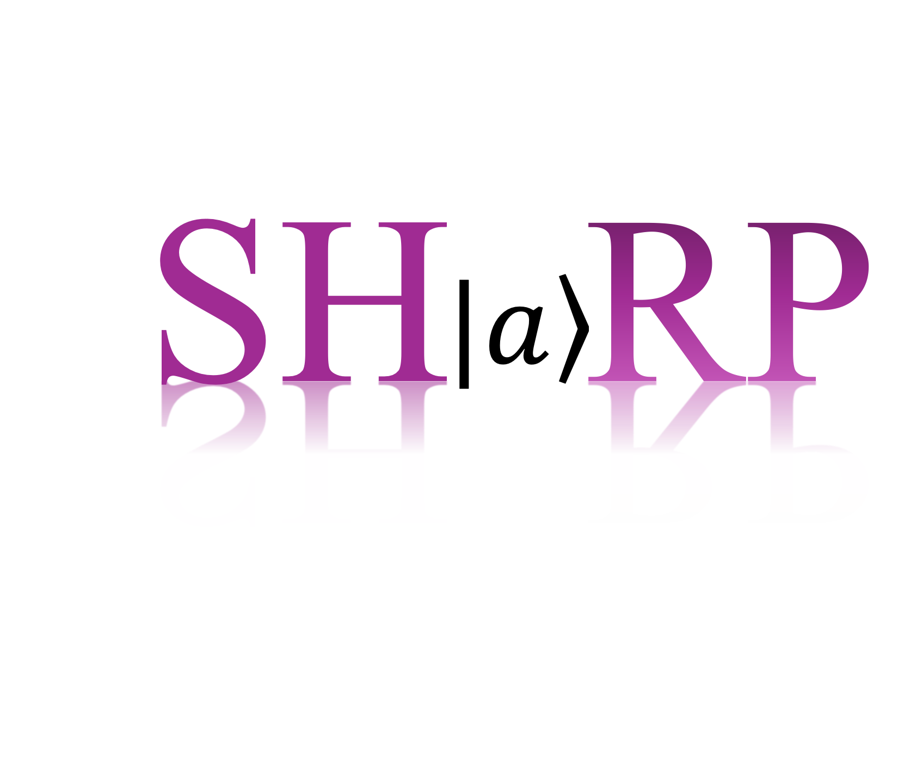
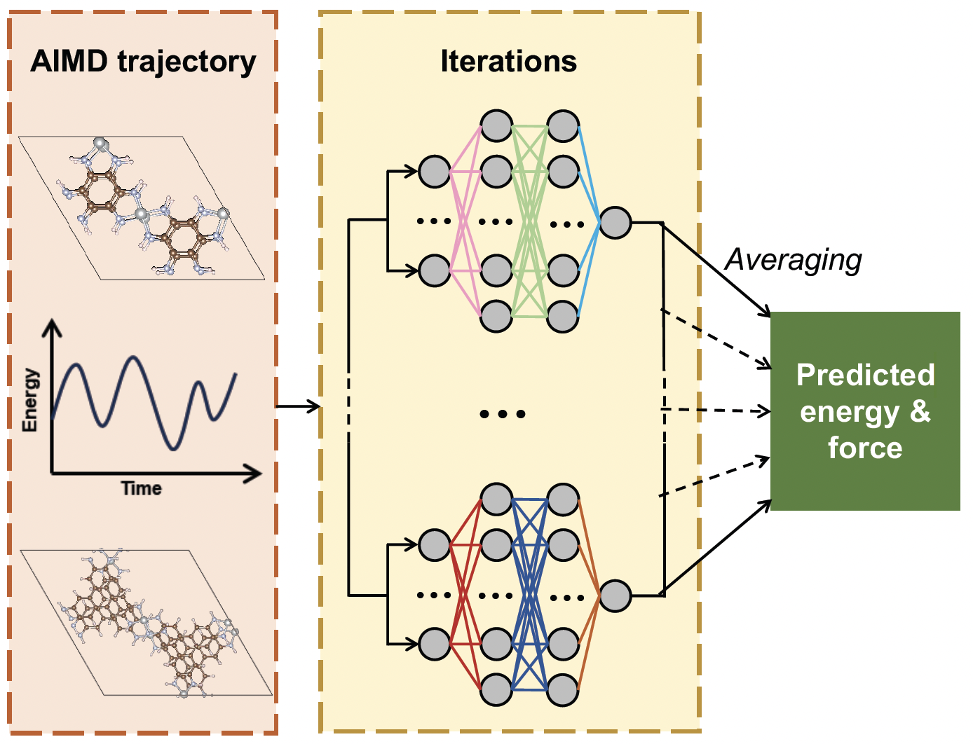
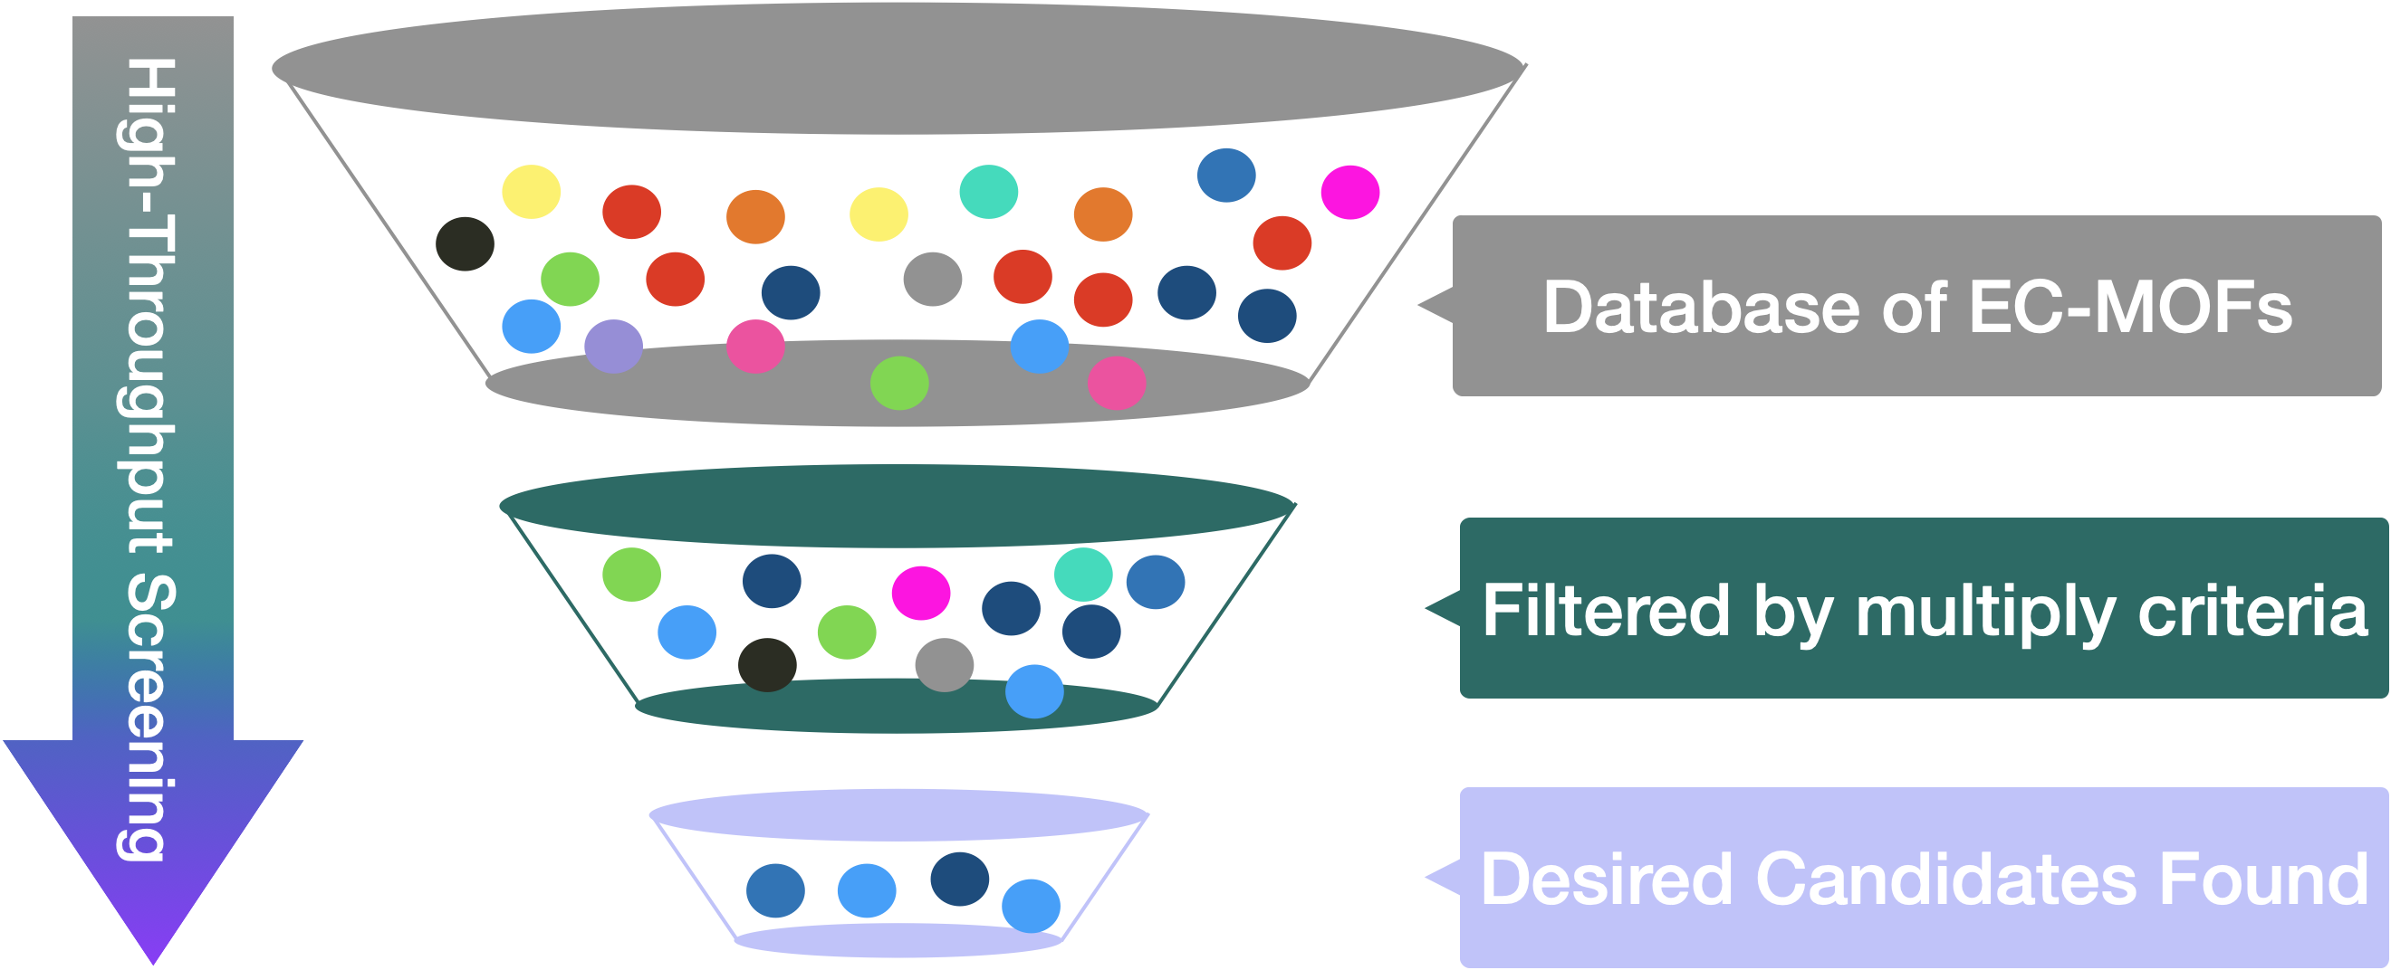

Multifunctional materials: Structure-Function
Non-adiabatic quantum dynamics
Ring Polymer Surface Hopping
J. Chem. Info. Model. 2023, 63, 7097
Chem. Mater. 2022, 34, 7730.
J. Chem. Phys. 2022, 156, 044109.
ACS Appl. Mater. Interfaces, 2021, 13, 25270.
APL Matter., 2021, 9, 051109.
Chem. Commun., 2021, 57, 315
J. Phys. Chem. Lett. 2023, 14, 8658.
Phys. Chem. Chem. Phys., 2021, 23, 3135.
J. Phys. Chem. Lett. 2017, 8, 3073.
Multifunctional materials: Design & discovery
Software development
Non-adiabatic quantum dynamics simulations subject to electronic and nuclear quantum effects
Large-scale molecular dynamics simulations subject to nuclear quantum effects
ACS Appl. Mater. Interfaces, 2025, Revisions Requested.
(Preprint: doi:10.26434/chemrxiv-2024-0mkw8).
J. Phys. Chem. C 2025, 129, 2222.
ACS Appl. Mater. Interfaces 2023, 15, 9494.
J. Phys. Chem. A 2025, Invited Software Paper.
J. Chem. Phys. 2024, 160, 132501.
Software Impacts 2024, 19, 100604.

Slide 3
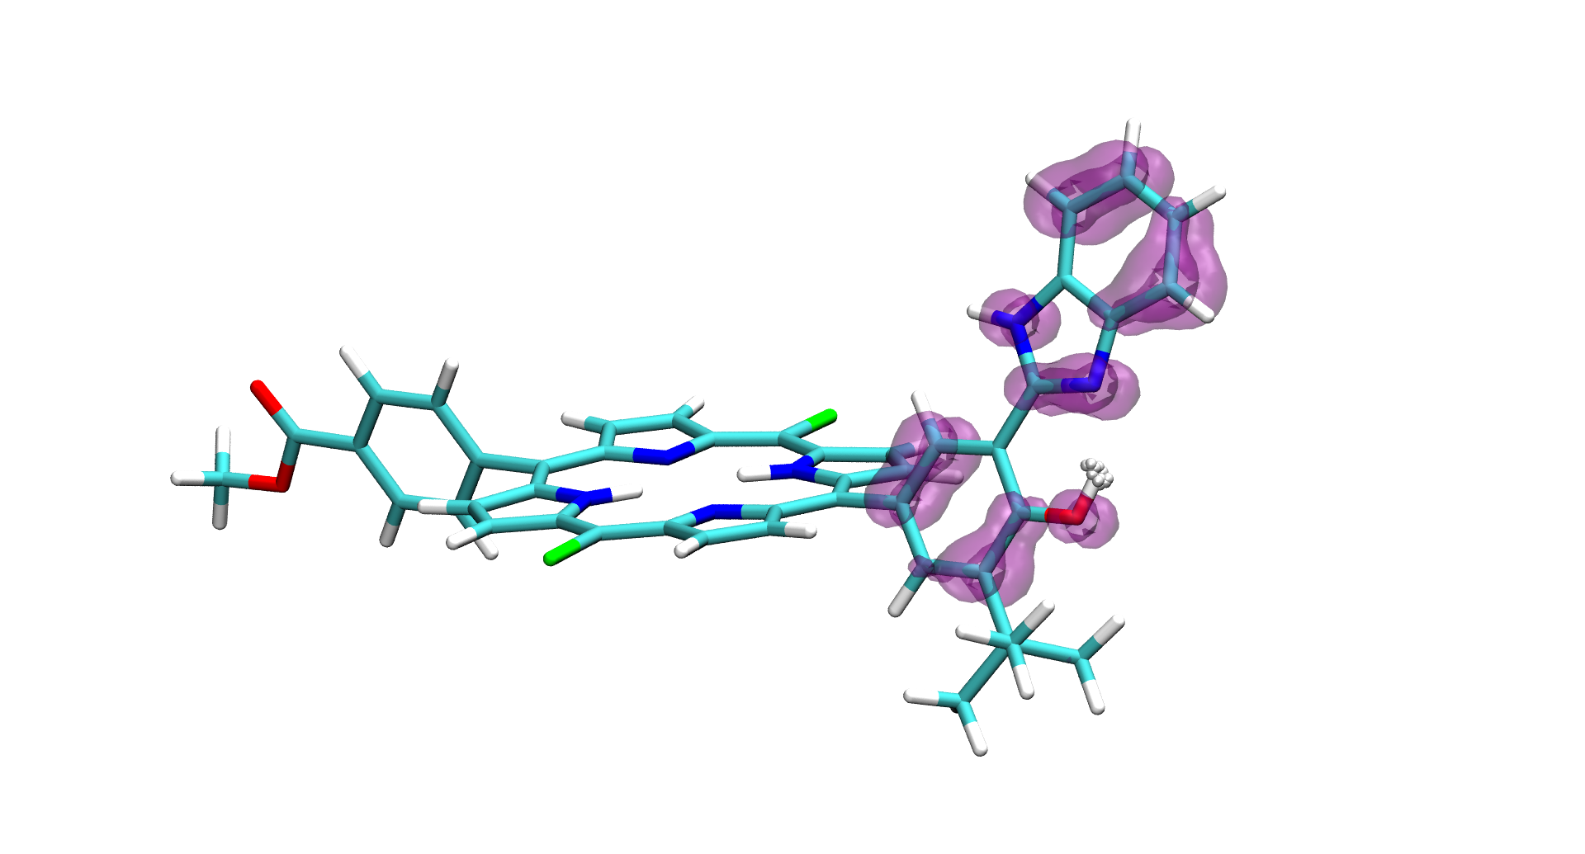
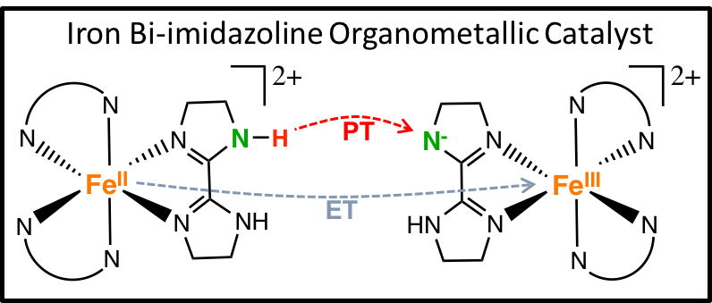
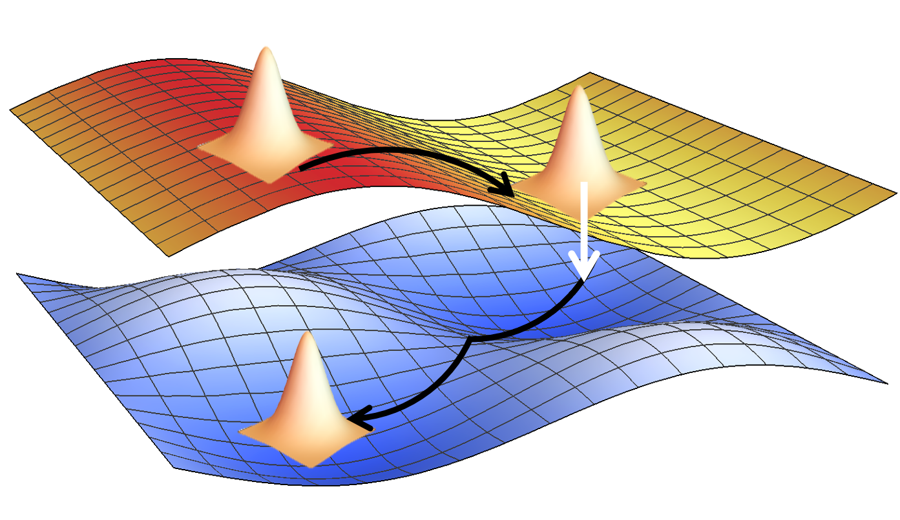
Incorporating NQEs into non-adiabatic quantum dynamics
ET
PT
Megiatto et. al. Nat. Chem. (2014)
Lee et. al. Angew. Chem., Int. Ed. (2009)

Slide 4
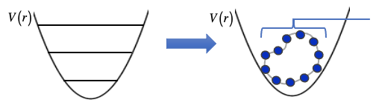

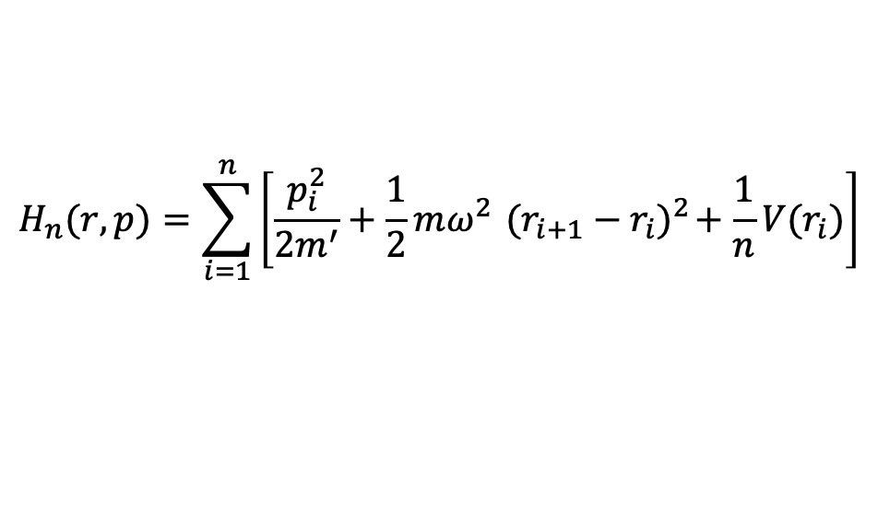
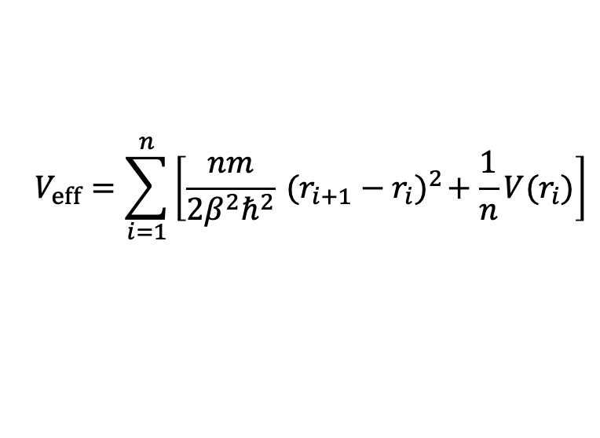

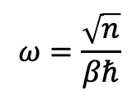
Path Integral Molecular Dynamics
Path integral formalism:
$$Z=\text{Tr} e^{−β\hat{H}}≈\lim_{n→∞}{∫{dr}_{1}{dr}_{2}…{dr}_{n} \text{exp}[−βV_{eff} (r_{1},r_{2},…,r_{n})]}$$
A finite value of $n$
$$V_{eff}=\sum_{i=1}^{n}{\left[\frac{1}{2}mω^{2}{ (r_{i+1}−r_{i})}^{2}+\frac{1}{n}V(r_{i})\right]}$$
$$V_{eff}=\sum_{i=1}^{n}{\left[\frac{nm}{{2β}^{2}ℏ^{2}}{ (r_{i+1}−r_{i})}^{2}+\frac{1}{n}V(r_{i})\right]}$$
$$ω=\frac{\sqrt{n}}{βℏ}$$
Remnants of kinetic energy operator
Quantum – Classical Isomorphism
Ring Polymer,
comprised of
n beads
Quantum Mechanics
Classical Mechanics
$$H_{n}(r,p)=\sum_{i=1}^{n}{\left[\frac{p_{i}^{2}}{2m^{′}}+\frac{1}{2}mω^{2}{ (r_{i+1}−r_{i})}^{2}+\frac{1}{n}V(r_{i})\right]}$$
Insertion of a fictitious kinetic energy
M. Parrinello, A. Rahman, J. Chem. Phys., 1984, 80, 860.

Slide 5
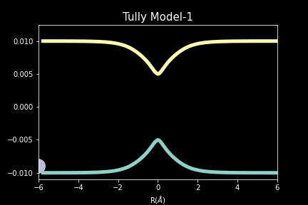
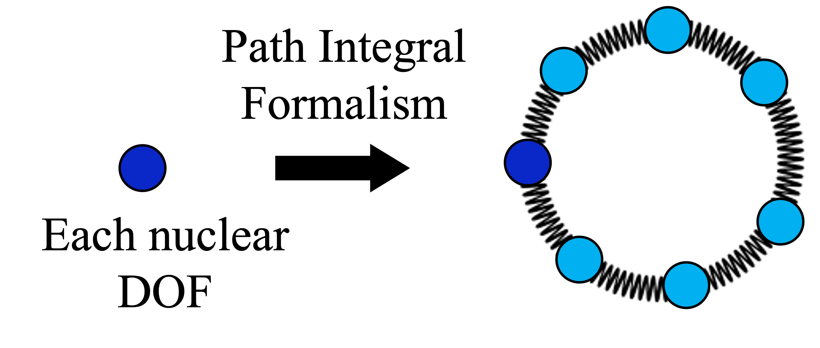


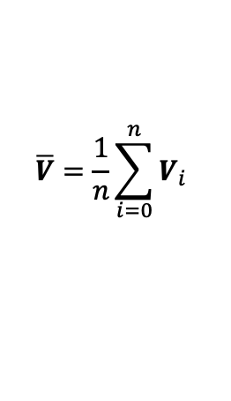
Ring Polymer Molecular Dynamics
PIMD¹
RPMD²
Temperature controlled by a thermostat (N,V,T)
No thermostat (N,V,E)
Real mass
$$p$$
Fictitious mass
$$r$$
Classical
RPMD
Classical
RPMD
Zero-point energy
$$\overline{V}=\frac{1}{n}\sum_{i=0}^{n}{V_{i}}$$
Quantum tunneling
¹M. Parrinello, A. Rahman, J. Chem. Phys., 1984, 80, 860. ²I.R. Craig, D.E. Manolopoulos, J. Chem. Phys., 2004, 121, 3368.

Slide 6
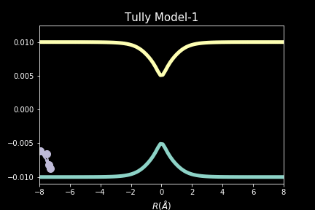
Ring Polymer Molecular Dynamics
PIMD¹
RPMD²
Temperature controlled by a thermostat (N,V,T)
No thermostat (N,V,E)
Real mass
$$p$$
Fictitious mass
$$r$$
Classical
RPMD
Classical
RPMD
Zero-point energy
$$\overline{V}=\frac{1}{n}\sum_{i=0}^{n}{V_{i}}$$
Quantum tunneling
¹M. Parrinello, A. Rahman, J. Chem. Phys., 1984, 80, 860. ²I.R. Craig, D.E. Manolopoulos, J. Chem. Phys., 2004, 121, 3368.

Slide 7

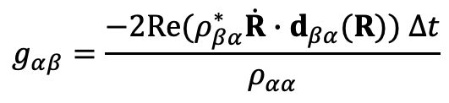


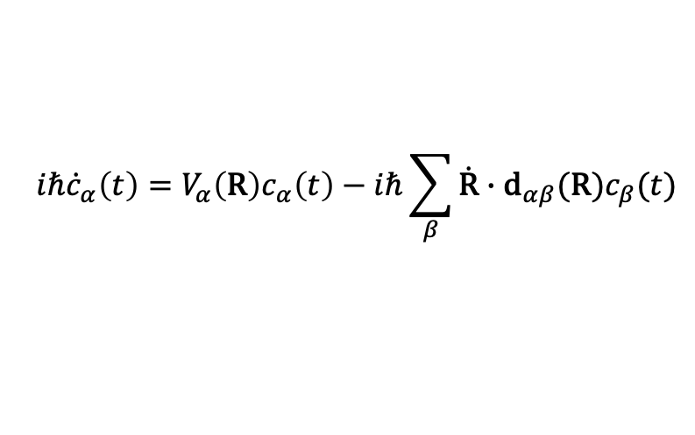

Trajectory-based nonadiabatic dynamics
John Tully
1990: Fewest-Switches Surface Hopping (FSSH)
2012: Ring polymer surface hopping (RPSH)
Full quantum mechanics
Surface hopping (SH)
$$V_{β}$$
Nonadiabatic reaction
$$V_{β}$$
Adiabatic potential energy surface
Adiabatic reaction
$$iℏ{\dot{c}}_{α}\left(t\right)=V_{α}\left(\text{R}\right)c_{α}\left(t\right)−iℏ\sum_{β}{\dot{\text{R}}∙{\text{d}}_{αβ}(\text{R})c_{β}(t)}$$
Nonadiabatic coupling vector
V_{𝛼}
V_{𝛼}
Probability of non-adiabatic transition
Quantum wavepacket bifurcates
Ensemble of classical trajectories
$$g_{αβ}=\frac{−2\text{Re}(ρ_{βα}^{∗}\dot{R}∙d_{βα}(R)) ∆t}{ρ_{αα}}$$
$$>ξ$$
Stochastic, phenomenological methodology
Ease of implementation, good convergence
Overcoherence problem
Good results in many applications
Neglect of Nuclear Quantum Effects (NQEs)
Mainstream non-adiabatic dynamics methodology

Slide 8
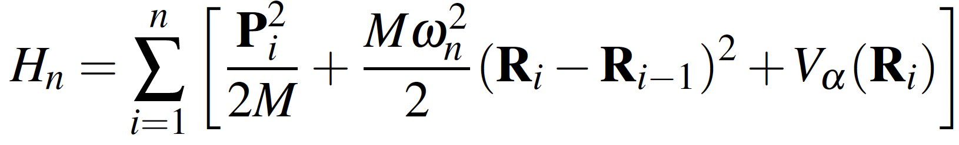
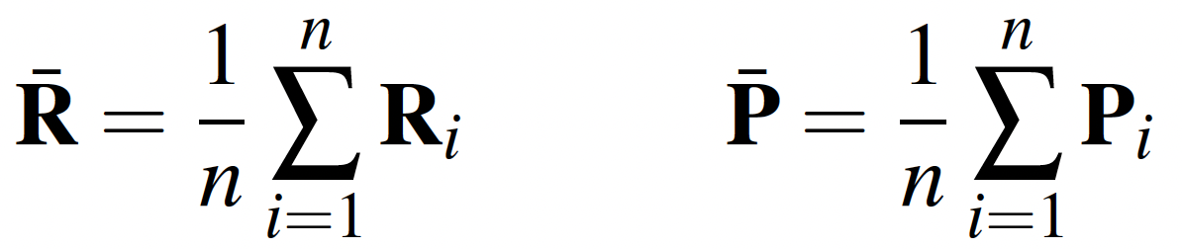
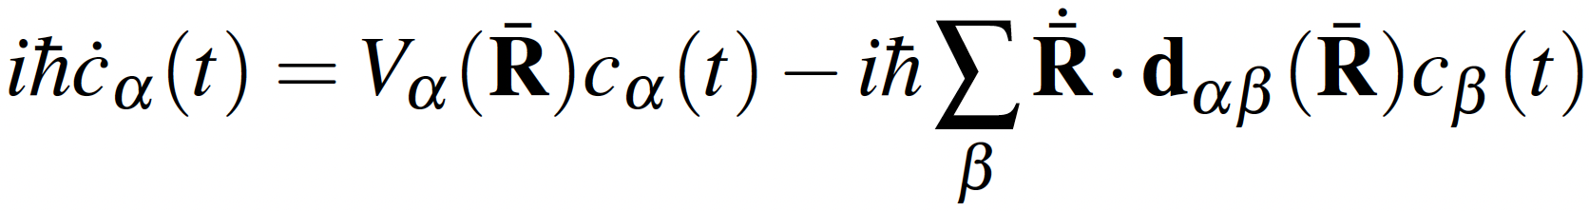

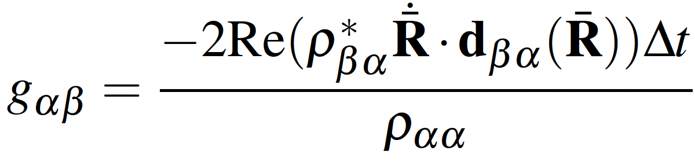

Surface Hopping
Ring Polymer Surface Hopping (RPSH) dynamics
Energy
Propagation
Reaction coordinate
RPSH conserves quantum plus classical energy
Solving TDSE
Velocity of each bead is re-scaled along the direction of the centroid non-adiabatic coupling vector:
Non-adiabatic transitions
$$>ξ$$
FAS; Huo, P. J. Phys. Chem. Lett. 2017, 8, 3073.
Shushkov, P.; Li, R.; Tully, J.C. J. Chem. Phys. 2012, 137, 22A549.

Slide 9


Frustrated hops in RPSH
$$V_{new}+K_{new}=V_{old}+K_{old}$$
$$V_{β}$$
Frustrated hops
How should be treated?
Always allowed
May be forbidden
Dr. Dil Limbu
Energy
V_{𝛼}
1. Reverse the velocity.¹
2. Not reverse the velocity.²
Reaction coordinate
3. Make a decision on reversing or not reversing based on the force that the classical particle feels from the final states.^{3,4}
Effect of proper treatment of frustrated hops in reproducing correct quantum Boltzmann populations in RPSH
¹Tully, J.C. J. Chem. Phys. 1990, 93, 1061. ²Müller, U.; Stock, G. J. Chem. Phys. 1997, 107, 6230. ³Jasper, A.W.; Truhlar, D.G. Chem. Phys. Lett. 2003, 369, 60. ⁴Jain, A.; Subotnik, J.E. J. Chem. Phys. 2015,143, 134107.

Slide 10
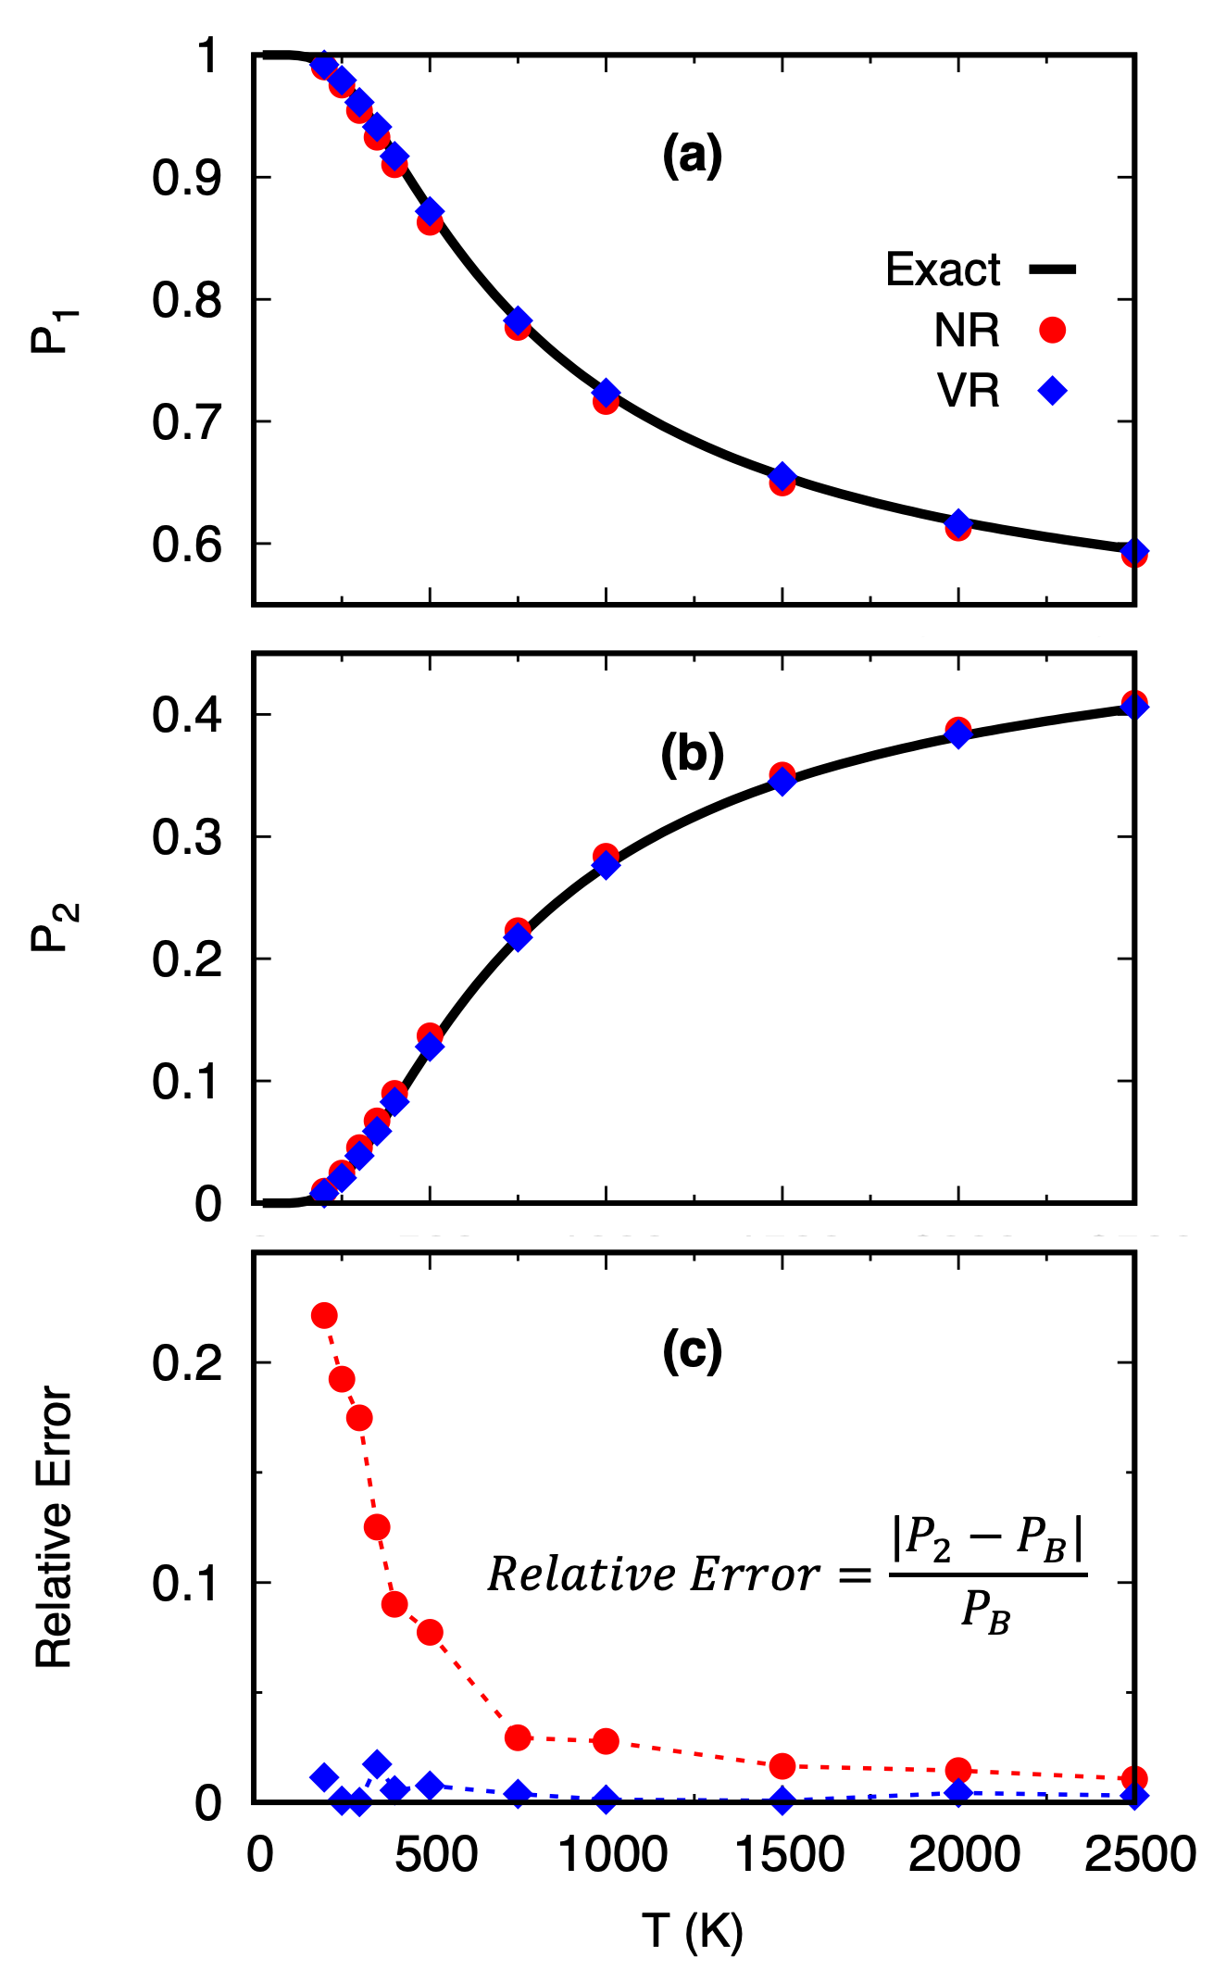
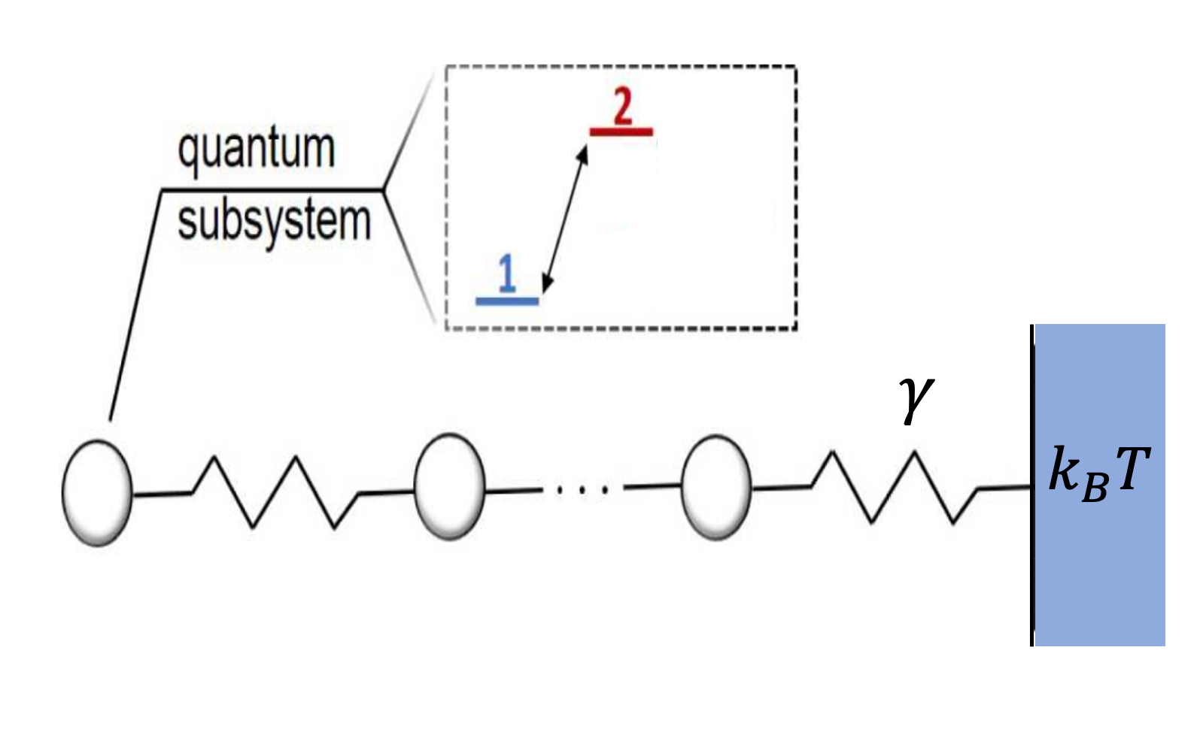
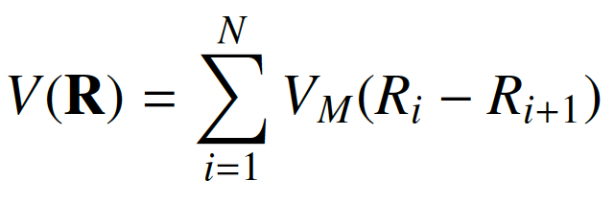

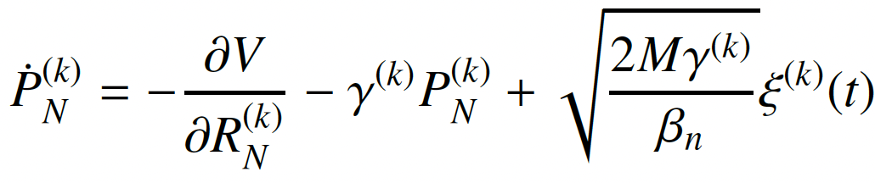
Surface Hopping
Quantum Boltzmann distribution
1
2
N
Followed the recipe for Thermostatted RPMD²:
¹Limbu, D.K.; FAS J. Phys. Chem. Lett. 2023, 14, 8658.
²Rossi, M.; Ceriotti, M.; Manolopoulos, D.E. J. Chem. Phys. 2014, 140, 234116.

Slide 11
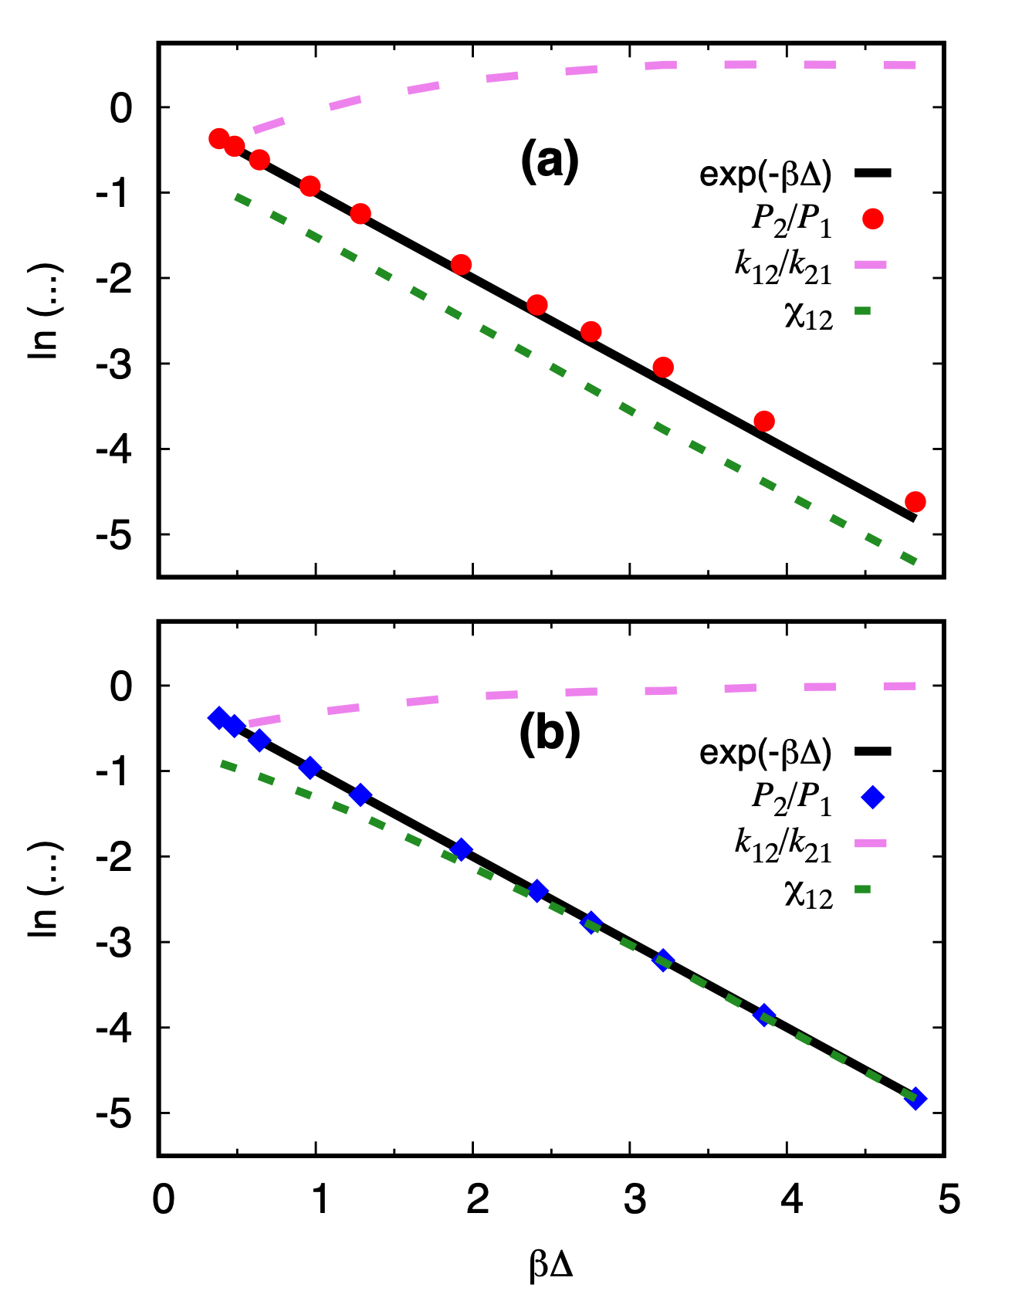
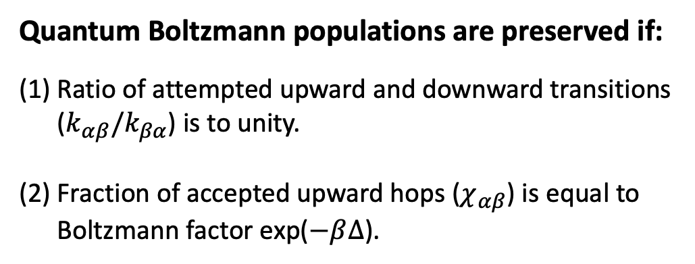
Quantum Boltzmann distribution
Quantum Boltzmann populations are preserved if:
Ratio of attempted upward and downward transitions ($k_{αβ}/k_{βα}$) is to unity.
Fraction of accepted upward hops ($χ_{αβ}$) is equal to Boltzmann factor exp($−β∆$).
Not reversing velocity
Q: Does it have an adverse effect on the dynamics?
Reversing velocity

Slide 12
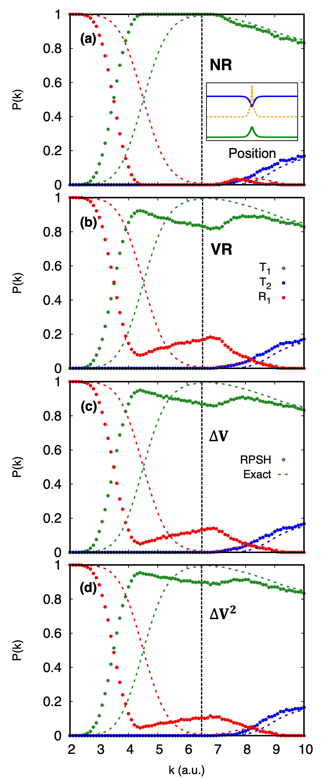
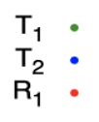


Frustrated hops in RPSH dynamics
Tully model I: Single avoided crossing
Deterministic momentum
Branching probabilities as a function of
initial nuclear momentum
T1/R1: transmission/reflection on state 1
T2/R2: transmission/reflection on state 2
FAS; Huo, P. J. Phys. Chem. Lett. 2017, 8, 3073.
Limbu, D.K.; FAS J. Phys. Chem. Lett. 2023, 14, 8658.

Slide 13
Frustrated hops in RPSH dynamics
Limbu, D.K.; FAS J. Phys. Chem. Lett. 2023, 14, 8658.
Jasper, A.W.; Truhlar, D.G. Chem. Phys. Lett. 2003, 369, 60. Jain, A.; Subotnik, J.E. J. Chem. Phys. 2015,143, 134107.

Slide 14
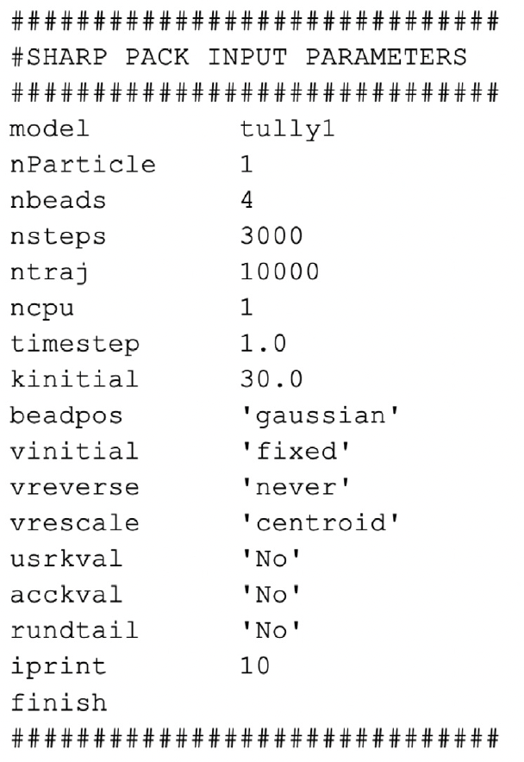
SHARP pack software package
RPSH is available to public in the context of a modular software package, SHARP pack.
https://github.com/SoftwareImpacts/SIMPAC-2023-481
Developed in Fortran 90.
A flexible and user-friendly input/output handling system
Comes with a variety of built-in models for method benchmarking.
The modular architecture enhances the software’s flexibility and adaptability, enabling integration of new methodologies or models.
Limbu, D.K.; FAS Software Impacts. 2024, 19, 100604.

Slide 15


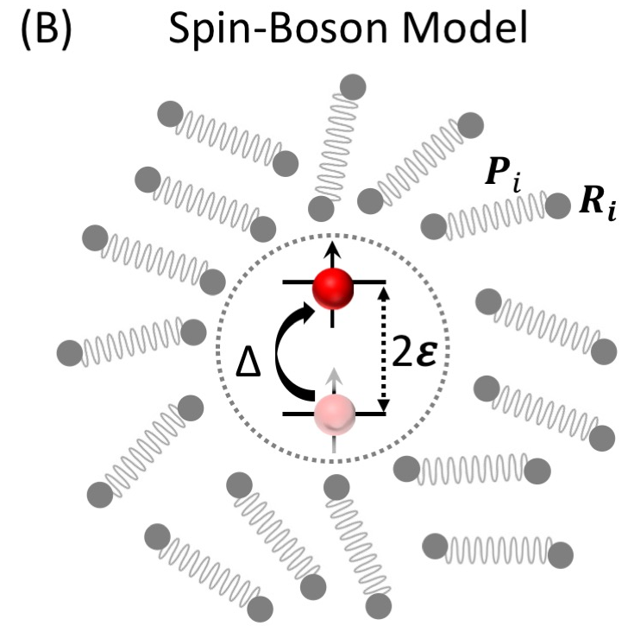
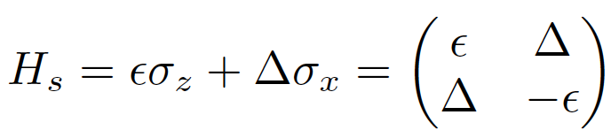

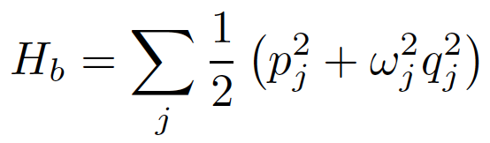
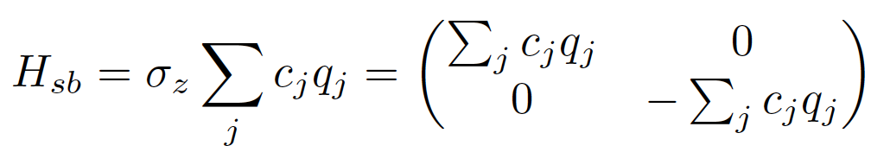
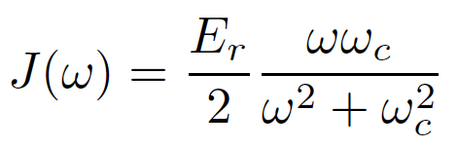


Fleshing out the method: Condensed-phase non-adiabatic dynamics
Spin-boson model is a widely used system to benchmark simulation methods for non-adiabatic dynamics in the condensed phases.
Total Hamiltonian:
$$p_{j}$$
Sandip Bhusal
$$q_{j}$$
Diana
Bagatella
The influence of the bath on the dynamics of the system can be captured in the compact form of a spectral density.
Reorganization energy
Deby spectral density:
Bhusal, S.; Limbu, D.K.; Castaneda-Bagatella, D.; FAS In preparation 2025.

Slide 16
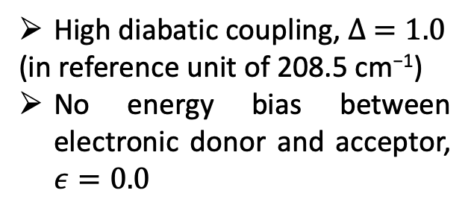




Spin-boson model: Benchmarking RPSH at low temperature limit
Condensed-phase non-adiabatic dynamics
$$E_{r}=0.02$$
Exact
FSSH
RPSH
$$E_{r}=0.1$$
High diabatic coupling, $∆ =1.0$
(in reference unit of 208.5 cm⁻¹)
No energy bias between electronic donor and acceptor, $ε=0.0$
Increasing number of beads:
Correcting the underestimation of population transfer seen in FSSH.
Deviating from correct Rabi oscillations.
$$E_{r}=1.0$$
$$E_{r}=5.0$$
Developing
Thermostatted RPSH
Bhusal, S.; Limbu, D.K.; Castaneda-Bagatella, D.; FAS In preparation 2025.
Notes:
We initiate the quantum subsystem in state 1 and monitor the change of population of diabatic state 1.
Generally, the exact results gives a P1 profile consist of a damped oscillation superimposed superimposed on a constant decaying component. The decaying component shows the adiabatic population transfer and the oscillation is the result of adiabatic coherence, which accumulates phase in time, both of which become mixed in diabatic basis.

Slide 17
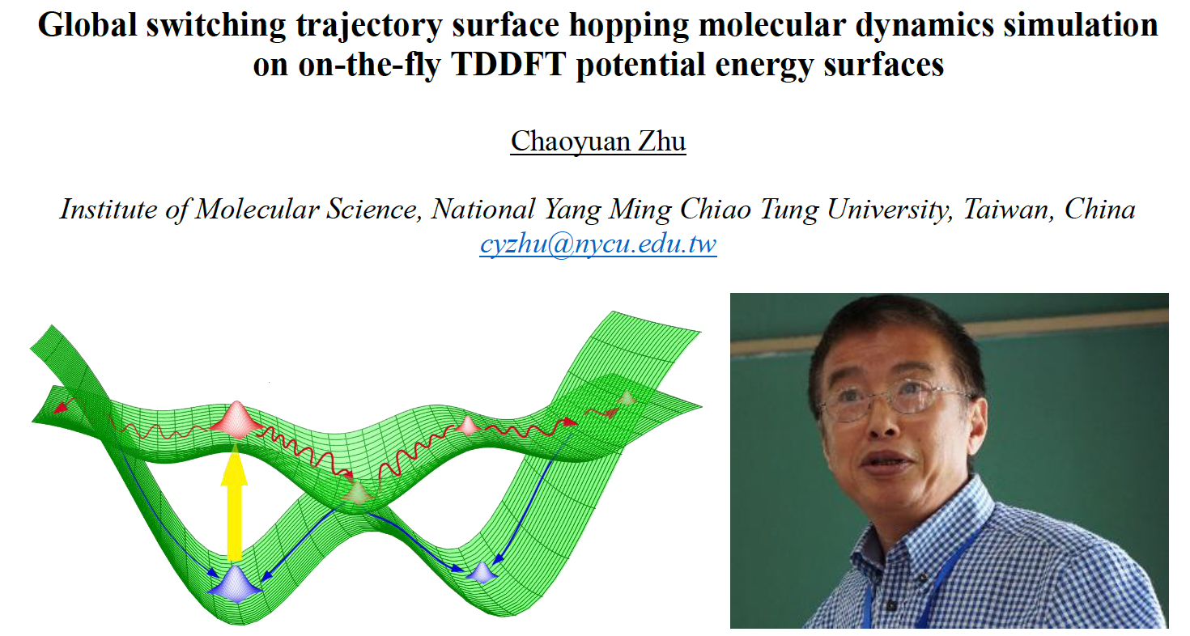
Zhu-Nakamura theory of nonadiabatic dynamics
79th VISTA seminar, Nov 13, 2024
Zhu-Nakamura (ZN) theory of nonadiabatic transitions.
Probability of nonadiabatic transitions are expressed in simple analytical formula based the shape of PES.
Applicable to diabatic and adiabatic surfaces.
It also provides analytical formula for classically forbidden transitions.
We expect to see a drastic time-efficiency.
It will be compatible with the use of machine learning potentials (MLPs) for condensed-phase simulations.
We have recently developed the first MLP for 2D electrically conductive metal-organic frameworks.
Zhu, C.; Nobusada, K.; Nakamura, H. J. Che. Phys. 2001, 115, 3031.
Shi, Y.; FAS J. Phys. Chem. C 2025, 129, 2222.

Slide 18





Shakib Theory Group at NJIT: Newark, NJ
Fundings and support

