Slide 1

Exploring the Complexity of Polaritonics:
From Single-Molecule Strong Coupling to Twin Polaritons
Norah M. Hoffmann – Department of Chemistry & Department of Physics – New York University, New York

Slide 2
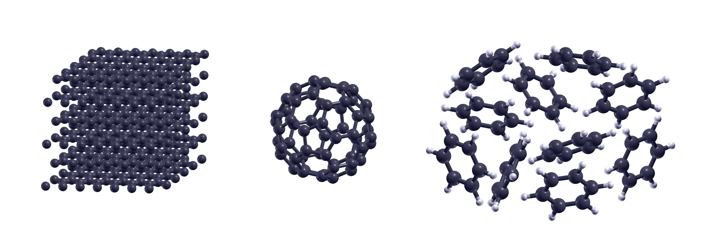


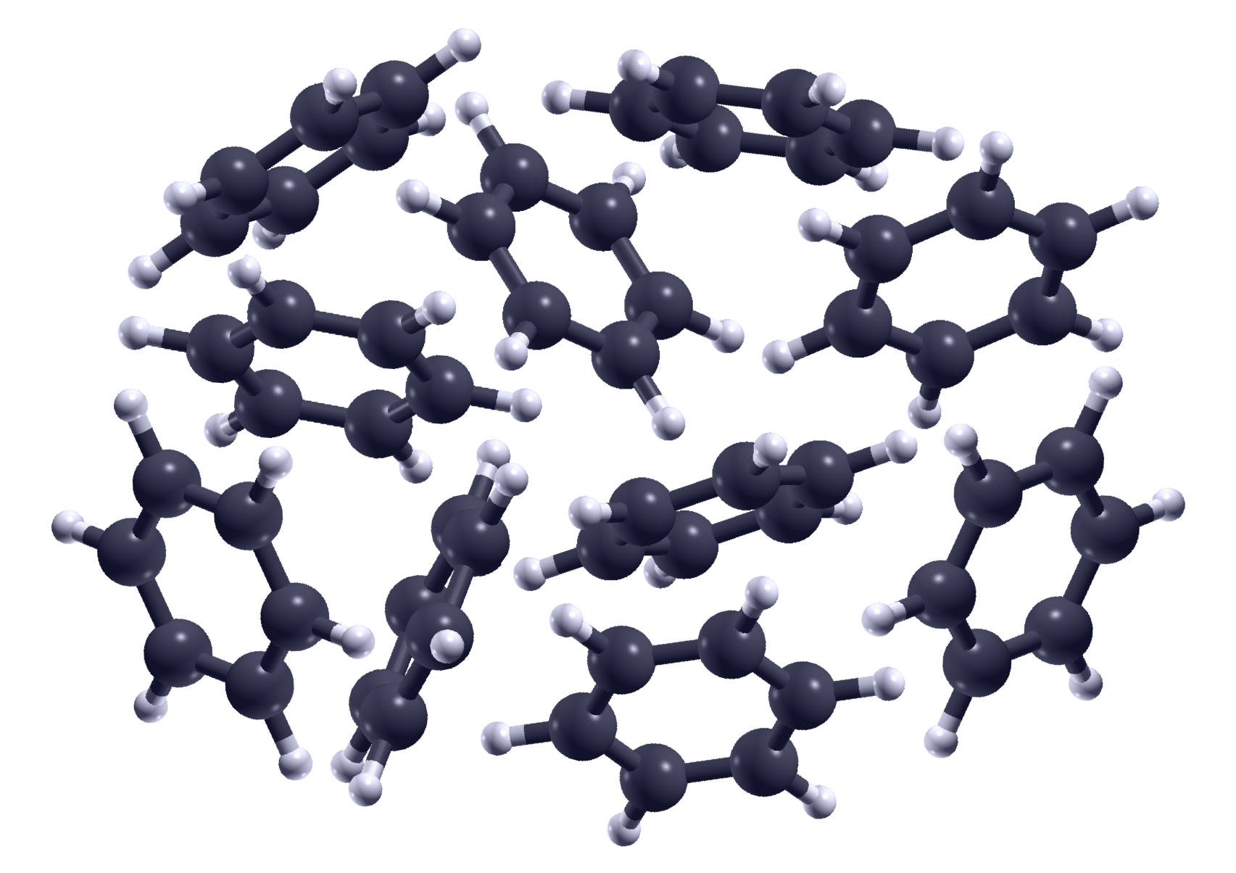

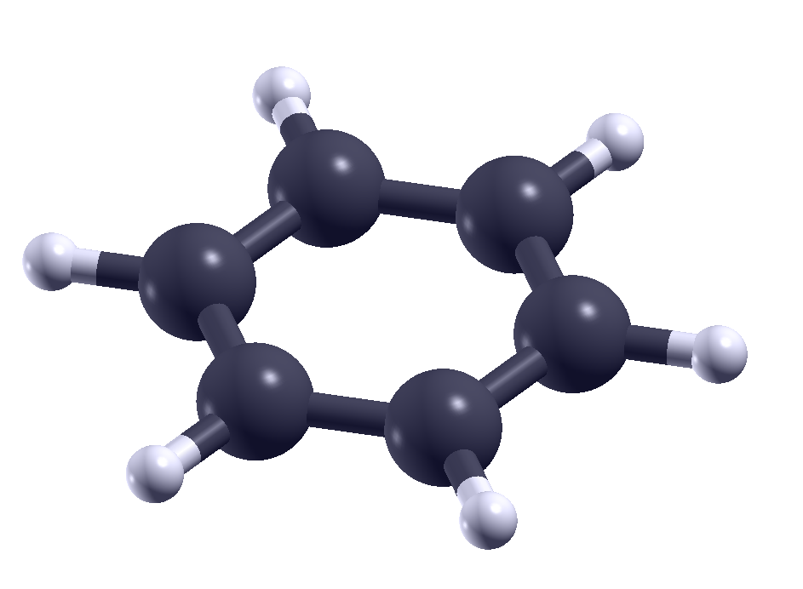

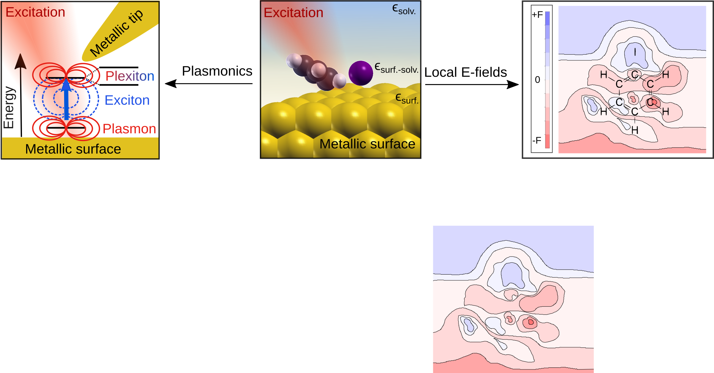
Complexity of matter
Solid
Chemistry
in electric
fields
Cluster
Molecules
Polaritonics
Molecule
Quantum Information
Energy Levels
Complexity of light
-
+
+
-
E(r,t)
B(r,t)
Static
E-Field
Inhomogeneous
static E-Field
Dynamical
E-Field
Classical
modes
Quantum

Slide 3
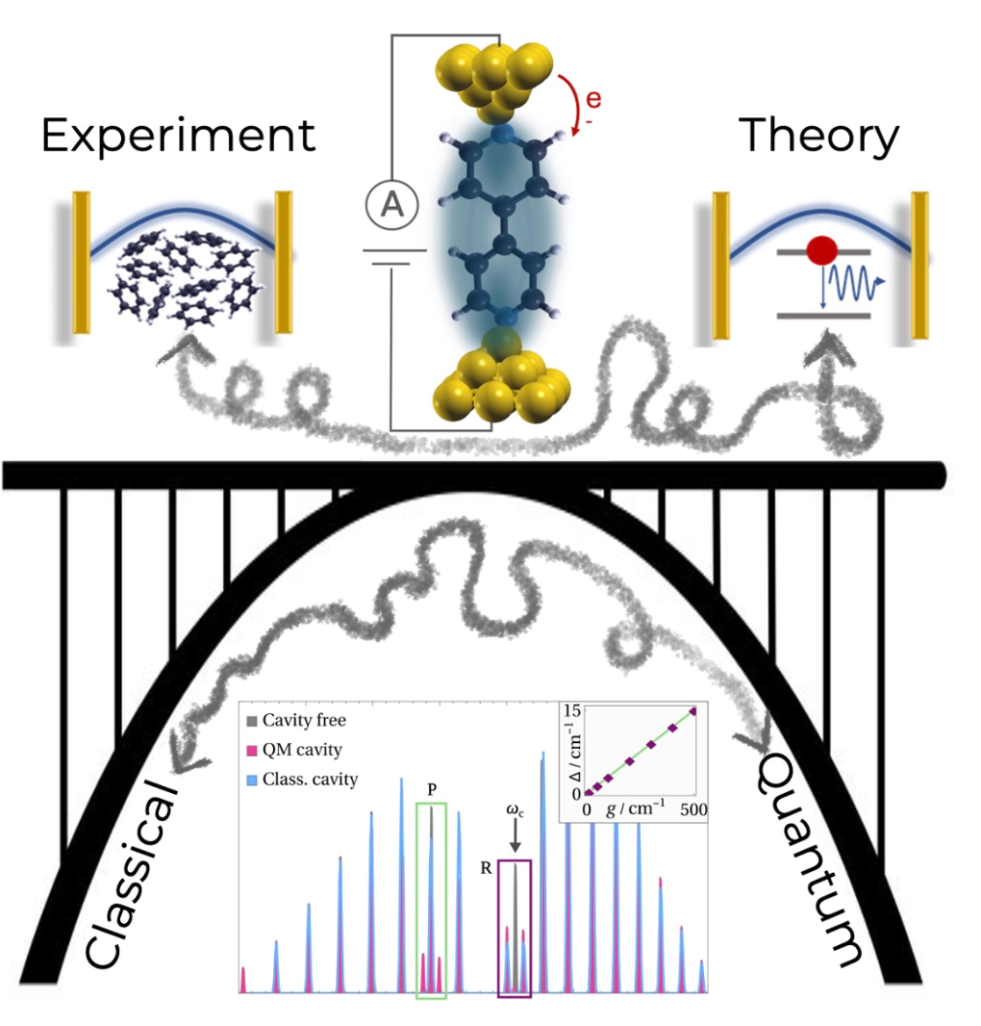
Complexity of matter
Solid
Cluster
Molecules
Molecule
Energy Levels
Complexity of light
-
+
+
-
E(r,t)
B(r,t)
Static
E-Field
Inhomogeneous
static E-Field
Dynamical
E-Field
Classical
modes
Quantum

Slide 4
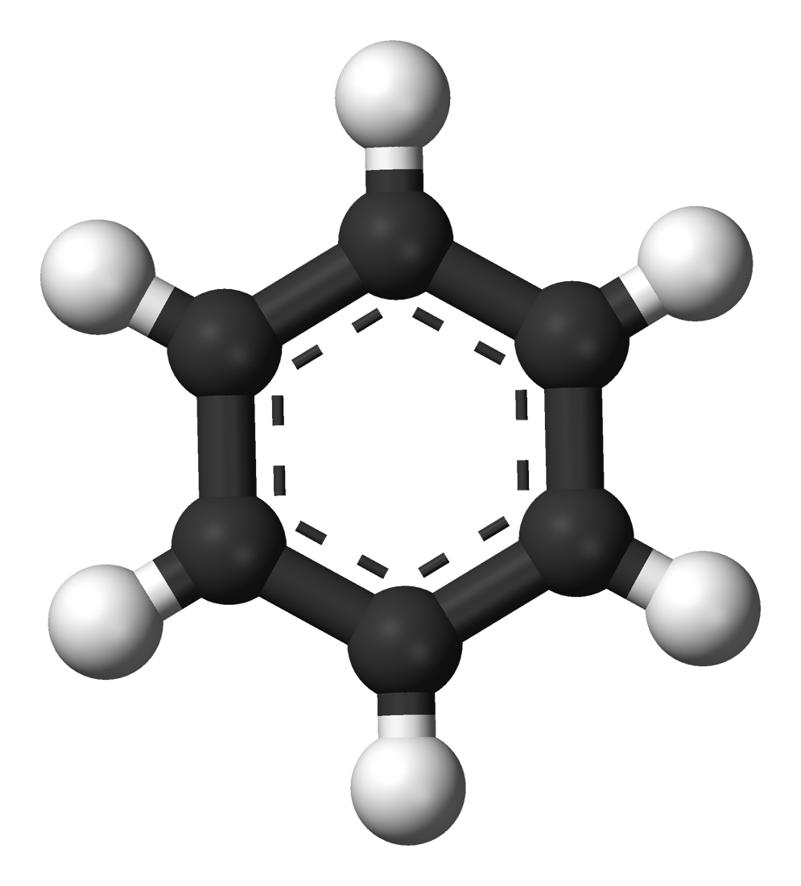
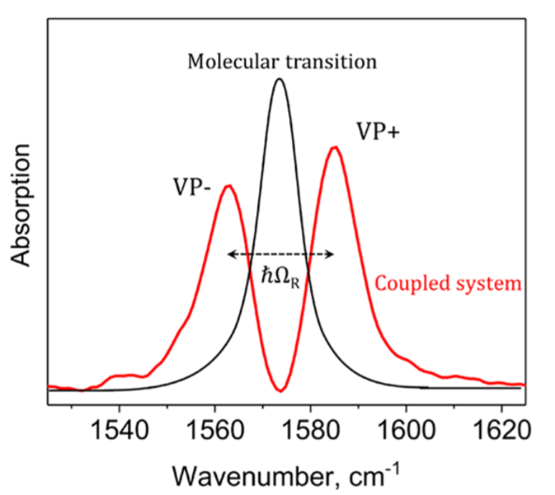

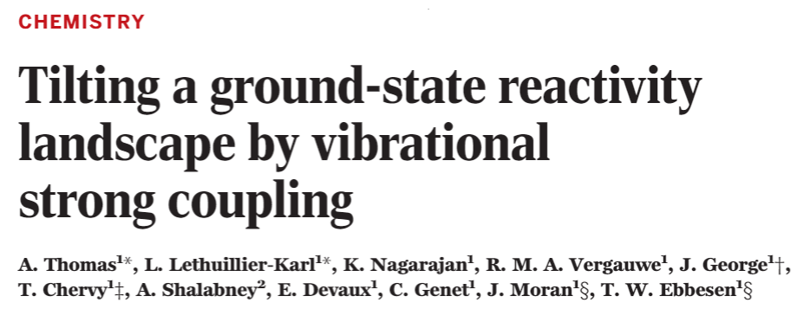
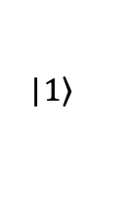

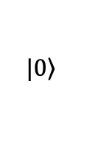
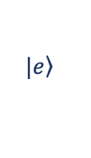
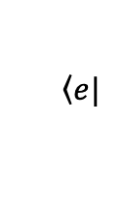
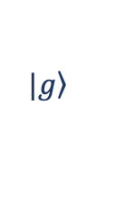
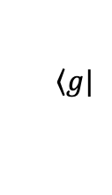

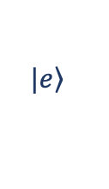
Polaritonic Chemistry
Idea: Change chemical reactivity with polaritons
Energy
Energy
UP
$$\left.|e\right\rangle$$
UP
UP
$$\left.|e\right\rangle$$
|$\left.1\right\rangle$
LP
$$\left\langle e|\right.$$
$$\left.|g\right\rangle$$
$$\left.|g\right\rangle$$
LP
Hybrid light-matter states
-
Polaritons
$$ω_{c}$$
LP
$$\left\langle g|\right.$$
$$\left.|0\right\rangle$$
$$ω_{pht}$$
R
R
Changing something macroscopically (mirrors) changes something microscopically (molecular properties)
Vacuum-field catalysis?
Norah M. Hoffmann
Columbia University

Slide 5
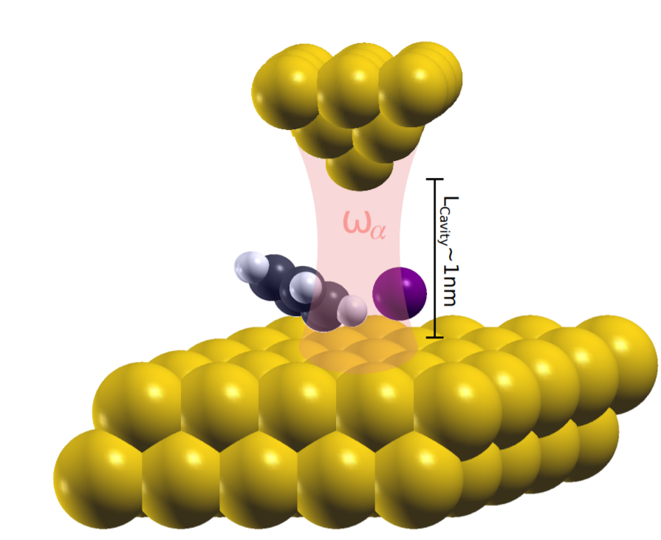
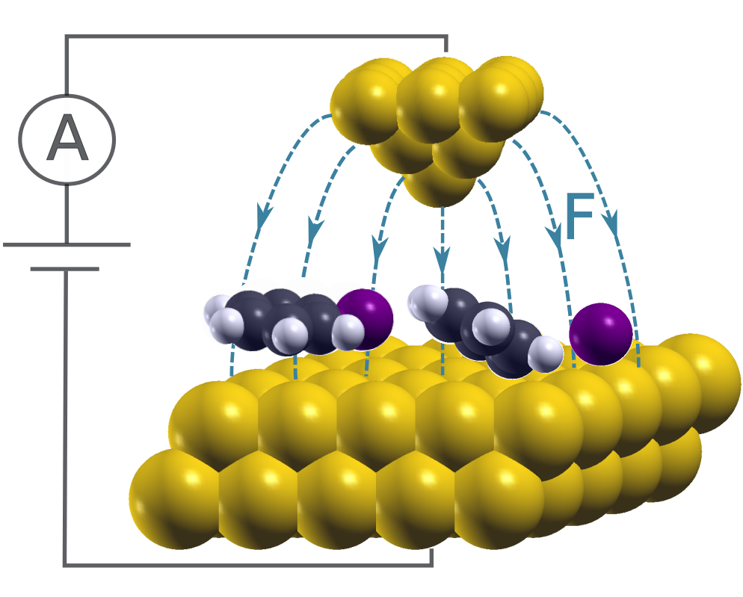
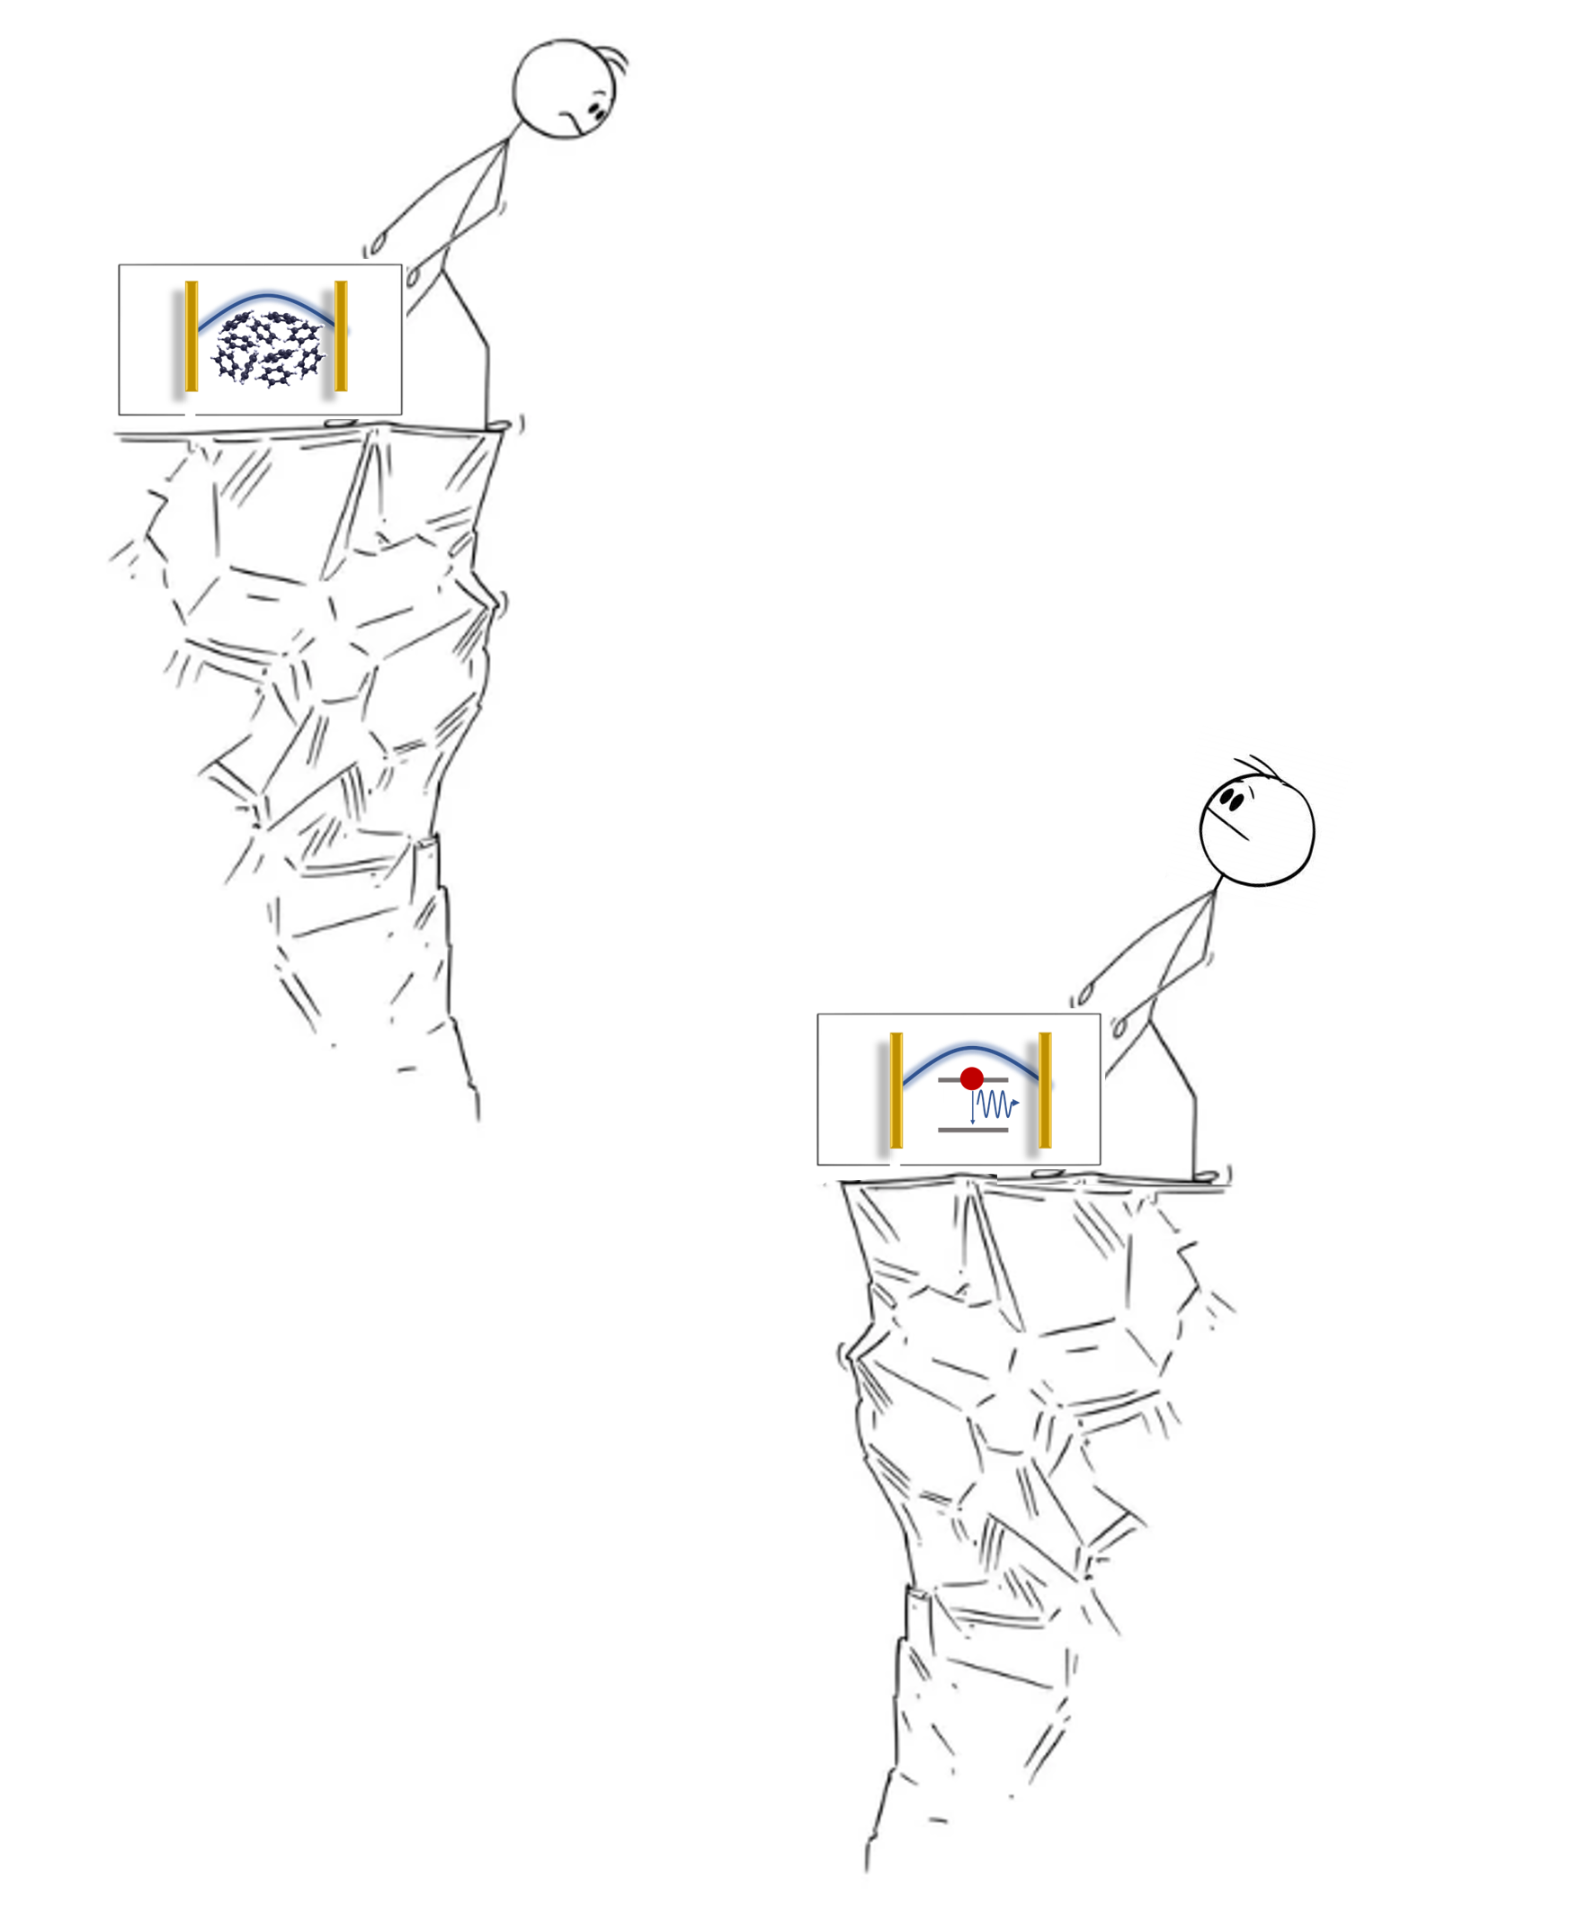
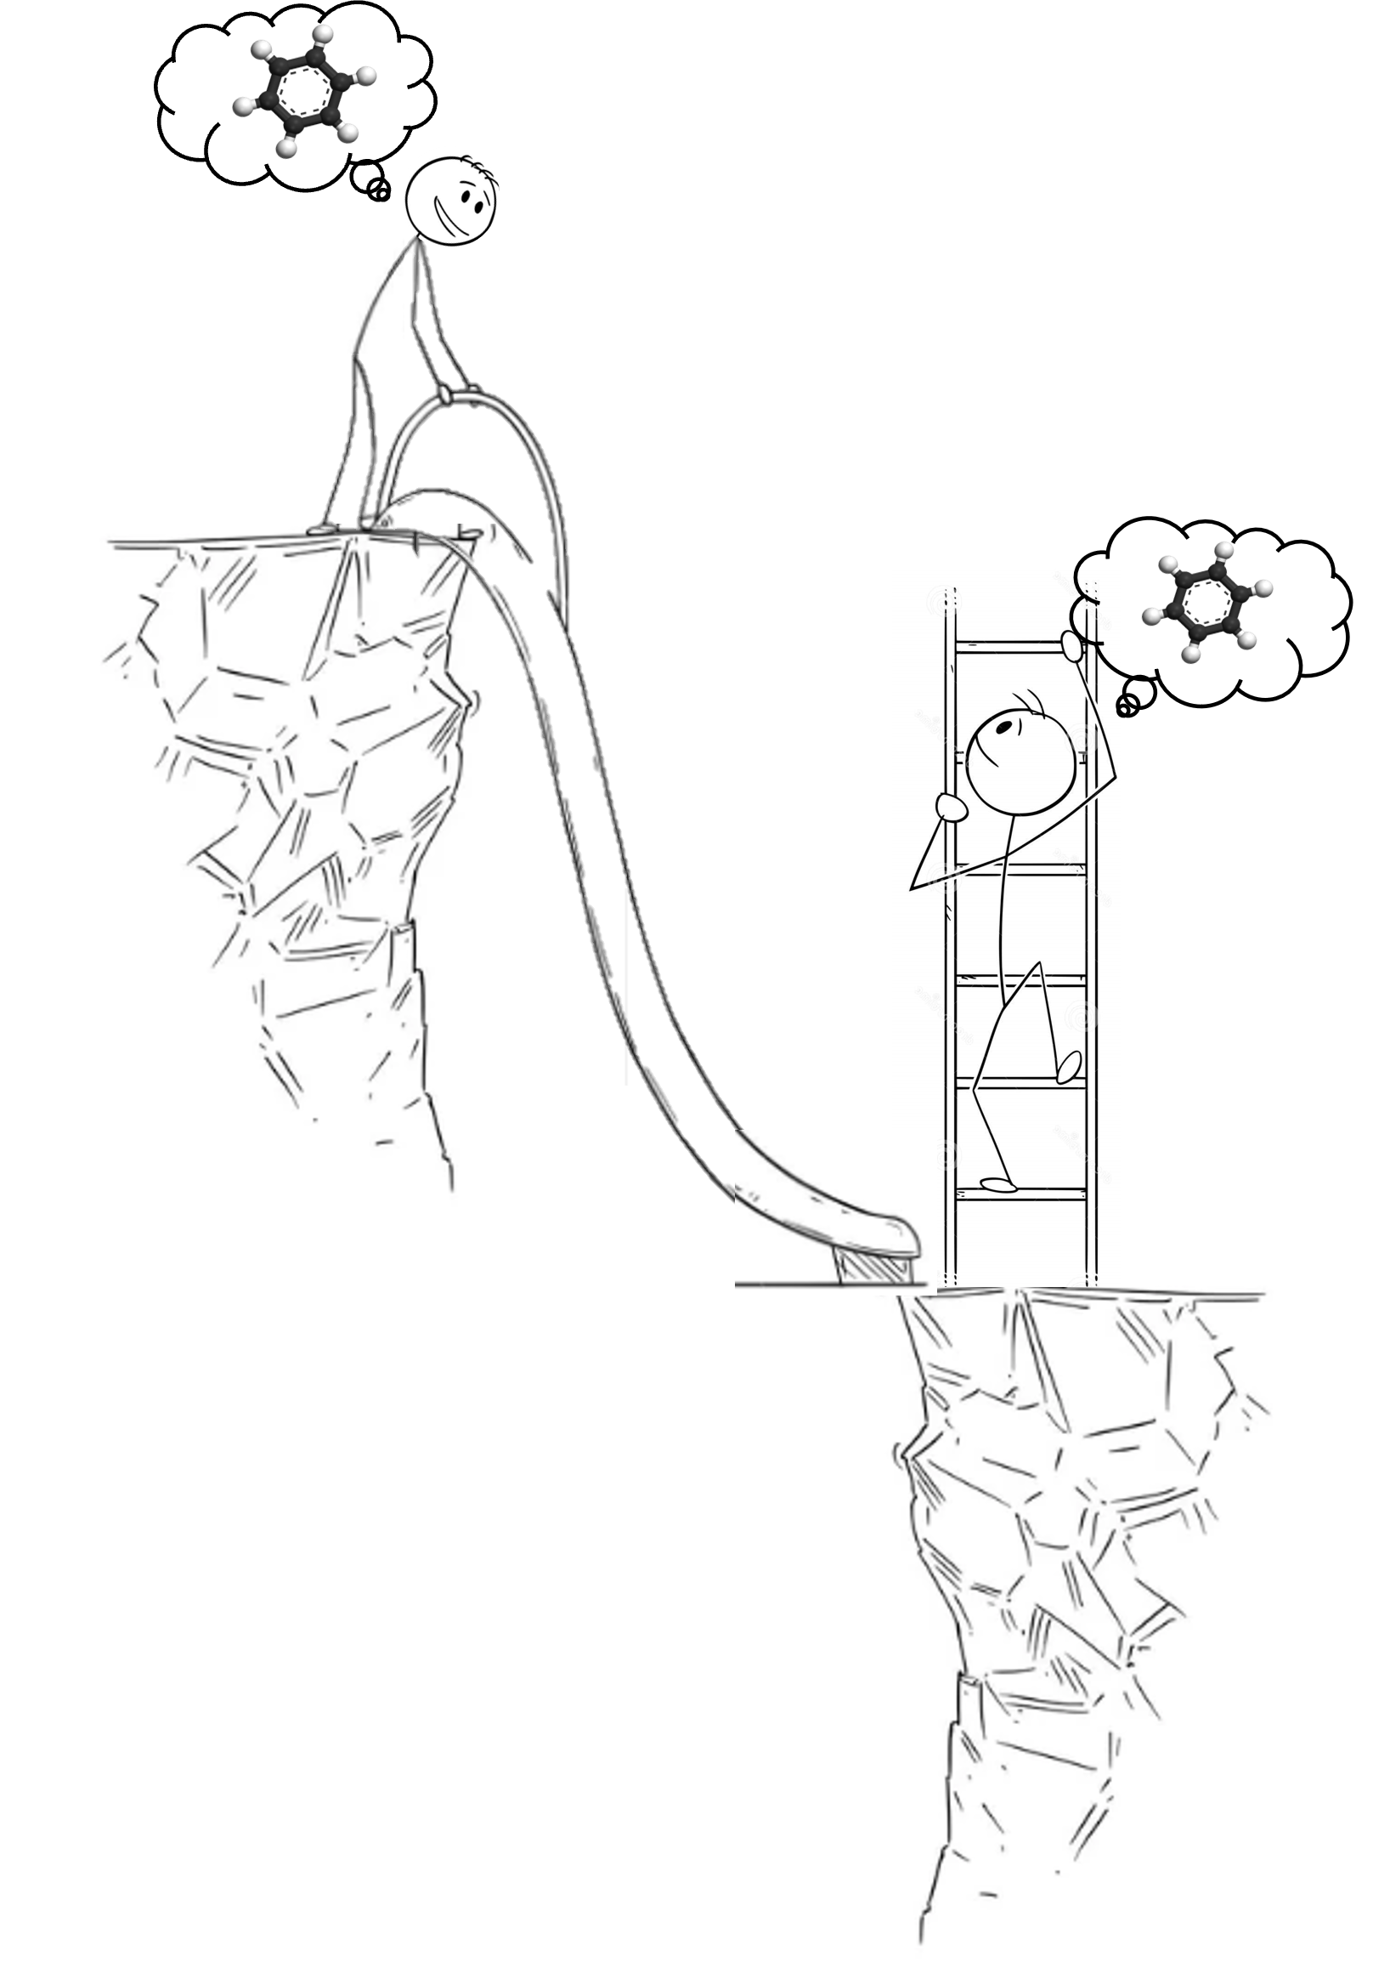

Complexity of matter
Solid
Experiment
Cluster
NMH, Wang, Berkelbach, ACS Catalysis, 2022
A. L. Paoletta, NMH, D. W. Cheng, et. al., JACS (2024)
Stone, Starr, NMH, Wang, et. al. , Chemical Science 2022
Molecules
Theory
Molecule
Energy Levels
Complexity of light
-
+
+
-
E(r,t)
B(r,t)
Static
E-Field
Inhomogeneous
static E-Field
Dynamical
E-Field
Classical
modes
Quantum

Slide 6
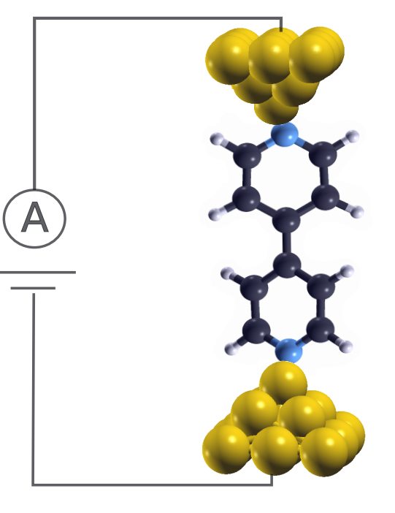

STM-BJ as Plasmonic Cavities
Energy
Excitation: resonant transport
e⁻
e⁻
Electroluminescence spectra
$$ΔE$$
A. L. Paoletta, NMH, D. W. Cheng, et. al., JACS (2024)

Slide 7
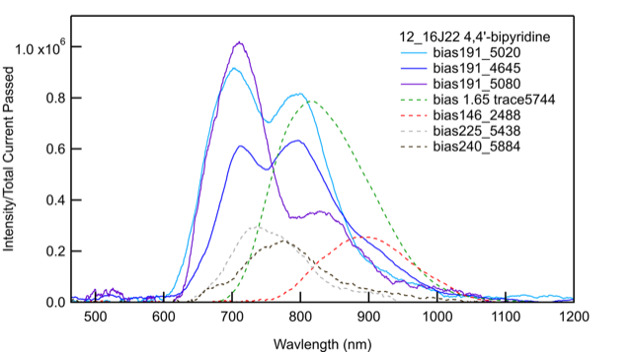



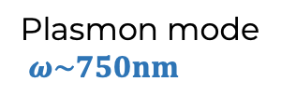
STM-BJ as Plasmonic Cavities
Resonant transport: 1.9V (solid)
Off resonant: 1.4V, 1.6V, 2.25V, 2.4V (dashed)
Energy
Plasmon mode
$ω\sim 750nm$
1.0
e⁻
0.8
e⁻
0.6
Intensity/Total current passed ${[10}^{−6}]$
$$ΔE$$
0.4
0.2
500 700 900 1100
wavelength$[nm]$

Slide 8


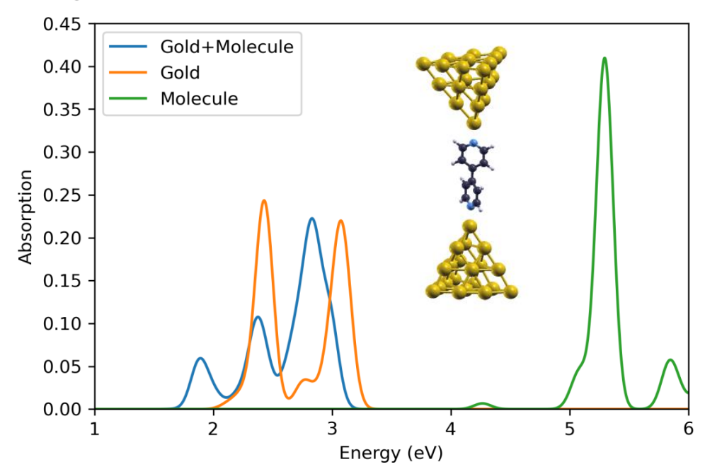
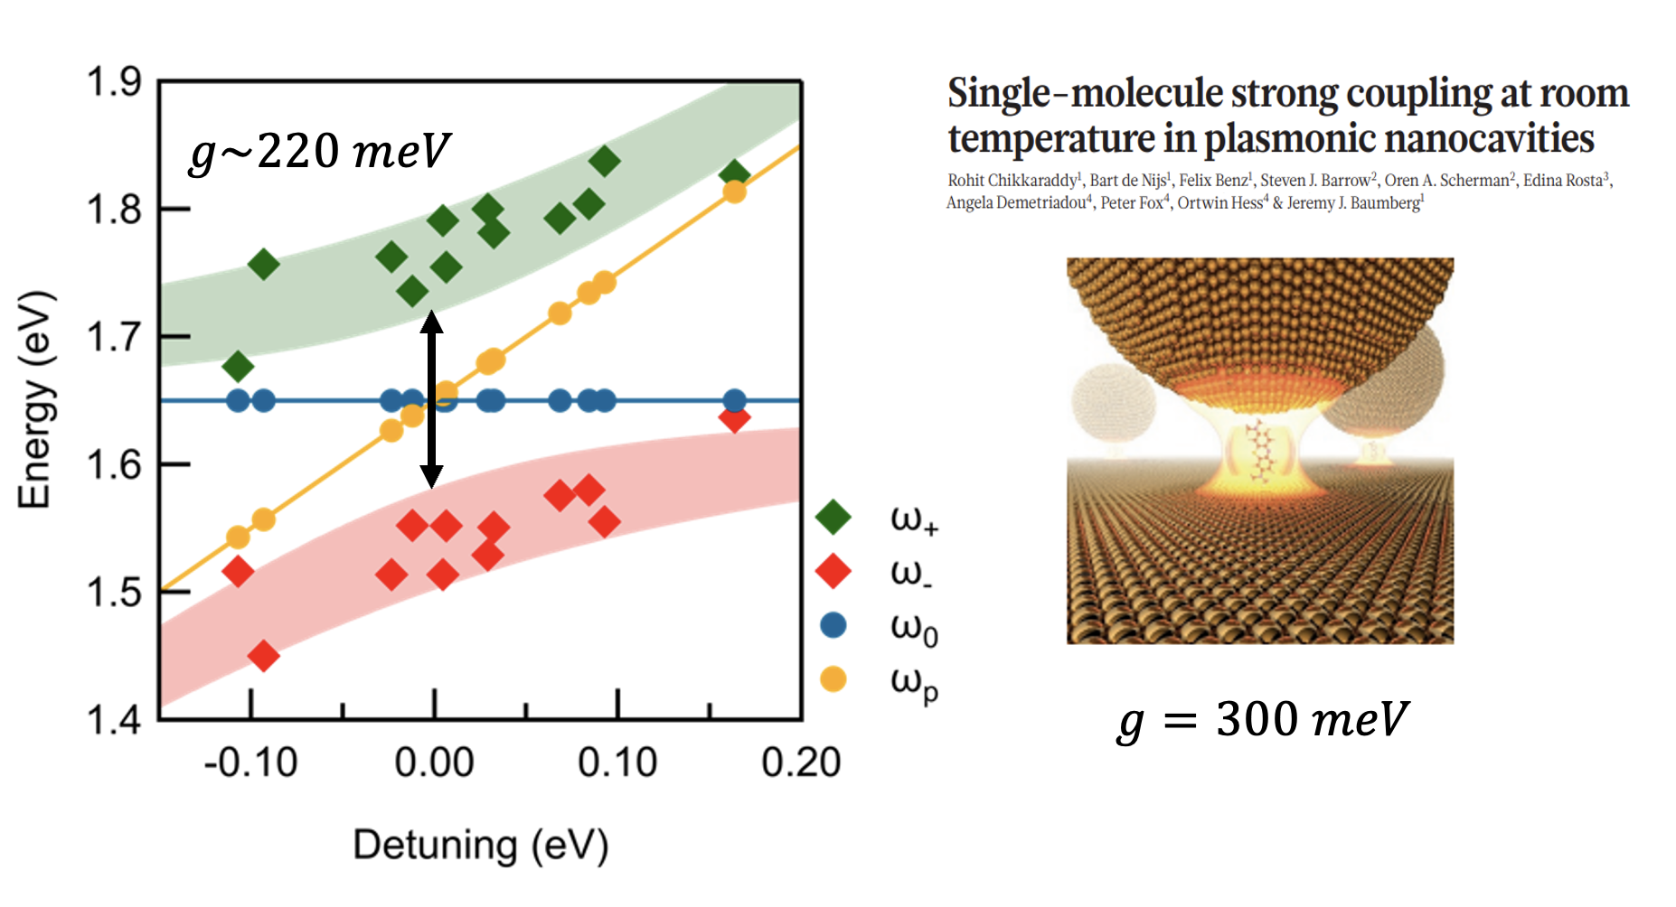
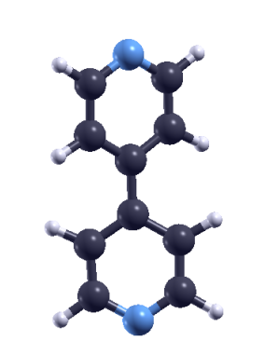
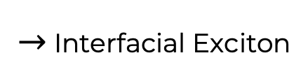

The Open Questions
Plasmon mode vs Bipyridine
$→$ Interfacial Exciton
Strong coupling regime
Theory: TDDFT Linear Response (Orca)
$$ω_{pl}$$
A. L. Paoletta, NMH, D. W. Cheng, et. al., JACS (2024)

Slide 9
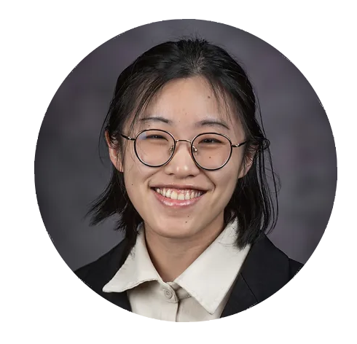
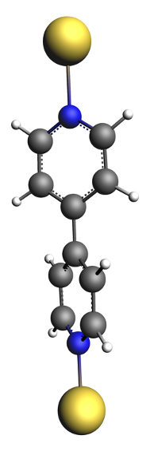





The Open Questions
Why do we have such long Exciton lifetime
What is the difference to laser driven systems
Yuchen Wang
Real-time TDDFT
Laser
Voltage
$$Laser$$
$$0.5 V/nm$$
$$1 V/nm$$
$$1.6 V/nm$$
1. Excite
2. Drive
2. Decay

Slide 10
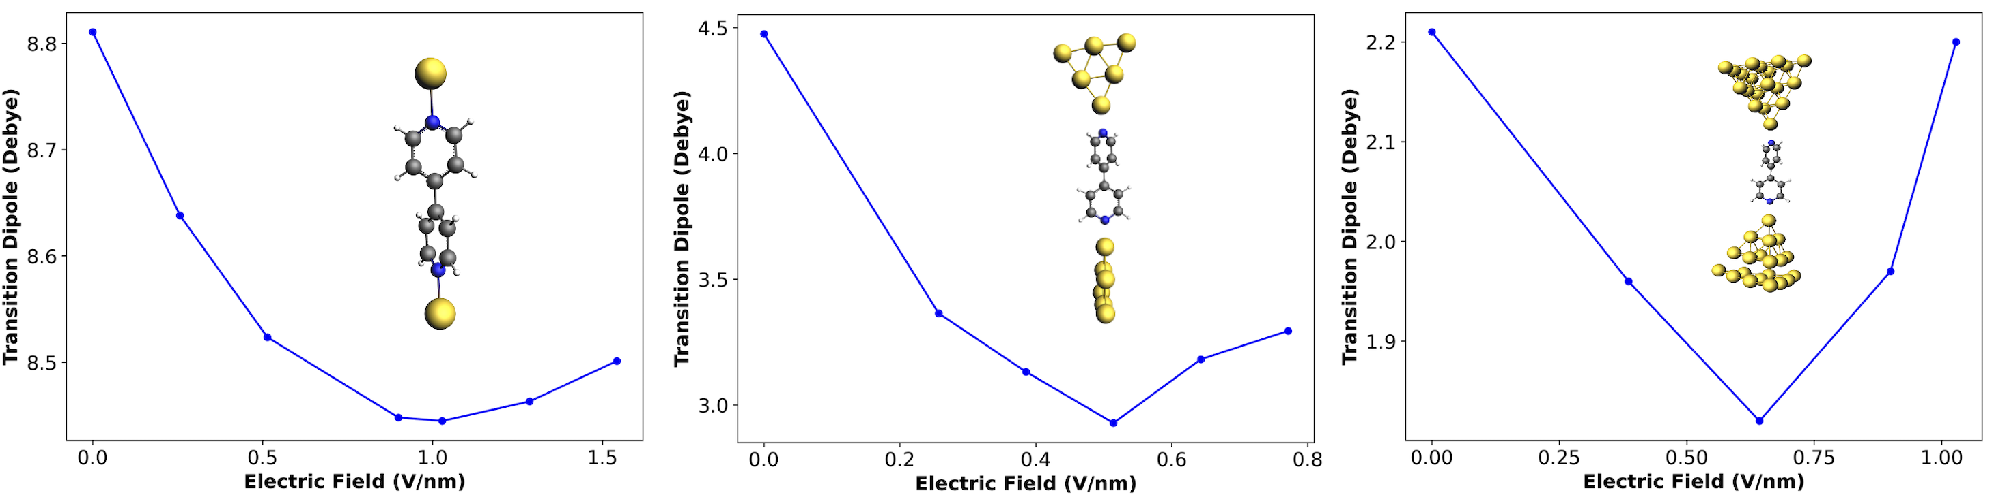
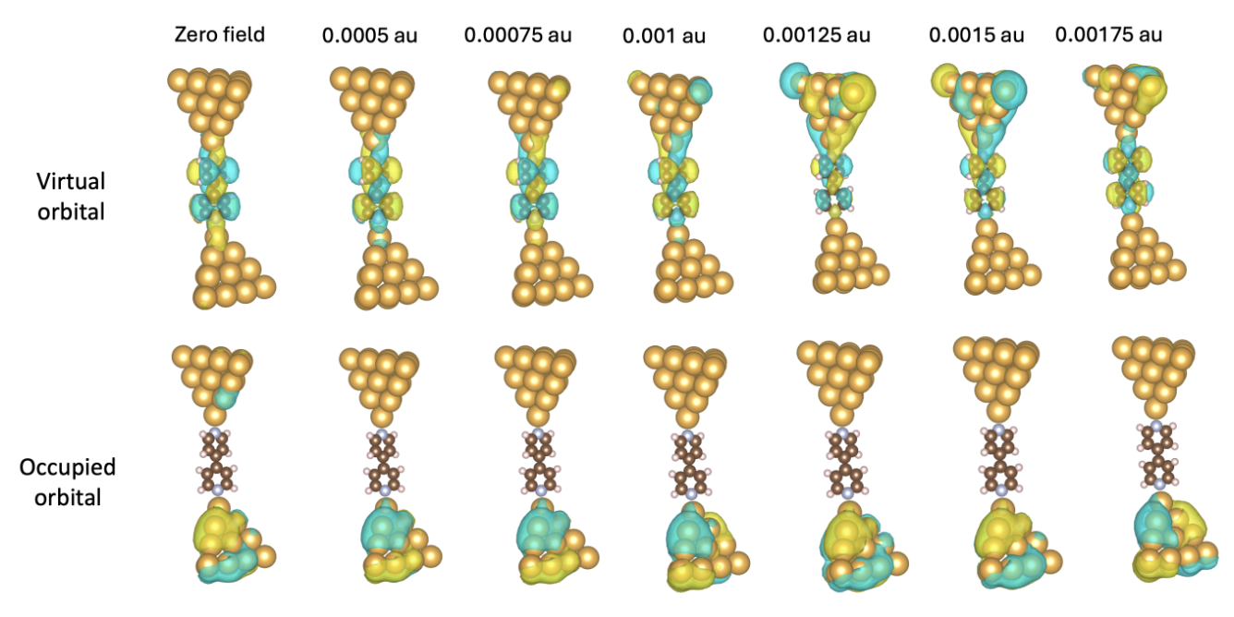
Lifetimes of Interfacial Excitons in STM-BJs
Densities in electric fields (Linear Response TDDFT)
Voltage
0 V/nm
0.3 V/nm
0.6 V/nm
0.7 V/nm
0.9 V/nm

Slide 11
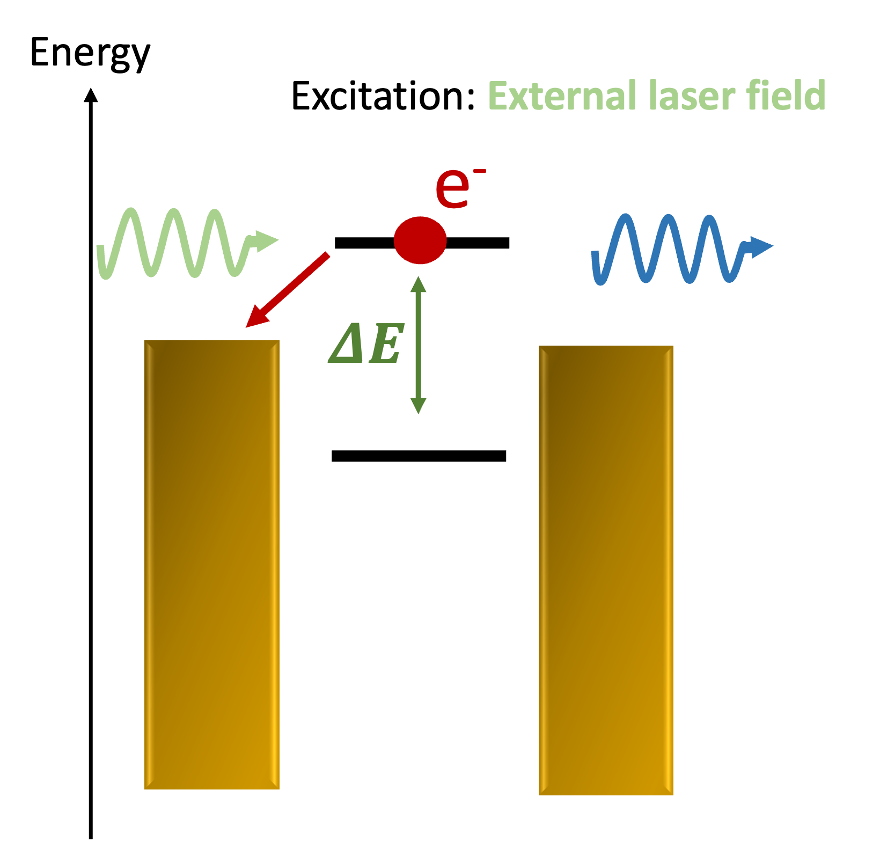
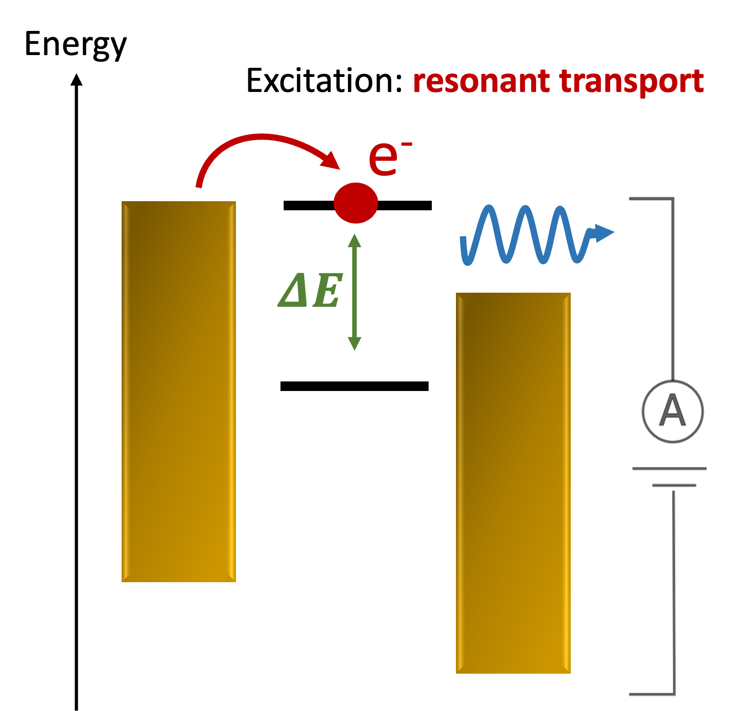

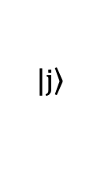
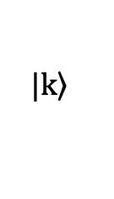
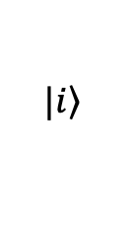
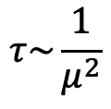
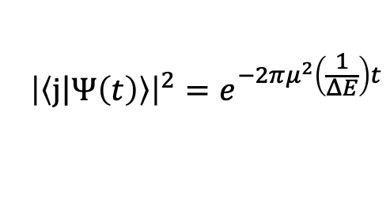
Two level system coupled to a continuum
Lifetimes of Interfacial Excitons in STM-BJs
$$1 V/nm$$
News-Anderson model
$$\left.|j\right\rangle$$
$${\left|\left\langle j\left|Ψ\left(t\right)\right.\right\rangle \right|}^{2}=e^{−2πμ^{2}\left(\frac{1}{ΔE}\right)t}$$
$$\left.|k\right\rangle$$
$$τ\sim \frac{1}{μ^{2}}$$
$$\left.|i\right\rangle$$
Yuchen Wang, Oliver Tan, NMH, in preparation

Slide 12
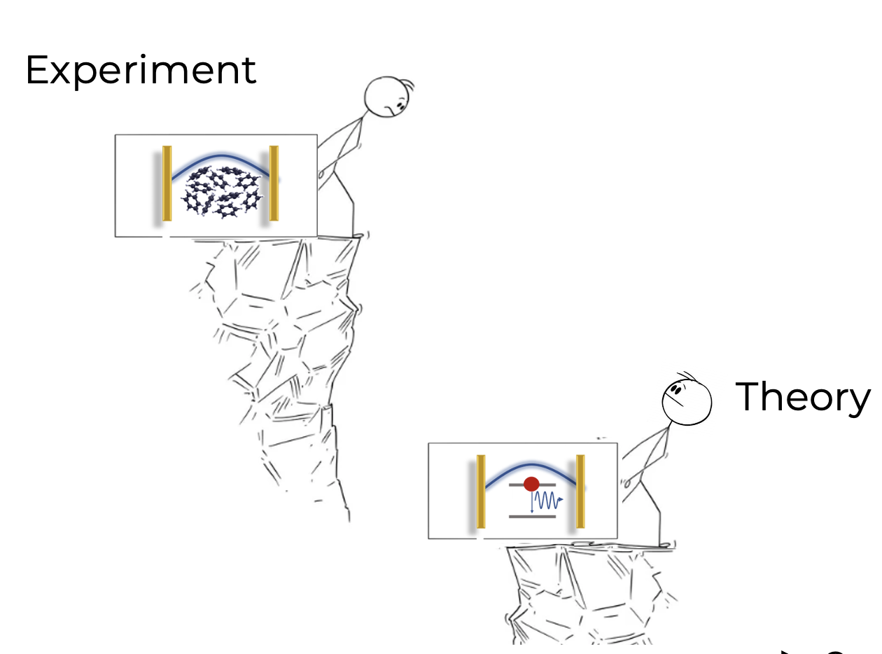
Complexity of matter
Solid
Cluster
STM-BJ are used to monitor reaction (But Exciton polaritons)
Strong coupling at single molecular level
Long exciton lifetimes through voltage
Molecules
Molecule
Energy Levels
Complexity of light
-
+
+
-
E(r,t)
B(r,t)
Static
E-Field
Inhomogeneous
static E-Field
Dynamical
E-Field
Classical
modes
Quantum

Slide 13
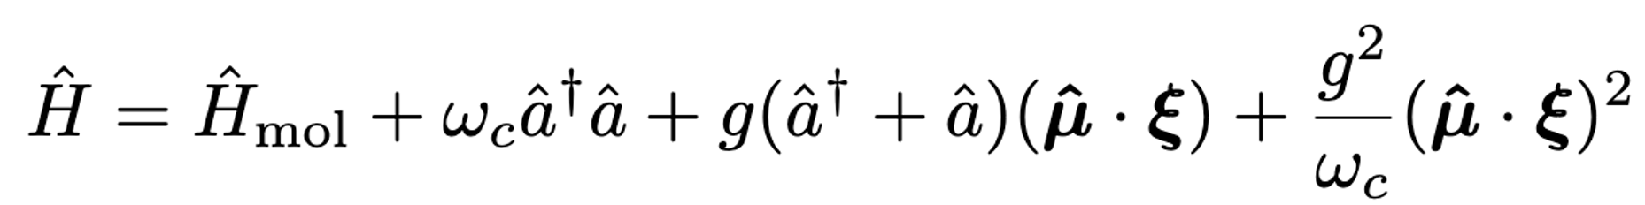
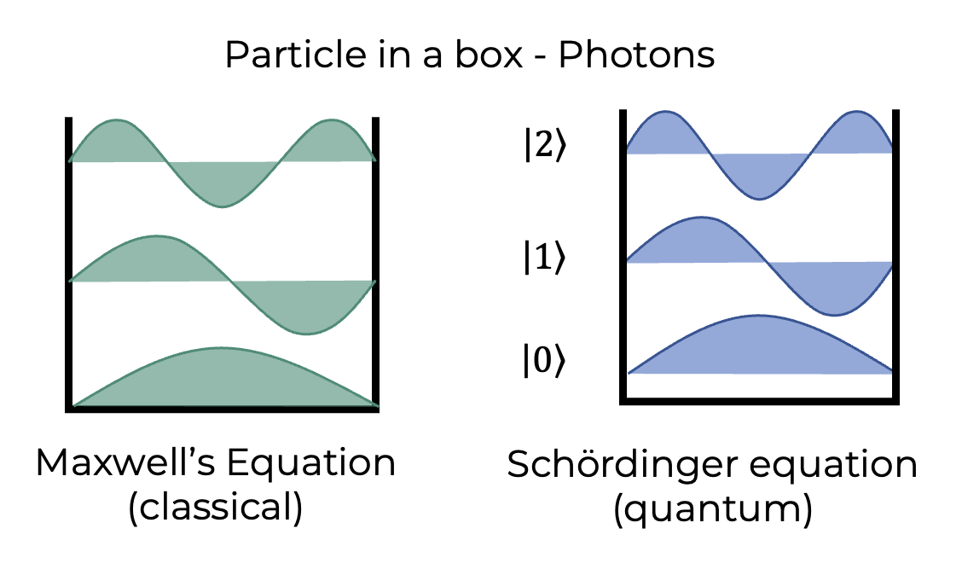
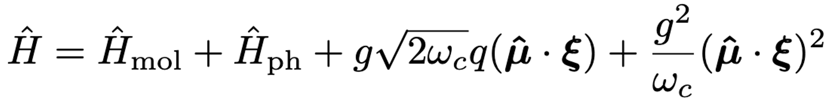
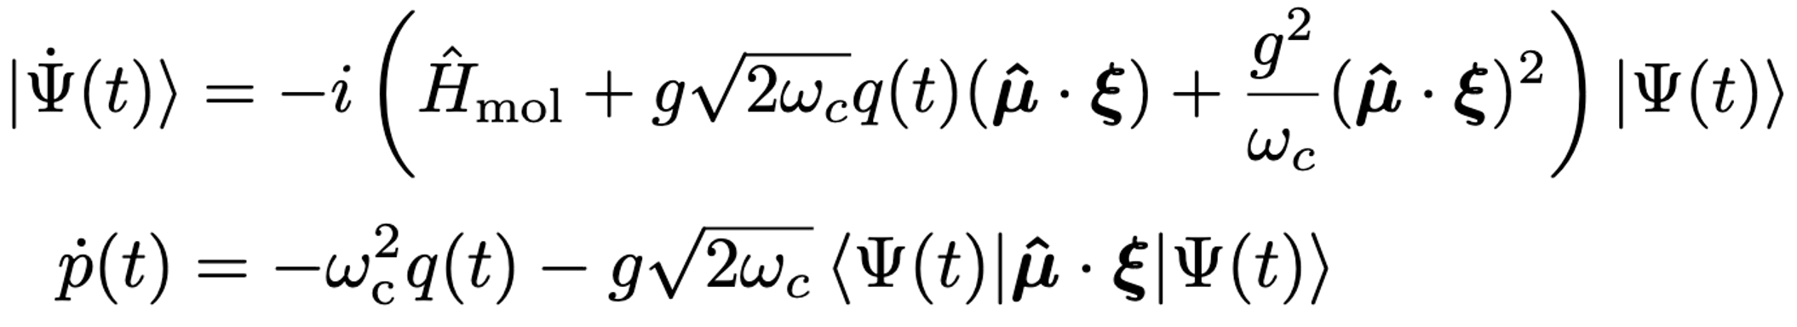


Complexity of matter
+ Diagonalization
Solid
Cluster
Quantized $≠$Quantum
Molecules
Classical:
No vacuum field fluctuation
No Fock state representation
No Entanglement
Molecule
Polaritonics
Irén Simkó
Energy Levels
Complexity of light
-
+
+
-
E(r,t)
B(r,t)
Static
E-Field
Inhomogeneous
static E-Field
Dynamical
E-Field
Classical
modes
Quantum

Slide 14
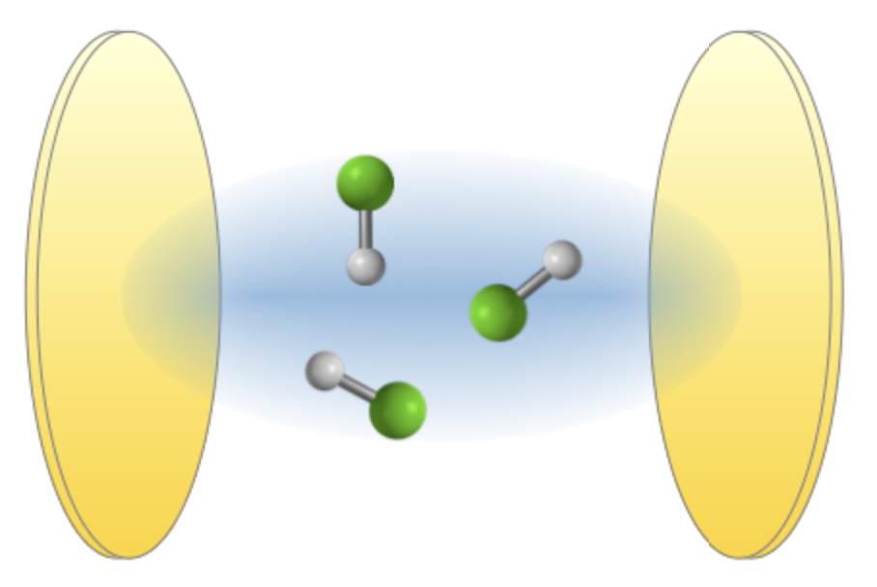
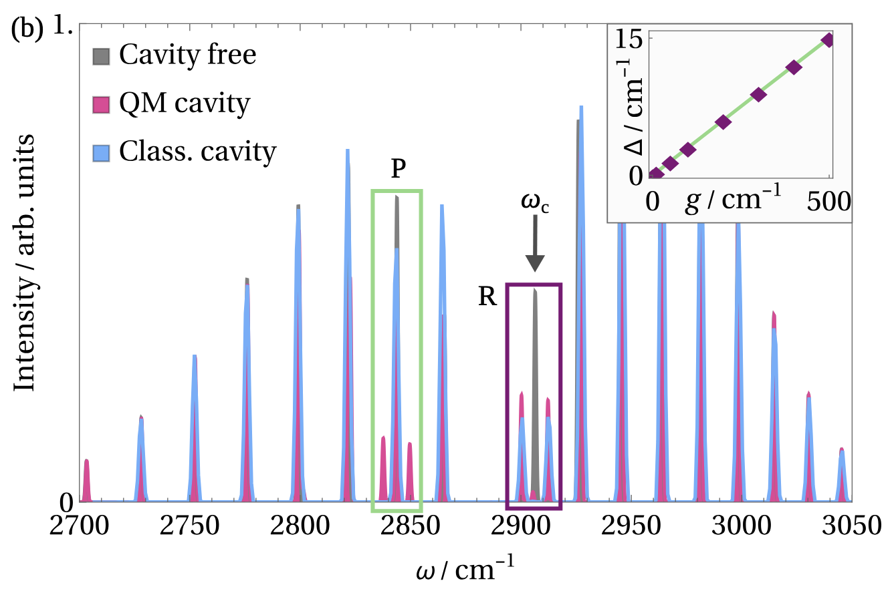
Classical vs Quantum Light Effects in Polaritonic Spectra
Transition II
Transition I
Transition II
Transition I
Is this effect really quantum and does it persist for many molecules?
Schwennicke, Kai, et al., arXiv preprint arXiv:2408.05036 (2024).
Wright, Adam D., Jane C. Nelson, and Marissa L. Weichman., JACS 145.10 (2023): 5982-5987.

Slide 15
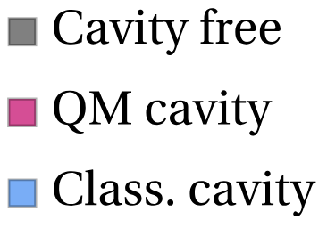
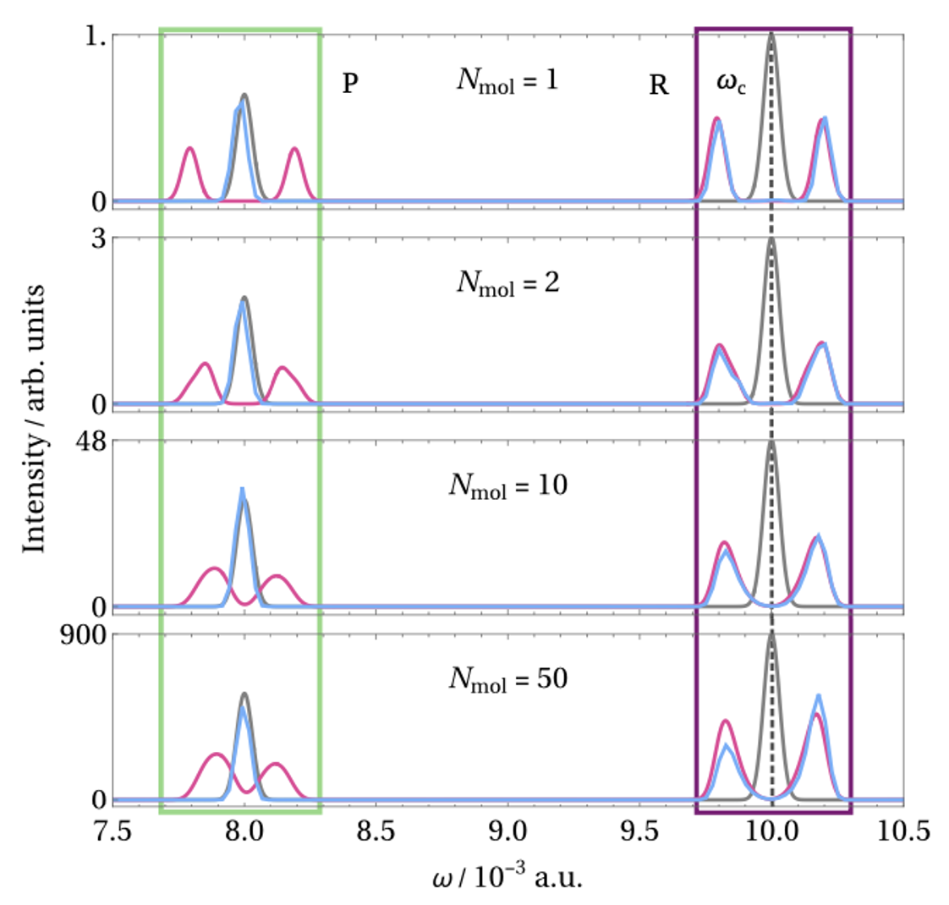
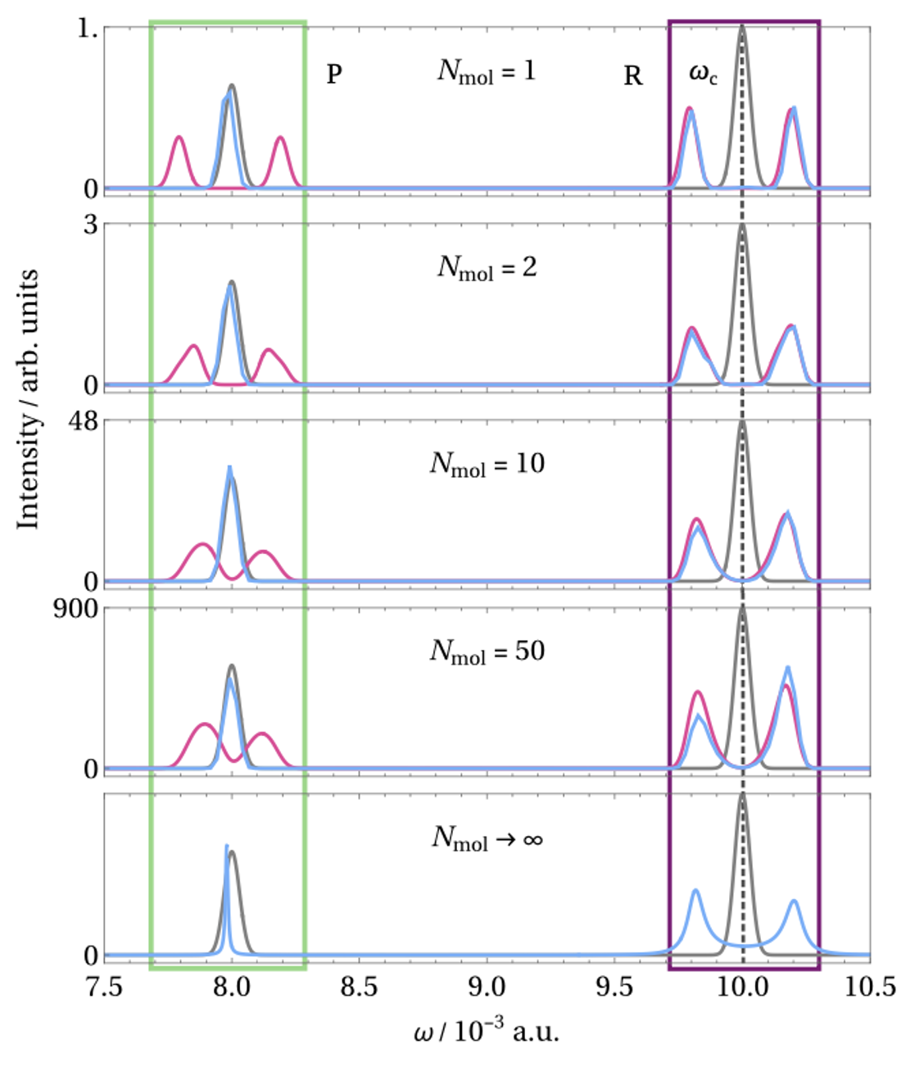
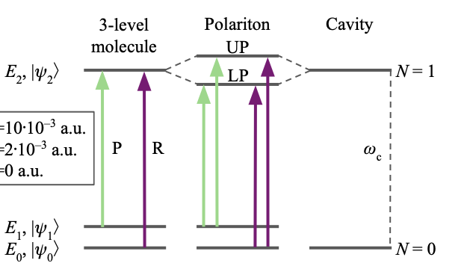

Twin-Polaritons: Many Molecule Case
Feature persist for many molecules
Not a residual from a semi-classical approximation (thermodynamic limit)
J. Yuen-Zhou, et al., JCP 160.15 (2024).

Slide 16
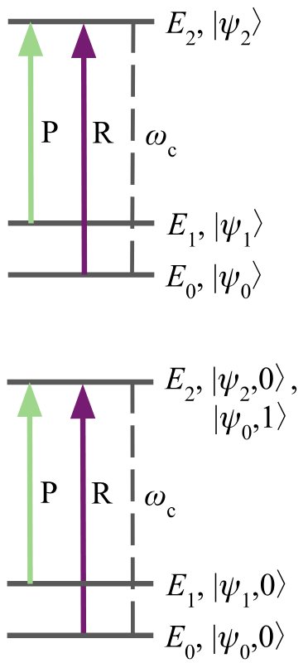
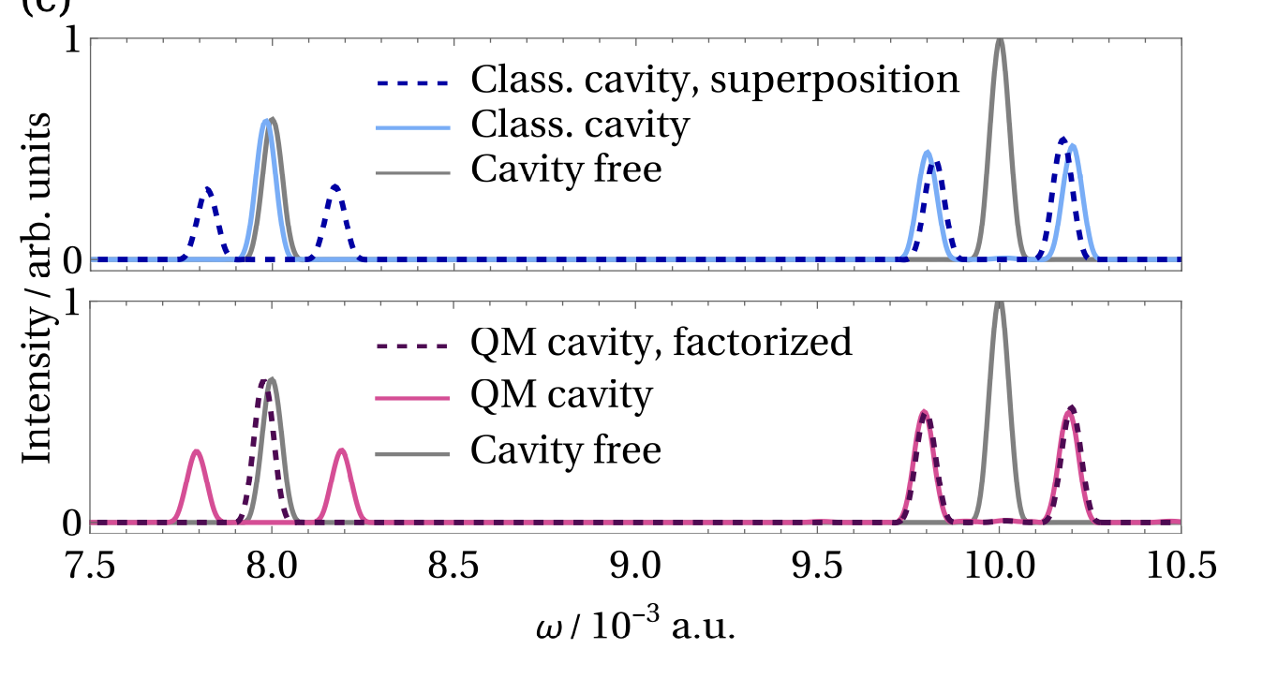

Twin-Polaritons: Source of Quantumness
What’s the origin of the quantumness:
(i) Vacuum field fluctuation (ii) Fock-state (iii) Entanglement (No factorization)
Quantum
Classical
Break the quantum:
Fix the classical:
Iren Simko, NMH, in preparation

Slide 17


Complexity of matter
Solid
Cluster
Quantized $≠$Quantum
Molecules
Twin Polaritons:
New quantum features
Inherently quantum
Persist for many molecule case
Tuning a quantum feature with a classical one
Molecule
Polaritonics
Energy Levels
Complexity of light
-
+
+
-
E(r,t)
B(r,t)
Static
E-Field
Inhomogeneous
static E-Field
Dynamical
E-Field
Classical
modes
Quantum

Slide 18
Complexity of matter
Solid
Cluster
Molecules
Molecule
Energy Levels
Complexity of light
-
+
+
-
E(r,t)
B(r,t)
Static
E-Field
Inhomogeneous
static E-Field
Dynamical
E-Field
Classical
modes
Quantum

Slide 19



Acknowledgements
Arianna Damiani
Muhammad Hasyim
Jillian Hoffstadt
Ekaterina Maximova
Iren Simko
Oliver Tan
Yuchen Wang
Rhiannon Zarotiadis
Davood Shahrjerdi
Moeid Jamalzadeh
Johannes Flick
Latha Venkataraman
Milan Delor
Angela Paoletta
Thank you!

