Slide 1
Simulations of Ultrafast Spectroscopy Observables Using the GPU-accelerated Time-dependent Complete Active Space Configuration Interaction Method
Arshad Mehmood* and Benjamin G. Levine
Institute for Advanced Computational Science (IACS)
and
Department of Chemistry
Stony Brook University, NY.

Slide 2
Transient Absorption Spectroscopy (TAS)
Probe
Pump
Δt
Sample
Characteristics
Time Resolution: TAS offers extremely high time resolution allows to monitor ultrafast processes in femtoseconds scale
Versatility: This technique is versatile and can be applied to a wide range of systems
Sensitivity: highly sensitive to changes in electronic and structural properties of molecules or materials
Berera, R., van Grondelle, R. & Kennis, J.T.M., Photosynth Res 2009, 101, 105-118.

Slide 3
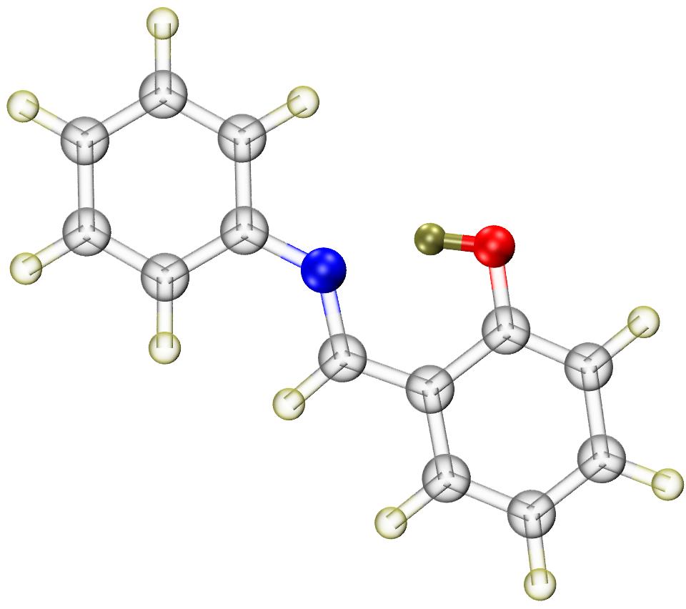
Limitations of TAS – The Motivation
The interpretation of the TA spectrum (TAS) is inherently indirect:
Lower-dimensional Observables
Overlap of positive (excited state absorbance) and negative (stimulated emission and ground state bleach) signals
Ultrafast theory has become an essential partner to experiment and is a standard requirement to correctly assign the ultrafast signals.
Silfies, M. C.; Mehmood, A.; Kowzan, G.; Hohenstein, E. G.; Levine, B. G.; Allison, T. K. J. Chem. Phys. 2023, 159, 104304.
Silfies, M. C.; Kowzan, G.; Lewis, N.; Allison, T. K., Phys. Chem. Chem. Phys., 2021, 23, 9743-9752.

Slide 4
Why to Simulate Ultrafast Signals…?
The AIMD provides $\left|\left.Ψ_{approx}(t)\right\rangle \right.$ that can be used to assign ultrafast experiment
Common procedure involve comparing experimental and AIMD time constants
Due to the exponential relation, error in rates are amplified due to a small error in the barrier height
Direct comparison of experimental and simulated observables provide a more accurate solution.
Our Approach
We combined non-adiabatic molecular dynamics (NAMD) simulations (a pump) with our GPU-accelerated Time-dependent Complete Active Space Configuration Interaction (TD-CASCI) method (a probe) for simulating both the ultrafast dynamics and TAS.
Silfies, M. C.; Mehmood, A.; Kowzan, G.; Hohenstein, E. G.; Levine, B. G.; Allison, T. K. J. Chem. Phys. 2023, 159, 104304.
Silfies, M. C.; Kowzan, G.; Lewis, N.; Allison, T. K., Phys. Chem. Chem. Phys., 2021, 23, 9743-9752.

Slide 5
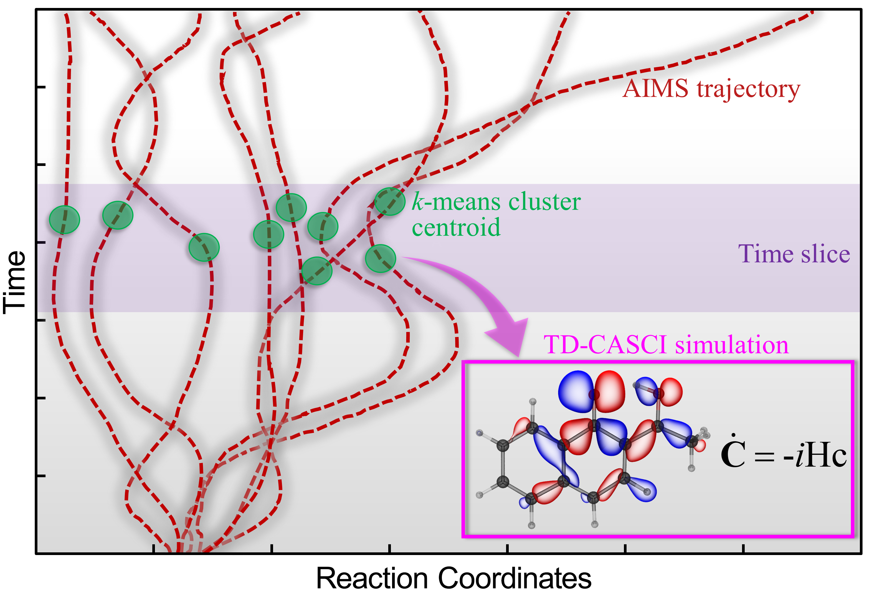
Simulation Protocol
TD-CASCI electronic dynamics are run on each selected conformation derived from the time-slices of NAMD trajectories
A δ-kick with a field polarized along the x, y, and z axes of the molecular axis.

Slide 6
Time-dependent CASCI (TD-CASCI): The Probe
Linear variational method for solving the Schrödinger equation using a wave function that is a linear combination of configuration state functions:
Virtual space
Active space
Inactive space
Peng, W.-T.; Fales, B. S.; Levine, B. G., J. Chem. Theory Comput. 2018, 14, 4129-4138.

Slide 7
Time-dependent CASCI (TD-CASCI): The Probe
Electric field excitation are included by using the electric dipole approximation:
Pump-probe orientations:
Salient Features
It gives the TAS without the need to calculate all higher excited states
It allows a large complete active space configuration expansions
No need to explicitly build, store, and diagonalize of the Hamiltonian matrix
The GPU-accelerated implementation allows cost-effective simulation of TAS.
Peng, W.-T.; Fales, B. S.; Levine, B. G., J. Chem. Theory Comput. 2018, 14, 4129-4138.

Slide 8
Salicylideneaniline (SA)
Non-adiabatic Dynamics Simulations (the pump):
2ps AIMS simulations with 360 initial conditions at ωPBEh-CAS(2,2)CI/6-31G**
TD-CASCI Simulations (the probe):
84 time slices (each slice 24.2 fs) of 2ps NAMD trajectories
80 representative geometries from each slice on S₁ electronic state
100 fs TD-CASCI electronic dynamics by applying field along x, y, z axis
Silfies, M. C.; Mehmood, A.; Kowzan, G.; Hohenstein, E. G.; Levine, B. G.; Allison, T. K. J. Chem. Phys. 2023, 159, 104304.
Pijeau, S.; Foster, D.; Hohenstein, E. G. J. Phys. Chem. A 2018, 122 (25), 5555-5562.

Slide 9
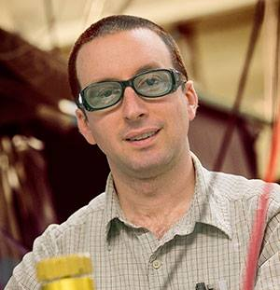
SA Experimental Cavity-Enhanced TAS (CE-TAS)
Gas phase TAS provides an opportunity to compare with theory as complexity of model is reduced significantly.
M. Silfies
T. Allison
Delay
Pump
Probe
S_{n}
S_{n}
Probe
S₁
S₁
Pump
S₀
S₀
Excited State Absorbance
Stimulated Emission
Silfies, M. C.; Mehmood, A.; Kowzan, G.; Hohenstein, E. G.; Levine, B. G.; Allison, T. K. J. Chem. Phys. 2023, 159, 104304.

Slide 10
Simulated TAS of SA
Simulated Magic Angle TAS
Experimental Magic Angle CE-TAS

Slide 11
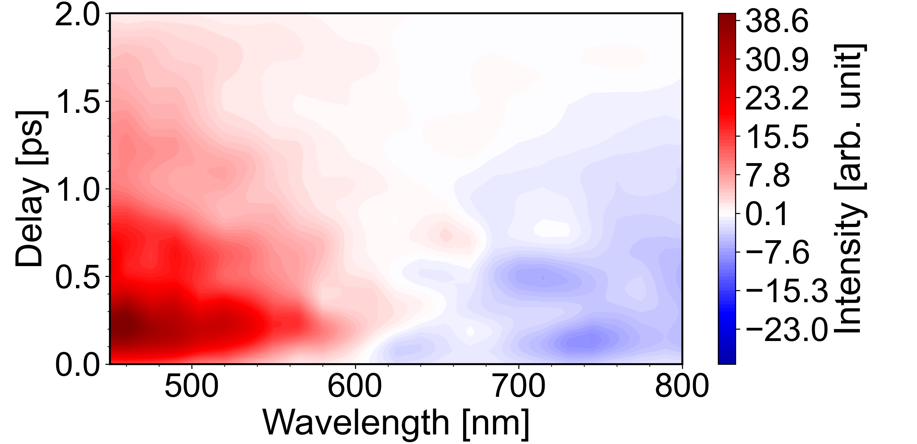
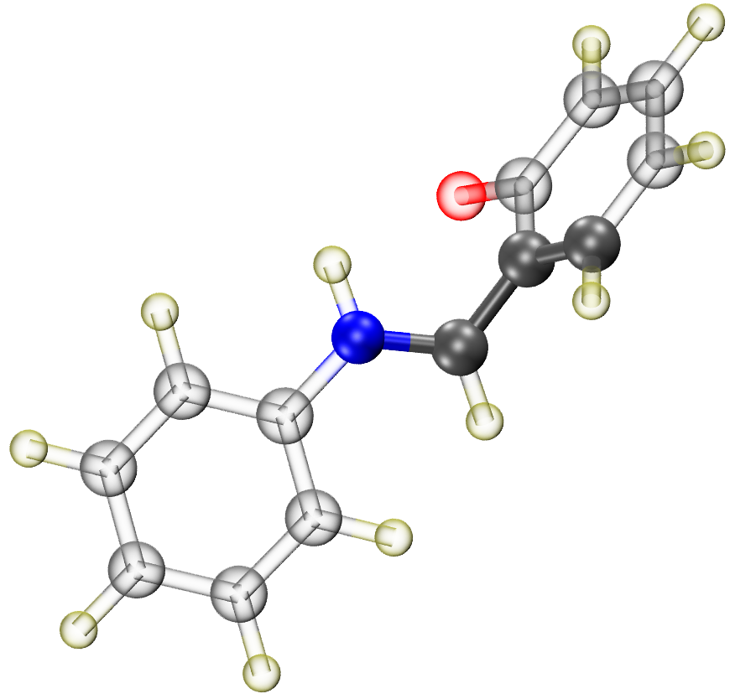
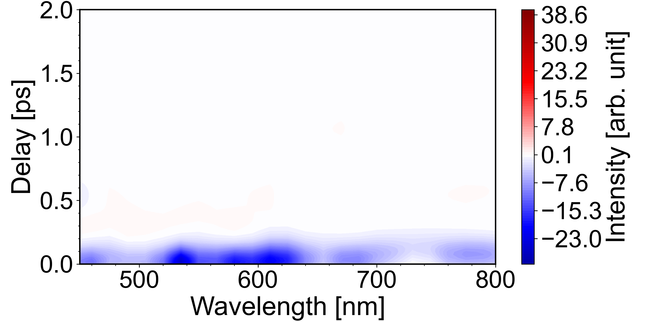
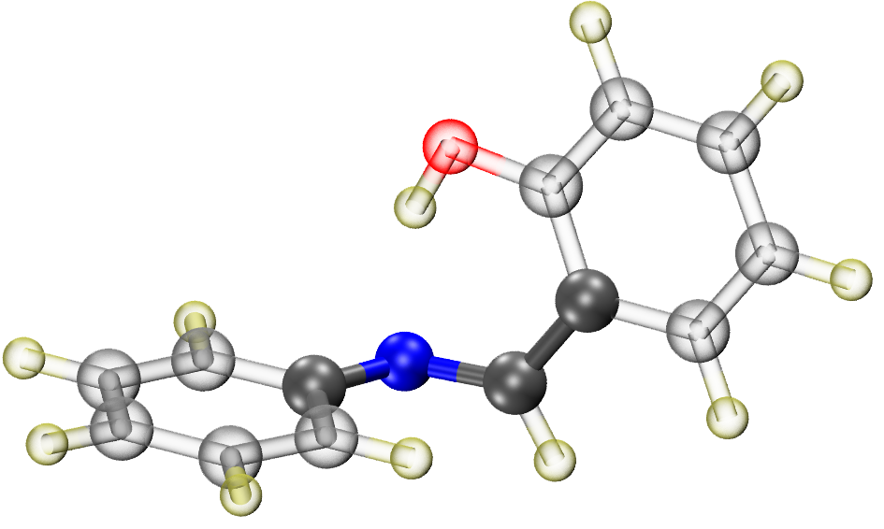
Simulation of TAS Along Different Relaxation Paths
TAS of Primary Relaxation Path
TAS of Secondary Relaxation Path

Slide 12
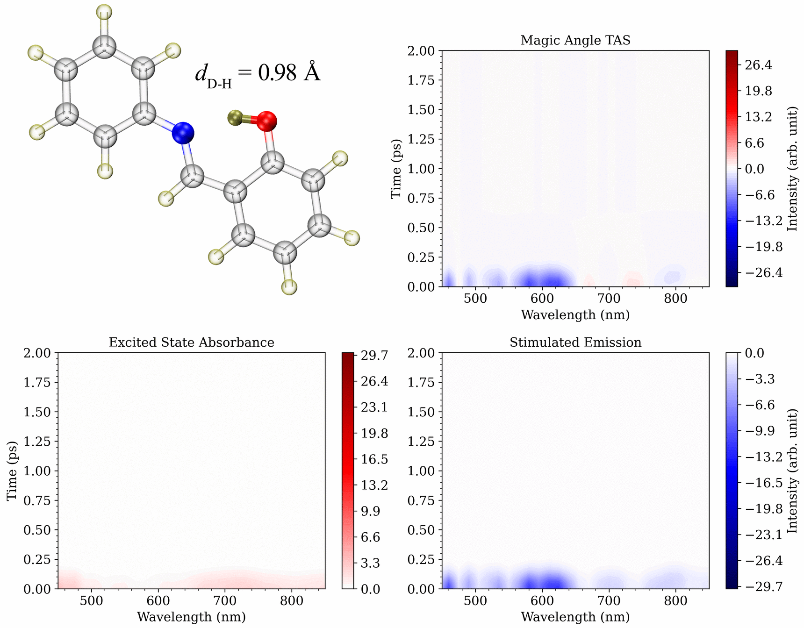
Dynamic Visualization of TAS Evolution on ESIPT Path

Slide 13
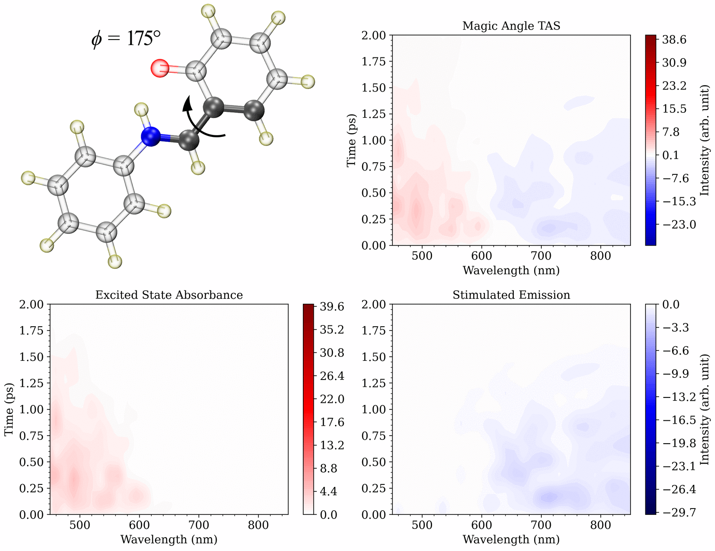
Dynamic Visualization of TAS Evolution on Twist Path

Slide 14
1-Hydroxy-2-acetonaphthone (HAN)
Non-adiabatic Dynamics Simulations (the pump):
2ps AIMS simulations with 45 initial conditions at FOMO-CAS(10,10)CI/6-31G**
The proton transfer time (542 fs) and S1 lifetime (1686 fs) are significantly distinct in NAMD which allows the assignment of the components of CE-TAS
TD-CASCI Simulations (the probe):
164 time slices (each slice 12.1 fs) of 2ps NAMD trajectories
80 representative geometries from each slice on S₁ electronic state
100 fs TD-CASCI electronic dynamics by applying field along x, y, z axis
Mehmood, A.; Silfies, M. C.; Durden, S. A.; Allison, T. K. .; Levine, B. G. J. Chem. Phys. submitted.

Slide 15
Simulated TAS of HAN
Simulated Magic Angle TAS
Experimental Magic Angle CE-TAS

Slide 16
Simulation of TAS Along Different Relaxation Paths
TAS of Enol Components
TAS of Keto Components

Slide 17
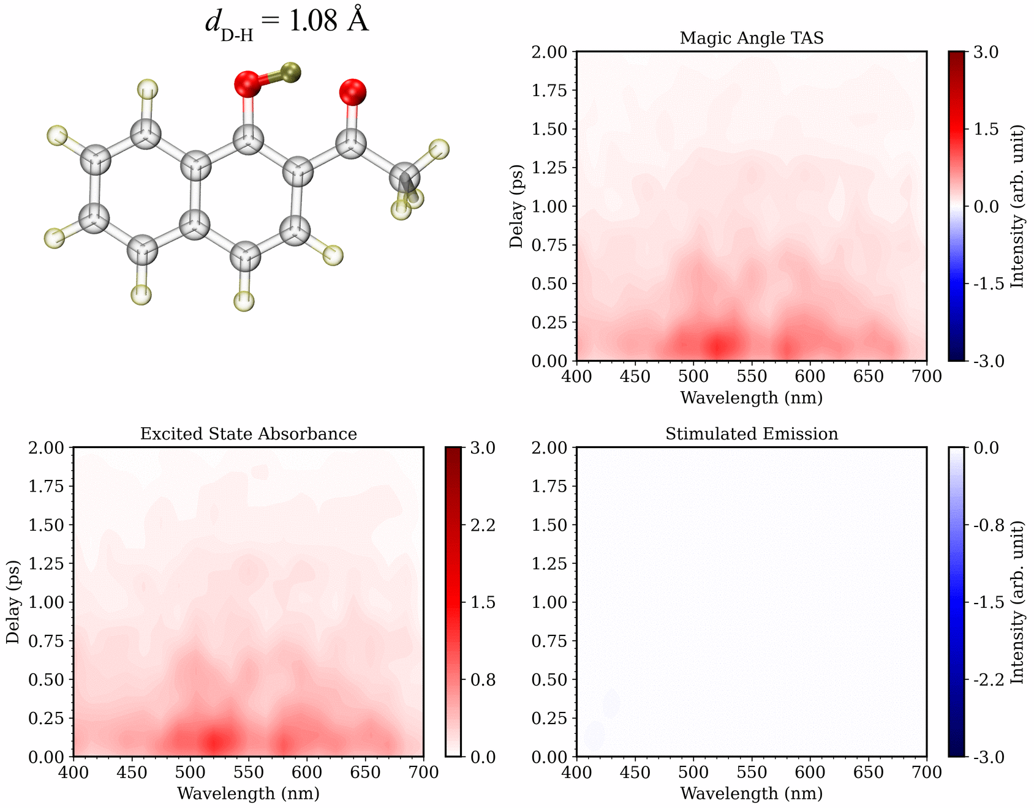
Dynamic Visualization of TAS on HAN ESIPT Path

Slide 18
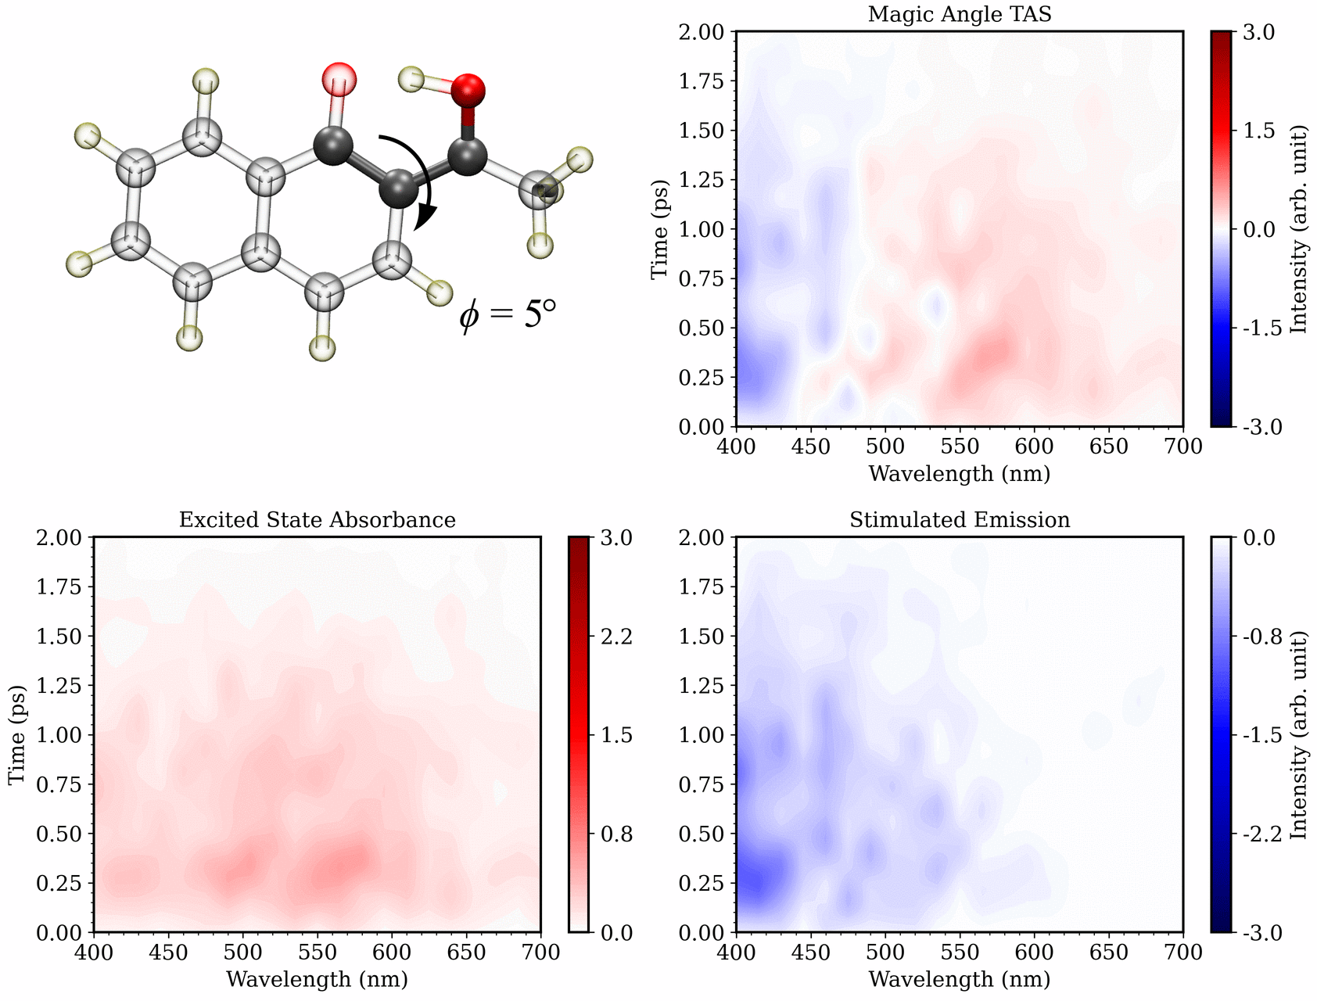
Dynamic Visualization of TAS on HAN Twist Path

Slide 19
Conclusions
The combination of non-adiabatic dynamic simulations such as AIMS, and TD-CASCI provides a power tool to simulate the TAS
The simulated spectrum can be used to correctly assign the experimental TAS
Splitting the simulated TAS signal into individual components can provide rich information about excited state chemistry of each competing photochemical path
The methodology can be used to study the excited state chemical reactions including but not limited to ESIPT and photoisomerization etc.

Slide 20
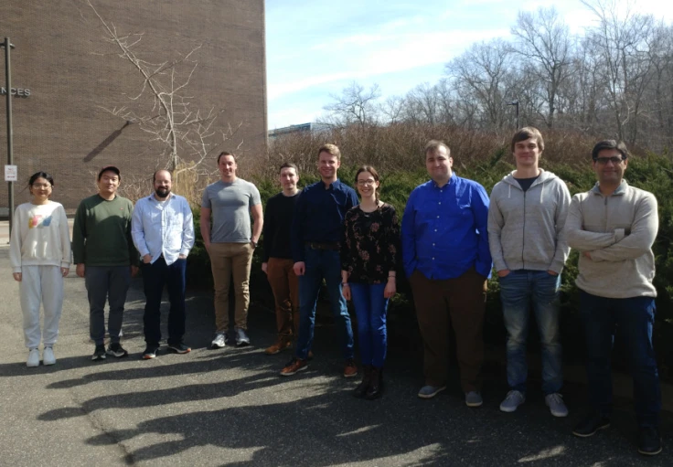
Acknowledgements
Levine Group
Institute for Advanced Computational Science and Department of Chemistry at Stony Brook University.
Thomas Allison Group (Collaborative)
Department of Chemistry and the Physics Department at Stony Brook University.
NSF Grant Number : CHE-2102319

