Slide 1
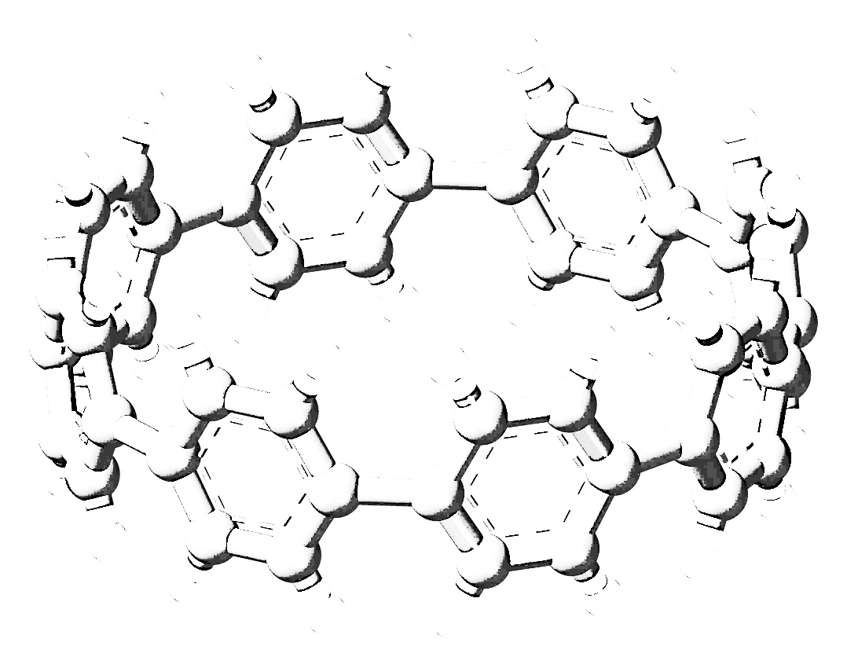
Investigating the theoretical optical properties of neutral Cycloparaphenylenes (CPPs)
By
Kakarlamudi Akhil Chakravarthy
Postdoc
Hebrew University of Jerusalem, Israel
To
VISTA seminar program
University at Buffalo, USA
October 2023

Slide 2
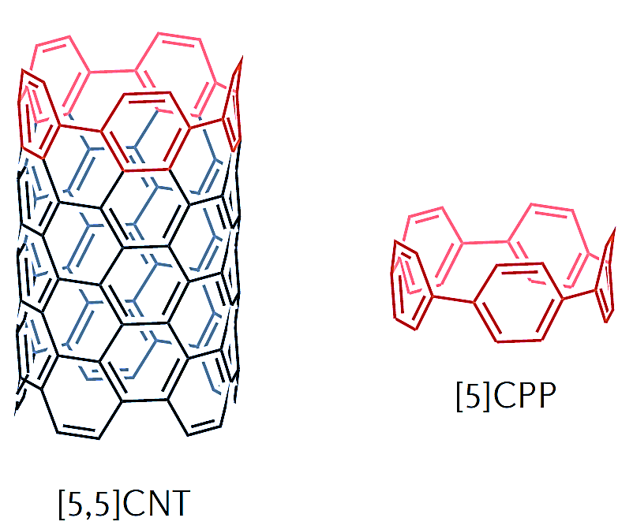
Introduction
In 1934 Perekh and Guha first attempt to make the smallest and simplest form of Cycloparaphenylenes(CPP) ª
In 1993, Fritz Vögtle “On The Way to Macrocyclic Paraphenylenes” ^{b}
In 2000, computational work done by Chandrasekhar, et al ^{c}
First CPPs were synthesized by Ramesh Jasti and Carolyn R. Bertozzi group in 2008 ^{d}
CPPs are cylindrical molecules made of para-linked benzene rings in a hoop-like structure ^{d}
Internal conversion and intersystem crossing processes in singlet–triplet photophysics is essential for designing efficient photoluminescent molecular systems^{e}
a. V. C. Parekh and P. C. Guha, J. Indian Chem. Soc., 11, 95, 1934
b. R. Friederich, M. Nieger and F. Vögtle, Chem. Ber., 126, 1723, 1993
c. Chandrasekhar, et al., Molecular Modeling Annual. 6,226–233, 2000
d. R. Jasti, J. Bhattacharjee, J. B. Neaton and C. R. Bertozzi, J. Am. Chem. Soc., 130, 17646, 2008
e. V. S. Reddy, C. Camacho, J. Xia, R. Jasti, and S. Irle J. Chem. Theory Comput. 13, 10, 4944,.2017

Slide 3
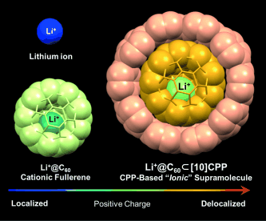
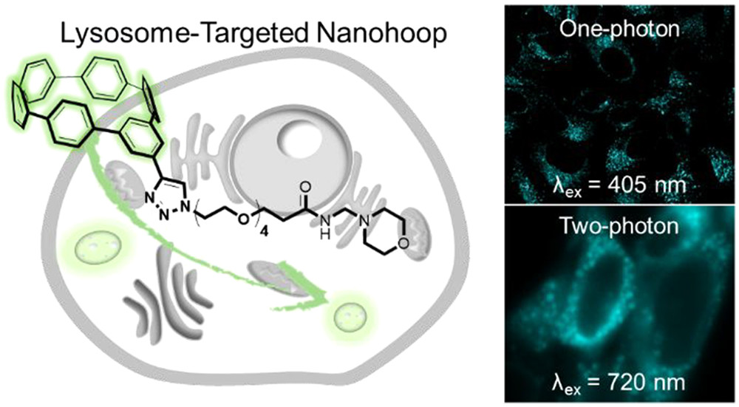
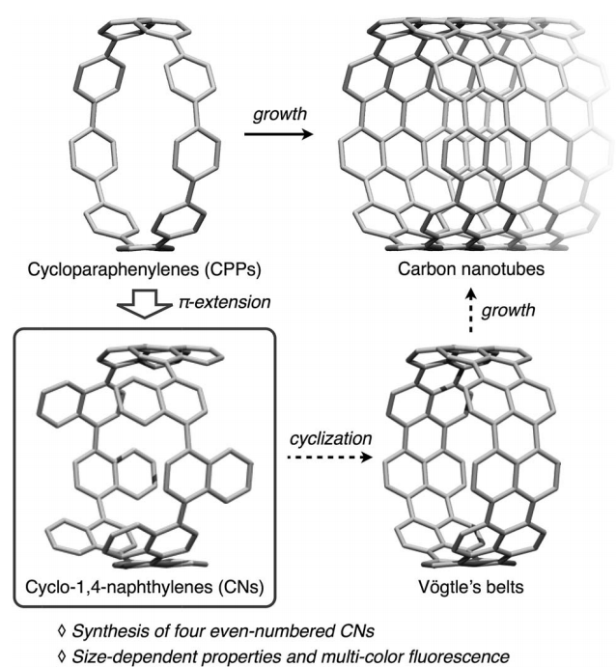
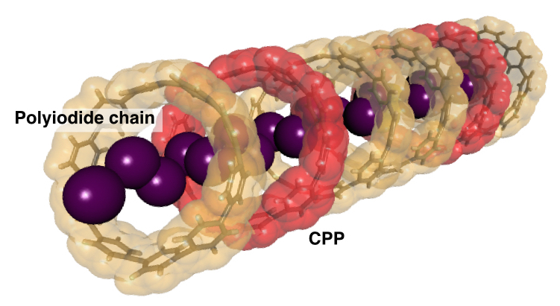
Applications
Unique ionic supra-molecular nanocarbons ^{b}
Live cell imaging ^{d}
Carbon nanotubes ª
Polymerization ^{e}
Electric stimuli ^{c}
a. Y. Nakanishi, H. Omachi, S. Matsuura, Y. Miyata, R. Kitaura, Y. Segawa, K. Itami, H. Shinohara, Angew. Chem. Int. Ed. 53, 3102 ,2014
b. H.Ueno,T. Nishihara. Y Segawa, and K. Itami Angew. Chem. Int. Ed. 54, 3707, 2015
c. N. Ozaki, H. Sakamoto, T. Nishihara, T Fujimori, Y. Hijikata, R. Kimura, S. Irle, and K. Itami. Angew. Chem. Int. Ed. 56, 11196, 2017
d. T. C. Lovell, S. G. Bolton, J. P. Kenison, J. Shangguan, C. E. Otteson, F. Civitci, X Nan, M. D. Pluth, and R. Jasti ACS Nano 15 (9), 15285, 2021
e. R. L. Maust, P. Li, B. Shao, S. M. Zeitler, P. B. Sun, H. W. Reid , L. N. Zakharov, M. R. Golder, and R. Jasti ACS Cent. Sci. 7, 6, 1056, 2021

Slide 4
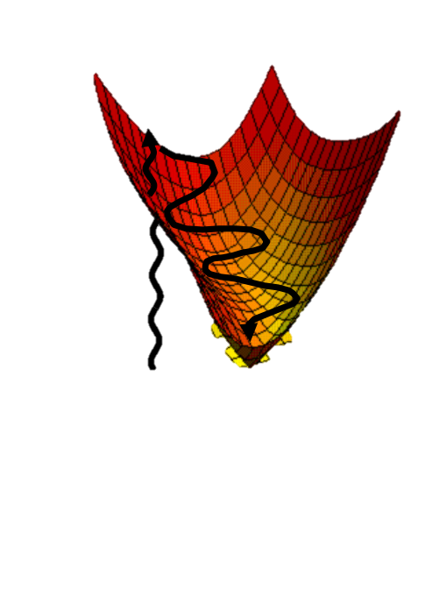
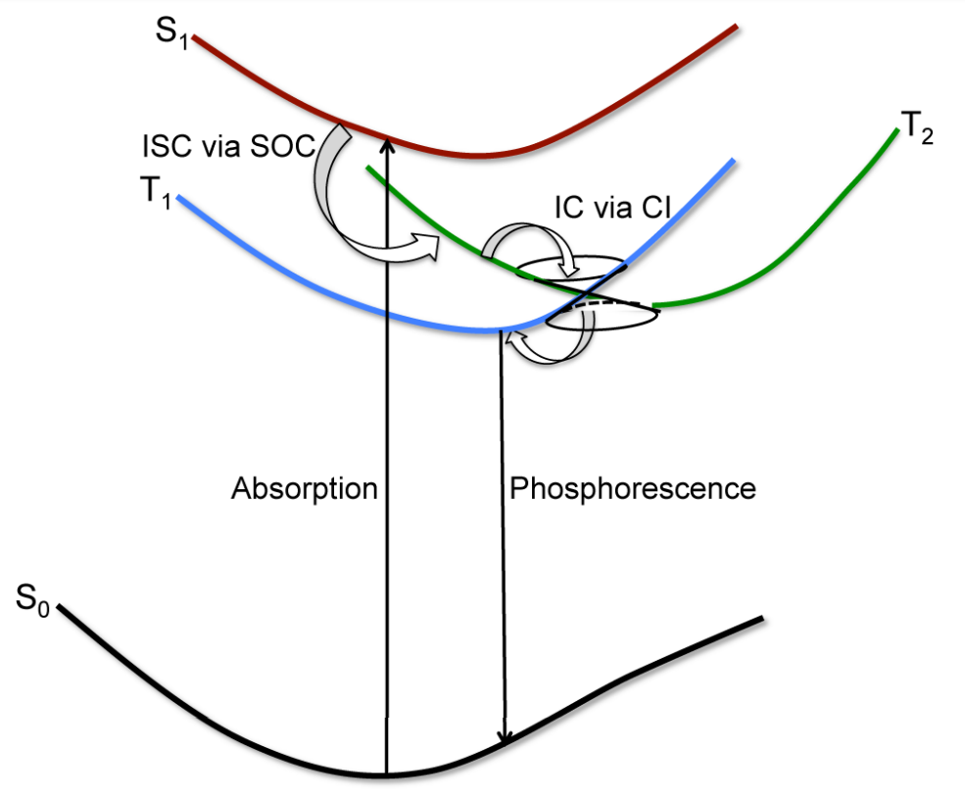
Pic credits: Edinburgh Instruments website
J. E. Subotnik, E. C. Alguire, Q. Ou, and B. R. Landry Acc. Chem. Res. 48, 1340, 2015

Slide 5
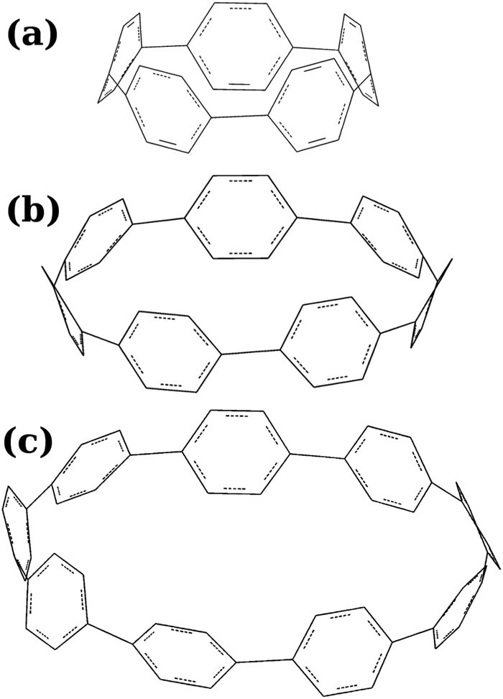
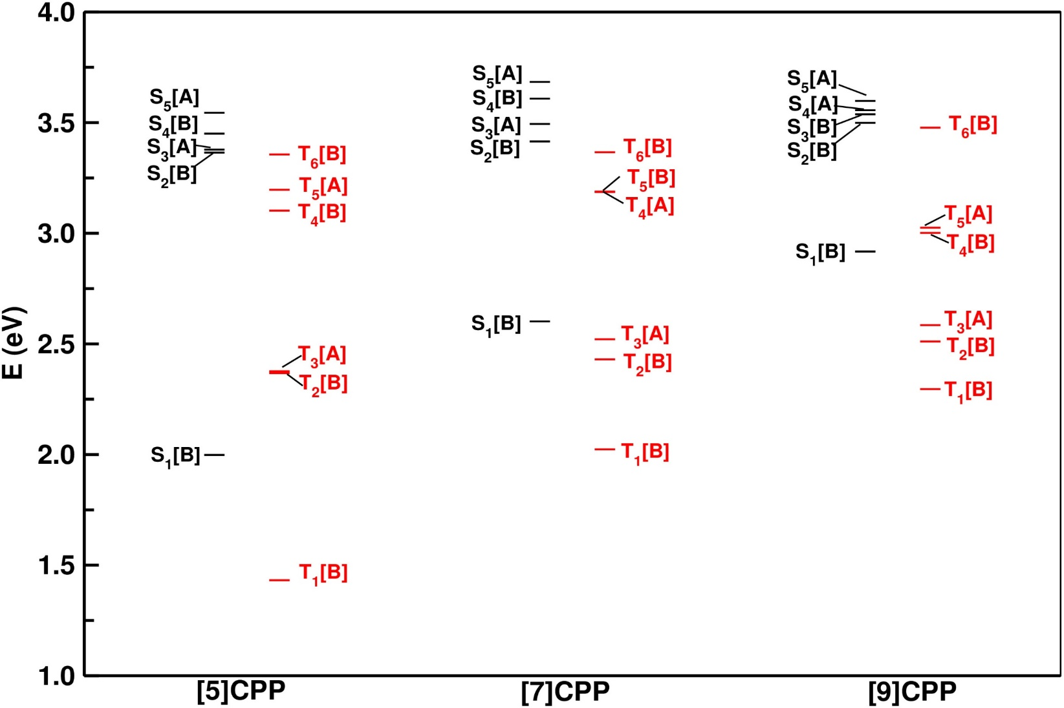
FIG. 1. Molecular structure of (a) [5]CPP (b) [7]CPP, and (c) [9]CPP.
FIG. 2. FC vertical excitation energies of low-lying excited states of [5]-, [7]-, and [9]CPP computed with C₂ symmetry point group constraints using the TD-B3LYP/6-311G(d) level of theory.
A.C. Kakarlamudi and S.R. Vennapusa J. Chem. Phys.,155, 044301, 2021

Slide 6
TABLE 1. Vertical excitation energies (in eV) of singlet excited-states and corresponding oscillator strength(parenthesis) of [5]-, [7]- and [9]CPP. Experimental absorption maximum of S₁ band of CPPs also given.
[n]CPP | state | TD-B3LYP/6-311g(d) | ADC(2)/cc-pVDZ | CASSCF/cc-pVDZ | Expt.
[5]CPP | S₁ | 2.01(0.00) | 2.57(0.00) | 2.59(0.00) | 2.47ª
 | S₂ | 3.37(0.00) | 3.83(0.02) | 3.73(0.00)
 | S₃ | 3.39(0.01) | 3.95(0.04) | 3.95(0.01)
 | S₄ | 3.46(0.00) | 4.15(0.05) | 3.95(1.51)
 | S₅ | 3.55(0.02) | 4.16(0.02) | 3.96(1.55) | 3.70^{d}
[7]CPP | S₁ | 2.61(0.02) | 3.33(0.03) |  | 3.04^{b}
 | S₂ | 3.42(0.00) | 4.15(1.42)
 | S₃ | 3.50(0.01) | 4.23(1.39)
 | S₄ | 3.62(1.04) | 4.25(0.06)
 | S₅ | 3.69(1.02) | 4.42(0.09) |  | 3.65^{d}
[9]CPP | S₁ | 2.93(0.02) | 3.68(0.07) |  | 3.14^{c}
 | S₂ | 3.51(0.06) | 4.17(2.14)
 | S₃ | 3.55(1.47) | 4.25(2.12)
 | S₄ | 3.56(0.02) | 4.43(0.00)
 | S₅ | 3.61(1.20) | 4.58(0.01) |  | 3.65^{d}
Note: CASSCF method involving the second-order strongly contracted n-electron valence state perturbation theory (SC-NEVPT2)
a. E. Kayahara, V. K. Patel, and S. Yamago, J. Am. Chem. Soc. 136, 2284,2014
b. P. Li, T. J. Sisto, E. R. Darzi, and R. Jasti, Org. Lett. 16, 182, 2014
c. N. Kubota, Y. Segawa, and K. Itami, J. Am. Chem. Soc. 137, 1356, 2015
d. E. J. Leonhardt and R. Jasti Nat. Rev. Chem. 3, 672, 2019
A.C. Kakarlamudi and S.R. Vennapusa J. Chem. Phys.,155, 044301, 2021

Slide 7
Estimation of the stabilization (or) reorganization energy
S₁
Stabilization
Energy (SE)
S_{min,1}
S₀
TABLE 2. Energetic minimum of S₁ and T₁ states of CPPs. The stabilization (or) reorganization energy of respective electronic state estimated by the LVC approach and TDDFT optimization calculation is given in the parenthesis. All values are in eV.
n in [n]CPP | Experiment |  | LVC |  | TDDFT Opt. | TDDFT Opt. literature ª
 | S_{min,1} | T_{min,1} | S_{min,1} | T_{min,1} | S_{min,1} | S_{min,1} | T_{min,1}
5 | - | - | 1.30(0.71) | 0.82(0.62) | 1.38(0.63) | 1.27 | 1.50
7 | 2.11 ^{b} | - | 2.03(0.58) | 1.59(0.44) | 2.06(0.55) | 2.20 | 2.09
9 | 2.51 ^{c} | 1.96 ^{d} | 2.43(0.50) | 1.90(0.41) | 2.48(0.46) | 2.67 | 2.26
a. J. Liu, L. Adamska, S. K. Doorn, and S. Tretiak, Phys. Chem. Chem. Phys.17, 14613, 2015
b. T. J. Sisto, M. R. Golder, E. S. Hirst, and R. Jasti, J. Am. Chem. Soc. 133, 15800, 2011
c. Segawa, A. Fukazawa, S. Matsuura, H. Omachi, S. Yamaguchi, S. Irle, and K. Itami, Org. Biomol.Chem.10, 5979, 2012
d. M. Fujitsuka, C. Lu, B. Zhuang, E. Kayahara, S. Yamago, and T. Majima, J. Phys. Chem. A 123,4737, 2019
A.C. Kakarlamudi and S.R. Vennapusa J. Chem. Phys.,155, 044301, 2021

Slide 8
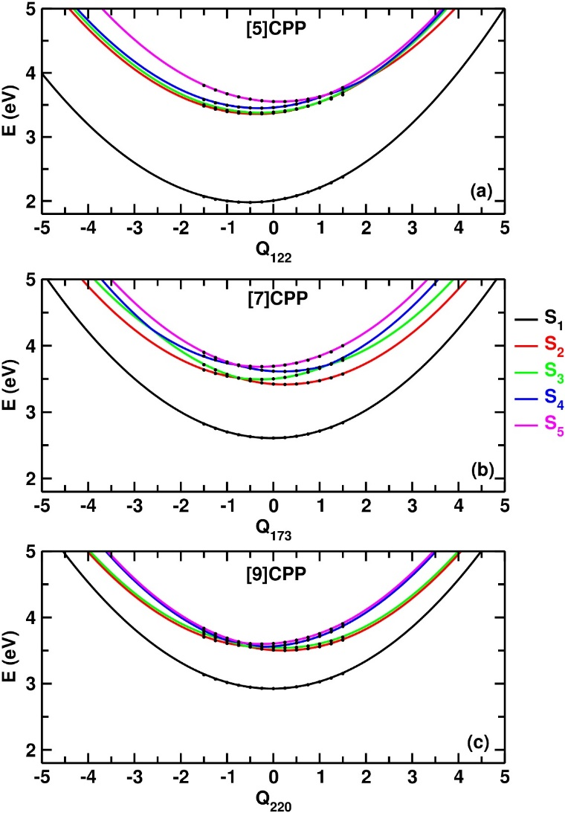
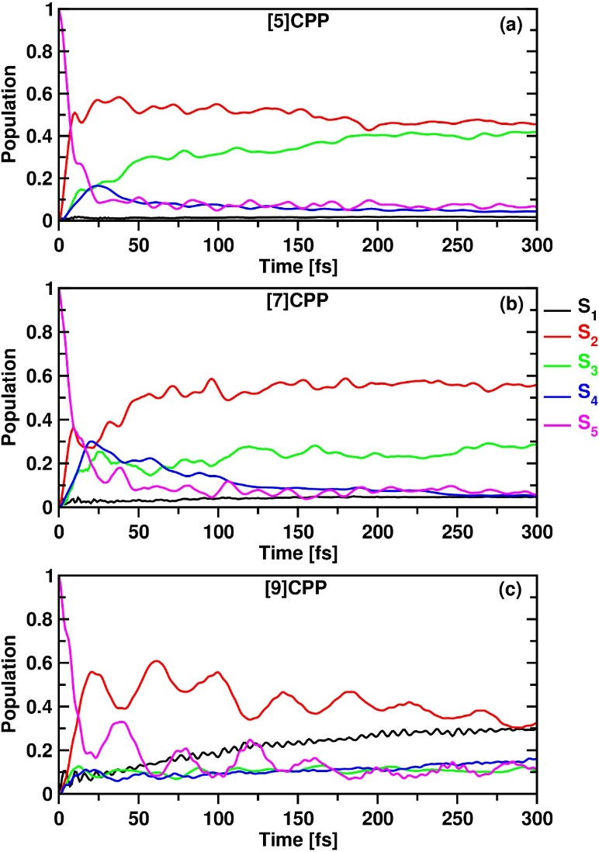
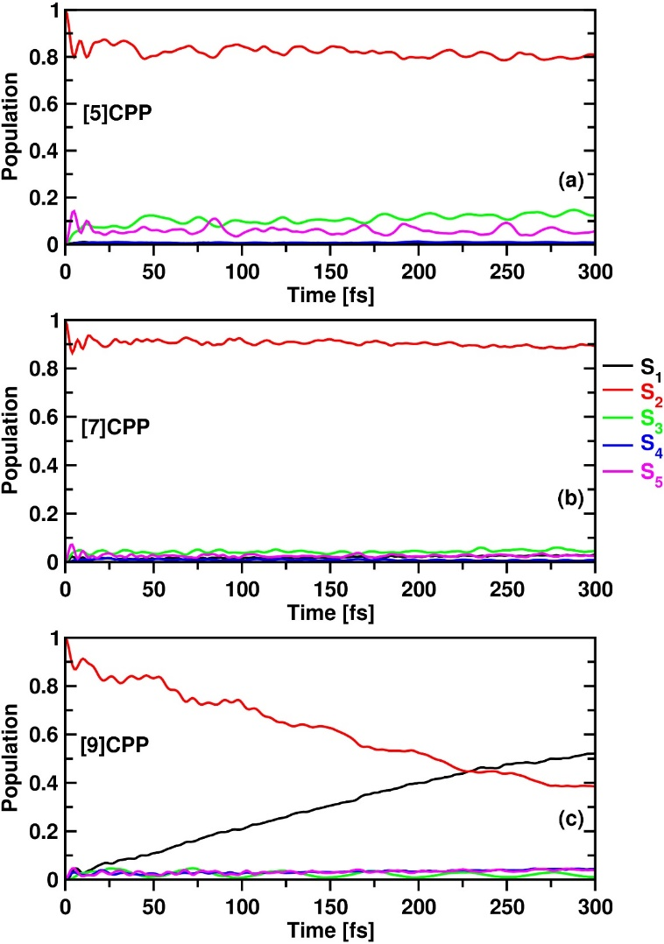
FIG. 3. Adiabatic potential energy cuts of low-lying singlet excited states of (a) [5]CPP, (b) [7]CPP, and (c) [9]CPP along the dimensionless normal coordinates of their respective C=C stretching mode. Computed ab initio vertical excitation energies (plus harmonic potential) are shown by the asterisks on each curve.
FIG. 4. Time-dependent diabatic electronic populations of singlet excited states generated by propagating the initial MCTDH wavepacket on S₅ of (a) [5]CPP, (b) [7]CPP, and (c) [9]CPP.
FIG. 5. Time-dependent diabatic electronic populations of singlet excited states generated by propagating the initial MCTDH wavepacket on S₂ of (a) [5]CPP, (b) [7]CPP, and (c) [9]CPP
A.C. Kakarlamudi and S.R. Vennapusa J. Chem. Phys.,155, 044301, 2021

Slide 9
Spin-orbit coupling(SOC) and ISC rates
Singlets
Rate constant for ISC ($K_{ISC}^{nm}$) is calculated using Fermi’s golden rule where SOC values are obtained from PySOC code
Triplets
is the SOC-matrix element between the S_{n} and T_{m} states
ρ_{FC} denotes the Franck–Condon weighted density of states and is computed within the Marcus theory framework
${\text{λ}}_{M}^{′}$, k_{B}, T, and ΔE_{ST} represent the Marcus-reorganization energy, Boltzmann constant, temperature, and adiabatic singlet–triplet energy gap, respectively
V. Lawetz, G. Orlandi, and W. Siebrand, J. Chem. Phys. 56, 4058, 1972
D. Beljonne, Z. Shuai, G. Pourtois, and J. L. Bredas, J. Phys. Chem. A 105, 3899, 2001
X. Gao, S. Bai, D. Fazzi, T. Niehaus, M. Barbatti, and W. Thiel, J. Chem. Theory Comput.13, 515, 2017

Slide 10
TABLE 3. Singlet-triplet energy difference (∆S₁−T_{n} and ∆S₂−T_{n} ) and associated spin-orbit coupling matrix elements (SOCMEs) computed using PySOCª at B3LYP/6-311G(d) level of theory for [5]-,[7]- and [9]CPP. SOCMEs are computed using the FC geometry of respective CPP.
[n]CPP | T_{n} | ∆S₁−T_{n} (cm⁻¹) | SOC (cm⁻¹) | K _{ISC} (s⁻¹) | ∆S₂−T_{n} (cm⁻¹) | SOC (cm⁻¹) | K _{ISC} (s⁻¹)
[5]CPP | T₆ | 10936.32 | 0.52 | 2.25E-43 | 69.37 | 0.51 | 1.81E+07
 | T₅ | 9653.07 | 0.20 | 2.51E-34 | 1352.62 | 0.42 | 1.47E+05
 | T₄ | 8890.05 | 0.11 | 1.75E-29 | 2115.64 | 0.55 | 5.70E+03
 | T₃ | 3032.71 | 0.35 | 7.44E+00 | 7972.97 | 1.42 | 2.53E-21
 | T₂ | 2963.35 | 0.32 | 1.02E+01 | 8042.34 | 0.41 | 7.83E-23
 | T₁ | 171.80 | 0.02 | 2.45E+04 | 15582.18 | 0.45 | 4.18E-88
[7]CPP | T₆ | 6167.06 | 0.13 | 2.66E-13 | 394.41 | 0.03 | 1.84E+04
 | T₅ | 4723.29 | 0.33 | 7.02E-06 | 1838.18 | 0.07 | 4.28E+02
 | T₄ | 4712.00 | 0.33 | 7.69E-06 | 1849.47 | 0.07 | 3.83E+02
 | T₃ | 657.36 | 0.12 | 1.79E+05 | 7218.83 | 0.7 | 1.89E-17
 | T₂ | 1387.31 | 0.08 | 4.64E+03 | 7948.78 | 0.09 | 1.44E-23
 | T₁ | 4658.77 | 0.03 | 7.85E-08 | 11220.24 | 0.15 | 9.38E-47
[9]CPP | T₆ | 4520.84 | 0.08 | 2.45E-06 | 171.80 | 0.01 | 6.35E+03
 | T₅ | 862.23 | 0.12 | 9.03E+04 | 3830.42 | 0.08 | 1.08E-03
 | T₄ | 671.88 | 0.11 | 1.39E+05 | 4020.77 | 0.05 | 9.48E-05
 | T₃ | 2683.47 | 0.07 | 2.74E+00 | 7376.11 | 0.32 | 4.91E-19
 | T₂ | 3286.78 | 0.05 | 2.43E-02 | 7979.43 | 0.03 | 9.22E-25
 | T₁ | 5017.69 | 0.03 | 2.85E-09 | 9710.33 | 0.09 | 2.03E-35
S₂ → T₆ for [5]CPP
S₂ → T₆ for [7]CPP
S₁ → T₄ for [9]CPP
a X. Gao, S. Bai, D. Fazzi, T. Niehaus, M. Barbatti, and W. Thiel, J. Chem. Theory Comput. 13, 515, 2017
A.C. Kakarlamudi and S.R. Vennapusa J. Chem. Phys.,155, 044301, 2021

Slide 11
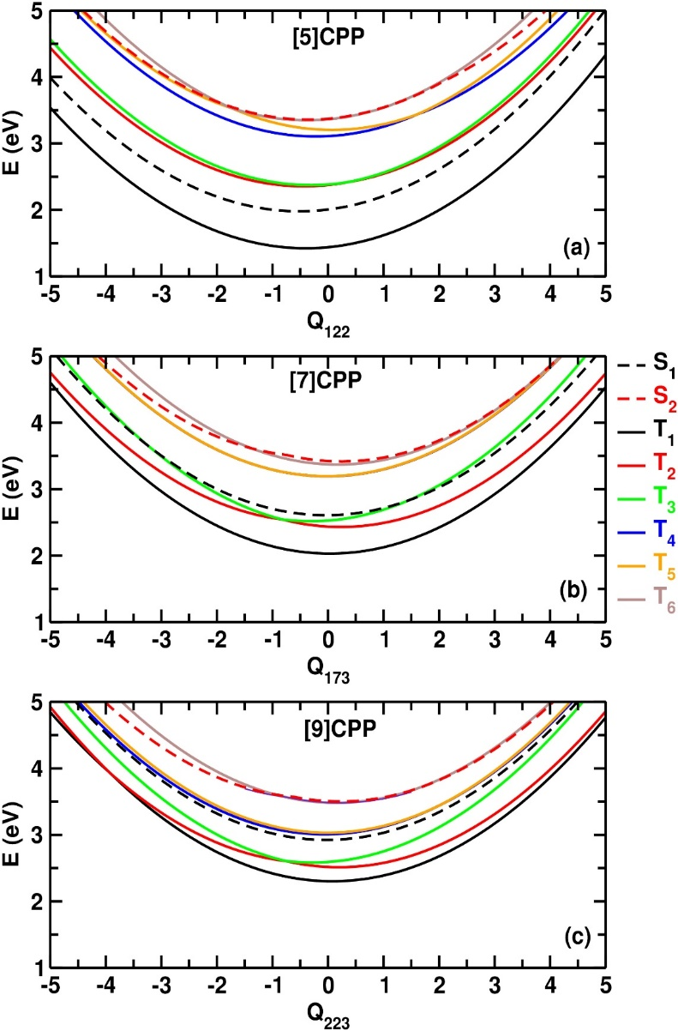
Hamiltonian to investigate the relaxation dynamics associated with S₂, S₃, S₄, S₅, T₄, T₅ and T₆ of [5]- and [7]CPP
Hamiltonian to investigate the relaxation dynamics associated with S₁, S₂, S₃, S₄, S₅, T₄, T₅ and T₆ of [9]CPP
FIG. 6. Adiabatic potential energy cuts of low-lying excited states of (a) [5]CPP, (b) [7]CPP, and (c) [9]CPP along the dimensionless normal coordinates of their respective C=C stretching mode.
A.C. Kakarlamudi and S.R. Vennapusa J. Chem. Phys.,155,044301, 2021

Slide 12
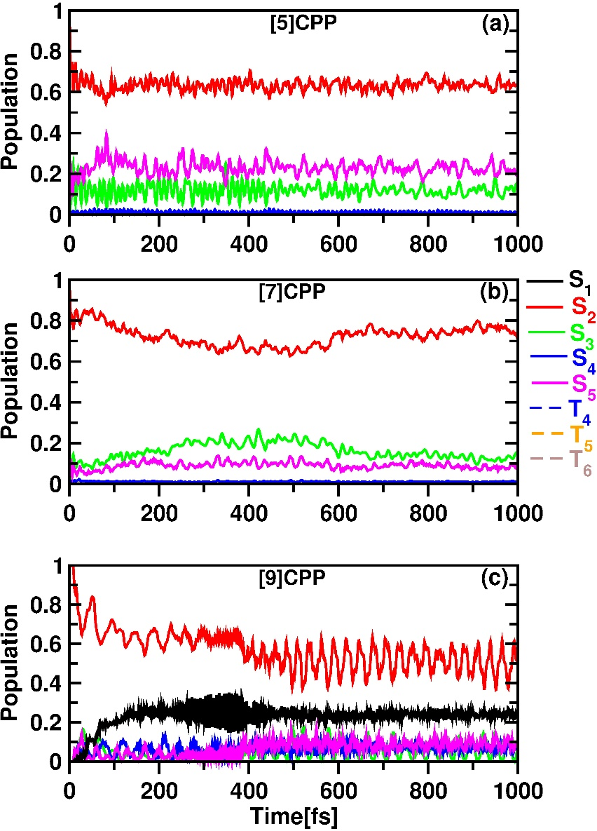
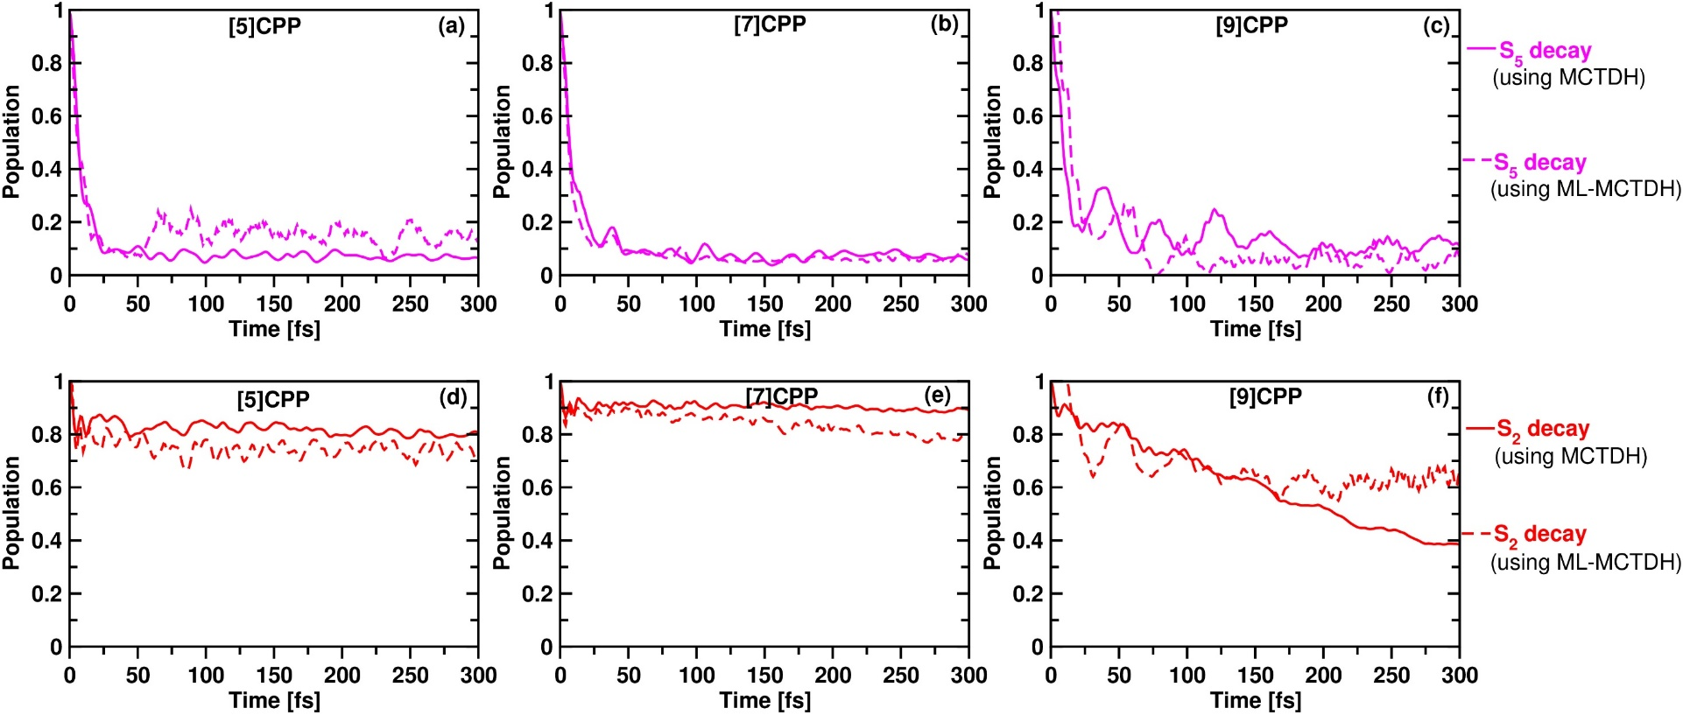
FIG. 8. Time-dependent diabatic electronic populations of singlet excited states generated by propagating the initial ML-MCTDH and MCTDH wavepacket on S₅ and S₂ of (a and d) [5]CPP, (b and e) [7]CPP, and (c and f) [9]CPP.
FIG. 7. Time-dependent diabatic electronic populations of singlet and triplet excited states generated by propagating the initial ML-MCTDH wavepacket on S₂ of (a) [5]CPP, (b) [7]CPP, and (c) [9]CPP. The Hamiltonian employed for the ML-MCTDH calculation contains the spin–orbit coupling constants of relevant singlet and triplet states
FIG. 9. Time-dependent diabatic electronic populations of triplet excited states generated by propagating the initial ML-MCTDH and MCTDH wavepacket on T₆ of (a) [5]CPP, (b) [7]CPP, and (c) [9]CPP.
A.C. Kakarlamudi and S.R. Vennapusa J. Chem. Phys.,155, 044301, 2021

Slide 13
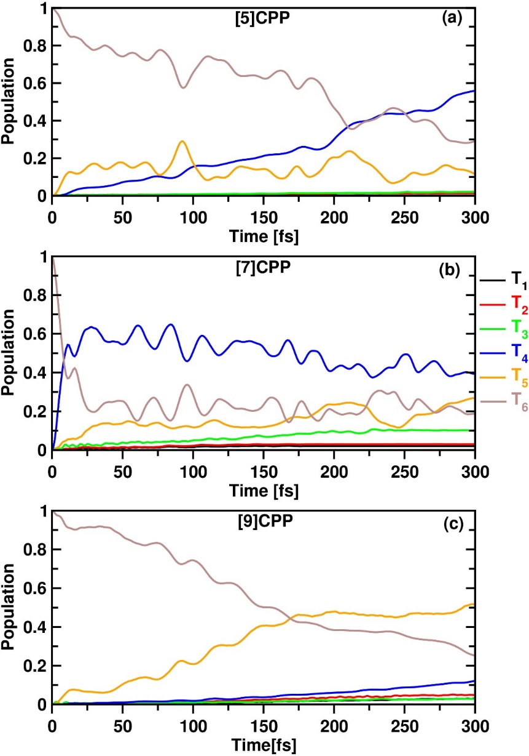
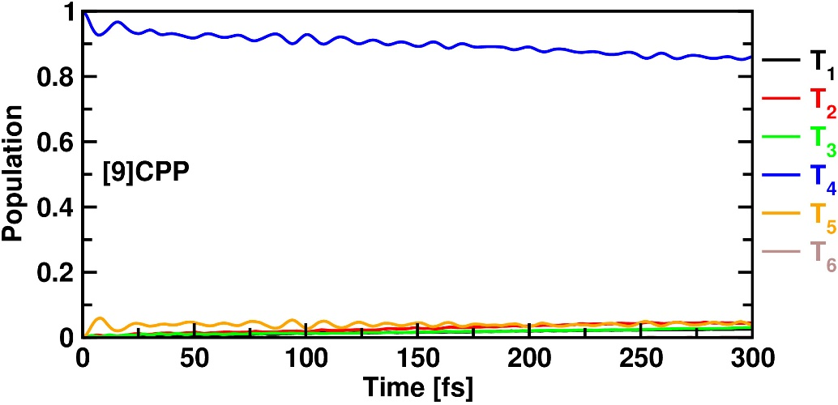
FIG. 11. Time-dependent diabatic electronic populations of triplet excited states generated by propagating the initial MCTDH wavepacket on T₄ of [9]CPP.
FIG. 10. Time-dependent diabatic electronic populations of triplet excited states generated by propagating the initial MCTDH wavepacket on T₆ of (a) [5]CPP, (b) [7]CPP, and (c) [9]CPP.
A.C. Kakarlamudi and S.R. Vennapusa J. Chem. Phys.,155, 044301, 2021

Slide 14
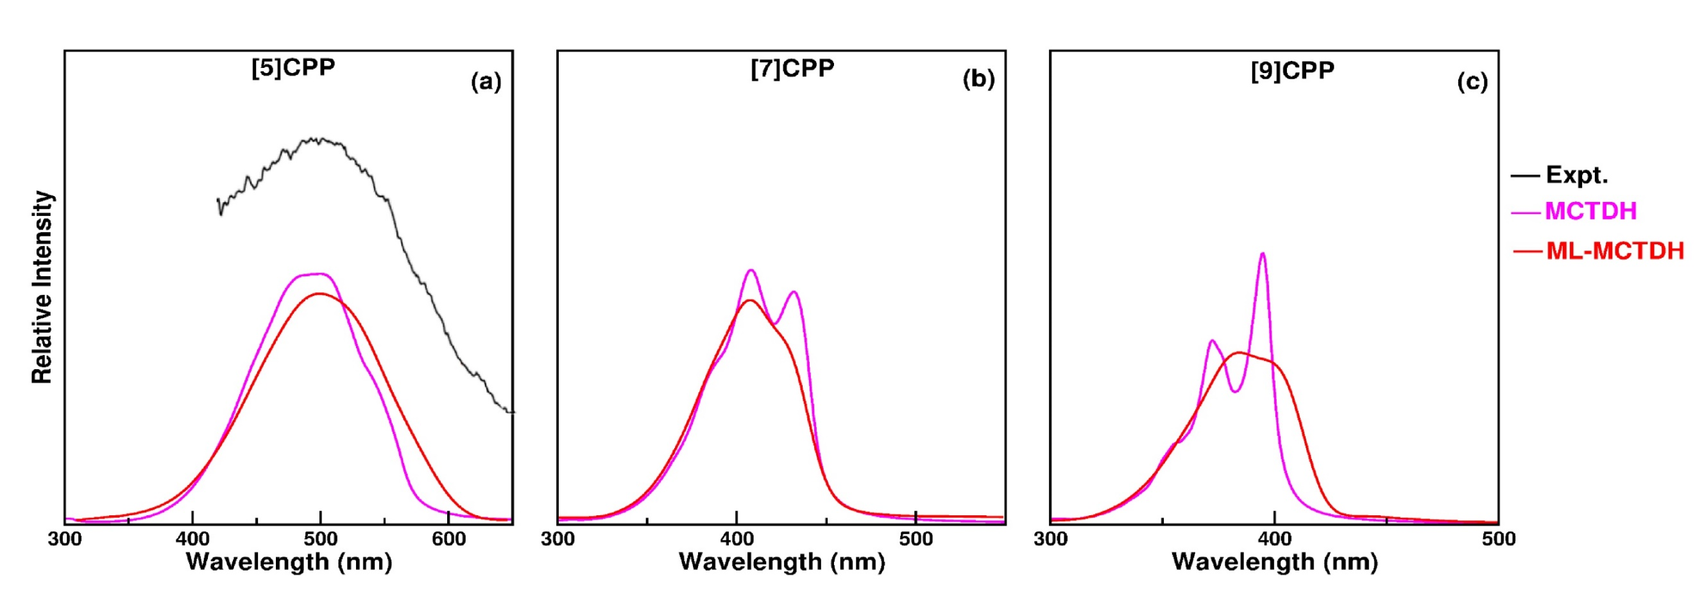
FIG. 12. The theoretical S₁ absorption spectrum of a) [5]CPP b) [7]CPP and [9]CPP. The MCTDH wavepacket dynamics simulations are performed using relevant 26 vibrational DOFs, whereas the ML-MCTDH method employs full-dimensionality of CPP. The experimental spectrum of [5]CPP is reproduced from Ref. [a]
a. E. Kayahara, V. K. Patel, and S. Yamago, J. Am. Chem. Soc. 136, 2284-2287, 2014
A.C. Kakarlamudi and S.R. Vennapusa J. Chem. Phys.,155, 044301, 2021

Slide 15
Conclusion
We perform a combined analysis of energetics and SOC constants
Wavepacket dynamics reveal an ultrafast S₅→S₂ IC in all these molecules
Hence ISC pathways more likely from S₂ state, with T₆ being the receiver state
On the other hand for [9]CPP, the S₁ → T₄ ISC happens after a rapid S₂ → S₁ IC decay
Experimental fluorescence and phosphorescence emission energies are well reproduced with the LVC framework employed in this study

Slide 16
Acknowledgement
Dr Vennapusa Sivaranjana Reddy
All the Faculty members of IISER-TVM
All my lab mates
Friends and Family members

Slide 17
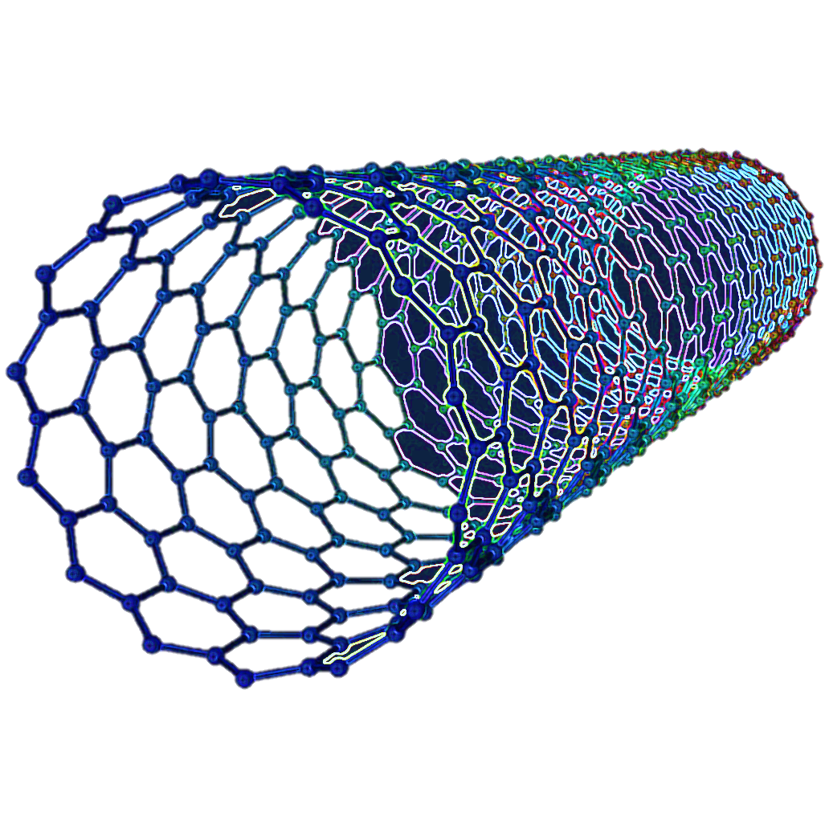
Thank you for Attention

