Slide 1
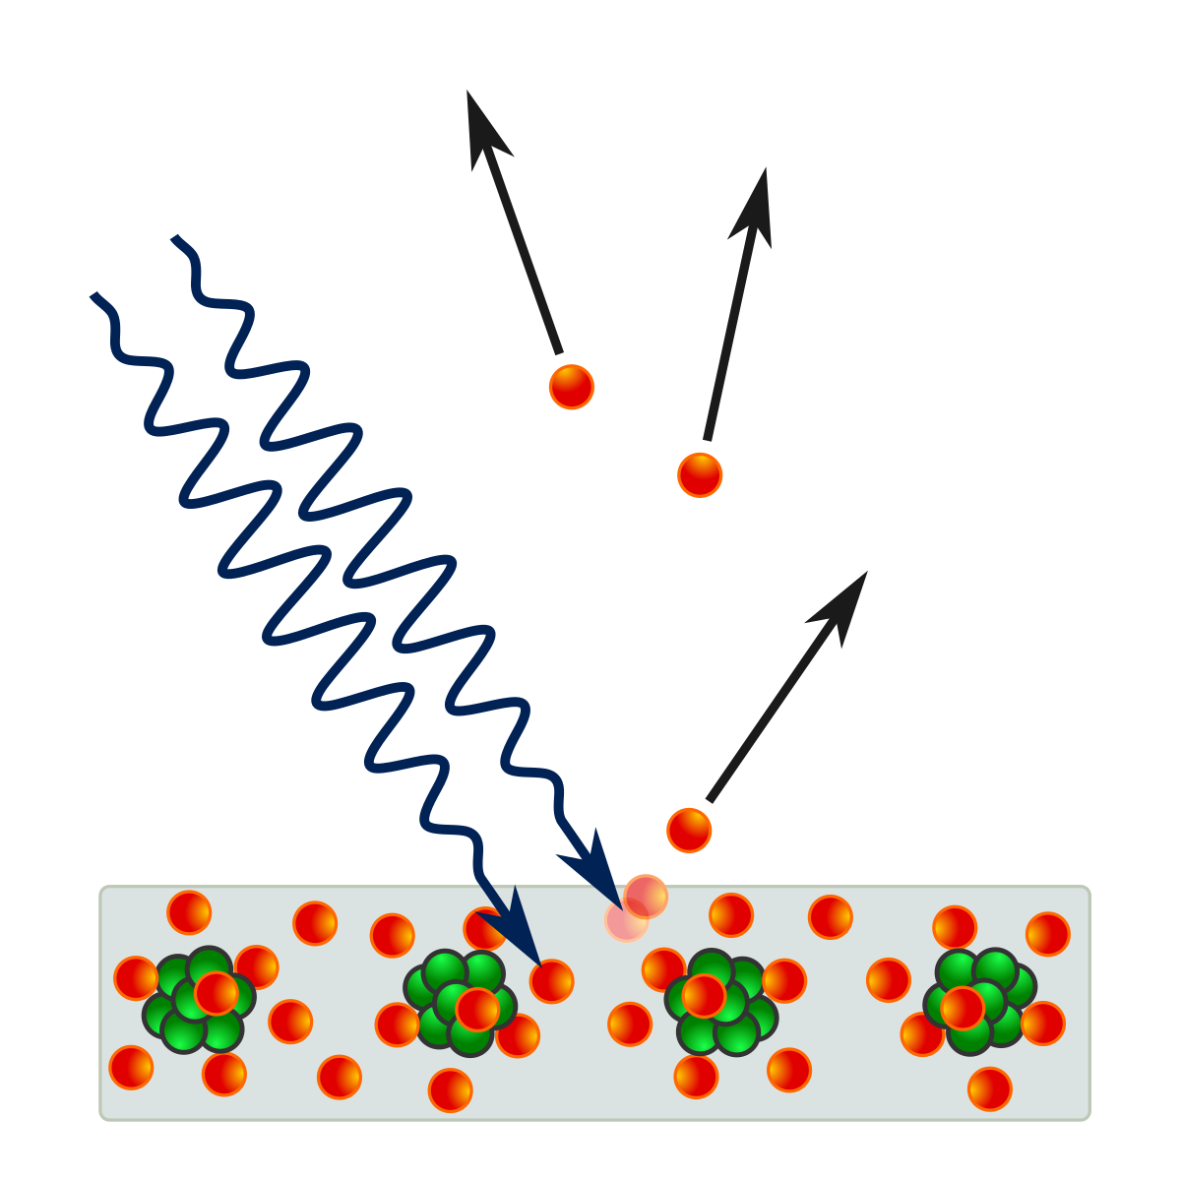
Rational Design of van-der Waals Heterostructures as Potential Photovoltaics and Photocatalysts: An Approach from Non-adiabatic Study
hυ

Slide 2
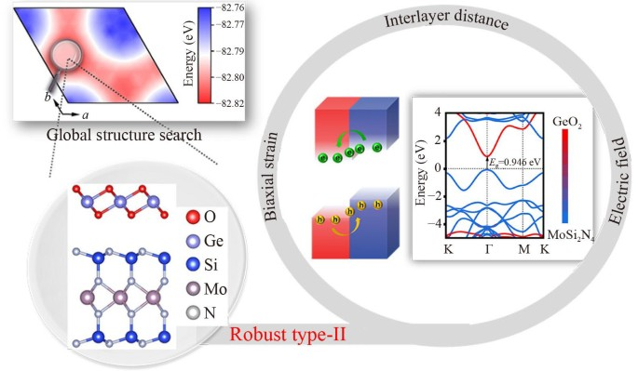
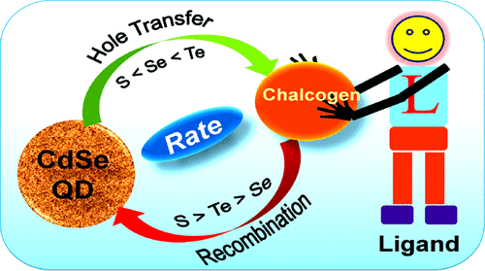
Motivation behind designing a solar cell
Gradual depletion of traditional fossil fuels, we require renewable energy.
Rapid increment of environmental pollution.
Increasing consumer demand of modern society.
Criteria of a good photovoltaic cell ^{1, 2}
Light-induced electron (e) or hole (h) transfer must occur at the interface.
The lifetime of the photogenerated carriers must be sufficiently long.
¹ J. Am.Chem. Soc. 2022, 144, 5543-5551
² J. Am.Chem. Soc. 2021, 143, 6649-6656

Slide 3
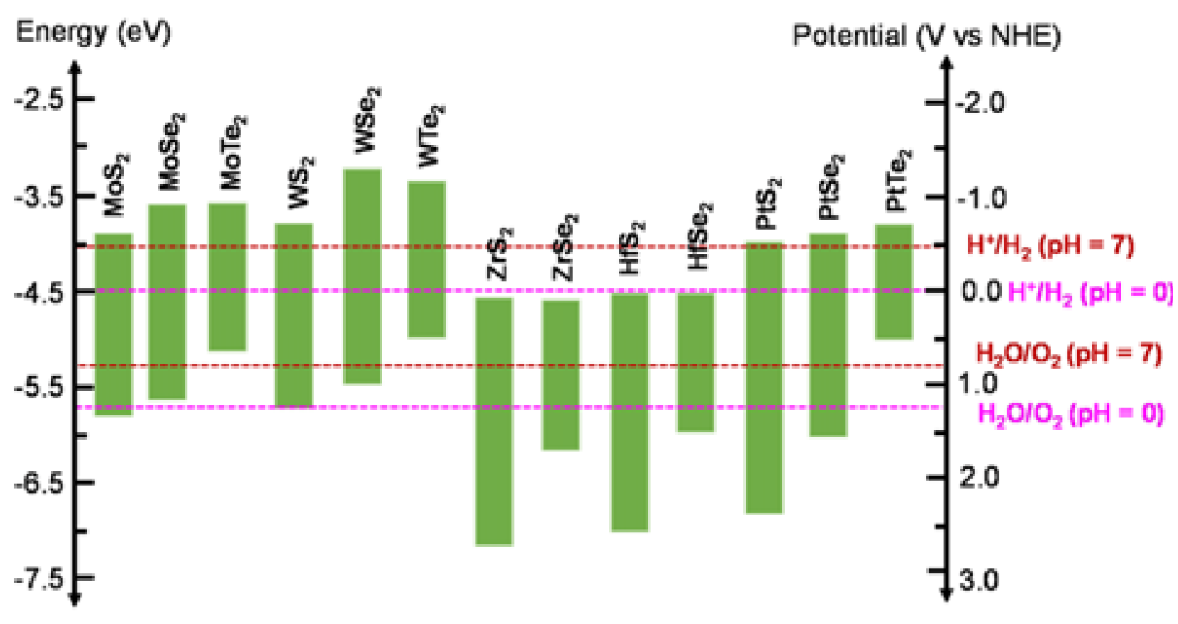
Motivation behind photocatalysis
Global problem of energy shortage needs to be addressed as soon as possible with an efficient and economical solution.
Photocatalysis has emerged as one of the most promising photoconversion technologies .
MXenes and TMDs are two widely exploited class of materials in this regard owing to their unique optical, electrical and mechanical properties.
But suffers from issues like poor charge separation, lessened photocatalytic efficiency and photocorrosion .
Z-scheme provides a prospective solution to fast recombination of charge carriers with stronger redox ability.
References: Chem. Sci., 2021, 12, 2863-2869

Slide 4
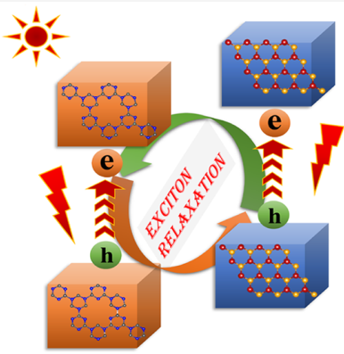
Section - I
Ultrafast Charge Transfer and Delayed Recombination in Graphitic-CN/WTe₂ van der Waals Heterostructure: A Time Domain Ab Initio Study

Slide 5
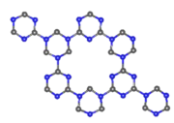
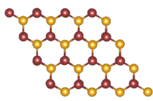
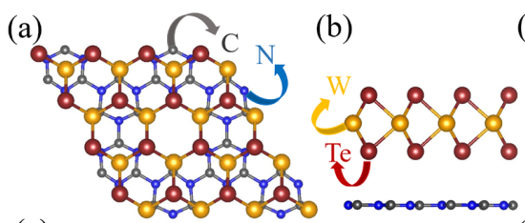
OUR CHOSEN MODEL SYSTEMS :
Graphitic-Carbon Nitride monolayer (top and side view)
Tungsten telluride monolayer (top and side view)
Constructed Graphitic-Carbon Nitride/Tungsten Telluride Heterostructure (top and side view)

Slide 6
Method of simulation :
Ground state properties were calculated by first principle calculations within the framework of DFT, using VASP.
Electronic structure calculations were performed, implementing both PBE and HSE06 functionals.
Employing AIMD simulation, the thermal stability of the heterostructure was explored.
Non-adiabatic Molecular Dynamics study was further done employing Hefei-NAMD code to quantitatively estimate the timescale of electron-hole recombination, electron-transfer, and hole-transfer processes.

Slide 7
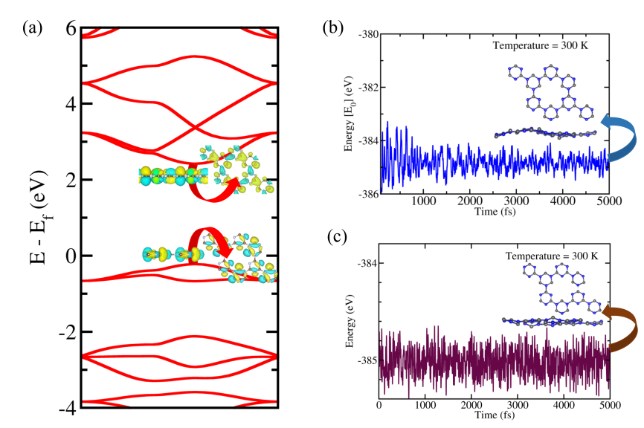
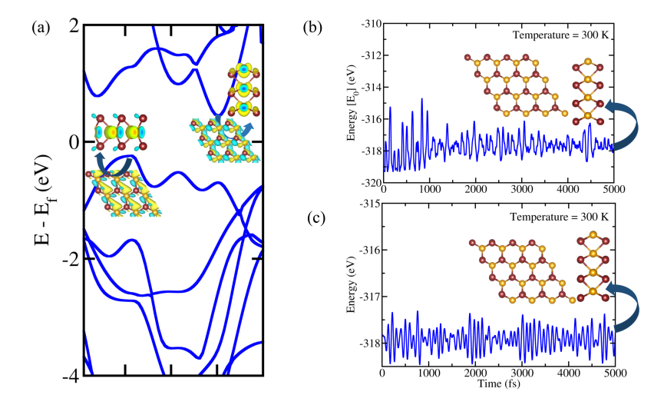
Electronic structure and AIMD simulation profiles of graphitic Carbon Nitride and Tungsten Telluride monolayers

Slide 8
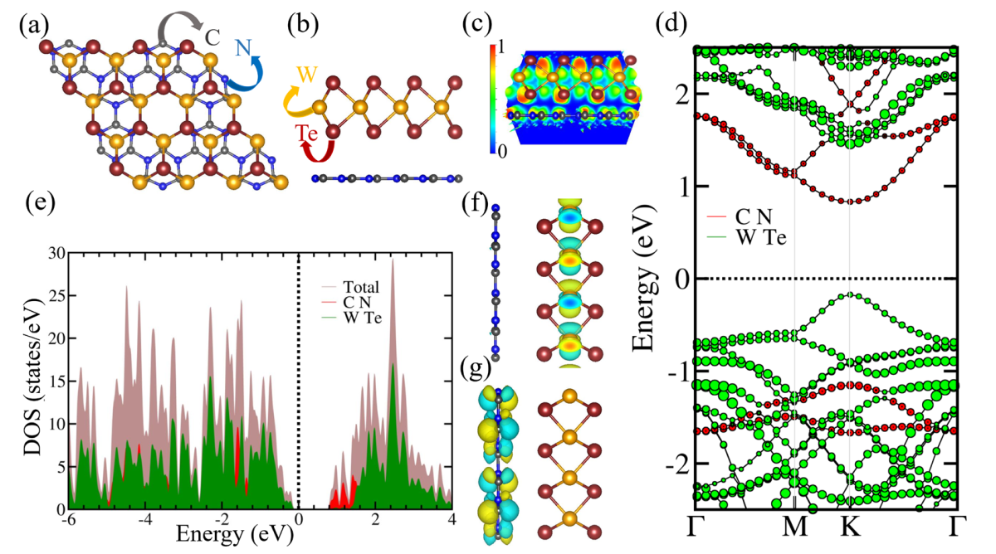
Optimized geometry of g-CN/WTe₂ heterostructure along with the band structure, DOS and localization of VBM and CBM plots

Slide 9
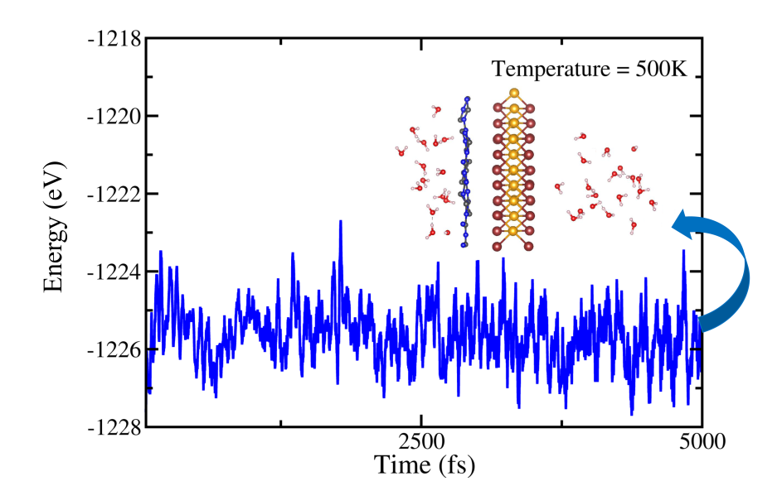
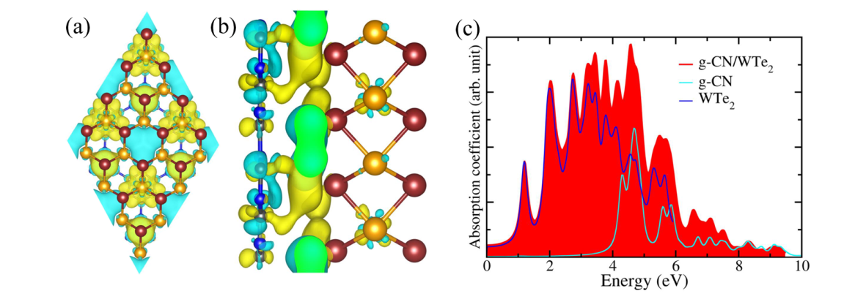
To confirm the stability of the g-CN/WTe₂ bilayer in harsh weather conditions, we have performed an AIMD simulation consisting of significant concentration of water molecules.
Charge density difference plots and the optical absorption plots of corresponding monolayers and the heterostructure

Slide 10
Carrier Transfer Dynamics
Thus, type-II band alignment delays e-h recombination
Electron transfer
hν
e-h recombination
hν
Hole transfer
SC1
SC2
e
SC1
e
SC2
Exciton generation
Exciton relaxation
Y. Q. Gao, et al., J. Chem. Phys. 2000, 112, 3358, K. Tvrdy, et al., PNAS, 2011, 108, 29

Slide 11
Excited State Dynamics of Charge Carriers
Electron and hole transfer occur at ultrafast timescale
Delayed e-h recombination

Slide 12
Non-adiabatic coupling between the corresponding energy states and the generation of quantum decoherence displayed in dephasing function plots strongly suggest the ultrafast nature of carrier transfer and the slow carrier cooling.

Slide 13
Conclusion:
We have systematically investigated the possibility of an efficient photovoltaic using g-CN and WTe₂ monolayer to construct thermodynamically stable (in both free and solvated state) organic-inorganic heterostructure employing first principle density functional calculations coupled with non-adiabatic molecular dynamics methodology.
Optimum bandgap of 1.05 eV, excellent optical property, effective interlayer charge separation, larger time scale of electron-hole recombination (2.4 ns) than electron transfer (589 fs) or hole transfer (807 fs) supports high efficiency photovoltaic performance.
J. Phys. Chem. Lett. 2022, 13, 34, 7898–7905
https://doi.org/10.1021/acs.jpclett.2c02196

Slide 14
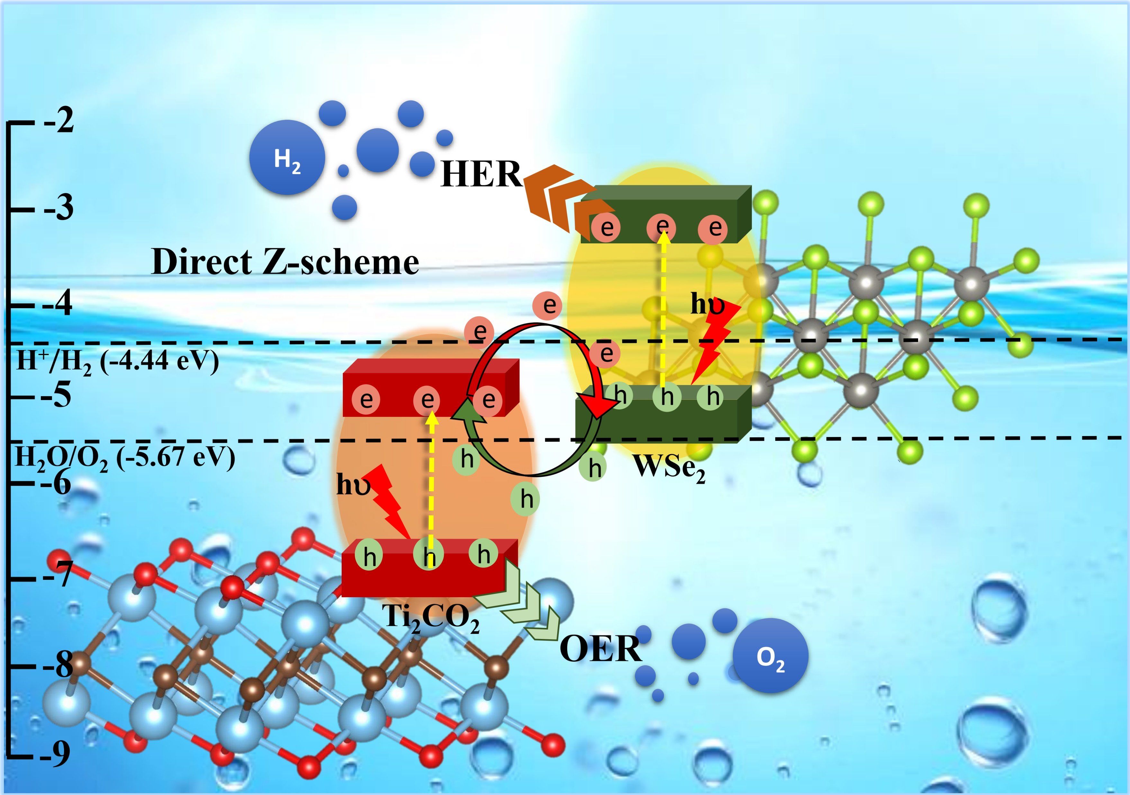
Section - II
Exploring Ti₂CO₂-WSe₂ heterostructure as a Z-scheme photocatalyst for water splitting : A non-adiabatic study

Slide 15
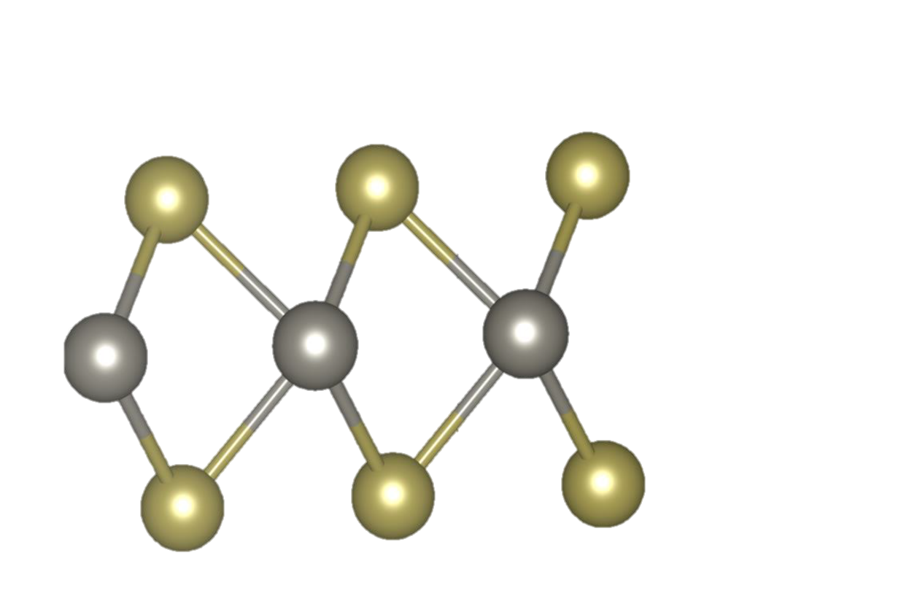
OUR CHOSEN MODEL SYSTEMS :
(I)
(II)
(III)
(IV)
(I)
(II)
(III)
Monolayers Ti₂CO₂ (I), WS₂ (II), WSe₂ (III) and WTe₂ (IV) respectively.
Constructed bilayer vdW heterostructures Ti₂CO₂-WS₂ (I), Ti₂CO₂-WSe₂ (II) and Ti₂CO₂-WTe₂ (III) respectively.
Method of simulation :
Ground state properties were calculated by first principle calculations within the framework of DFT, using VASP implementing PBE and HSE06 functional.
Non-adiabatic Molecular Dynamics study was further done employing Hefei-NAMD code.

Slide 16
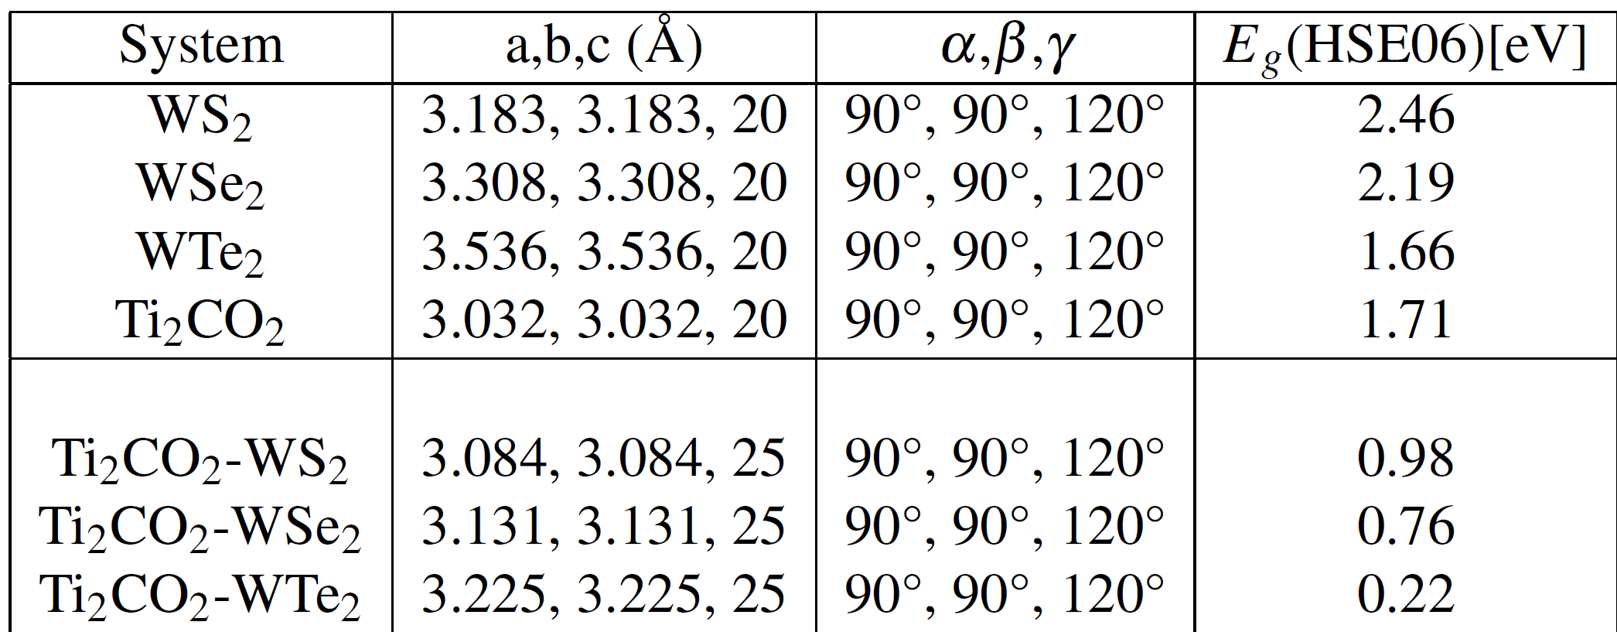
Our choice of the monolayers stands viable structurally.
We see that the final geometries are intact , indicating the satisfactory thermal stability of the heterostructures.
(a)
(b)
(c)

Slide 17
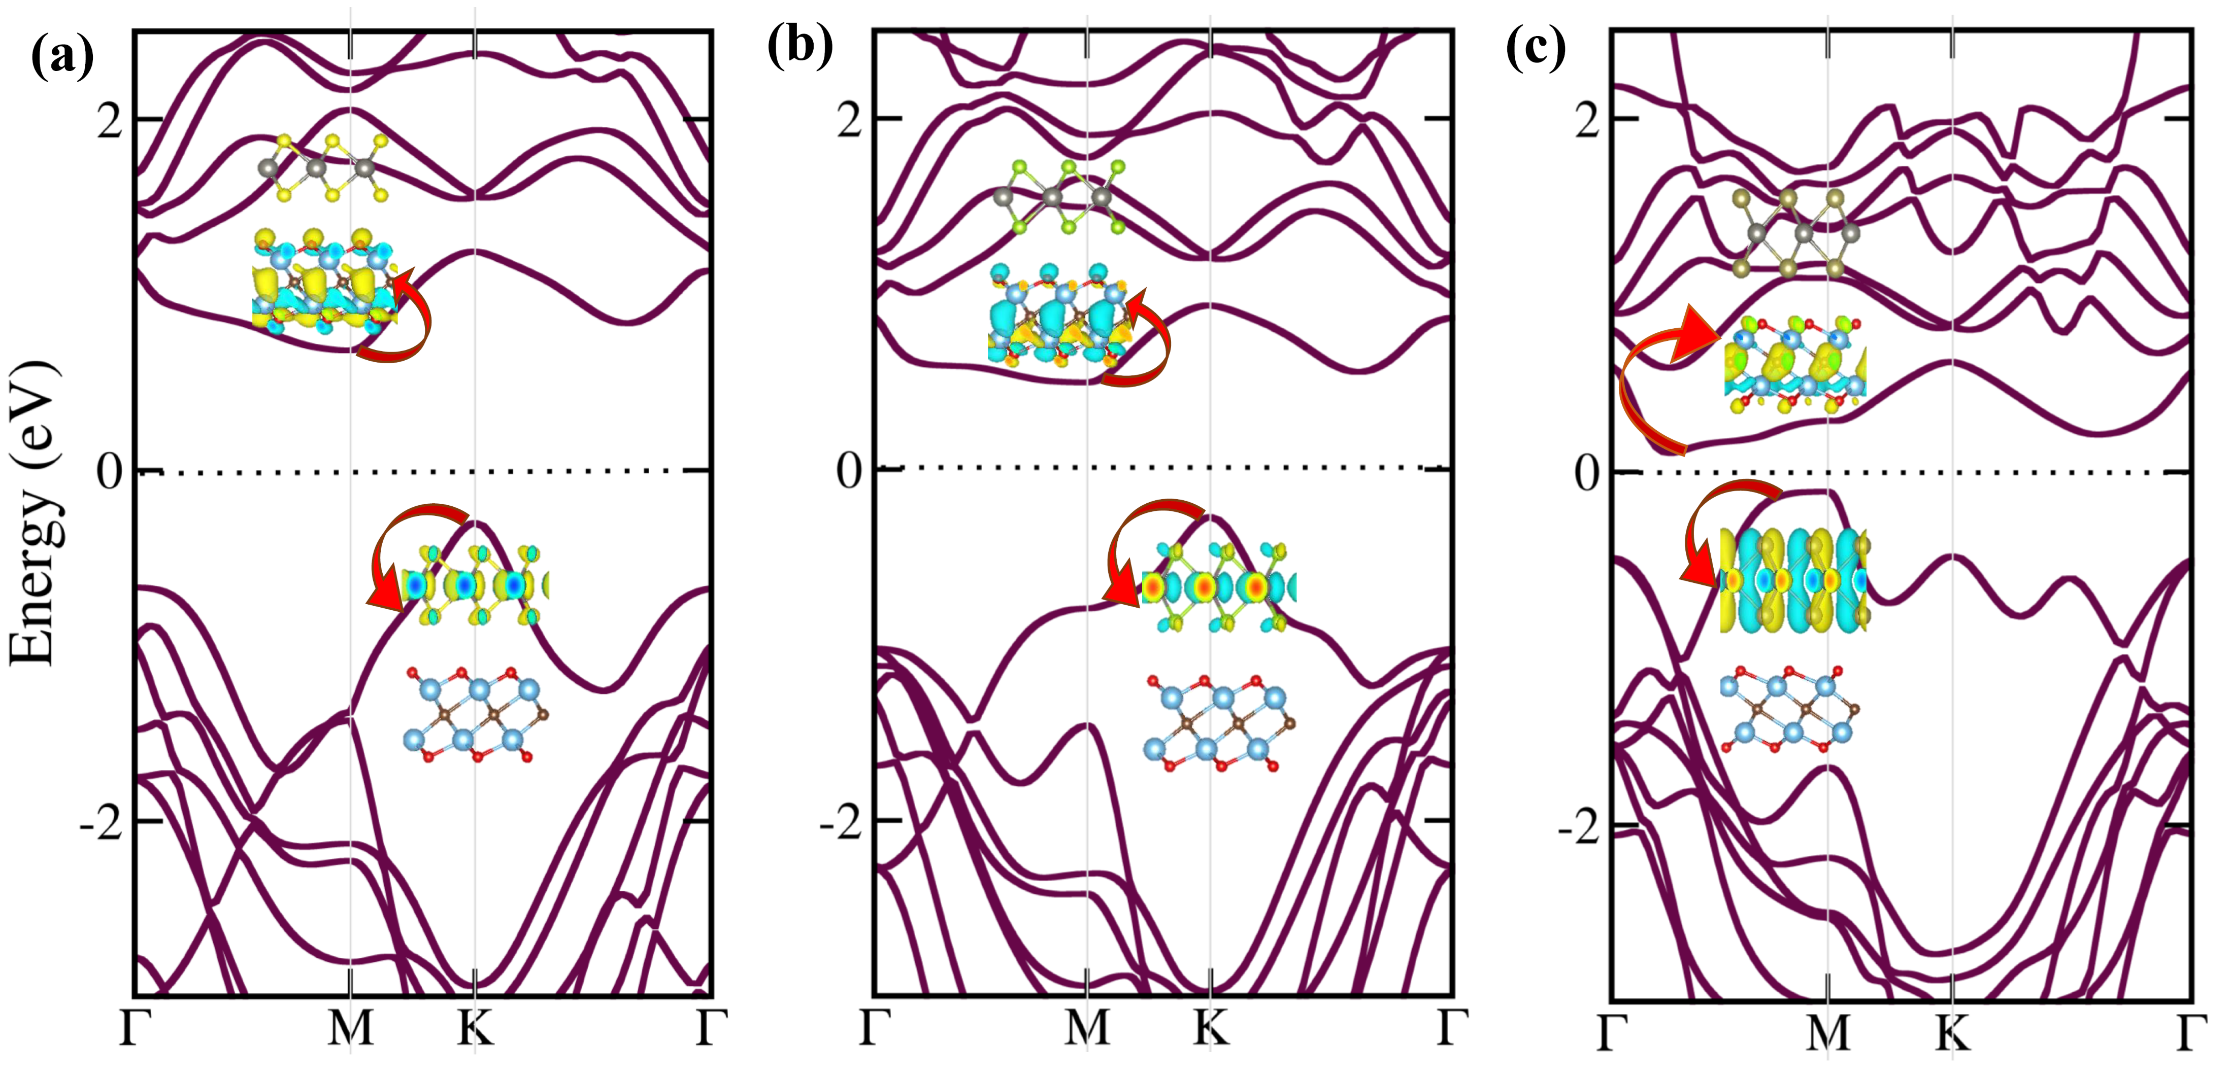
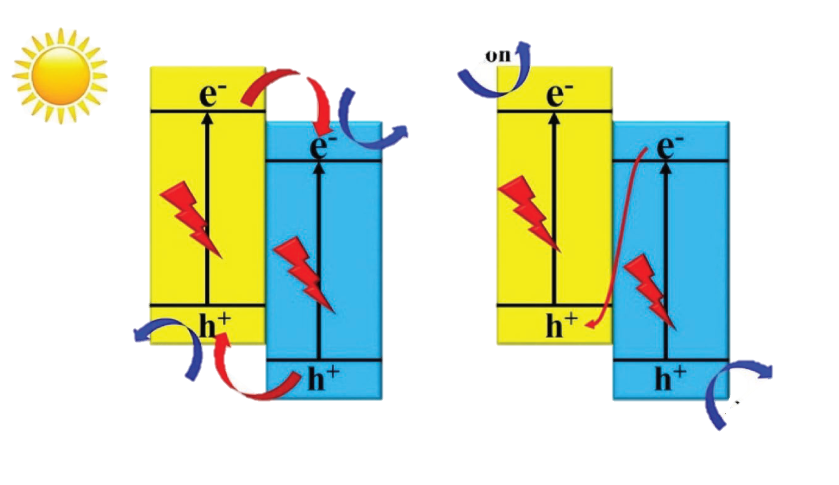
From Figure - (a), (b) and (c) we can confirm that the three heterostructures follow type-II band alignment.
Location of VBM and CBM on two different layers facilitates charge separation.
SC-I
SC-I
SC-II
Reduction
SC-II
Reduction
In a typical direct Z-scheme charge carrier transfer pathway, the photogenerated electrons with strong reduction abilities in the CBM and holes with strong oxidation abilities in the VBM are preserved, while the photogenerated electrons and with inferior redox power, recombine.
Oxidation
Oxidation
(d) Type-II heterojunction
(e) Z-scheme
Remarks : The band plots reveal the type-II behaviour, but to confirm Z-scheme behaviour, we need to explore further.
References : Small Methods 2017, 1, 1700080

Slide 18
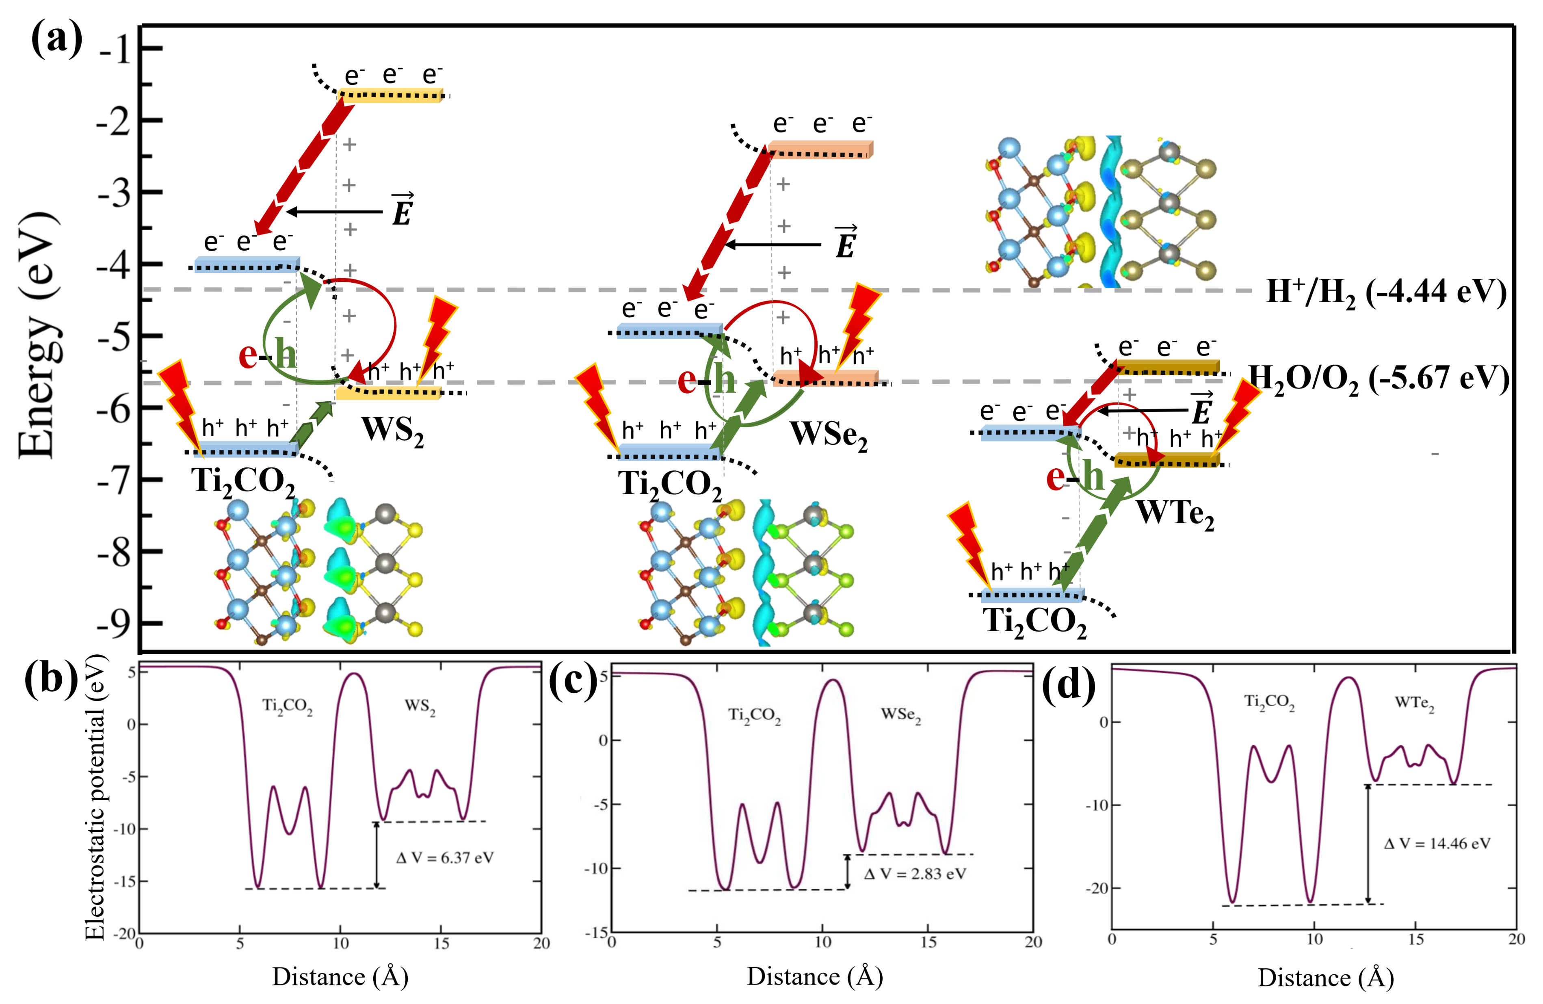
Three steps of photocatalytic water splitting:
Photogeneration of electron-hole pairs under light irradiation.
Charge carrier separation and migration to surface.
Participation of electrons/holes in reduction /oxidation of water.
To satisfy these criteria, the band edges of the material must straddle water redox potential
Ti₂CO₂-WS₂ and Ti₂CO₂-WSe₂ efficiently straddles water redox potential having bandgaps of 0.98 eV and 0.76 eV.

Slide 19
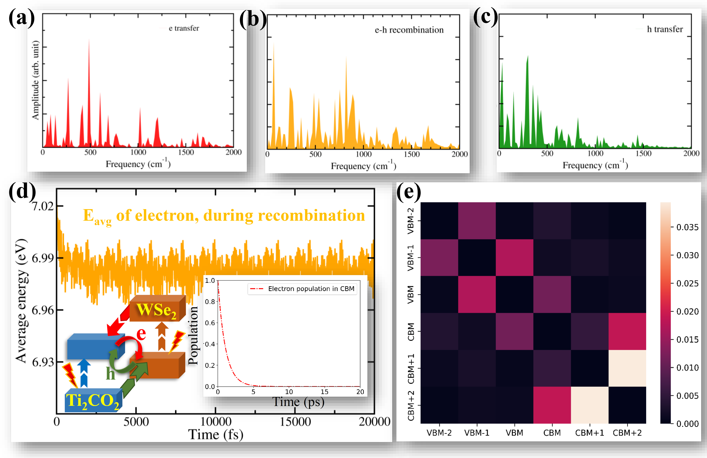
WHY NON-ADIABATIC STUDY?
Non-adiabatic study accounts the effect of nuclear motion on the electronic motion.
Therefore, we can mimic real time resolved spectroscopic measurement, and predict exact timescales of electron-hole recombination, electron transfer and hole transfer.
Non-adiabatic coupling is calculated using the following equation:
…… (4)
RESULTS:
The electron-hole recombination time is 0.45 ps for 60% recombination.
70% of electron transfer lasts up to 1.13 ps, and 75% of hole transfer lasts up to 1.22 ps.
The decoherence time is 70.82 fs for the carrier transfer process and 94.29 fs for the electron-hole recombination process.
Smaller electron-hole recombination time confirms the Z-scheme mechanism.
(ACS Catal. 2020, 10, 3, 1976–1983, Acc. Chem. Res. 2021, 54, 23, 4239–4249)

Slide 20
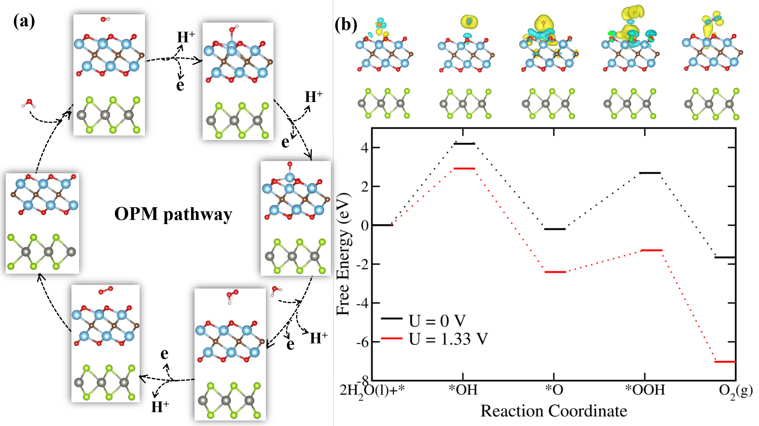
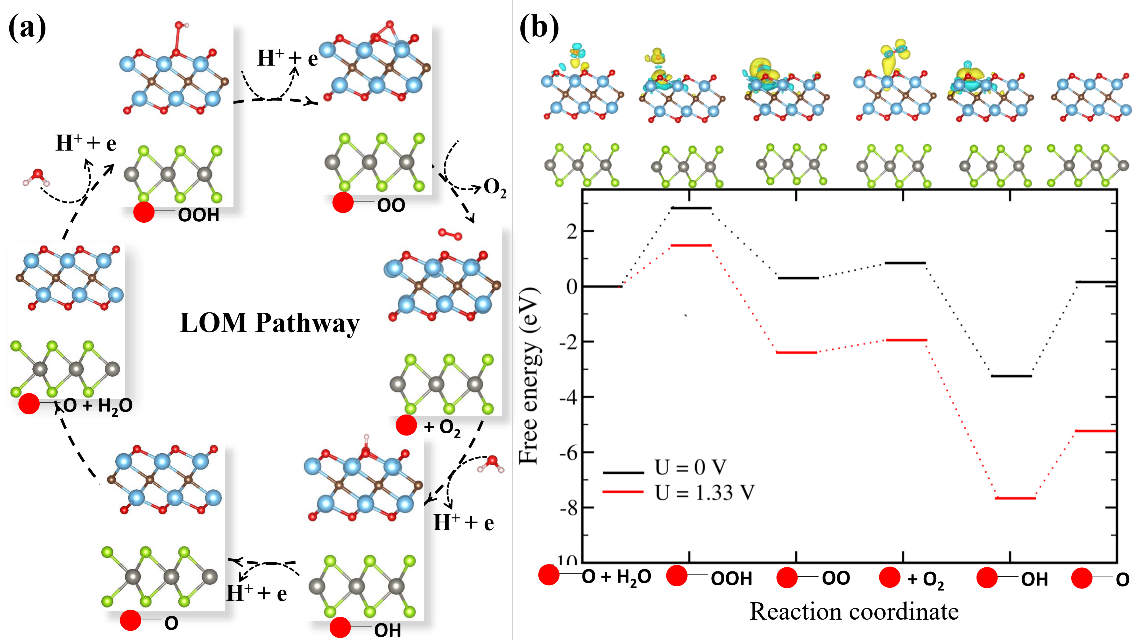
Steps of oxygen evolution reaction(OPM):
Firstly, an adsorbed H₂O molecule over Ti₂CO₂ monolayer dissociates into an OH group by losing an electron-proton pair and generates OH.
Next, the adsorbed OH is oxidized to O , followed by the O* reacting with another molecule of H₂O to produce *OOH.
Finally, the release of another electron-proton pair can be spotted, inducing the desorption of O₂ molecule from the material surface.
Steps of oxygen evolution reaction (LOM)
Firstly, a lattice oxygen of the Ti₂CO₂ layer reacts with a H₂O molecule to form O_{lattice}-OH, which next evolves oxygen by releasing two e-h pairs in the two steps.
This results in an O-vacancy, which reacts with another H₂O molecule to form O_{lattice}-H with release of e-h pair.
In last step, original heterostructure is regenerated along with the release of a e-h pair.
ACS Catal. 2020, 10, 3, 1976–1983 , J. Phys. Chem. C 2022, 126, 5, 2587–2595,
Theoretical basis of electrocatalysis-Chi Ho Lee, Sang Uck Lee

Slide 21
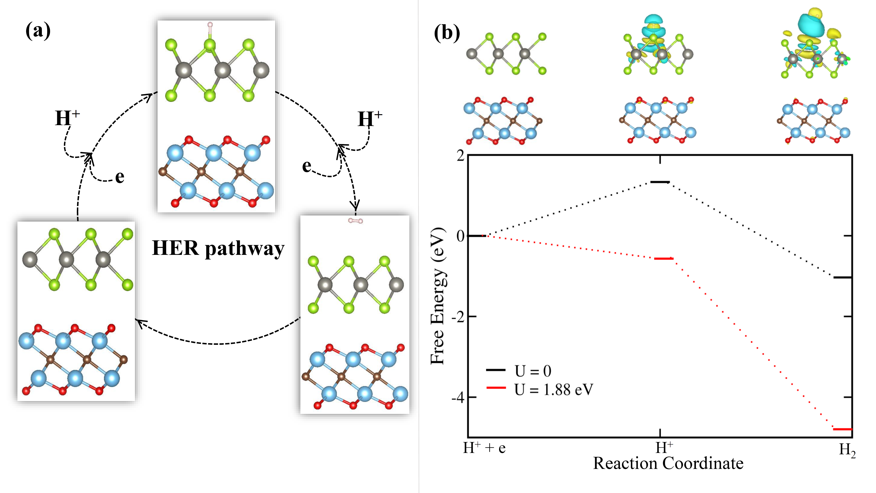
ΔG = ΔE + ΔE_{ZPE} - TΔS – eU ……….(5)
We have constructed the plots using this equation.
Steps of hydrogen evolution reaction (HER)
A proton and electron pair firstly gets adsorbed on the WSe2 layer of the heterostructure.
The adsorbed H then reacts with another proton electron pair to produce H₂ which finally gets desorbed from the material surface and the cycle continues.

Slide 22
Conclusion:
We have systematically investigated the possibility of an efficient Z-scheme photocatalyst among Ti₂CO₂-WS₂ , Ti₂CO₂-WSe₂ and Ti₂CO₂-WTe₂ heterostructures employing first principle density functional calculations.
Rigorous electronic structure analysis indicated Ti₂CO₂-WSe₂ as the most suitable candidate for the same.
Optimum bandgap of 0.76 eV, excellent optical property, effective interlayer charge separation, high anisotropic carrier mobility value, smaller time scale of electron-hole recombination(0.45-1.01 ps) than electron transfer (1.13 ps) or hole transfer (1.22 ps) and stable OER and HER on its surfaces makes Ti₂CO₂-WSe₂ a potential coveted material in the field of clean energy production.
The Journal of Physical Chemistry C 126 (49), 20852-20863
https://doi.org/10.1021/acs.jpcc.2c06171

Slide 23
Acknowledgement
We are sincerely grateful to the Department of Chemistry, Visva-Bharati university.
I am extremely thankful to my supervisor Prof. Pranab Sarkar for his guidance.
Thanks a lot to Prof. Alexey Akimov for providing this opportunity to present our work.
Thanks to Prof. Jin Zhao’s entire lab (USTC) for helping us in different difficulties during these works.
Finally, thanks to entire quantum dynamics hub for the valuable talks, seminars, online materials and quick support in each and every small problem.

Slide 24
THANK YOU

