Slide 1
Diagrammatic Quantum Monte Carlo toward The Calculation of Transport Properties in Disordered Semiconductors
Yu-Chen Wang
Department of Chemistry, Xiamen University
4/13/2022
Virtual International Seminar on Theoretical Advancements

Slide 2
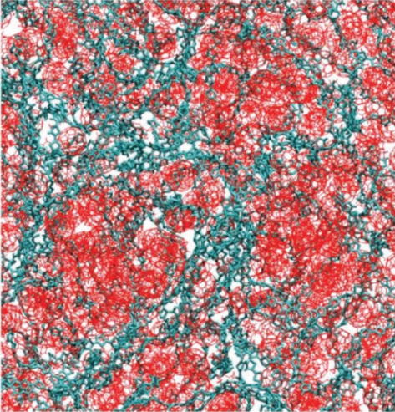
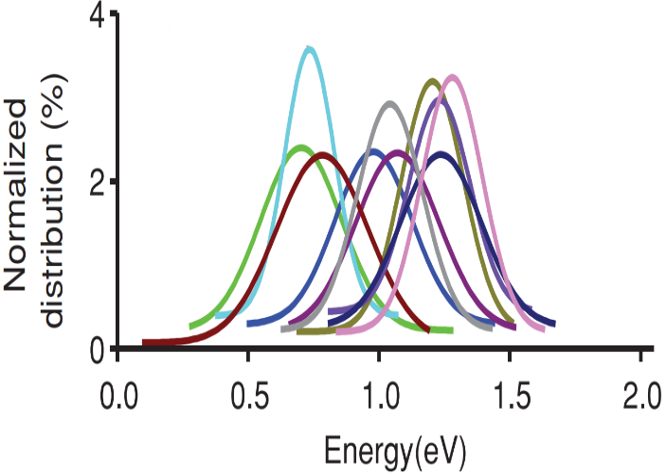
Microscopic disorders in materials
Structural disorders induce certain variations in the electronic properties of materials
Static disorder
Dynamic disorder
(Electron-phonon interaction)
Zheng et al. Adv. Energy Mater. 2019, 9, 1803926.
From structural imperfections like impurities, vacancies, …
From the continuous motion of nuclei
Do not obviously vary over a long time scale
Dynamically vary at a short time scale (fs to ps)
Random in nature
Local and nonlocal disorders refer to the variations in the electronic-state energies and electronic couplings, respectively

Slide 3
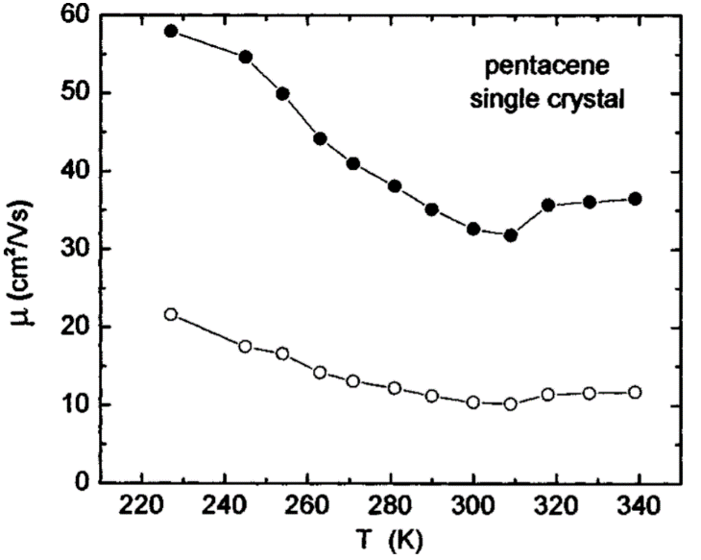
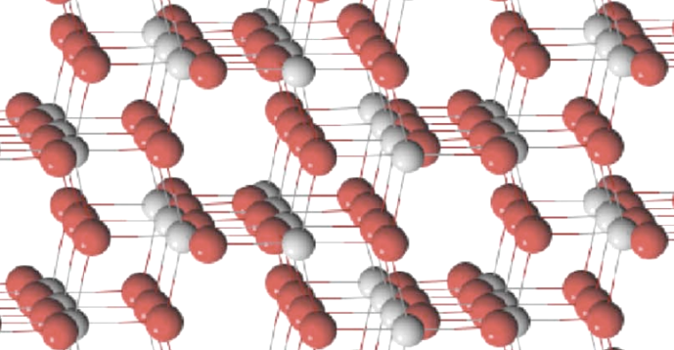
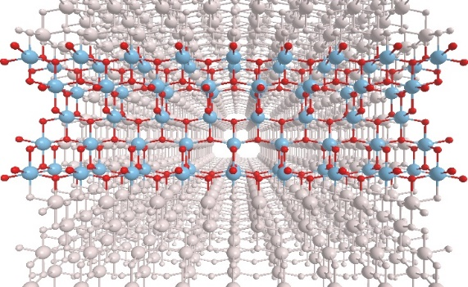
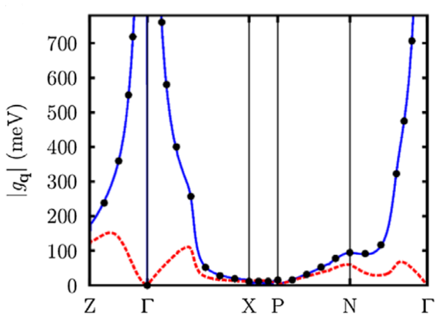
The influences of disorders on charge carrier transport
Band-like mobility in organic single crystal
Hopping or Band?
Nuclear tunneling
Transient localization
Time evolving
Jurchescu et al. Appl. Phys. Lett. 2004, 84, 3061.
Nan et al. Phys. Rev. B 2009, 79, 115203.
Asadi et al. Nat. Commun. 2013, 4, 1710.
Troisi et al. Phys. Rev. Lett. 2006, 96, 086601.
Ciuchi et al. Phys. Rev. B 2011, 83, 081202.
Electron-phonon interaction in anatase TiO₂
Boltzmann transport equation
Hopping model for TiO₂
Deskin et al. Phys. Rev. B 2007, 75, 195212.
Spreafico et al. Phys. Chem. Chem. Phys. 2014, 16, 26144.
Verdi and Giustino, Phys. Rev. Lett. 2015, 115, 176401.

Slide 4
Quantum dynamics beyond perturbation approximation
Currently available methods
Real time
Numerically exact:
Hard
ML-MCTDH, TD-DMRG, HEOM, QUAPI, hierarchy of SSE, …
Approximate:
Mixed quantum-classical approach, quantum master equation, perturbative SSE, …
Imaginary time
Easy
Requirements for simulations in semiconductors
Treating various types of disorders nonperturbatively
Free of finite-size effects and applicable to 3D systems
Flexible to be combined with first-principles calculations
Full quantum dynamics
These requirements can be achieved much easier in imaginary time

Slide 5
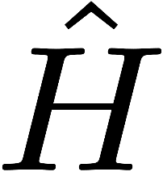
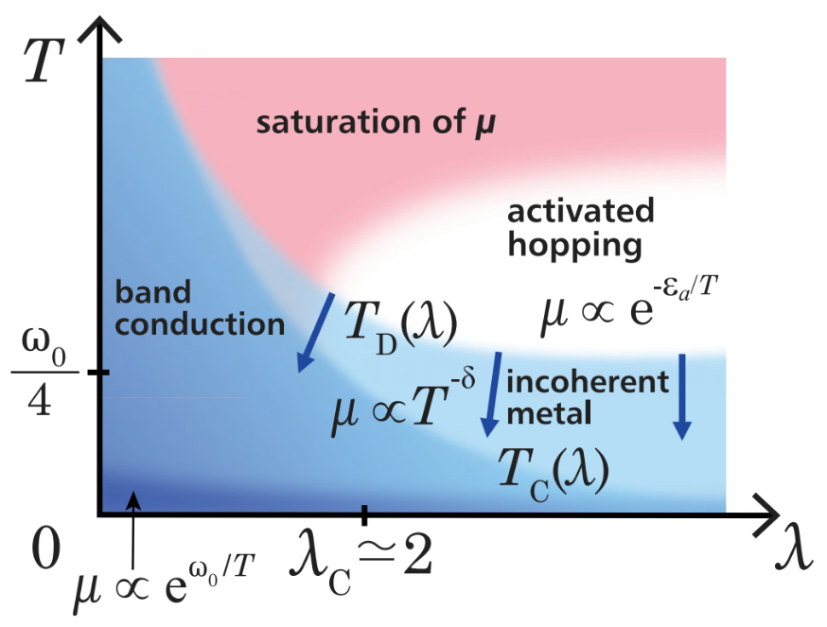
Matsubara formalism and Diagrammatic QMC
Imaginary-time data
Basic idea of DQMC
Analytic continuation
$$e^{−β}$$
Summation of Feynman diagrams
=
Real-time data
Current autocorrelation function
Beard et al. Phys. Rev. Lett. 1996, 77, 5130.; Prokof’ev et al. JETP Lett. 1996, 64, 911;
Prokof’ev et al. Sov. Phys. JETP, 1998, 87, 310; Mishchenko et al. Phys. Rev. B 2000, 62, 6317.
DQMC study on Holstein model
Optical conductivity
One-particle Green’s function
Spectral function
G. D. Mahan, Many-particle physics (Springer Science & Business Media, 2013)
Mishchenko et al. Phys. Rev. Lett. 2015, 114, 146401.

Slide 6
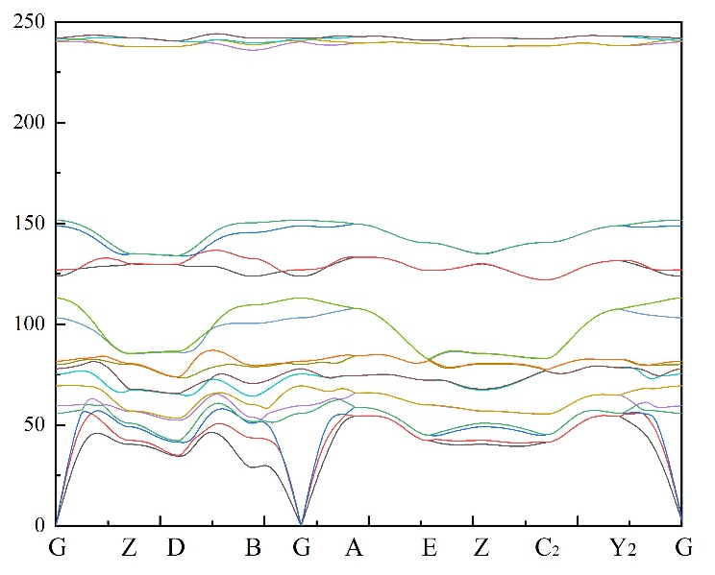
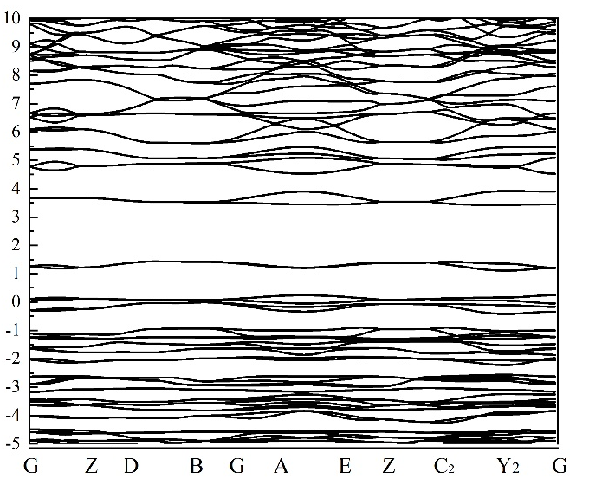
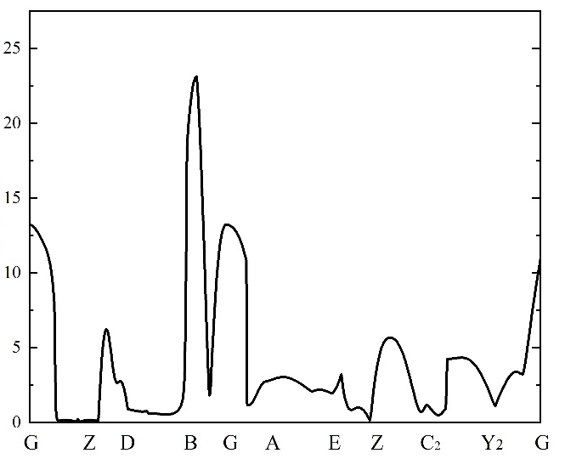
Methodology of DQMC (dynamic disorder)
Electron
Phonon
Electron-phonon interaction
Band Energy (eV)
Frequency (cm⁻¹)
|g| (meV)
Parameters can be directly obtained from DFT and DFPT
Baroni et al., Rev. Mod. Phys., 73, 515, 2001; Giustino, Rev. Mod. Phys., 89, 015003, 2017.

Slide 7
Methodology of DQMC (dynamic disorder)
Electron
Phonon
Zero-order term:
Interaction term:
Expanding Partition function into infinite series
$$q_{1}$$
$$q_{2}$$
$$k_{1}$$
$$k_{1}+q_{1}$$
…
$$k_{1}$$
$$τ_{1}$$
$$τ_{2}$$
…
$$τ_{2κ}$$

Slide 8
Methodology of DQMC (dynamic disorder)
Wick’s theorem:
Thermal average over multiple products of phonon coordinates
= All possible pairwise combinations of binary thermal averages
Binary thermal average:
Free phonon propagator:
Wang and Zhao, arXiv:2203.12480, 2022.

Slide 9
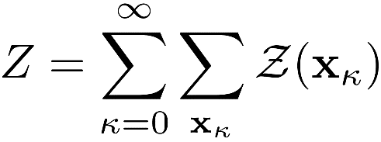
Methodology of DQMC (dynamic disorder)
Recast into a form suitable for the Monte Carlo implementation:
Monte Carlo configuration space
Summation over MC “grids”
Concrete expression at each MC “grid”
Wang and Zhao, arXiv:2203.12480, 2022.

Slide 10
Methodology of DQMC (dynamic disorder)
Basic updates for MC configurations: Change the end electronic crystal momentum
$$v_{1}q_{1}$$
$$v_{1}q_{1}$$
$$m_{1}k_{1}$$
$$m_{2},k_{1}+q_{1}$$
$$m_{1}k_{1}$$
$$m_{1}k_{1}^{′}$$
$$m_{2},k_{1}^{′}+q_{1}$$
$$m_{1}k_{1}^{′}$$
$$0$$
$$τ_{1}$$
$$τ_{2}$$
$$β$$
$$0$$
$$τ_{1}$$
$$τ_{2}$$
$$β$$
Acceptance ratio for changing $k_{1}$:
The calculation of the acceptance ratio is very simple and fast

Slide 11
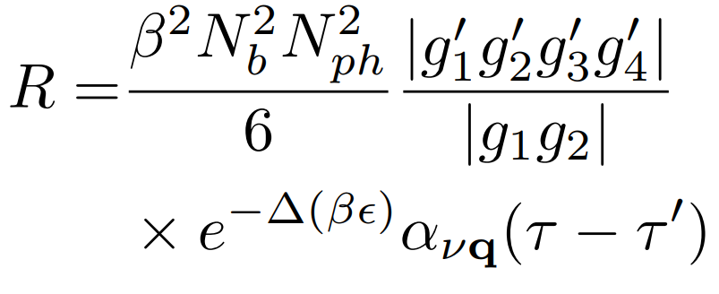
Methodology of DQMC (dynamic disorder)
Basic updates for MC configurations: Insert or remove an interaction vertex pair
Acceptance ratio for inserting:
$$v_{1}q_{1}$$
$$m_{1}k_{1}$$
$$m_{2},k_{1}+q_{1}$$
$$m_{1}k_{1}$$
$$0$$
$$τ_{1}$$
$$τ_{2}$$
$$β$$
Insert
Remove
$N_{b}$ is the number of electronic bands
$N_{ph}$ is the number of phonon branches
The computational cost is independent of the total number of unit cells N.
$$vq$$
$$v_{1}q_{1}$$
$$m^{′}k_{1}$$
$$m_{1},k_{1}+q$$
$$m,k_{1}+q_{1}+q$$
$$m_{2},k_{1}+q_{1}$$
$$m^{′}k_{1}$$
$$0$$
$$τ^{′}$$
$$τ_{1}$$
$$τ$$
$$τ_{2}$$
$$β$$

Slide 12
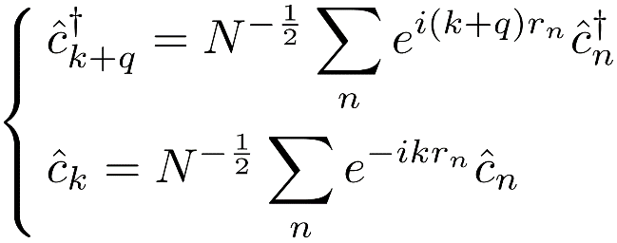
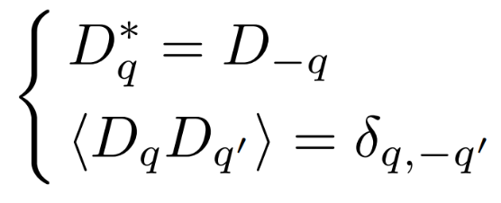
Methodology of DQMC (static disorder)
How to express the static disorder in reciprocal space?
One-dimensional toy model
Gaussian random variables
Translational invariant
Static disorder in real space
Transform to reciprocal space
Define:
${\{D}_{q}\}$ constitute a complete basis set and is equivalent to ${\{γ}_{n}\}$
Decoupled
Reciprocal-space expression:

Slide 13
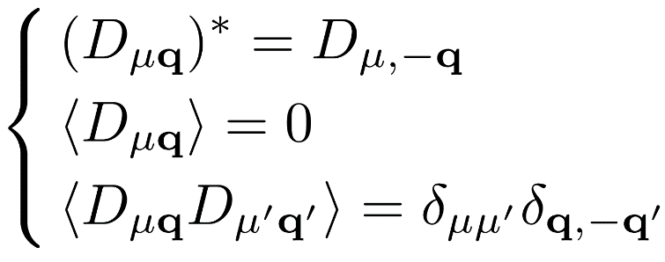
Methodology of DQMC (static disorder)
General expressions for static disorder
Static disorder in real space
Covariance property:
Static disorder in reciprocal space
in reciprocal space resembles very much
Wang and Zhao, arXiv:2203.12480, 2022.

Slide 14
Methodology of DQMC (static disorder)
Zero-order term:
Interaction term:
Expanding Partition function into infinite series
This expression is analytic and may be suitable for the Monte Carlo implementation …
But most of the terms cancel out with each other to give a zero average due to the random nature of $D_{μq}$.
Must find a way to pick out the terms that really contribute to $Z$ …
Wang and Zhao, arXiv:2203.12480, 2022.

Slide 15
Methodology of DQMC (static disorder)
Generalized Wick’s theorem for static disorder
(Proven by the central limit theorem)
Terms in which all $D_{μq}$ are in pairwise combination with each other contribute to $Z$.
Wang and Zhao, arXiv:2203.12480, 2022.

Slide 16
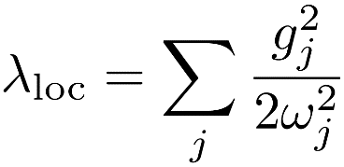
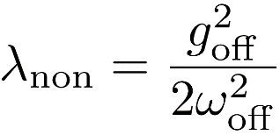
One-dimensional molecular chain model
…
…
Electronic coupling
Dynamic disorder strength
Electron:
Phonon:
Intermolecular phonon
Intramolecular phonon
Static disorder strength
Electron-phonon interaction:
Nonlocal el-ph
Local el-ph
Static disorder:
Nonlocal sd
Local sd
Results of DQMC are obtained in the thermodynamic limit $N→∞$
Wang and Zhao, arXiv:2203.12480, 2022.

Slide 17
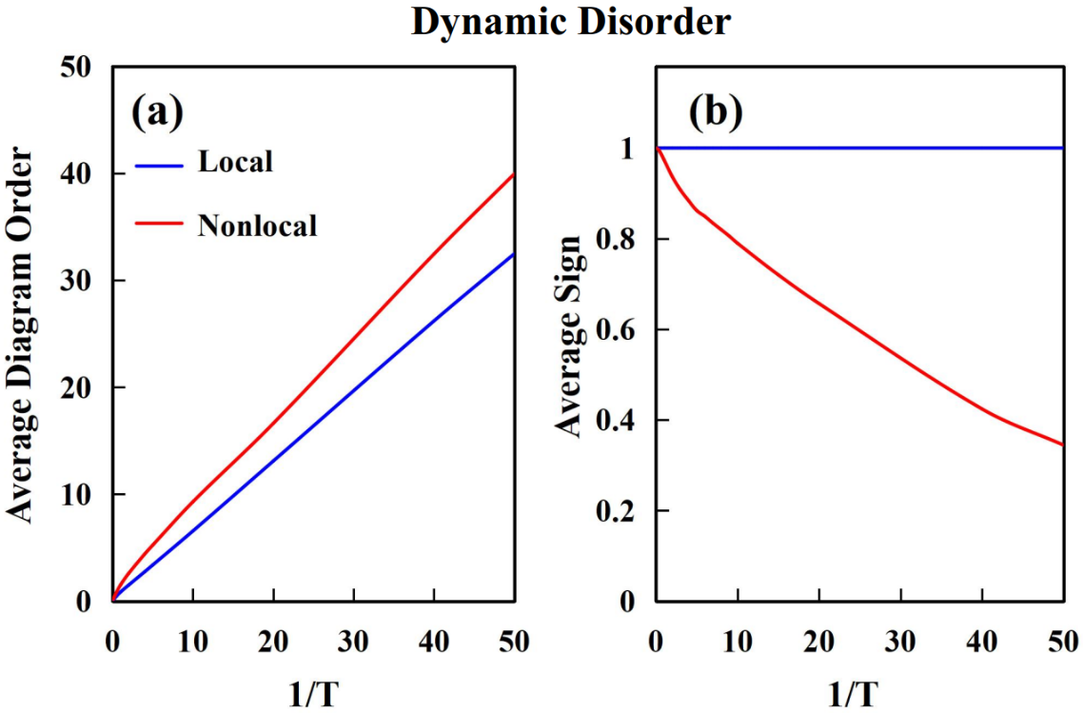
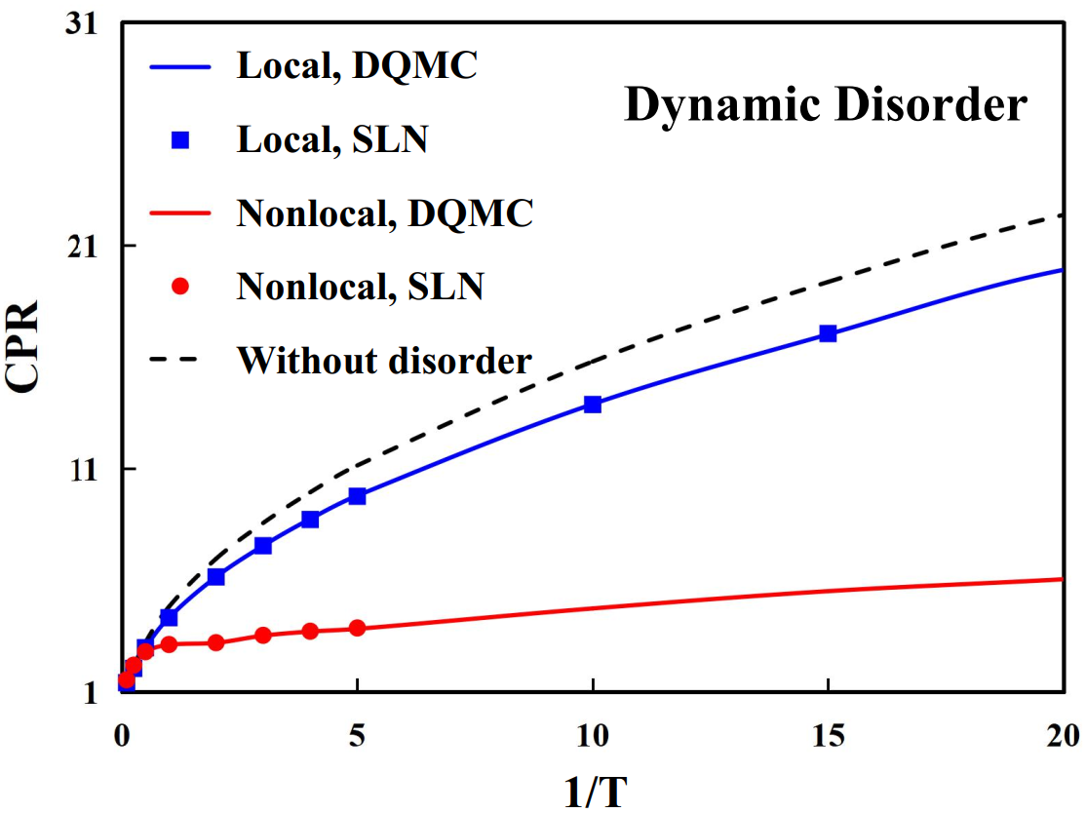
One-dimensional molecular chain model
Histogram
$$V=λ=1$$
*SLN: Stochastic Liouville von Nemann equation
Average diagram order linearly depends on 1/T.
Nonlocal dynamic disorder strongly suppresses the real-space coherence of the charge carrier.
Negligible sign problem for nonlocal dynamic disorder.
Wang and Zhao, arXiv:2203.12480, 2022.

Slide 18
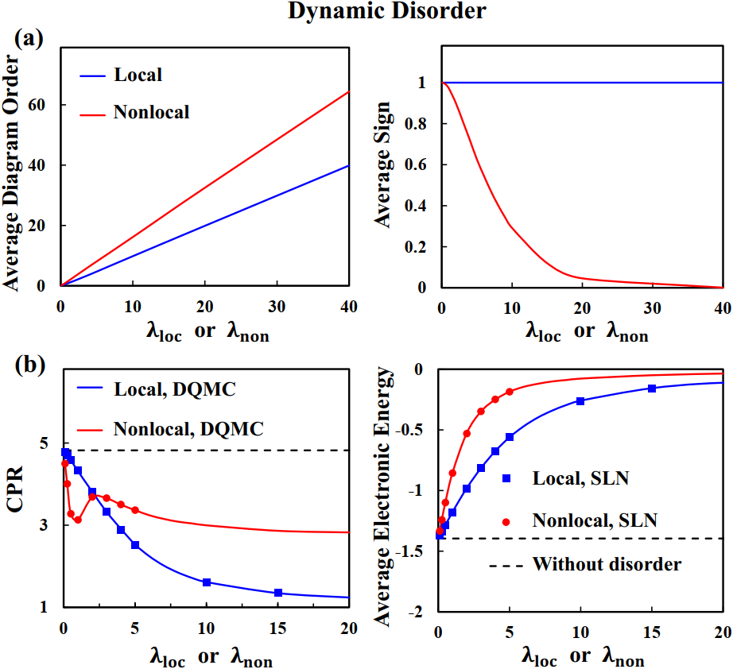
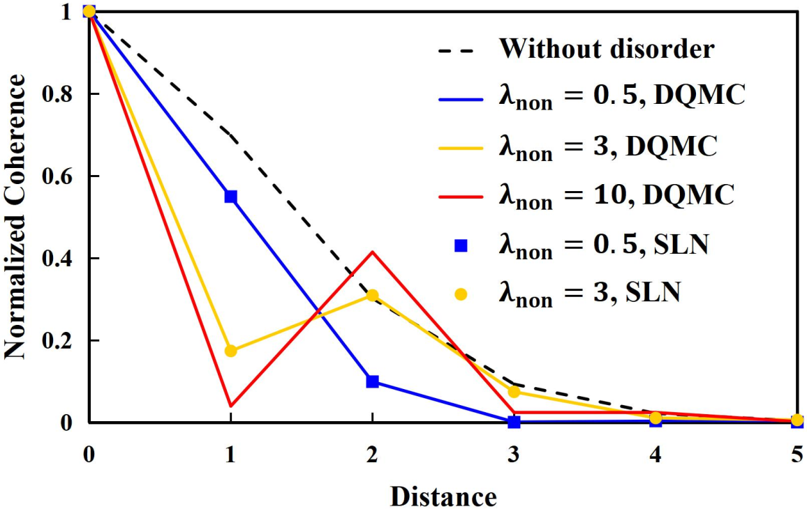
One-dimensional molecular chain model
Average diagram order linearly depends on $λ$.
$$V=T=1$$
Significant sign problem for very large $λ_{non}$ (>20).
Dual role of nonlocal disorder on coherence
Wang and Zhao, arXiv:2203.12480, 2022.

Slide 19
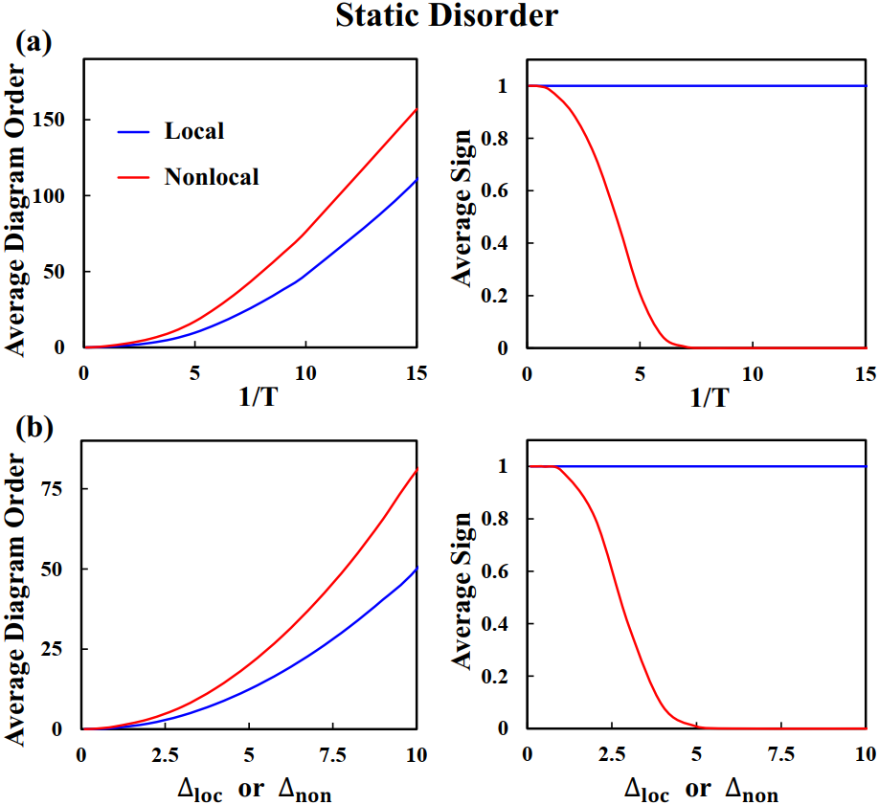
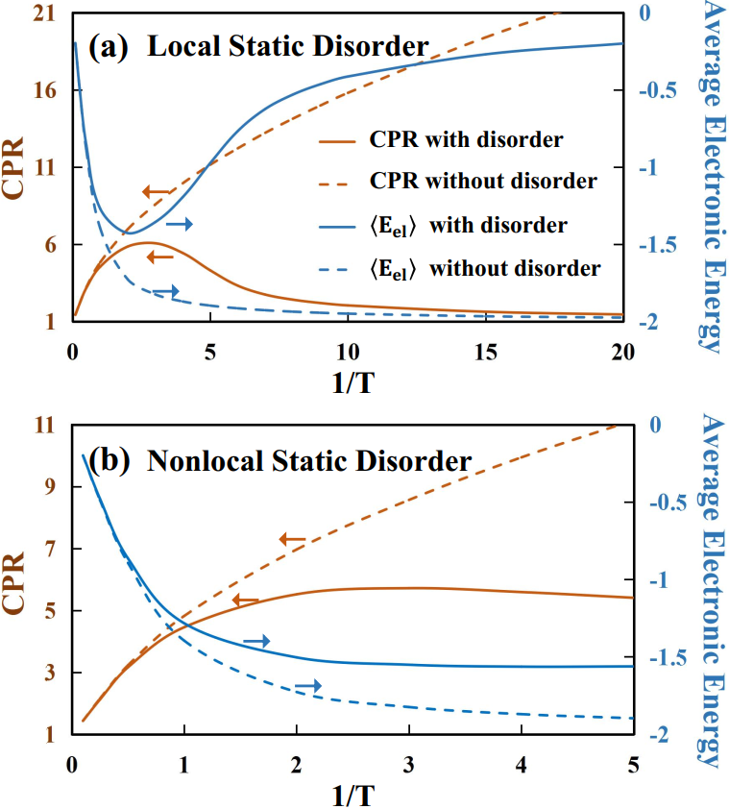
One-dimensional molecular chain model
$$V=∆=1$$
$$V=T=1$$
$$V=∆=1$$
Average diagram order quadratically depends on 1/T or $∆$.
Influence of static disorder emerges at low temperatures
Sign problem is more significant for (nonlocal) static disorder
Wang and Zhao, arXiv:2203.12480, 2022.

Slide 20
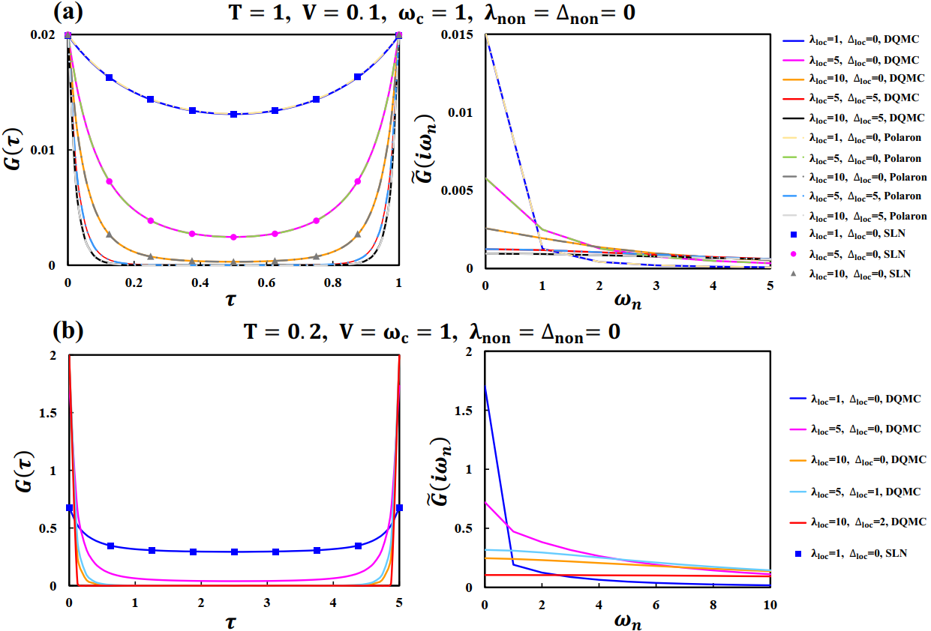
One-dimensional molecular chain model
Imaginary-time (left) and imaginary-frequency (right) current autocorrelation functions
Converged DQMC results can be obtained in the regimes from weak to strong disorder strengths for a broad tempe-rature range.
Wang and Zhao, arXiv:2203.12480, 2022.

Slide 21
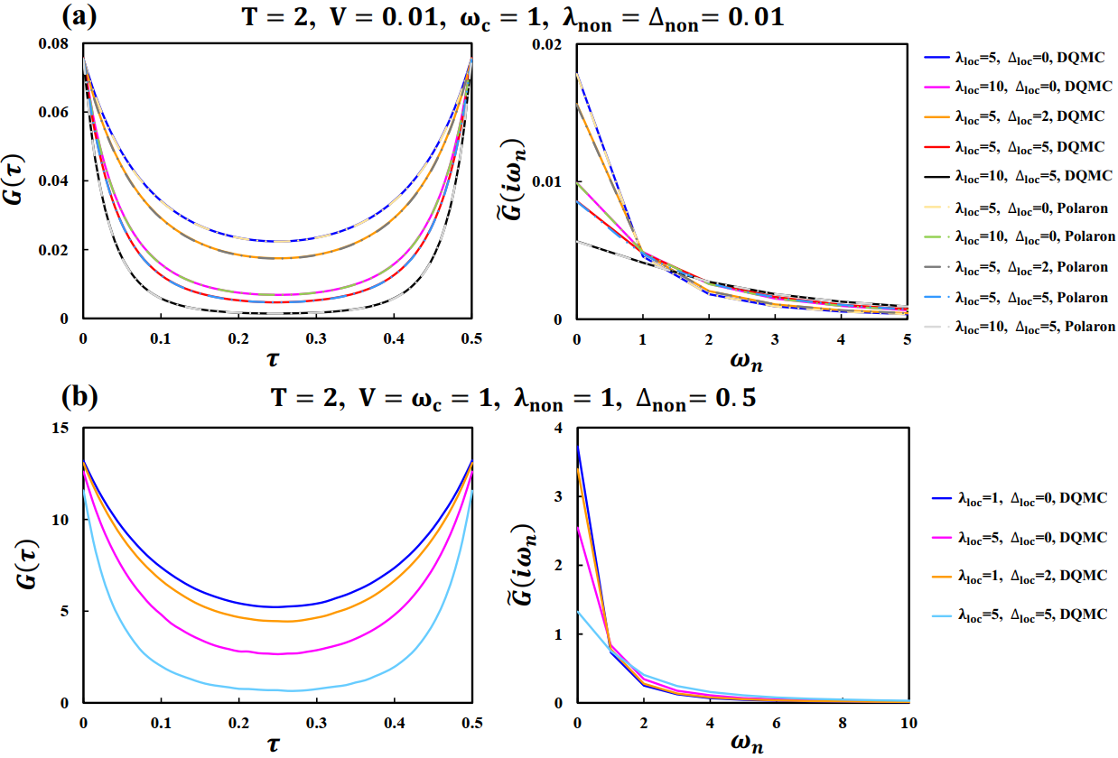
One-dimensional molecular chain model
Imaginary-time (left) and imaginary-frequency (right) current autocorrelation functions
Converged DQMC results can be obtained in the regimes from weak to strong disorder strengths for a broad tempe-rature range.
Wang and Zhao, arXiv:2203.12480, 2022.

Slide 22
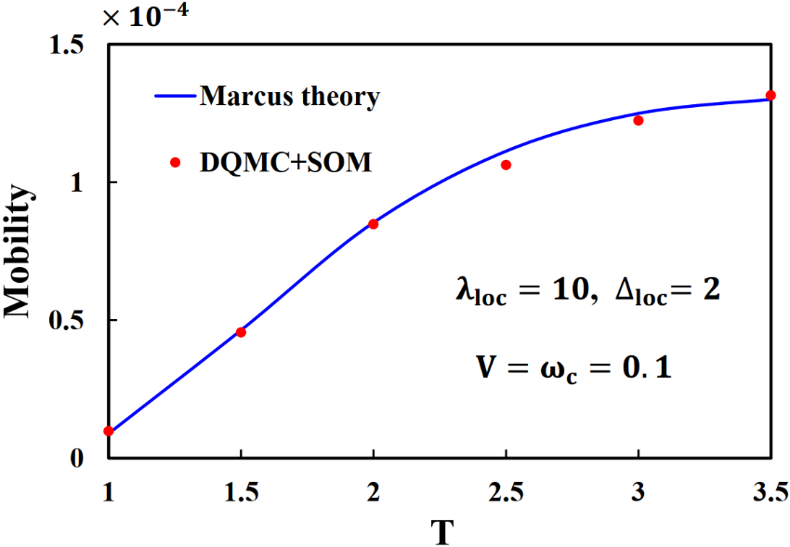
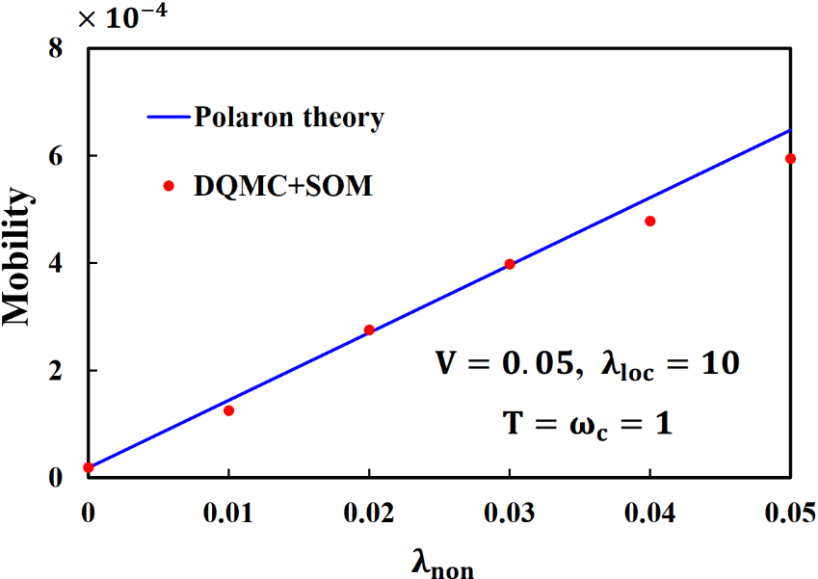
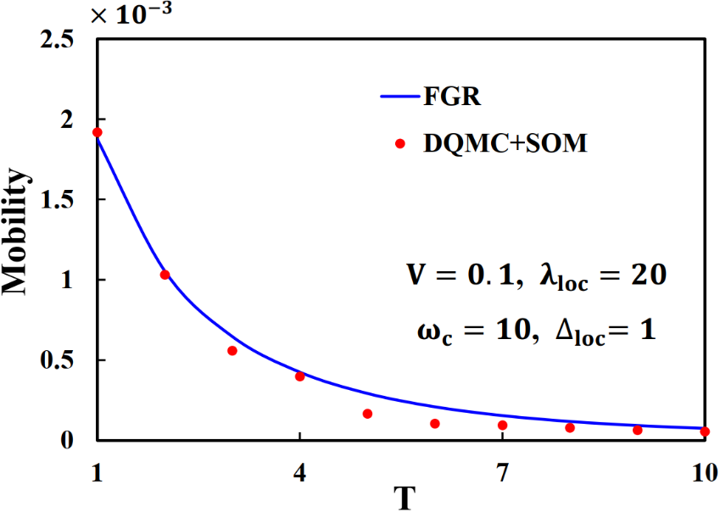
One-dimensional molecular chain model
Thermally-activated hopping
Phonon-assisted transport
Nuclear tunneling
*SOM: stochastic optimization method for numerical analytic continuation
DQMC+SOM can give accurate mobilities in strong disorder regimes.
Significant errors may exist at some temperatures for the nuclear tunneling regime
Wang and Zhao, arXiv:2203.12480, 2022.

Slide 23
Summary
DQMC for the accurate and efficient calculations of charge carrier transport properties in disordered semiconductors.
Treating various types of disorders nonperturbatively
Free of finite-size effects and applicable to 3D systems
Full quantum dynamics
Flexible to be combined with first-principles calculations
Next step:
Interpolation of DFT/DFPT parameters to infinitely large-sized systems
Parameterization of the static disorder
22

Slide 24
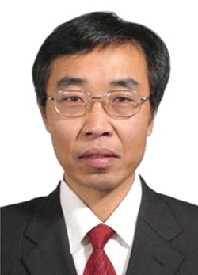
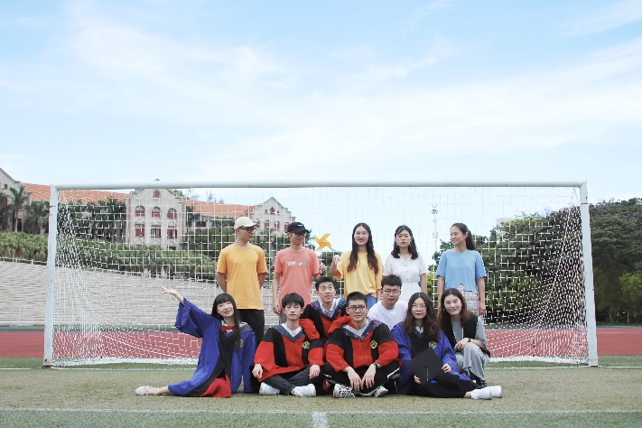
Acknowledgements
Supervisors:
Prof. Yi Zhao
Prof. WanZhen Liang
Prof. Binju Wang
Group members:
Thanks for your patient listening!

