Slide 1



Virtual International Seminar on Theoretical Advancements
Nonadiabatic excited-state dynamics in nanoscale TiO₂: from size and environment to fluxional nuclear motion
Miguel Recio-Poo*
Departament de Ciència de Materials i Química Física
Institut de Química Teòrica i Computacional (IQTCUB)
Universitat de Barcelona
*miguelrecio@ub.edu

Slide 2

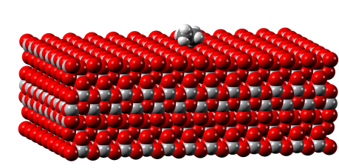
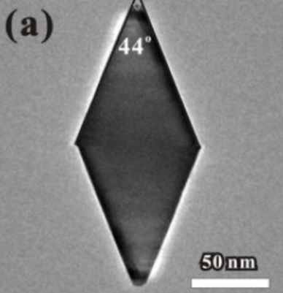
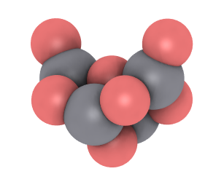
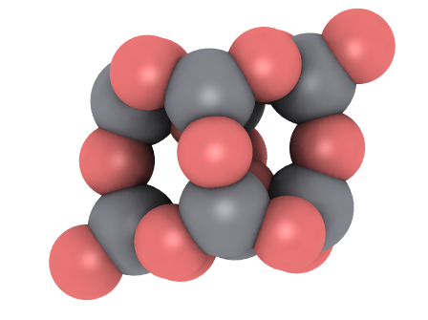
2026
TiO₂ is a benchmark photoactive oxide
used in photocatalysis, environmental remediation, or solar-energy conversion
Lee et al., ACS Omega 2018, 3, 10225
Extended/surface models
simplified, periodic… idealized
Real nanoparticles
realistic, but structurally complex
Nanoclusters: Controlled finite models
known size and structure
size and finite-temperature motion effects?

Slide 3
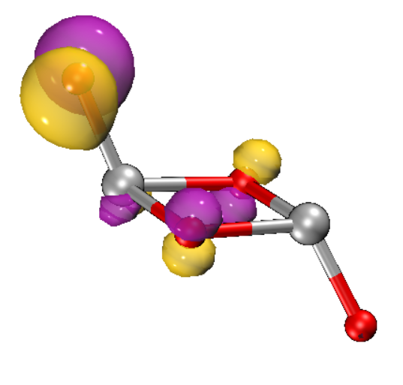
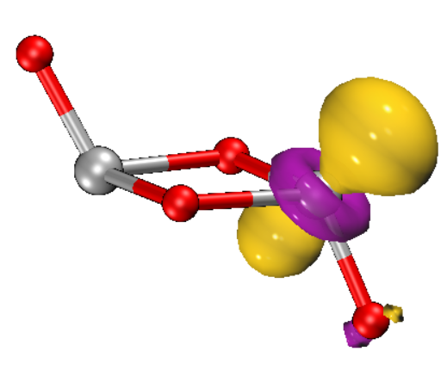






2026
Electronic picture:
light absorption
→ e⁻ / h⁺ generation
→ charge separation
→ surface reactions
-
hole
particle
O_{2p} → Ti_{3d} excitation
→ sequential excited-state decay:
$$S_{n}$$
$τ_{1}$: relaxation
$$S_{1}$$
What controls these timescales in TiO₂ nanoclusters?
$τ_{2}$: recombination
$$S_{0}$$

Slide 4
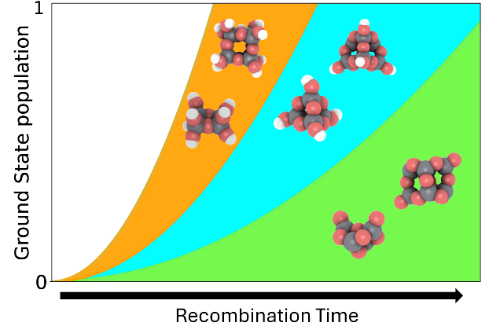
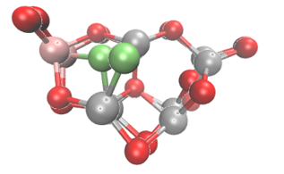
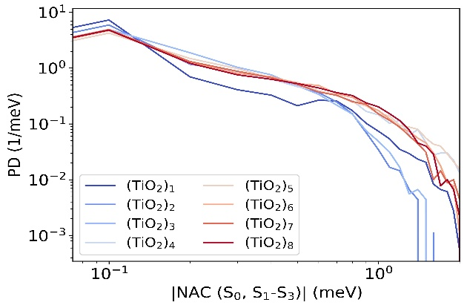
2026
Three ways to reshape the excited-state landscape
Chemical environment: bare → hydrated | Size: small → large | Nuclear motion: rigid ↔ fluxional
Hydroxylation changes excitation energies and NACs | Cluster size changes DOS, gaps, and state mixing | Fluxionality changes the sampled excited-state landscape
Altered relaxation and recombination
Faster recombination
Non-trivial size trends
JPCC 2025, 129 (3), 1806-1823
JPCL 2026
JACS 2025, 147(44), 40900-40909

Slide 5
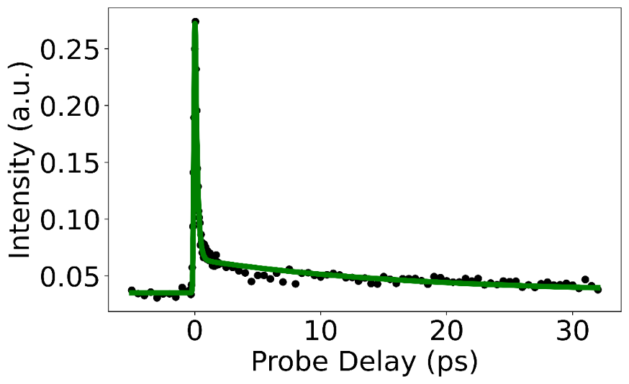
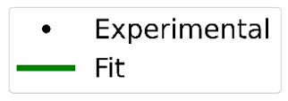





2026
Strategy: experiment + mixed quantum–classical dynamics
(TiO₂)_{n}, n = 1–8 femtosecond pump–probe spectroscopy observed lifetimes: τ₁, τ₂
AIMD
trajectories
CP2K
TD-DFT (CAM-B3LYP)
Excited-state manifold
CP2K + libra
Hammes-Schiffer Tully approach
Nonadiabatic
couplings
libra
Trajectory Surface Hopping: FSSH, mSDM…
Population dynamics
libra
relaxation to S₁ ${(τ}_{1})$
recombination to S₀ $(τ_{2})$
Scott G. Sayres, ASU
istate
JPCL 2021, 12, 4098−4103
JPC 2016, 37, 1626-1649
CP2K: step 1, step 2 (excitations); Libra: step 2 (overlaps), step 3, step 4

Slide 6
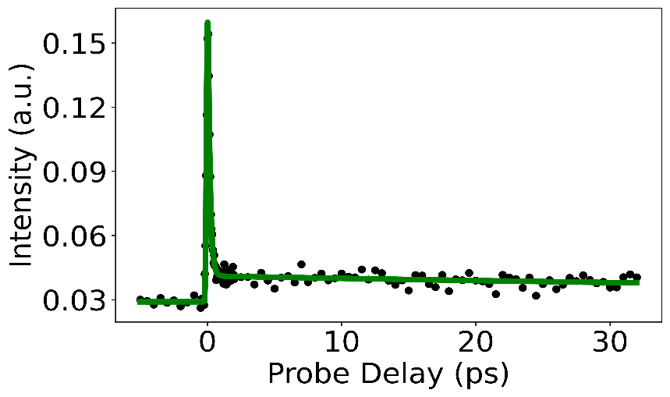
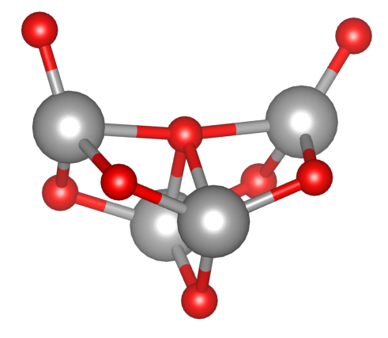

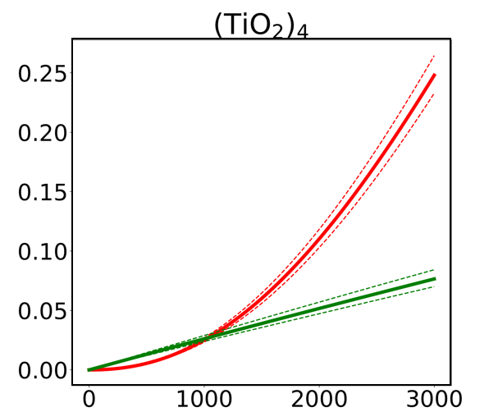
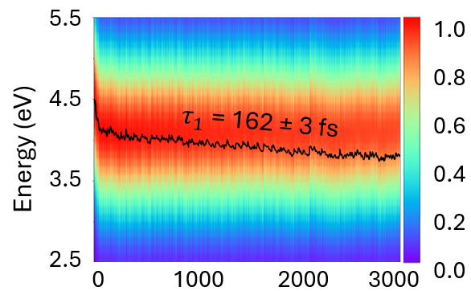

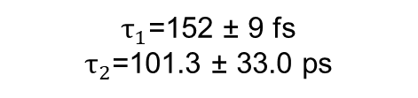

2026
$τ_{1}$=152 ± 9 fs
$τ_{2}$=101.3 ± 33.0 ps
Experiment
(TiO₂)₄
Two dynamical regimes require two observables:
$τ$₁: average excitation-energy decay · $τ$₂ : S₀ population recovery
Relaxation observable
Recombination observable
$$E\left(t\right)=\sum_{I=0}^{N}{p_{I,SH}\left(t\right)E_{I}\left(t\right)}$$
Ground State Population
FSSH: τ₂ = 5.3 ± 0.2 ps
mSDM: τ₂ = 37.7 ± 3.6 ps
Time (fs)
Time (fs)
JACS 2025, 147(44), 40900-40909

Slide 7
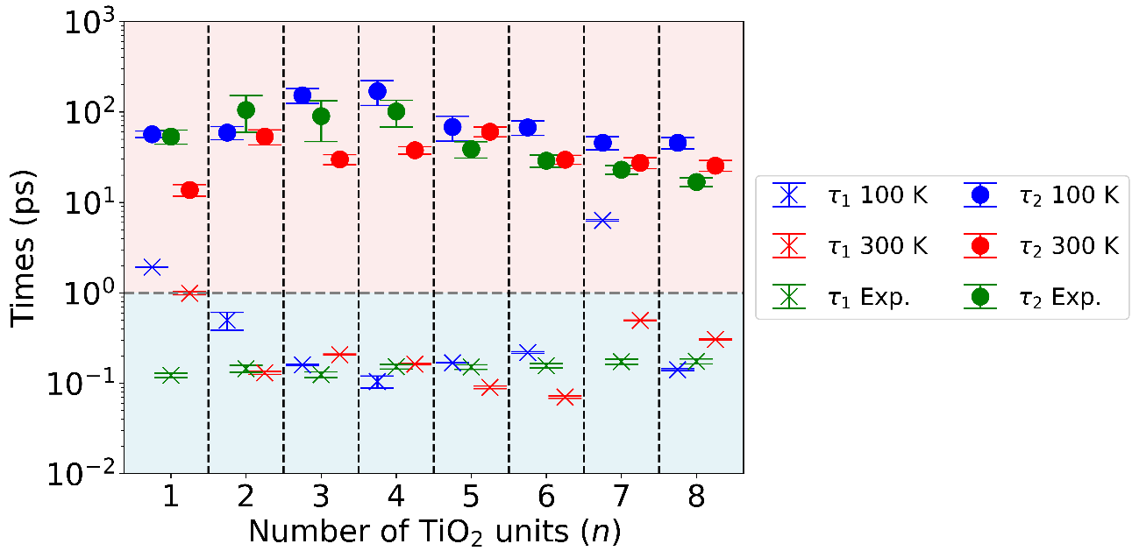
2026
Experiment and NA-MD reveal size-dependent lifetimes
Two separated regimes: τ₁ ≪ τ₂ ; Size dependence is non-trivial, especially for τ₂
Higher temperature accelerates recombination
Good agreement with pump–probe lifetimes
JACS 2025, 147(44), 40900-40909

Slide 8
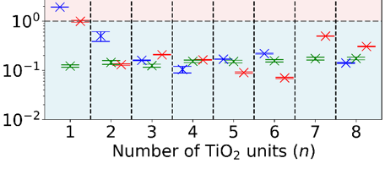

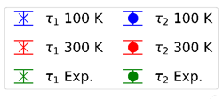
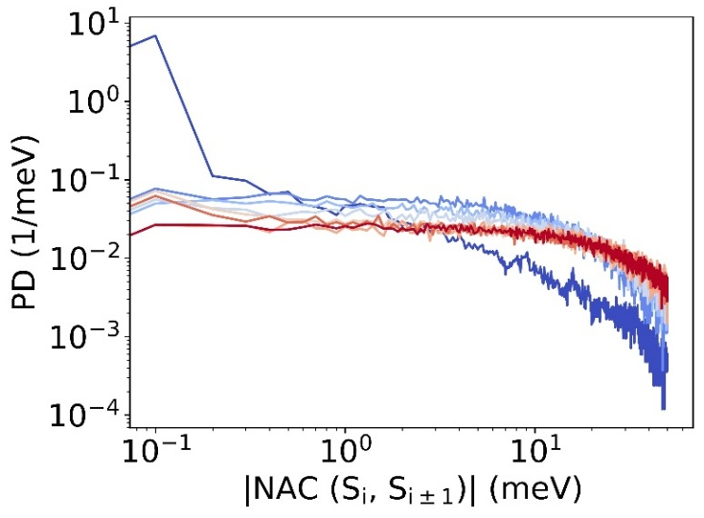
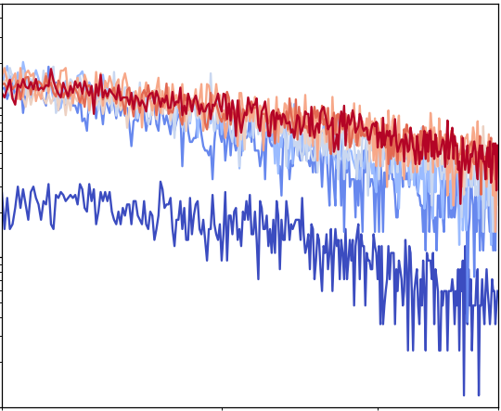
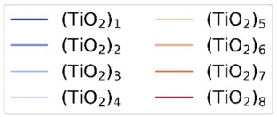
2026
Microscopic origin of the size-dependent lifetimes (I)
Relaxation: motion within excited-state manifold.
Denser manifolds and adjacent-state NACs promote population transfer and spreading in larger systems
JACS 2025, 147(44), 40900-40909

Slide 9
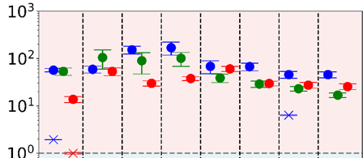

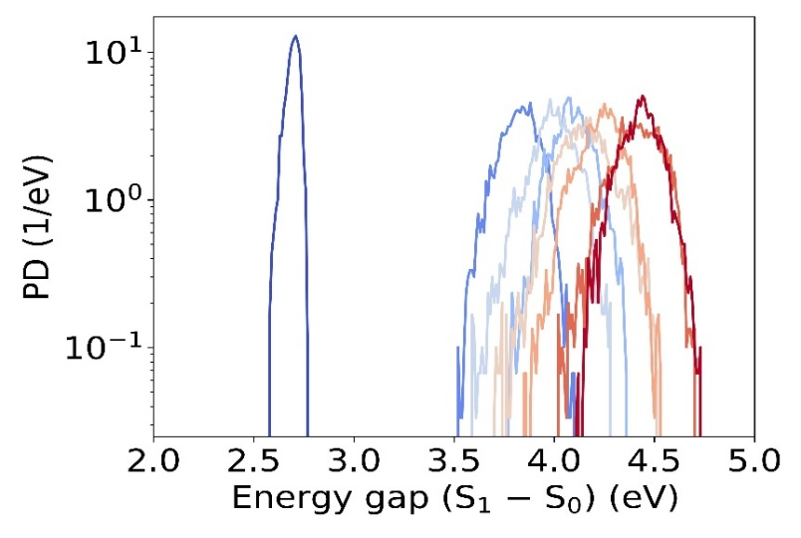
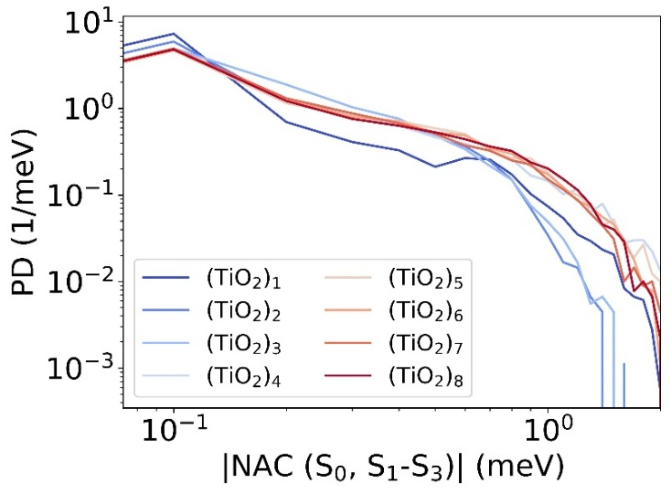
2026
Microscopic origin of the size-dependent lifetimes (II)
Recombination: coupling back to S₀.
Larger gaps slow recombination; larger S₀/S₁ NACs accelerate it.
JACS 2025, 147(44), 40900-40909

Slide 10
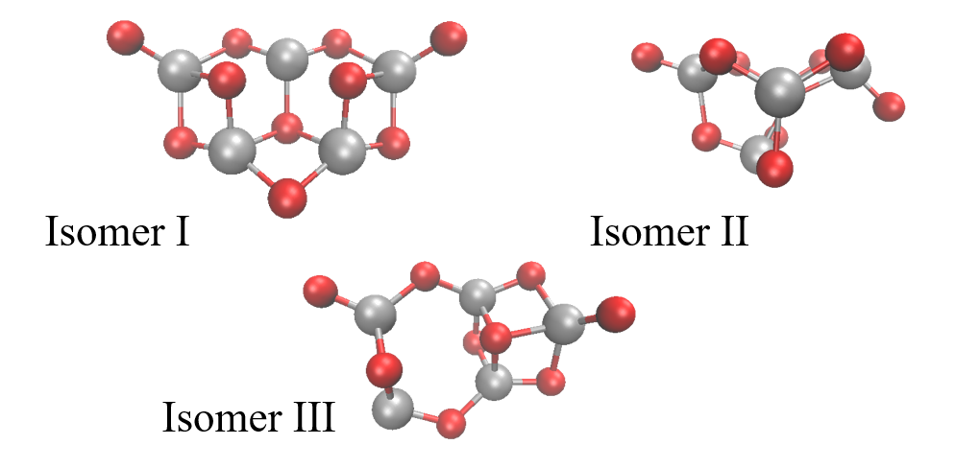
2026
Beyond size: which geometries define the landscape?
Nanoclusters are not always single static structures!
At finite temperature: shallow PESs can sample multiple motifs.
(TiO₂)₅ NC
Isomer I (0.00 eV) Isomer II (+0.02 eV) Isomer III (+0.08 eV)
Can thermally activated structural motion reshape excitation energies, NACs, and excited-state decay pathways?

Slide 11
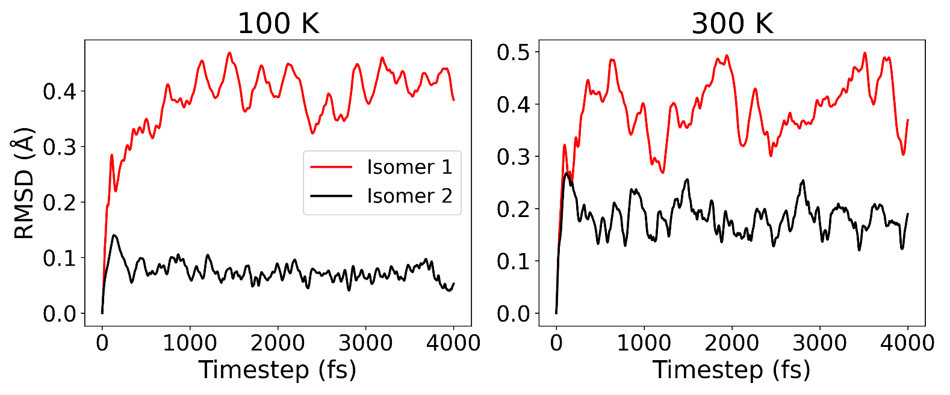
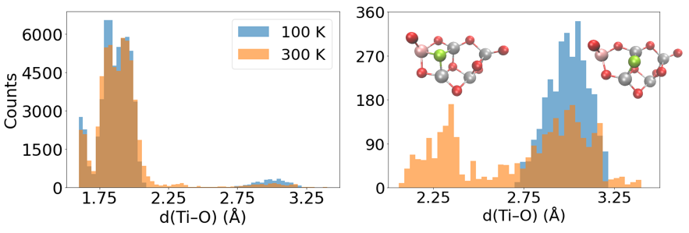
2026
Thermally activated local fluxionality
Isomer I samples a broader configurational space than rigid isomer II.
Not a random global distortion! One Ti_{flux}–O_{flux} pair switches between coordinated and detached regimes
JPCL 2026

Slide 12
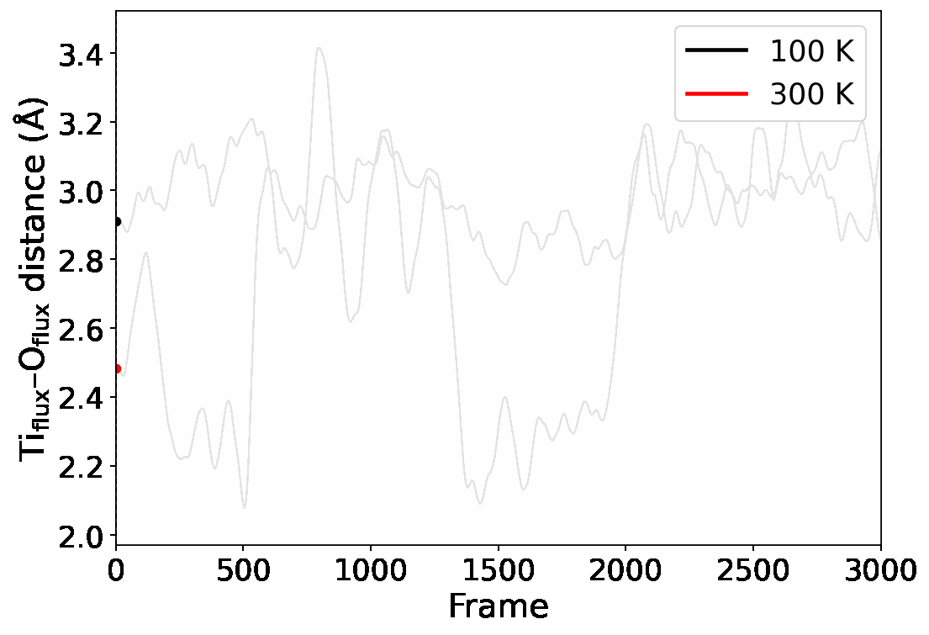
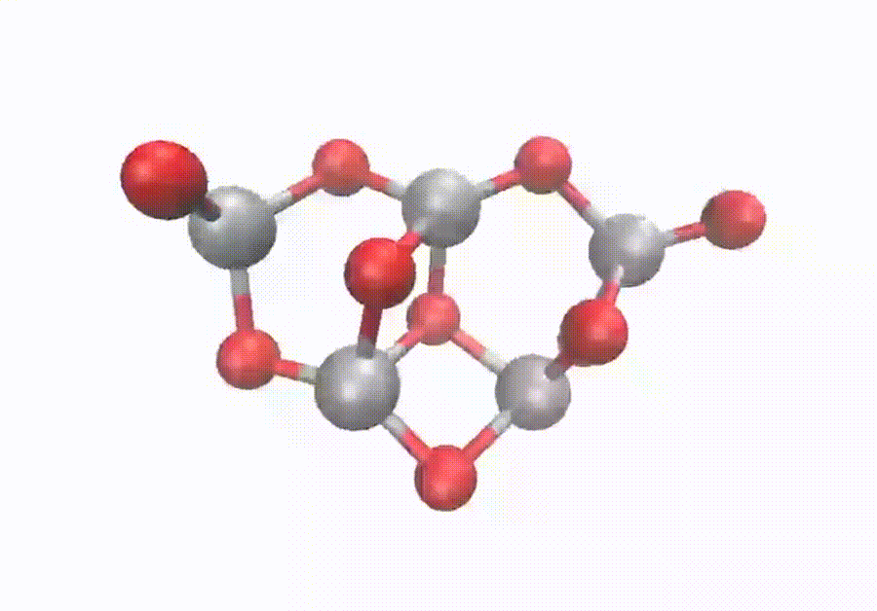
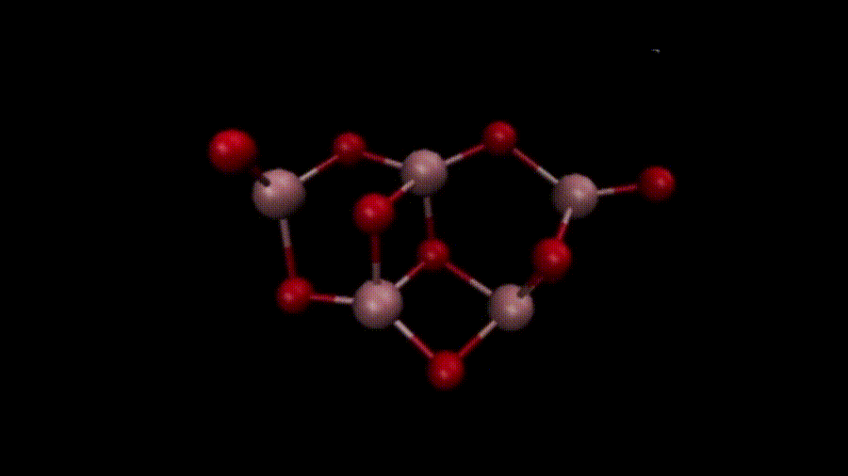
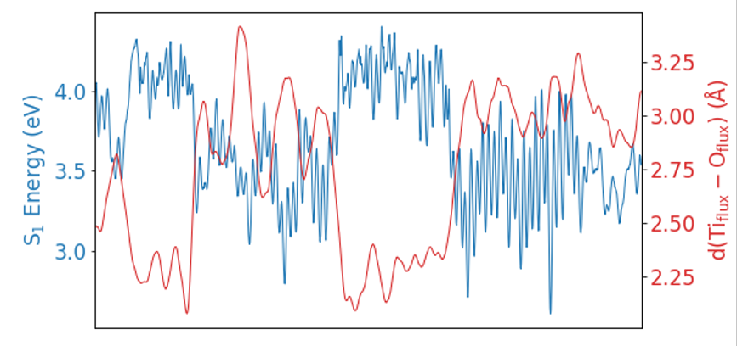

2026
Ti_{flux}
Part of a real collective motion:
O_{flux}
Strachan-v
Fluxionality reshapes the low-energy excited-state landscape
Anti-correlation: elongation of Ti_{flux}–O_{flux} lowers the S₁ excitation energy
JPCL 2026

Slide 13
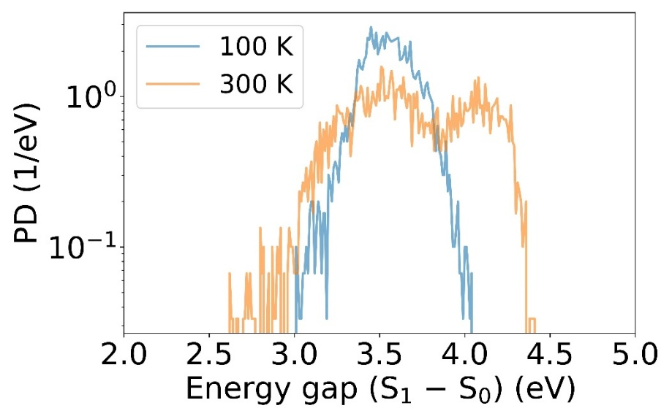
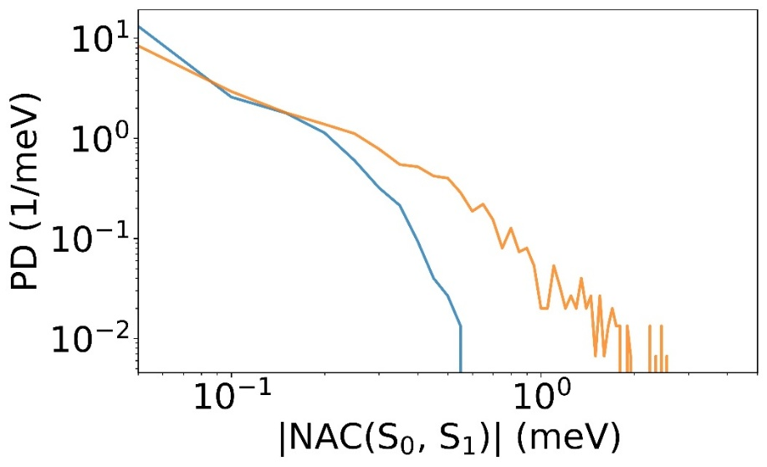
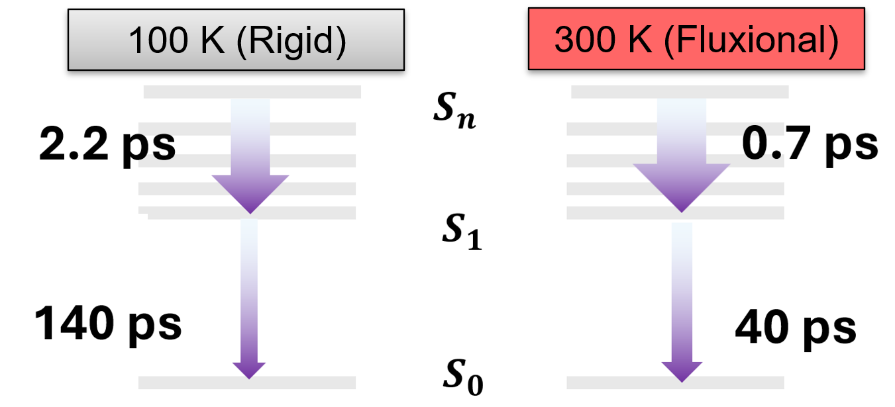
2026
Bimodal S₁–S₀ gap distribution and a stronger high-NAC tail at 300 K
Relaxation to S₁ is faster at 300 K because the bright state lies closer to the S₁ destination
S₁ → S₀ recombination accelerated because 300 K samples stronger-coupling geometries
JPCL 2026

Slide 14
2026
Take-home message:
Size defines the electronic landscape; nuclear motion determines how it is sampled. Together, they control excited-state lifetimes.
Size effect: DOS · gaps · state mixing · NACs → non-trivial relaxation/recombination trends
Fluxionality effect: finite-temperature Ti–O motion → altered excitation energies and faster decay pathways
TiO₂ nanoclusters provide atomically precise platforms to resolve these effects.

Slide 15











2026
Acknowledgments
Alexey V. Akimov
Stefan T. Bromley
Ángel Morales García
Francesc Illas
Scott Sayres
PRE2019-087627
PID2020-115293RJ-I00
PID2021-126076NB-I00
PID2021-127957NB-100
TED2021- 129506B-C22
TED2021-132550B-C22
CEX2021-001202-M
GRANT NSF-2045204
2021-SGR-00079
2021-SGR-00354

