Slide 1

Many Body Quantum Dynamics
of Exciton-Polaritons
Pritha Ghosh
Mandal Group, Department of Chemistry
Ghosh, Manjalingal, Wickramasinghe, Rahmanian, Mandal, Phys. Rev. B. (2025)
Editors’ Suggestion

Slide 2
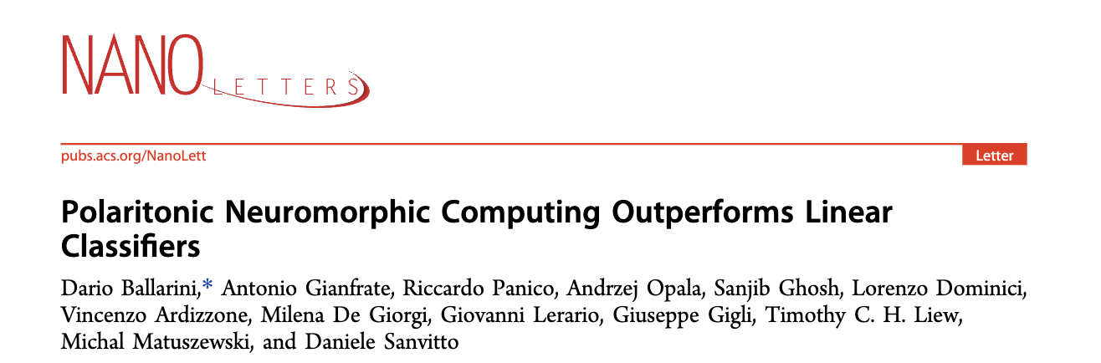
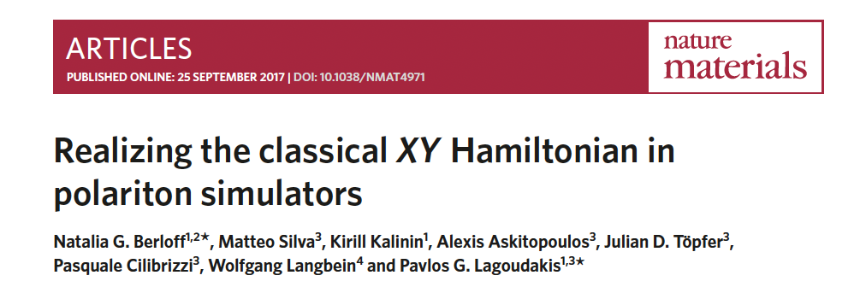

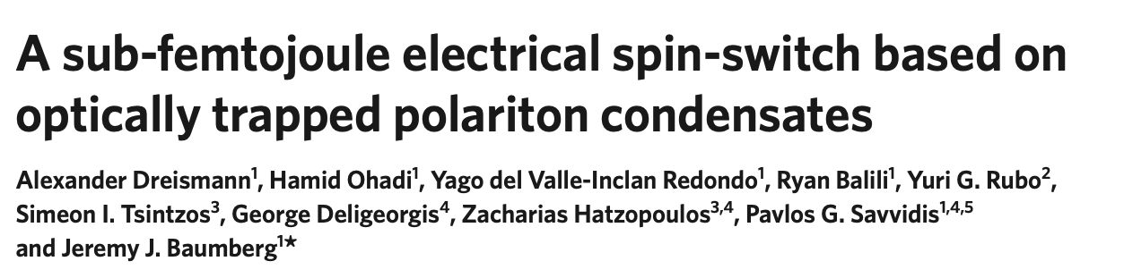
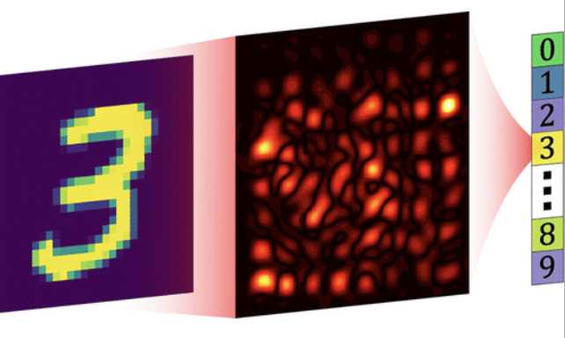
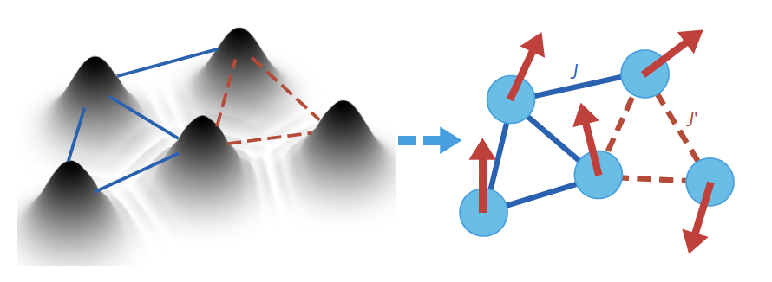
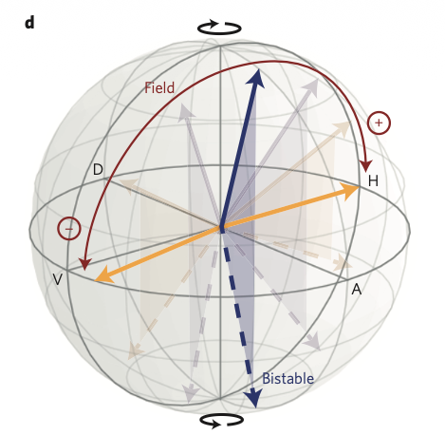
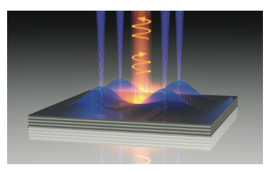
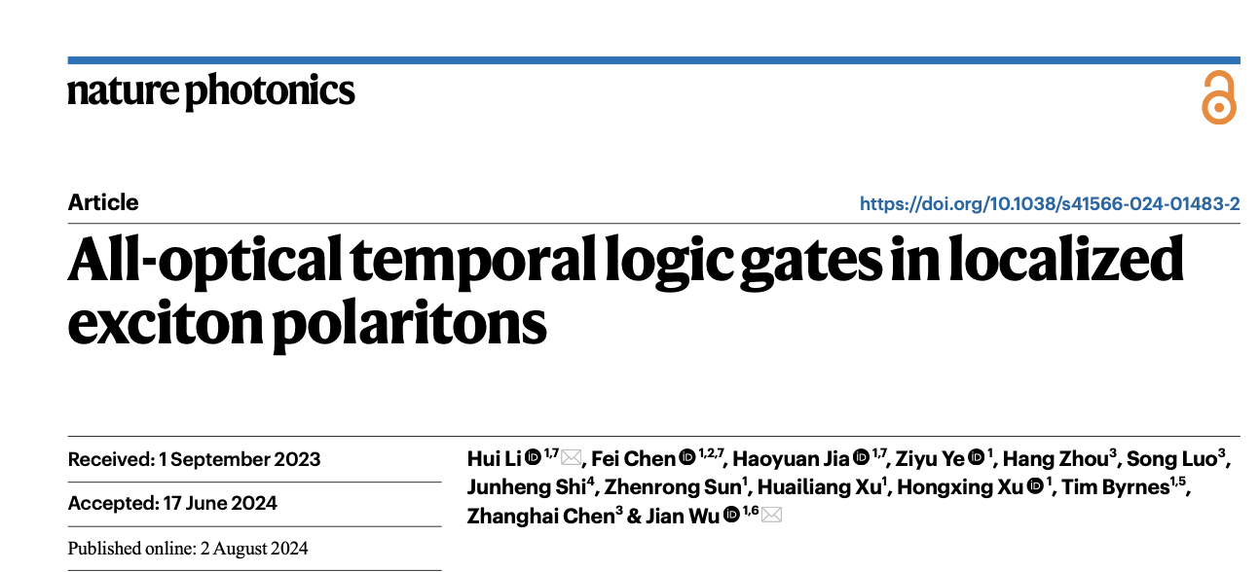
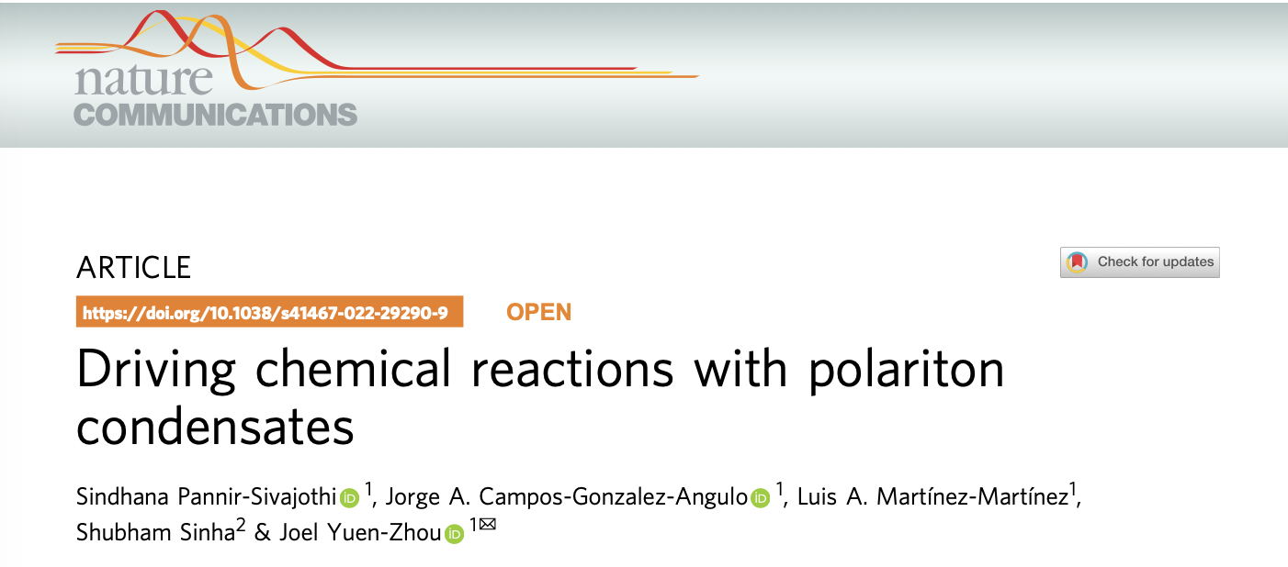
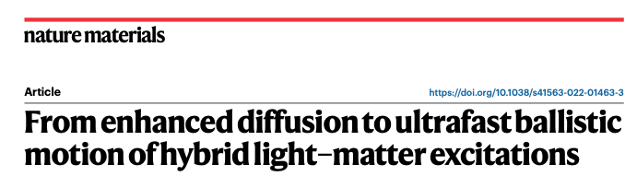
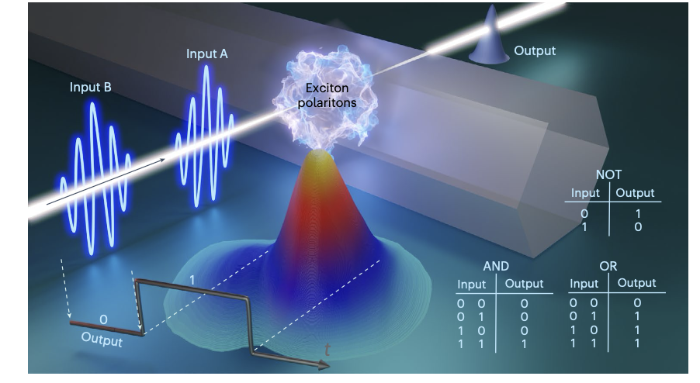
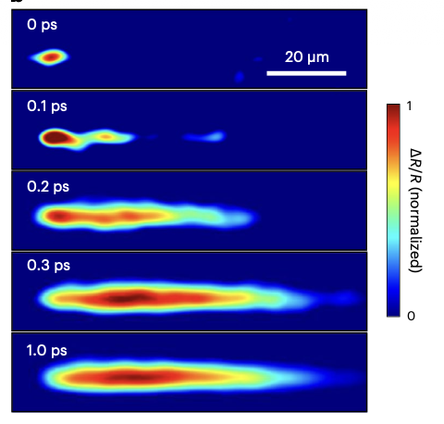
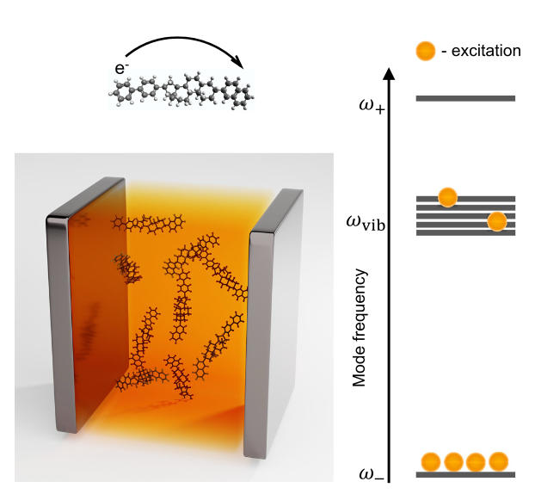
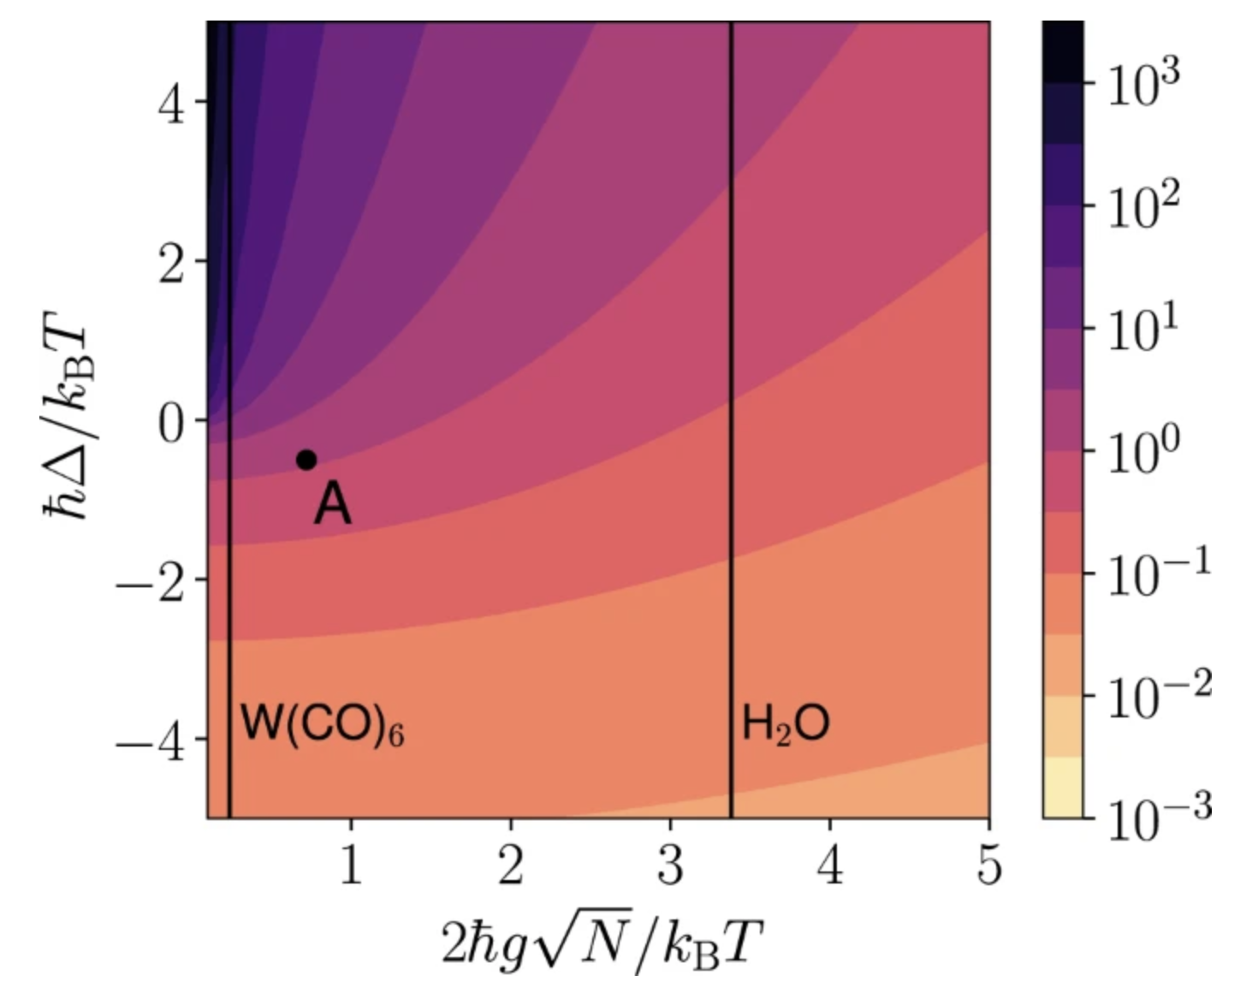
Motivation
Polaritons Exhibit Room-temperature Quantum Coherence!
Diverse Applications!
Efficient Neuromorphic Computing
Platform for Analogue Quantum Computing
Room-temperature Bose-Einstein Condensate.
Room temperature Coherent Propagation of Excitons.
Exciton-polariton Based Logic Gates
Exotic Chemistry in Cavities

Slide 3
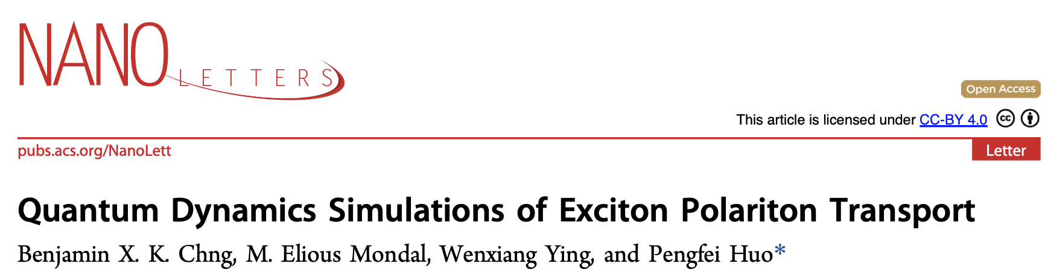
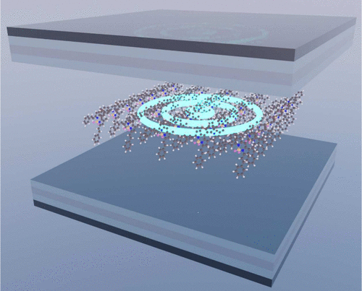
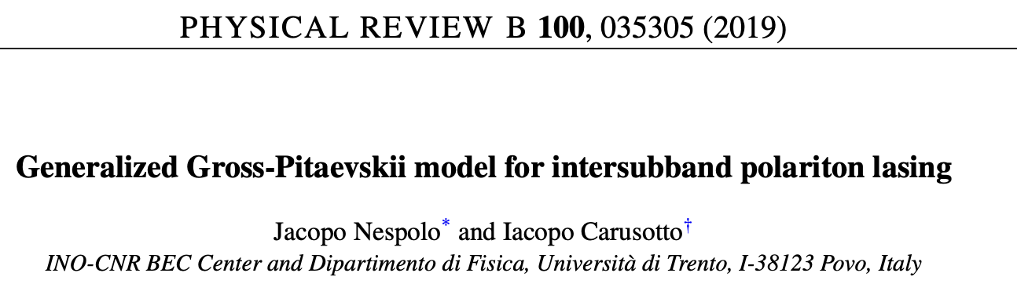
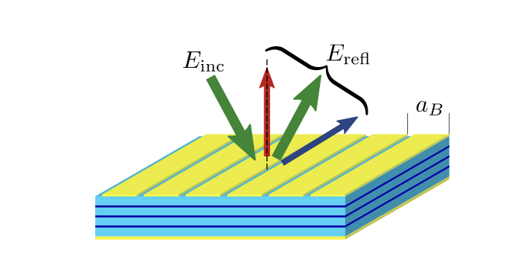
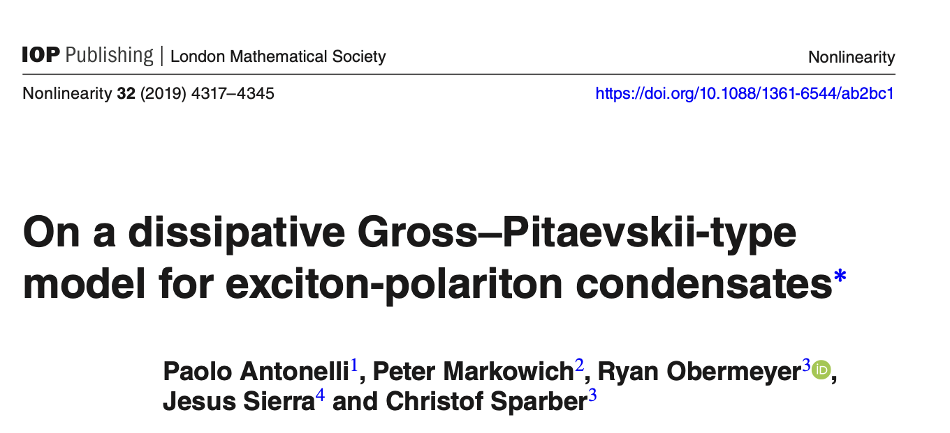
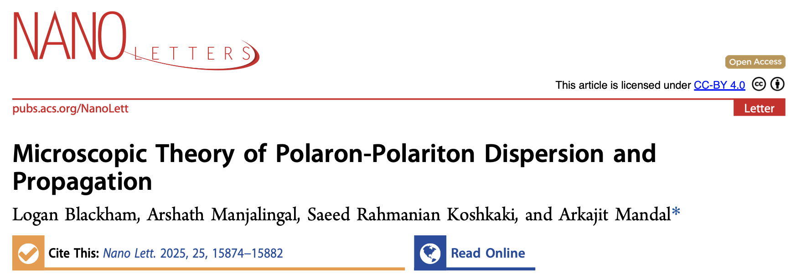

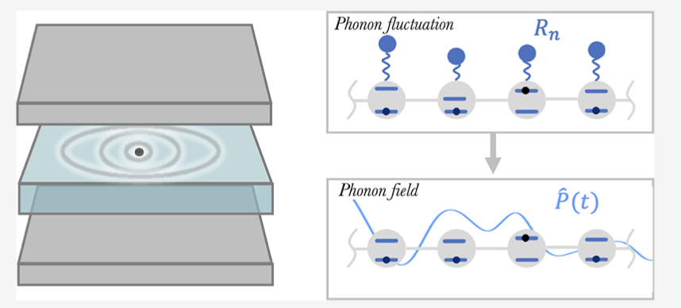
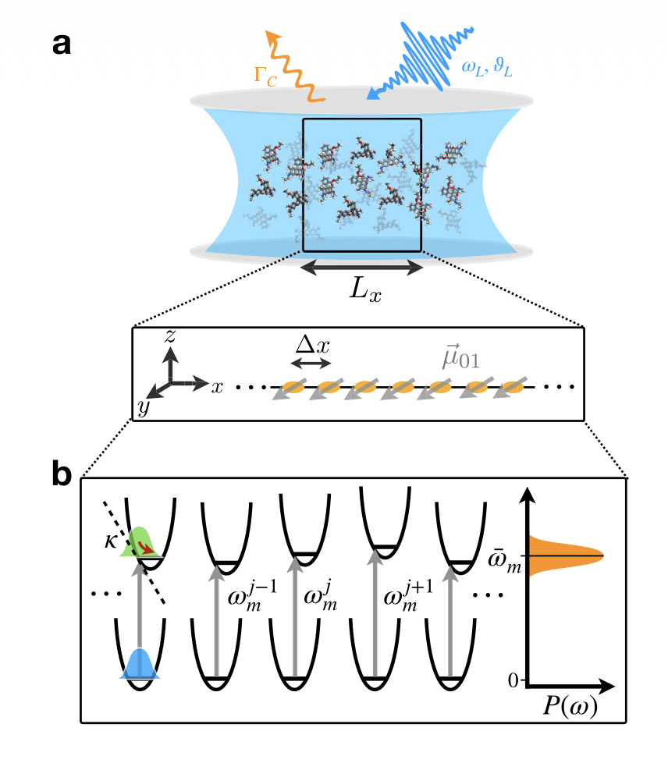
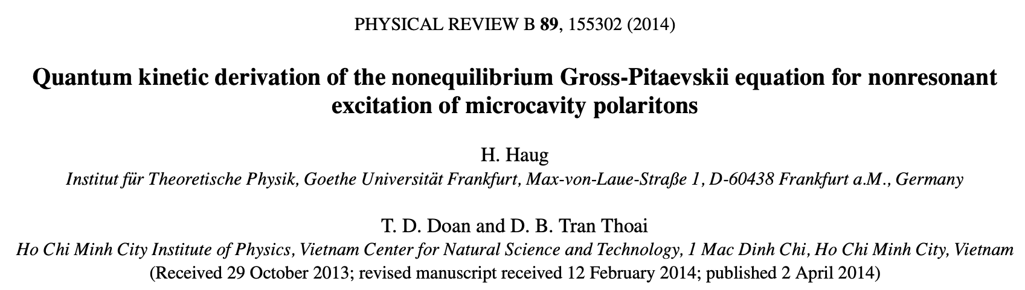
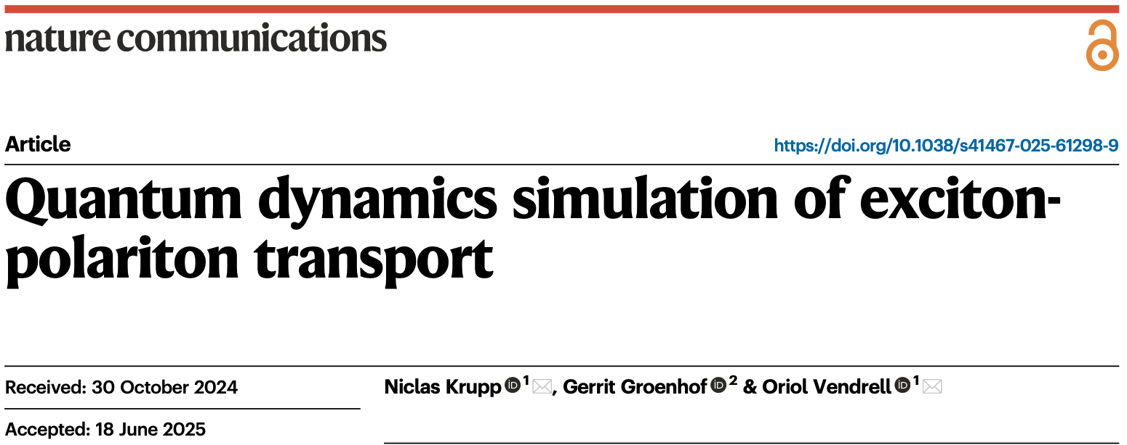
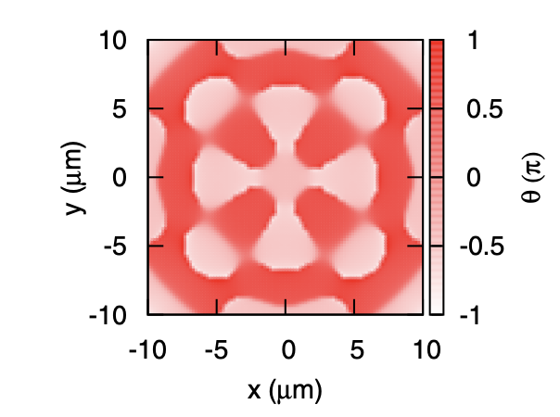
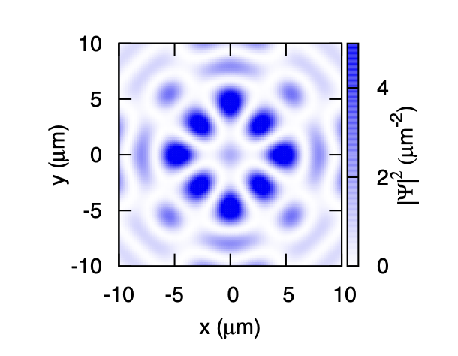
Theoretical Challenges
Holstein Tavis-Cummings
Gross-Pitaevskii
Explicit Phonon Interaction
Many body interactions
Simulating polaritons at room temperature → Mesoscale systems + many-body interactions + coupling to phonons
Notes:
Some qualitative idea of GP and HTC

Slide 4
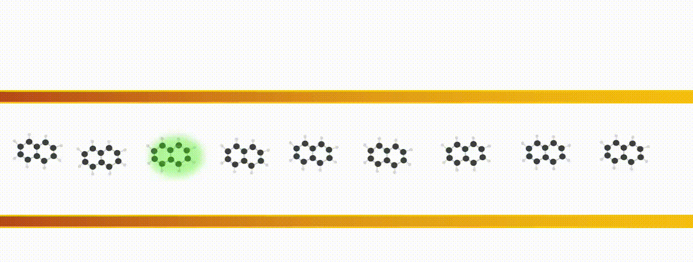



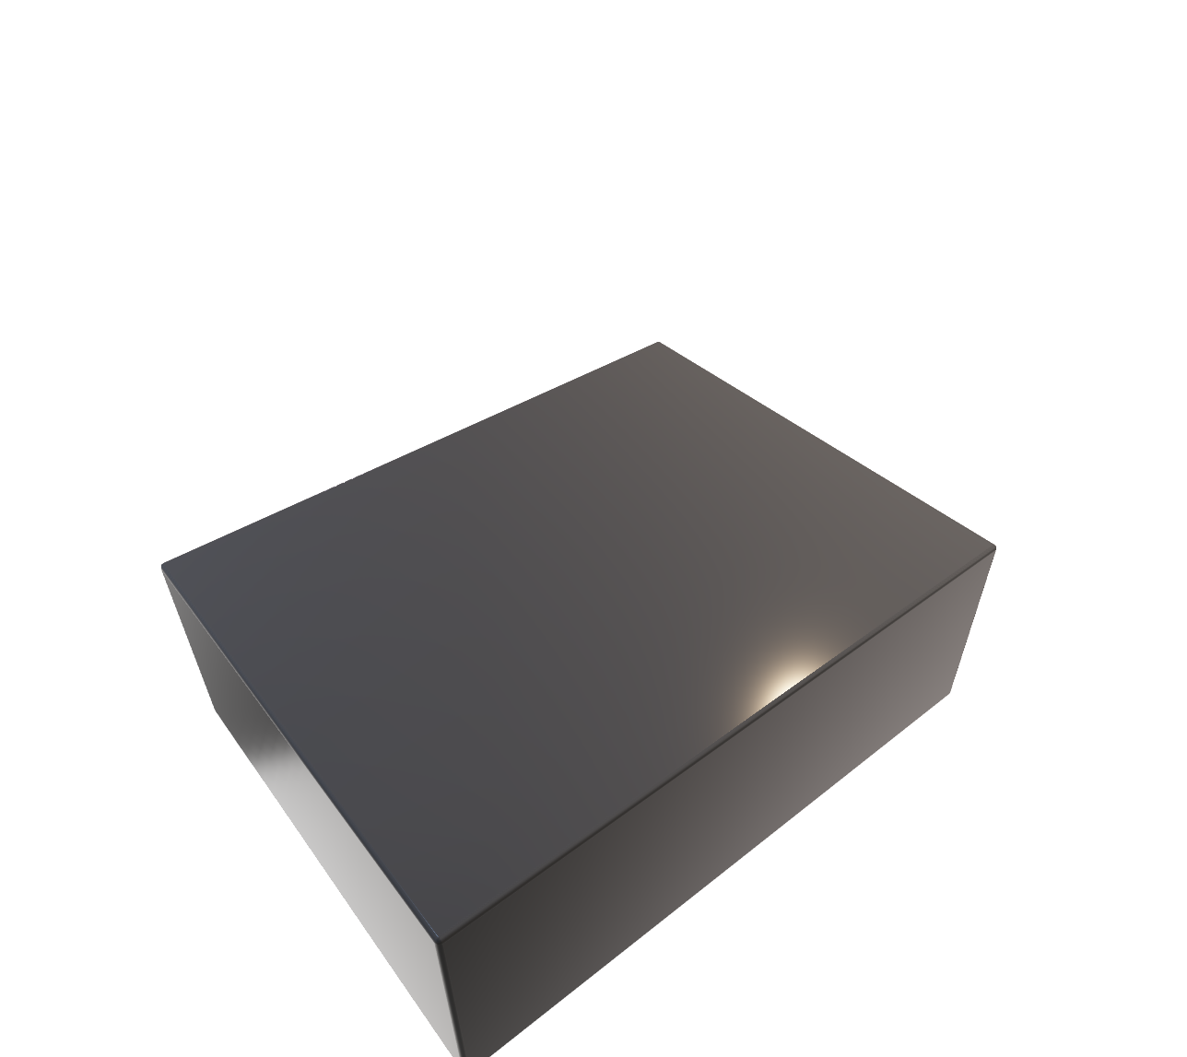



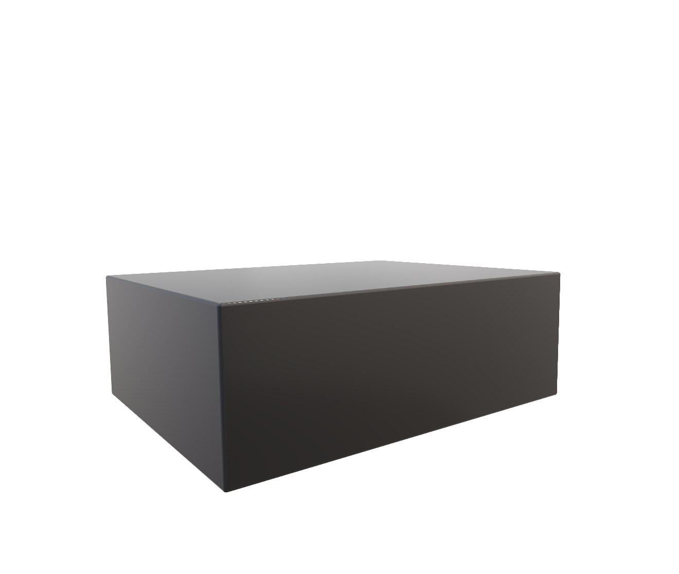






Exciton-polaritons
Quantized cavity radiation mode
mirror
+
exciton-polariton
laser
cavity radiation
material
In a bare material, exciton shows (incoherent) diffusive transport.
In a cavity, exciton-polaritons show (coherent) ballistic transport.

Slide 5
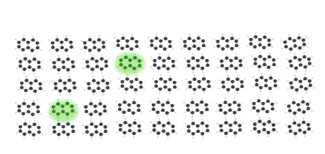
INCOMPATIBLE with experiments!
N_{ex}=1
Single excited subspace
For Nex>>1, many-body interactions have to be included → dynamics become complicated!

Slide 6
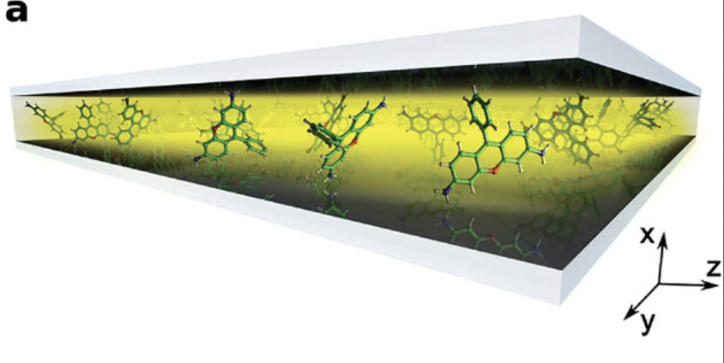
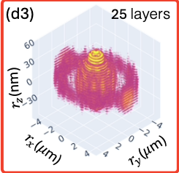
Mixed quantum classical simulation
R. H.Tichauer, I.Sokolovskii, G.Groenhof,. Adv. Sci. 2023
|e⟩
~500 molecules
|g⟩
Multitrajectory Ehrenfest
Chng, Nano Lett. 2025
~10⁴ molecules
Fewest Switches Surface Hopping
Koshkaki, arXiv:2502.12933v2
>10⁶ molecules
Path Integral Based Approach
Huge numbers of classical degrees of freedom
Computationally intractable!

Slide 7
A novel approach
Multitrajectory mean field Ehrenfest for the phonons (quasi–classical)
+
Mean field Gross-Pitaevskii for the exciton-polaritons (quantum)
Interacting polaritons
Decoherence through scattering
LP band

Slide 8
Light-Matter Hamiltonian

Slide 9
Light-Matter Hamiltonian
Material
Excitation (quantum)

Slide 10
Light-Matter Hamiltonian
Cavity
Photons (quantum)

Slide 11
Light-Matter Hamiltonian
Light Matter Interactions

Slide 12
Light-Matter Hamiltonian
Phonon interactions
(quasi-classical)

Slide 13
Light-Matter Hamiltonian
Exciton-Exciton interactions (on-site)

Slide 14
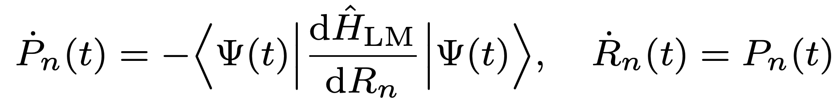
Choice of Ansatz
m=n → on-site energy (𝜖₀ )
m ≠ n → hopping (𝜏 )
On- site many body interactions
Mixed Quantum Classical Dynamics
Mean-field Ansatz
Intractable

Slide 15
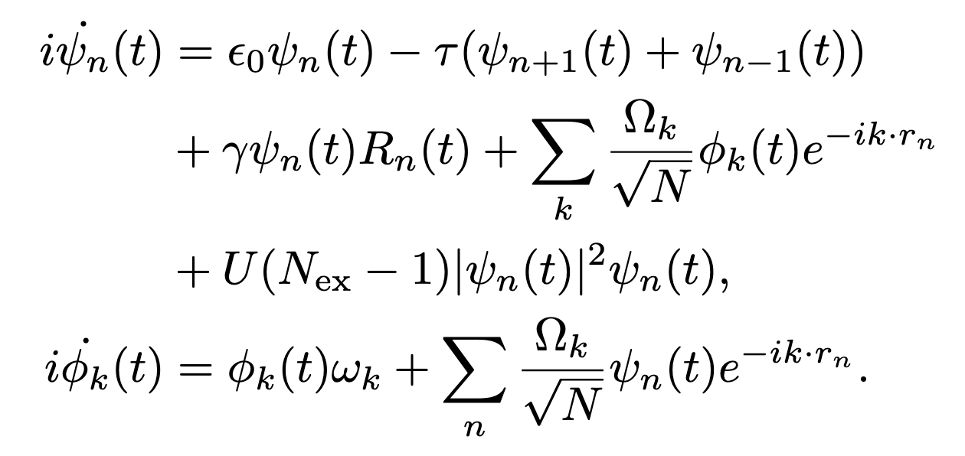
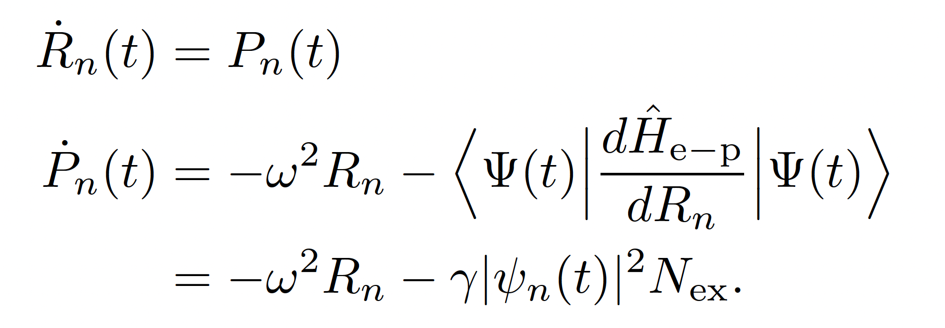
EOM
Finally, using the Dirac-Frenkel Variational Principle,
EOM of the exciton-photon quantum subsystem
EOM of the phonons

Slide 16
Results
Quantum Dynamics of Bare Excitons
Quantum Dynamics of Exciton-polaritons
(Non-interacting case)
Mean Square Displacement
Dynamic Disorder Induced Scattering
Initial state

Slide 17
Results
Quantum Dynamics of Interacting Exciton-Polaritons
Interaction Strength Dependent Non-linearity
Many-body interactions can combat phonon induced decoherence.

Slide 18

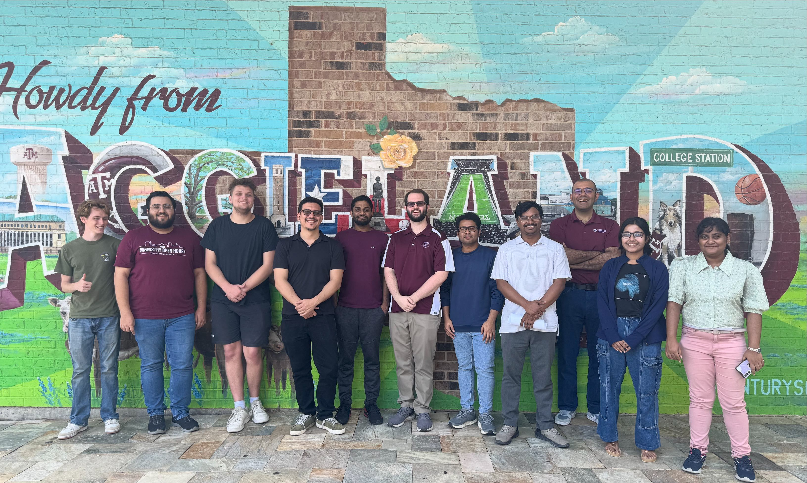
Thank you

