Slide 1

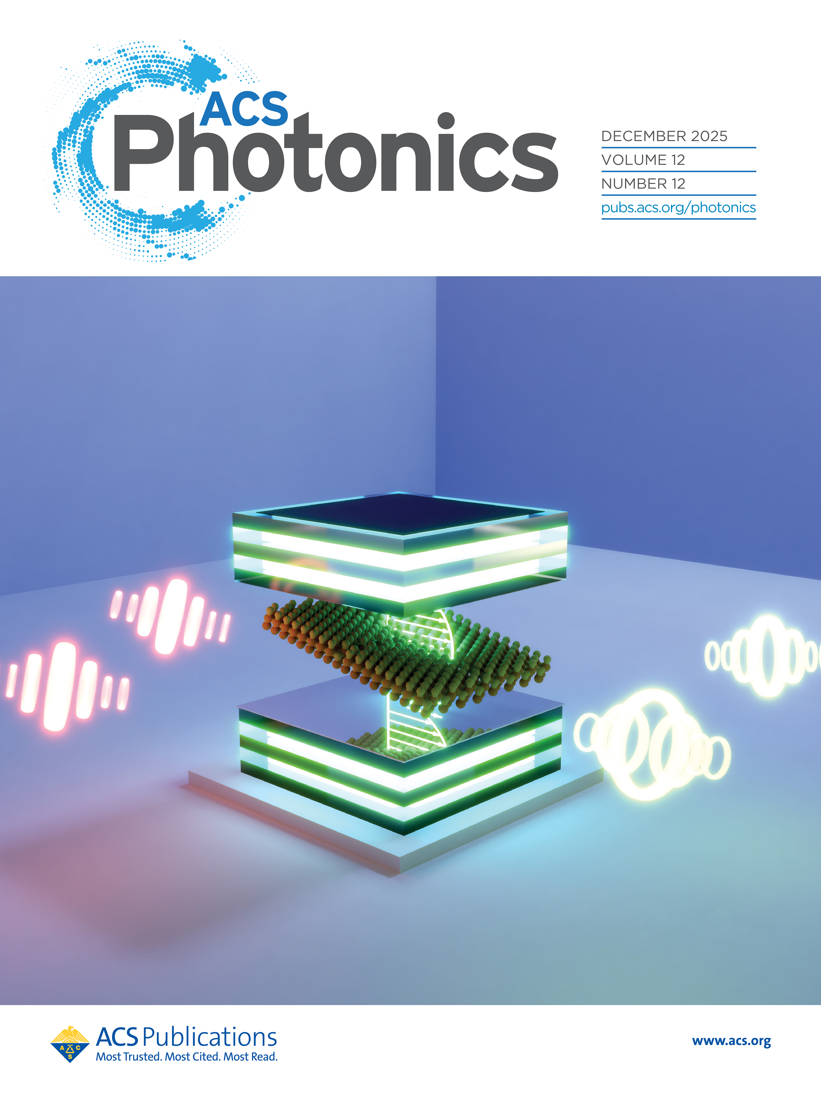
Tuning Quantum Dynamics
of
Materials Between two Mirrors
Arshath Manjalingal, Mandal Group, Texas A&M
Manjalingal$^{†}$, Rahmanian$^{†}$, Blackham, Mandal, ACS Photonics (2025)
Blackham$^{†}$, Manjalingal$^{†}$, Rahmanian, Mandal, Nano Letters (2025)
Ghosh, Manjalingal, Wickramasinghe, Rahmanian, Mandal, Physical Review B (2025)
Haines $^{†}$, Manjalingal$^{†}$, Blackham, Rahmanian, Mandal, arXiv (2026)
Rahmanian, Manjalingal, Blackham, Mandal, arXiv (2025)
$^{†}$equal contribution
Notes:
Hi everyone, my name is Arshath. I’m a second-year PhD student at Texas A&M University working in the Mandal group. Our lab mainly focuses on developing and employing different quantum dynamical methods to study various phenonmenons which includes light–matter interactions. In this talk, I’ll discuss how we can tune the quantum dynamics of materials inside an optical cavity

Slide 2
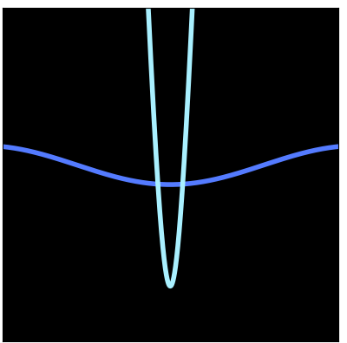
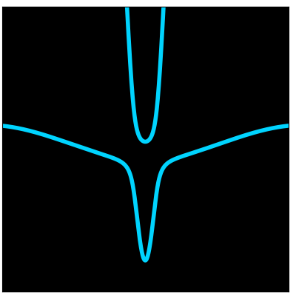
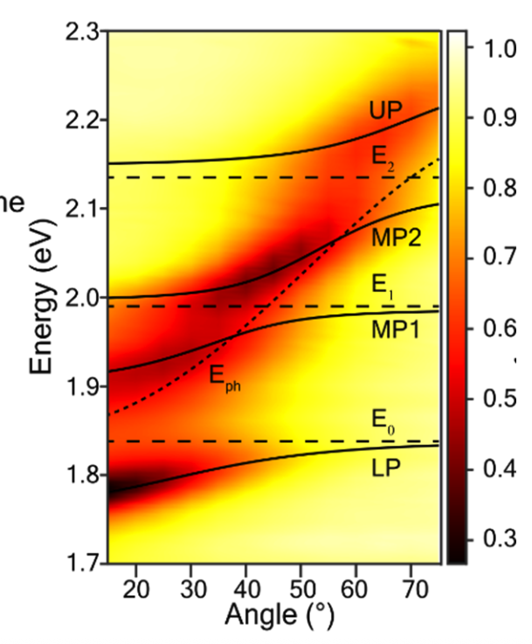
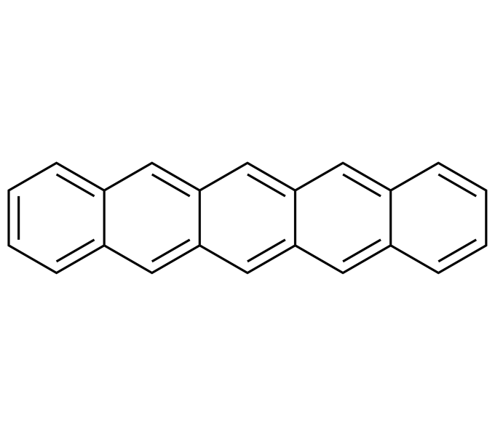

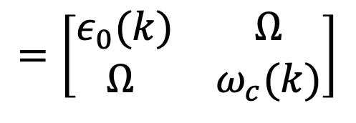




Polaron-Polariton Dispersion
$Ω=$ 0
$Ω≠$ 0
UP
$$=\left[\begin{matrix}ε_{0}(k) & Ω \\ Ω & ω_{c}(k)\end{matrix}\right]$$
Energy
$$ω_{c}(k)$$
$$ε_{0}(k)$$
LP
Our Analytical Theory
k
k
Alam,… , Frontiera, arXiv. (2025)
Blackham$^{†}$, Manjalingal$^{†}$, Rahmanian, Mandal, Nano Letters (2025)
Notes:
Before getting to the main results, I’d like to briefly set the background by highlighting some of the key works that motivated this study. Here, we start with a single-layer excitonic material placed inside an optical cavity, where strong light–matter coupling leads to the formation of exciton–polaritons. This physics can be captured using a simple two-level Hamiltonian, as shown here. We can observe this in the angle-resolved spectra, where $ε\left(k\right)$represents the excitonic band and $ω_{c}\left(k\right)$represents the photonic band. When these two modes couple through the light–matter coupling constant $Ω$, we can clearly see the formation of hybridized upper and lower polariton bands, as shown here.
However, in actual experiments, when the cavity is filled with materials—for example, organic crystals such as pentacene or hexacene—we cannot ignore the effect of molecular vibrations. As a result, we observe additional splittings in the upper and lower polaritonic band structure. Here, I’m showing Shahzad’s work from Renée’s group on pentacene crystals inside an optical cavity, where we can clearly see the emergence of these middle polariton bands.
In my first work, together with Logan Blackham, we derived an analytical expression for this polaron–polariton dispersion effect using a Floquet formalism, and the effective analytical Hamiltonian is shown here. Logan already gave a beautiful talk on this topic a few weeks back. Here, we can clearly see that our analytical theory matches extremely well with the band structure obtained from simulations using the quantum dynamical methods Here we implemented mean-field Ehrenfest approach (MFER).

Slide 3
Single vs Multilayer Materials in Cavities
Rahmanian, Manjalingal, Blackham, Mandal, arXiv (2025)
Notes:
with the single-layer picture the poloron polariton dispersion can be captured exactly, but actual experiments use filled cavities, which have multiple layers, as shown in the figure. Here, in the multilayer case, we can clearly see that there exist dark bands which do not couple to light, and for sure this will lead to differences in the coherence and transport properties.
In my work, along with Saeed and Logan, we found that these multilayer materials result in a phonon fluctuation synchronization effect.

Slide 4
Single vs Multilayer Materials in Cavities
Phonon Fluctuation Synchronization Effect
Bright layer
Rahmanian, Manjalingal, Blackham, Mandal, arXiv (2025)
Notes:
Here, we can see that when we have a multilayer picture, the phonons from all the layers get averaged, and that is what is felt by the bright layer which couples to light.

Slide 5
Single Layer Vs Multi-Layer with 3D Cavity-Material Architecture
Notes:
**“As a result of this averaging effect, the transport properties are different in single- and multilayer materials. So her we are creating an excitation in the single layer material and studing how that propagates along time and now lets see what happens if we stack multiple layers.
we can clearly see that the excitation created in a multilayer system propagates faster than in the single-layer material. This is a result of increased coherence in multilayer materials due to the phonon fluctuation synchronization effect. These are the same figure from different view in 3D space.
So, our study reveals that we can decrease decoherence in a material inside an optical cavity by stacking layers or increasing the thickness along the quantization direction.

Slide 6
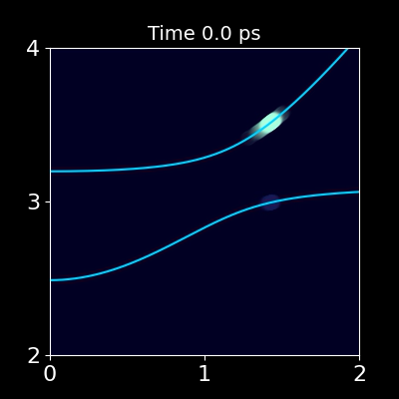
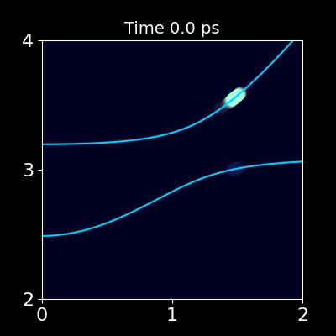


Mechanistic Principles of Exciton–Polariton Relaxation
Energy
Energy (eV)
$k({×10}^{−3})$ a.u.
Energy
Energy (eV)
$k({×10}^{−3})$ a.u.
Notes:
This also has an influence on the relaxation pathway, where we create an excitation in the upper polariton and observe the relaxation process. We can see here that the relaxation follows two steps: first, a momentum-conserving direct transition, where the relaxation is $k→k$and is perpendicular. After that, in the single-layer case, we can see the excitation spreading to other states with different momentum vectors. This is due to phonon-mediated Fröhlich scattering.
In the multilayer material, as I explained earlier, there is this averaging effect, and as a result of the phonon fluctuation synchronization effect, the Fröhlich scattering is reduced. So effectively, the multilayer material is ideally suited for QIS-based devices, with increased coherence and a more momentum-conserving nature.

Slide 7





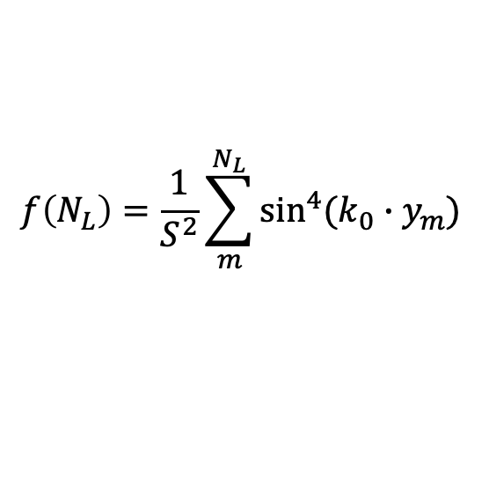

Mechanistic Principles of Exciton–Polariton Relaxation
UP $→$LP
$$Dark →LP$$
UP $→Dark$
$$K_{UL}\left(N_{L}\right) ∝ f(N_{L})$$
$$K_{UD}\left(N_{L}\right) ∝(N_{L} −1)f(N_{L})$$
$$K_{DL}\left(N_{L}\right) ∝f(N_{L})$$
$$f\left(N_{L}\right)=\frac{1}{S^{2}}\sum_{m}^{N_{L}}{\sin^{4}(k_{0}∙y_{m}) }$$
Haines $^{†}$, Manjalingal $^{†}$, Blackham, Rahmanian, Mandal, arXiv (2026)
Notes:
We can also compute the rates corresponding to these relaxation pathways, as shown here, where $K_{UL}$is the rate from the upper to the lower polariton. We obtain these rates by fitting the population dynamics using a rate equation. Similarly, we see that the relaxation from the upper polariton to the lower polariton decreases as the number of layers increases. This is evident from the fact that the availability of dark layers increases the population in dark states, thereby reducing the population in the lower polariton states.
The analytical expression that we developed also matches extremely well with the simulations, and the equations are given below.

Slide 8
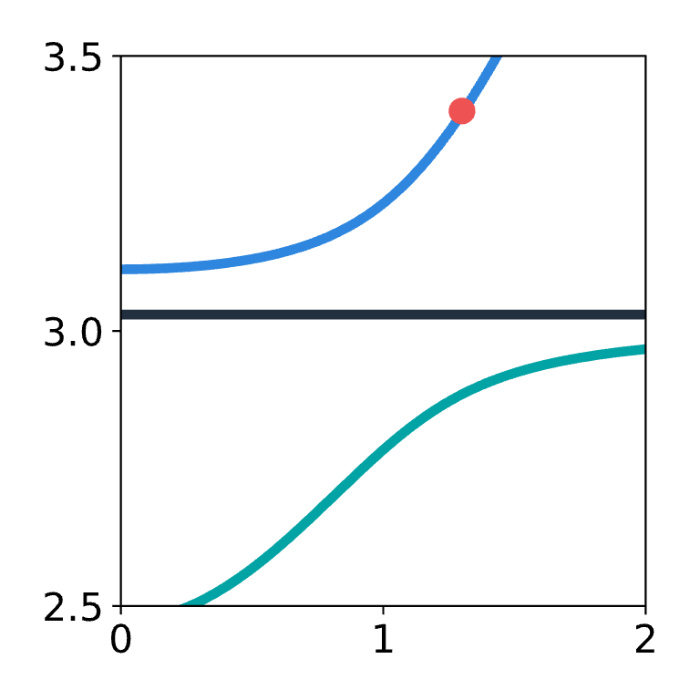
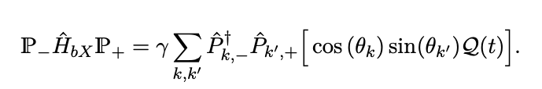
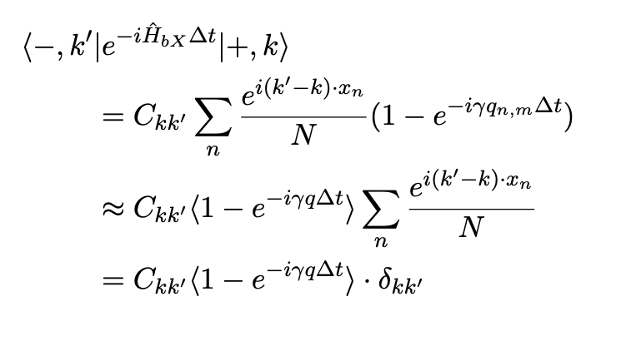


Direct Transition from Upper to Lower Polariton
Upper
Polariton
$$|+,k⟩$$
Energy (eV)
Lower
Polariton
$$|−,k′⟩$$
Exciton-Phonon coupling
k
Using separation of length-scales
Notes:
**“But why a direct transition? In principle, the excitation could have populated any other sites in the lower polariton. If we check the expression for the coefficients corresponding to the lower polariton population, we can see that all sites have a proportionality to be occupied. However, in the animation, we clearly saw that this is not the case. Why?
To understand this, we look at the expectation value of the time evolution of the Exciton-phonon coupling component of the Hamiltonian. Using a separation of length scales, we can separate the Fastly fluctuating phonon contribution with the slowly moving spatial variation of the wave vector. you are effectively taking the discrete Fourier transform of a plane wave over the lattice. If $k≠k^{′}$, the phase $e^{i\left(k^{′}−k\right)x_{n}}$oscillates rapidly as $n$runs over sites, and all those contributions cancel out by destructive interference. Only when $k=k^{′}$do all the phases add constructively, giving a nonzero value. From this, we can see that the transition is momentum conserving. Here, for the transition matrix, we are plotting the expectation value of time evolution of exciton-phonon coupling component of the Hamiltonian for k’ site in the lower polariton and k th site in the upper polariton, we can clearly see that it is diagonal. Which means the transition is direct.

Slide 9
Moiré Pattern
Graphene Bilayer
Notes:
Now, we want to study what happens if we change the cavity–material architecture itself.
Before that, I’d like to briefly introduce the moiré effect. For example, here we have a graphene bilayer with a certain periodicity, and if we twist one layer by an angle $θ$, a new, larger periodicity emerges, as shown here. This is what we call a moiré pattern.

Slide 10
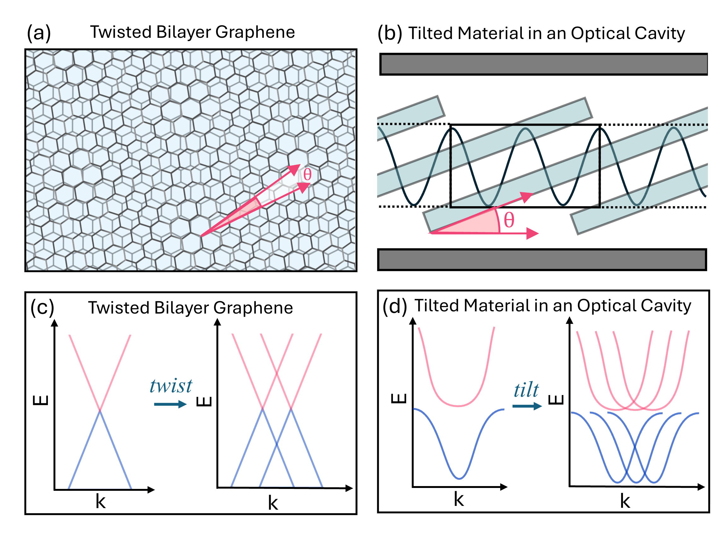
Twisted Bilayer
Band structure modification
Notes:
As a result of this new periodicity, when we plot the band structure, we can see two Dirac cones instead of one, compared to the untwisted case. This is what we call the moiré effect.

Slide 11
Notes:
We predict a similar effect when a material is placed inside an optical cavity and tilted along the cavity quantization direction, as shown here. This tilt leads to the emergence of additional bands, similar to moiré effect.

Slide 12
Light-Matter Moiré Effect
Single Layer Material
3 eV
3 eV
Manjalingal$^{†}$, Rahmanian$^{†}$, Blackham, Mandal, ACS Photonics (2025)
Notes:
Here, we plot the two-dimensional band structure for the material without any tilt. This axis corresponds to the momentum vector along the $x$direction, and this one is along the $y$direction. The two-dimensional absorption spectrum is plotted at an energy of 3 eV.
But when we tilt the material with respect to the cavity quantization axis, as illustrated here, we can clearly see additional bands emerging, similar to the moiré effect. This is what we call the light–matter moiré effect. Unlike the moiré effect in twisted bilayer systems, the LMME requires only a single-layer material.
In the two-dimensional absorption spectrum, we can clearly see additional circular bands overlapping. Another interesting feature is the emergence of flat bands, as seen here. Specifically, the appearance of flat bands implies a strong enhancement of the density of states near $k_{∥}→0$, which may facilitate the formation of polariton condensates at room temperature.
.

Slide 13

$$ΔK=\sin\left(θ\right)\frac{m_{z}}{{2L}_{z}}$$
Manjalingal$^{†}$, Rahmanian$^{†}$, Blackham, Mandal, ACS Photonics (2025)
Notes:
“where $θ$is the tilt angle, $m_{z}$is the cavity quantization index, and $L_{z}$is the distance between the mirrors., $Δk$is directly proportional to the tilt angle. This means we can use the tilt angle to finely tune the separation between the bands, as shown here for different tilt angles. However, this effect has not been observed in experiments so far—why?
In actual experiments, the cavity is typically filled with material, so instead of a single layer, we have multiple layers, as shown here. I performed simulations with multiple layers. For example, with five layers, we still see this effect, of course, but it gradually vanishes when we go to around forty layers, as shown here. The reason is that, as shown here, the effective light–matter coupling along the cavity quantization direction becomes nearly identical when the number of layers is large.

Slide 14
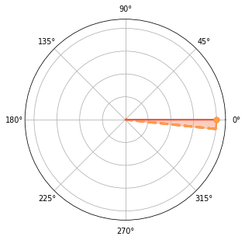
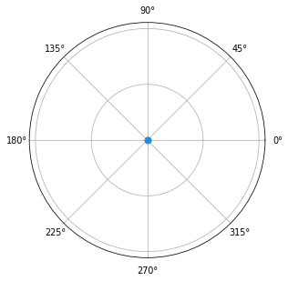


Coherent Frequency Conversion
$$\frac{1}{\sqrt{2}}\left(A_{k_{1}}^{†}+A_{k_{2}}^{†}\right)|0⟩$$
$$⟨0|\left(A_{k_{1+2Δk}}^{†}+A_{k_{2+2Δk}}^{†}\right)|ψ(t)⟩$$
Input
Output
Notes:
Another application of this effect is coherent frequency conversion, as shown here. We can create an initial entangled photonic state, as shown here, and then time-evolve the system. After some time, we observe an output either in the photonic mode with a $2Δk$separation, as shown here.
This is similar to an energy or frequency conversion process, and it could also be used for energy transduction, since the excitonic modes also become populated as a result of the light–matter coupling in reciprocal space. So this system could provide an ideal platform for future light–matter-based quantum devices

Slide 15
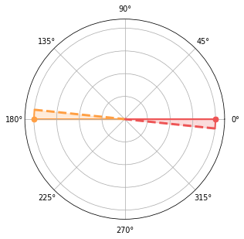
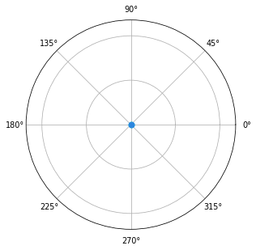
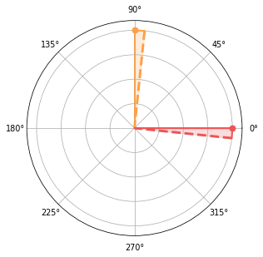
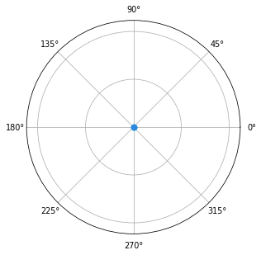
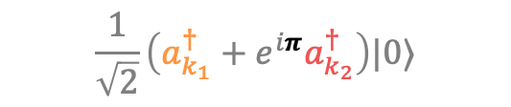
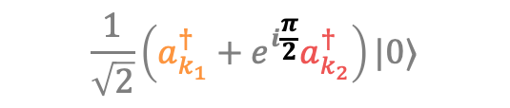
Coherent Frequency Conversion
$$\frac{1}{\sqrt{2}}\left(a_{k_{1}}^{†}+e^{iπ}a_{k_{2}}^{†}\right)|0⟩$$
Input
Output
$$\frac{1}{\sqrt{2}}\left(a_{k_{1}}^{†}+e^{i\frac{π}{2}}a_{k_{2}}^{†}\right)|0⟩$$
Input
Output
Notes:
Here, the initial state has a phase difference, and we can see that this phase difference is also preserved in the output, making it suitable for communication purposes as well.

Slide 16
Summary
Multilayer material-cavity configurations give rise to a phonon-fluctuation synchronization effect
This synchronization leads to enhanced quantum coherence, accompanied by more robust polaritonic transport properties.
The relaxation pathway from the upper to the lower polariton is strongly modified by the presence of dark layers, resulting in a two-step relaxation mechanism:
Step I: A momentum-conserving direct transition
Step II: Phonon-induced Fröhlich-type intraband scattering
When the material is tilted inside the cavity, a light-matter moiré effect emerges. However, increasing the material thickness causes this effect to fade away.
Finally, we derive simple analytical expressions that directly relate a material’s finite thickness to its relaxation dynamics and coherence properties.

Slide 17

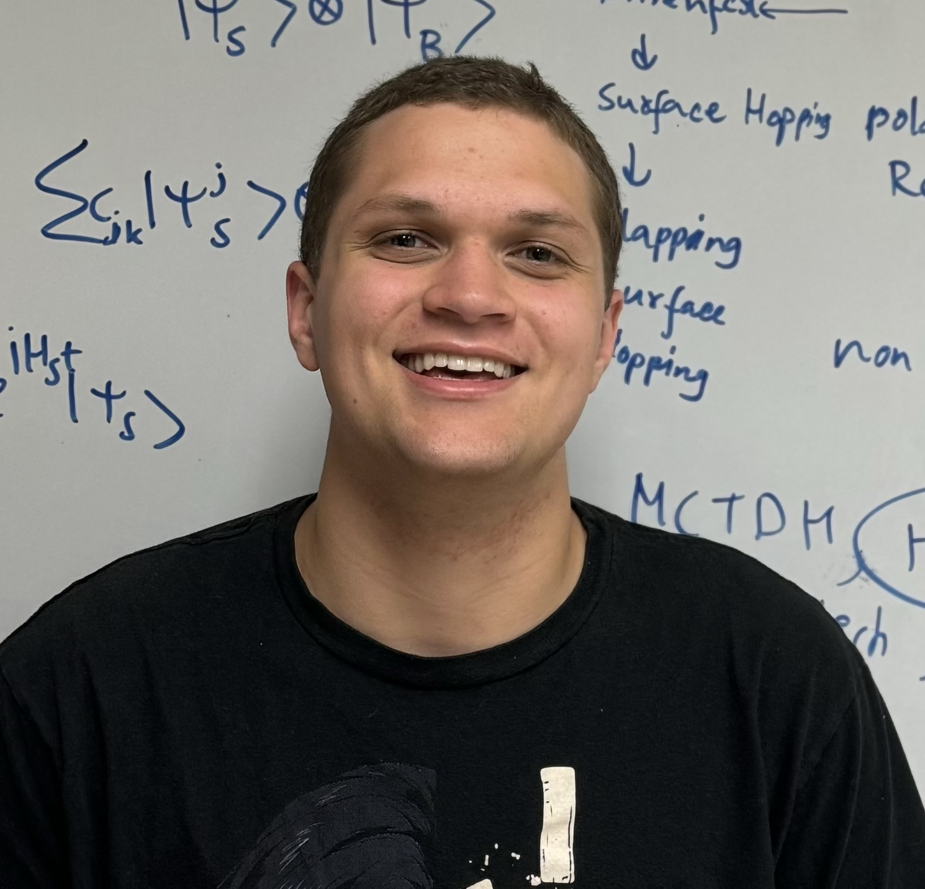
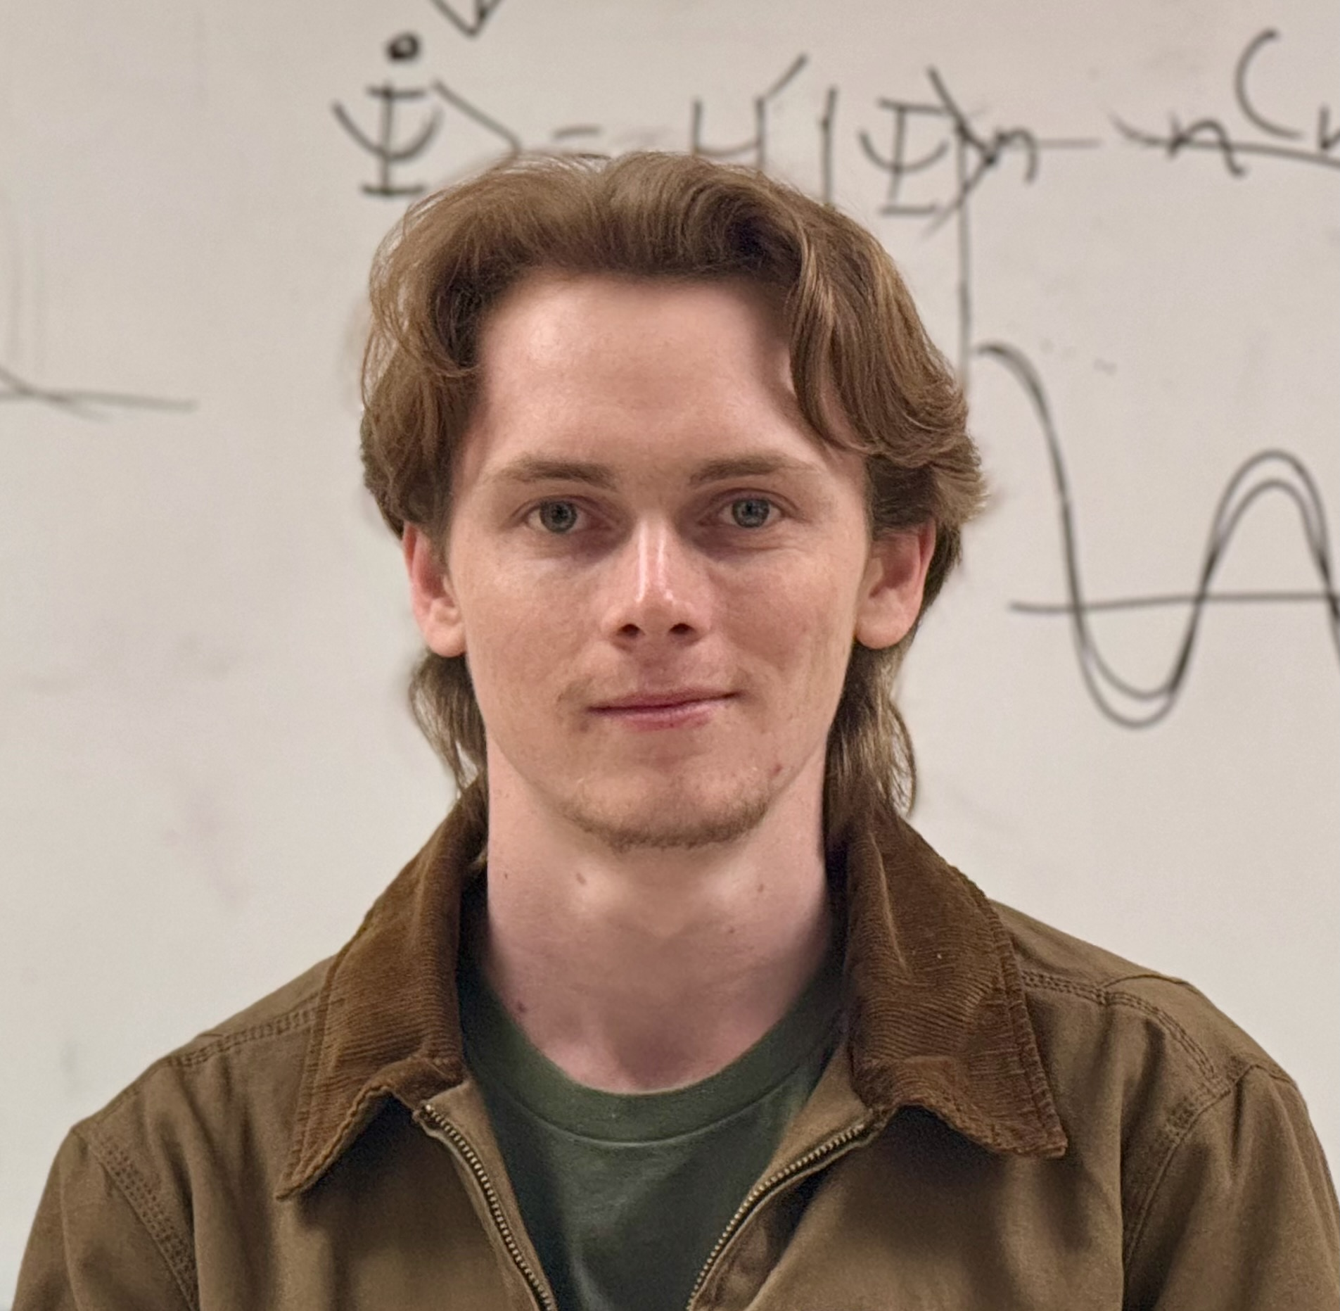




Acknowledgements
Saeed Rahmanian Koshkaki
Logan Blackham
Ian Haines

Slide 18

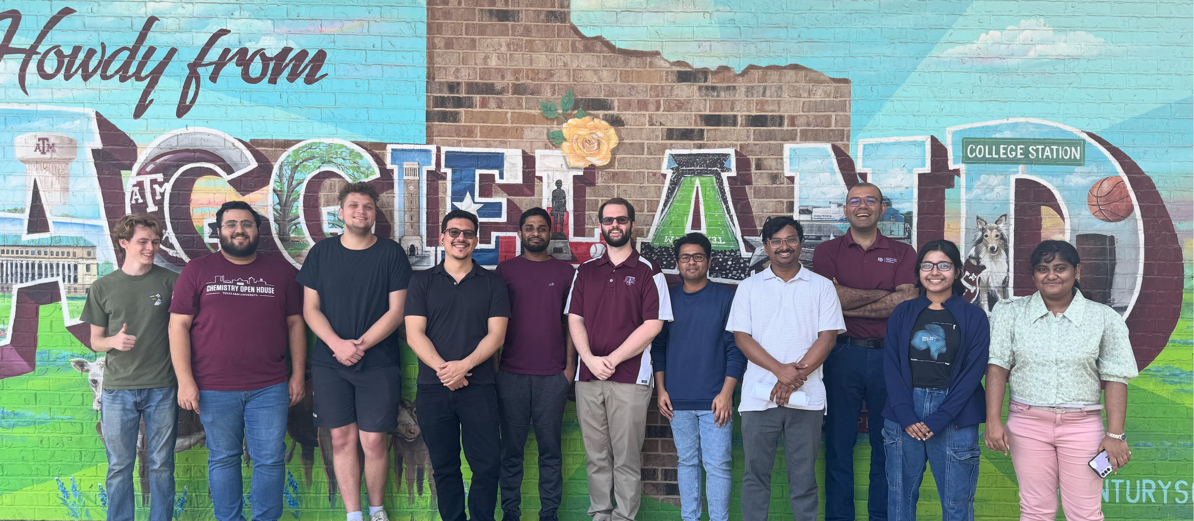

Slide 19
Future Direction
Developing a Package for Ab-initio Quantum Dynamics
DFTB propagation (10000 molecules.)
Manjalingal,…, Rao, Mandal, in prep (2025)

Slide 20
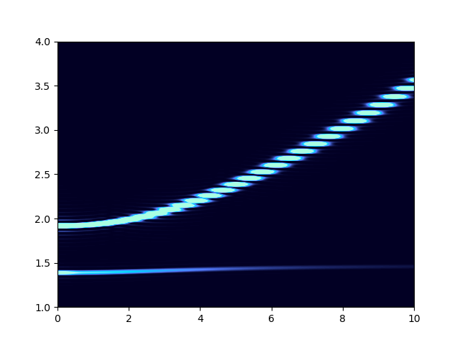
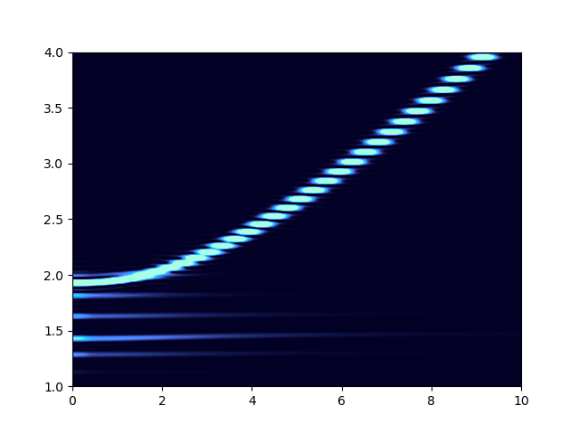
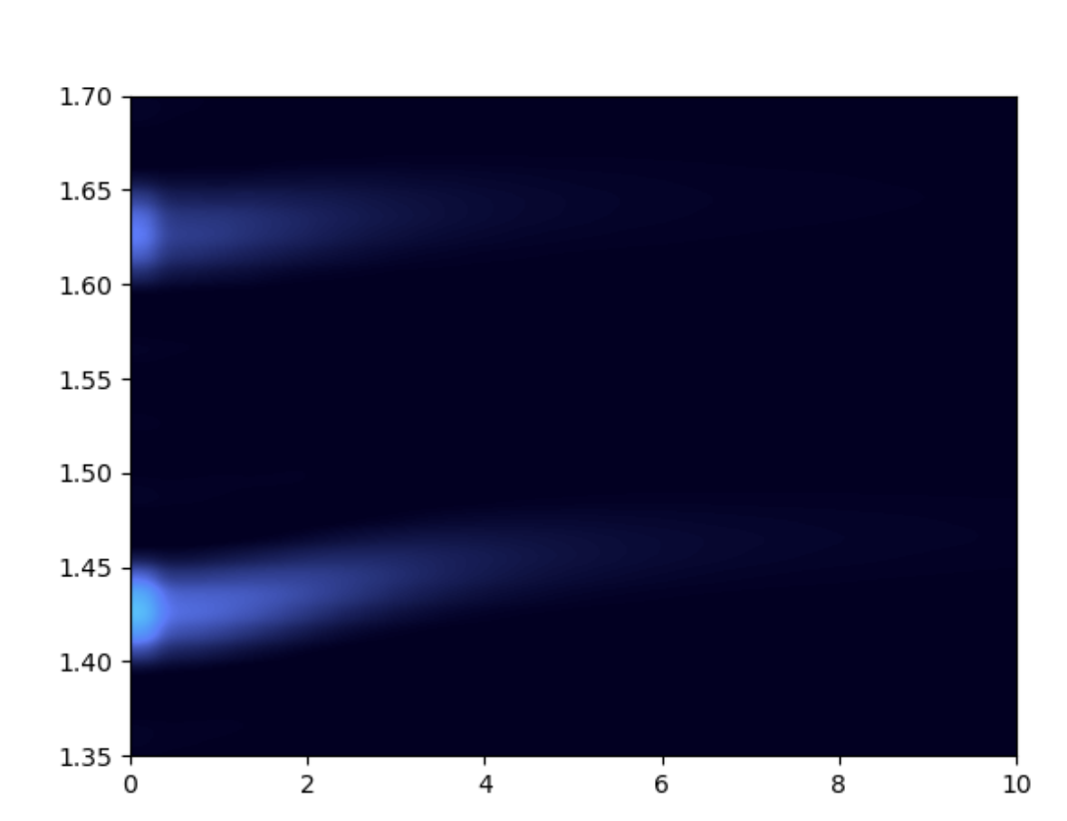
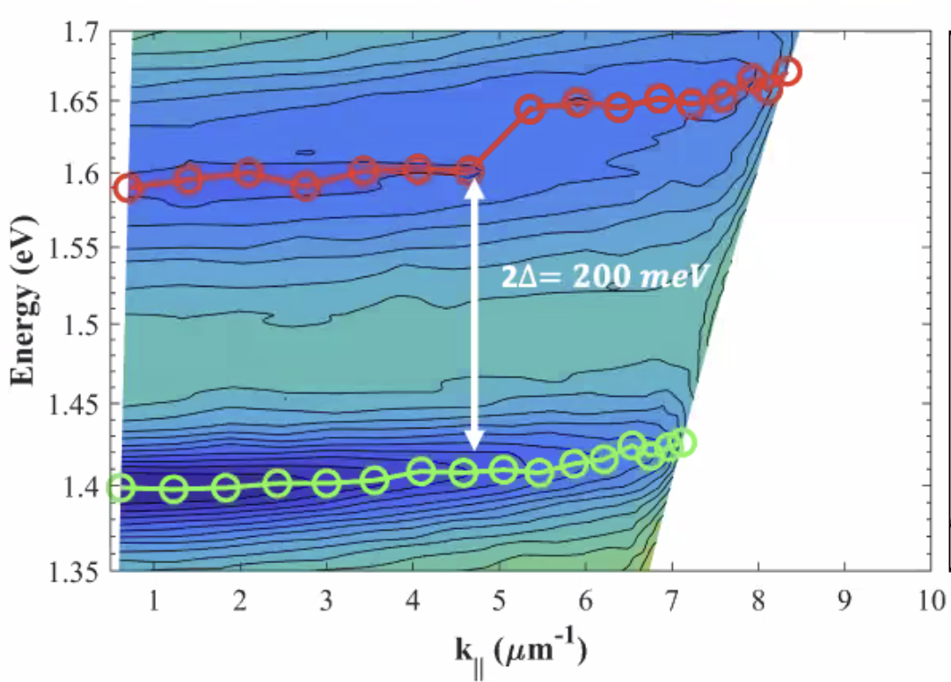




Comparing to Experiment
Bare exciton-polariton
Polaron-polariton
Energy (eV)
Energy (eV)
1 peak
2 peaks
K ($μ$m⁻¹)
K ($μ$m⁻¹)
K ($μ$m⁻¹)
We observe the polaron
polariton peaks in the
organic polaron polaritons
experiment
Prof. Yi Rao
Utah State
Manjalingal,…, Rao, Mandal, in prep (2025)

Slide 22





















$${\hat{H}}_{I}$$
$${\hat{a}}_{k_{1}}^{†}$$
$${\hat{a}}_{k_{2}}^{†}$$
$${\hat{a}}_{k_{3}}^{†}$$
$${\hat{a}}_{k_{4}}^{†}$$
$${\hat{a}}_{k_{5}}^{†}$$
$${\hat{X}}_{k_{1}}^{†}$$
$${\hat{X}}_{k_{2}}^{†}$$
$${\hat{X}}_{k_{3}}^{†}$$
$${\hat{X}}_{k_{4}}^{†}$$
$${\hat{X}}_{k_{5}}^{†}$$
Real space
$${\hat{a}}_{n_{1}}^{†}$$
$${\hat{a}}_{n_{2}}^{†}$$
$${\hat{a}}_{n_{3}}^{†}$$
$${\hat{a}}_{n_{4}}^{†}$$
$${\hat{a}}_{n_{5}}^{†}$$
$${\hat{X}}_{n_{1}}^{†}$$
$${\hat{X}}_{n_{2}}^{†}$$
$${\hat{X}}_{n_{3}}^{†}$$
$${\hat{X}}_{n_{4}}^{†}$$
$${\hat{X}}_{n_{5}}^{†}$$
Notes:
And why do we see this splitting of bands? If we write the light–matter interaction Hamiltonian in the full reciprocal space, as shown here, we can see that the photonic creation operator couples to the exciton with a finite $Δk$separation in a somewhat non-intuitive way. We can explain this clearly using the following animation.
So here, this illustration represents the coupling of the photonic mode with excitons at different sites in real space. In real space, all the excitons are coupled to all photonic modes. However, this picture changes when we move to the reciprocal-space representation, where the Hamiltonian becomes block diagonal. In this representation, each photon with a specific momentum couples only to excitons with the same momentum vector, as shown here. But…

Slide 23











$$ΔK=\sin\left(θ\right)\frac{m_{z}}{{2L}_{z}}$$
$${\hat{H}}_{I}$$
$${\hat{a}}_{k_{1}}^{†}$$
$${\hat{a}}_{k_{2}}^{†}$$
$${\hat{a}}_{k_{3}}^{†}$$
$${\hat{a}}_{k_{4}}^{†}$$
$${\hat{a}}_{k_{5}}^{†}$$
$${\hat{X}}_{k_{1}}^{†}$$
$${\hat{X}}_{k_{2}}^{†}$$
$${\hat{X}}_{k_{3}}^{†}$$
$${\hat{X}}_{k_{4}}^{†}$$
$${\hat{X}}_{k_{5}}^{†}$$
Real space
$${\hat{a}}_{n_{1}}^{†}$$
$${\hat{a}}_{n_{2}}^{†}$$
$${\hat{a}}_{n_{3}}^{†}$$
$${\hat{a}}_{n_{4}}^{†}$$
$${\hat{a}}_{n_{5}}^{†}$$
$${\hat{X}}_{n_{1}}^{†}$$
$${\hat{X}}_{n_{2}}^{†}$$
$${\hat{X}}_{n_{3}}^{†}$$
$${\hat{X}}_{n_{4}}^{†}$$
$${\hat{X}}_{n_{5}}^{†}$$
Notes:
In the tilted material, the light–matter coupling has a spatial dependence, as shown here. When we represent this in reciprocal space, we can see a different pattern, as shown here. From the Hamiltonian, we can see that there is a $Δk$term, and in this case we assume it to be one. As a result, a photon at momentum $k_{1}$couples to a photon at $k_{3}$via an exciton at $k_{2}$. And there is 2 delta k separation between them.
We can see two non-interacting paths like this, and as a result of these independent coupling channels, we observe the splitting of bands.

Slide 24











$$ΔK=\sin\left(θ\right)\frac{m_{z}}{{2L}_{z}}$$
$${\hat{H}}_{I}$$
$${\hat{a}}_{k_{1}}^{†}$$
$${\hat{a}}_{k_{2}}^{†}$$
$${\hat{a}}_{k_{3}}^{†}$$
$${\hat{a}}_{k_{4}}^{†}$$
$${\hat{a}}_{k_{5}}^{†}$$
$${\hat{X}}_{k_{1}}^{†}$$
$${\hat{X}}_{k_{2}}^{†}$$
$${\hat{X}}_{k_{3}}^{†}$$
$${\hat{X}}_{k_{4}}^{†}$$
$${\hat{X}}_{k_{5}}^{†}$$
Real space
$${\hat{a}}_{n_{1}}^{†}$$
$${\hat{a}}_{n_{2}}^{†}$$
$${\hat{a}}_{n_{3}}^{†}$$
$${\hat{a}}_{n_{4}}^{†}$$
$${\hat{a}}_{n_{5}}^{†}$$
$${\hat{X}}_{n_{1}}^{†}$$
$${\hat{X}}_{n_{2}}^{†}$$
$${\hat{X}}_{n_{3}}^{†}$$
$${\hat{X}}_{n_{4}}^{†}$$
$${\hat{X}}_{n_{5}}^{†}$$
Notes:
And this $Δk$ is defined by the relation shown here, where $θ$is the tilt angle, $m_{z}$is the cavity quantization index, and $L_{z}$is the distance between the mirrors.

Slide 25
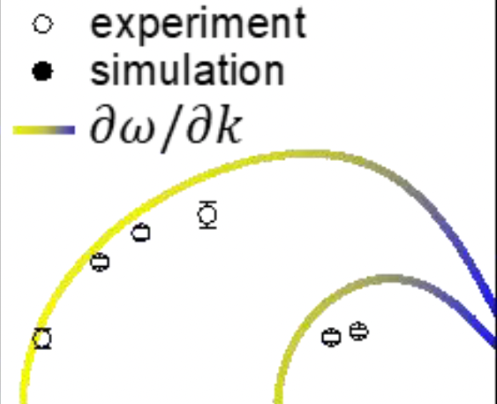
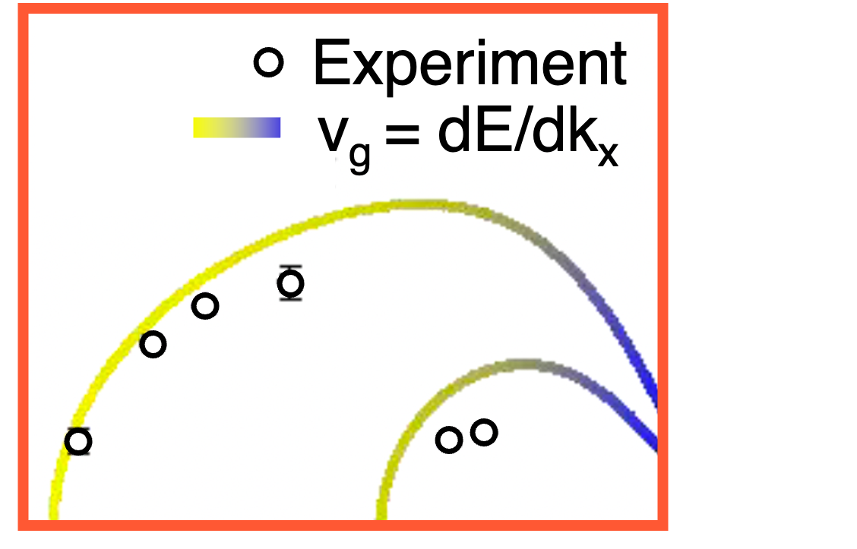
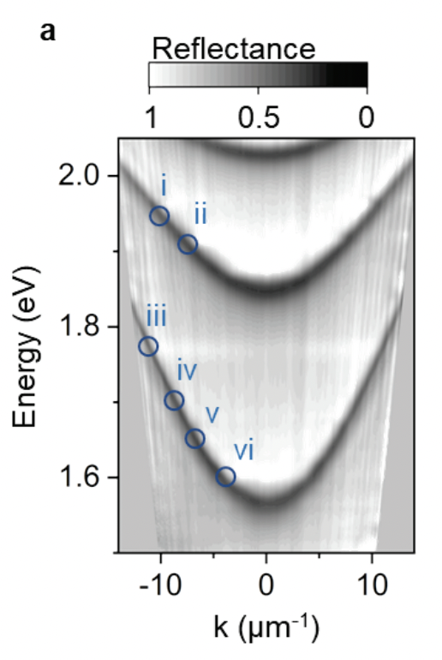
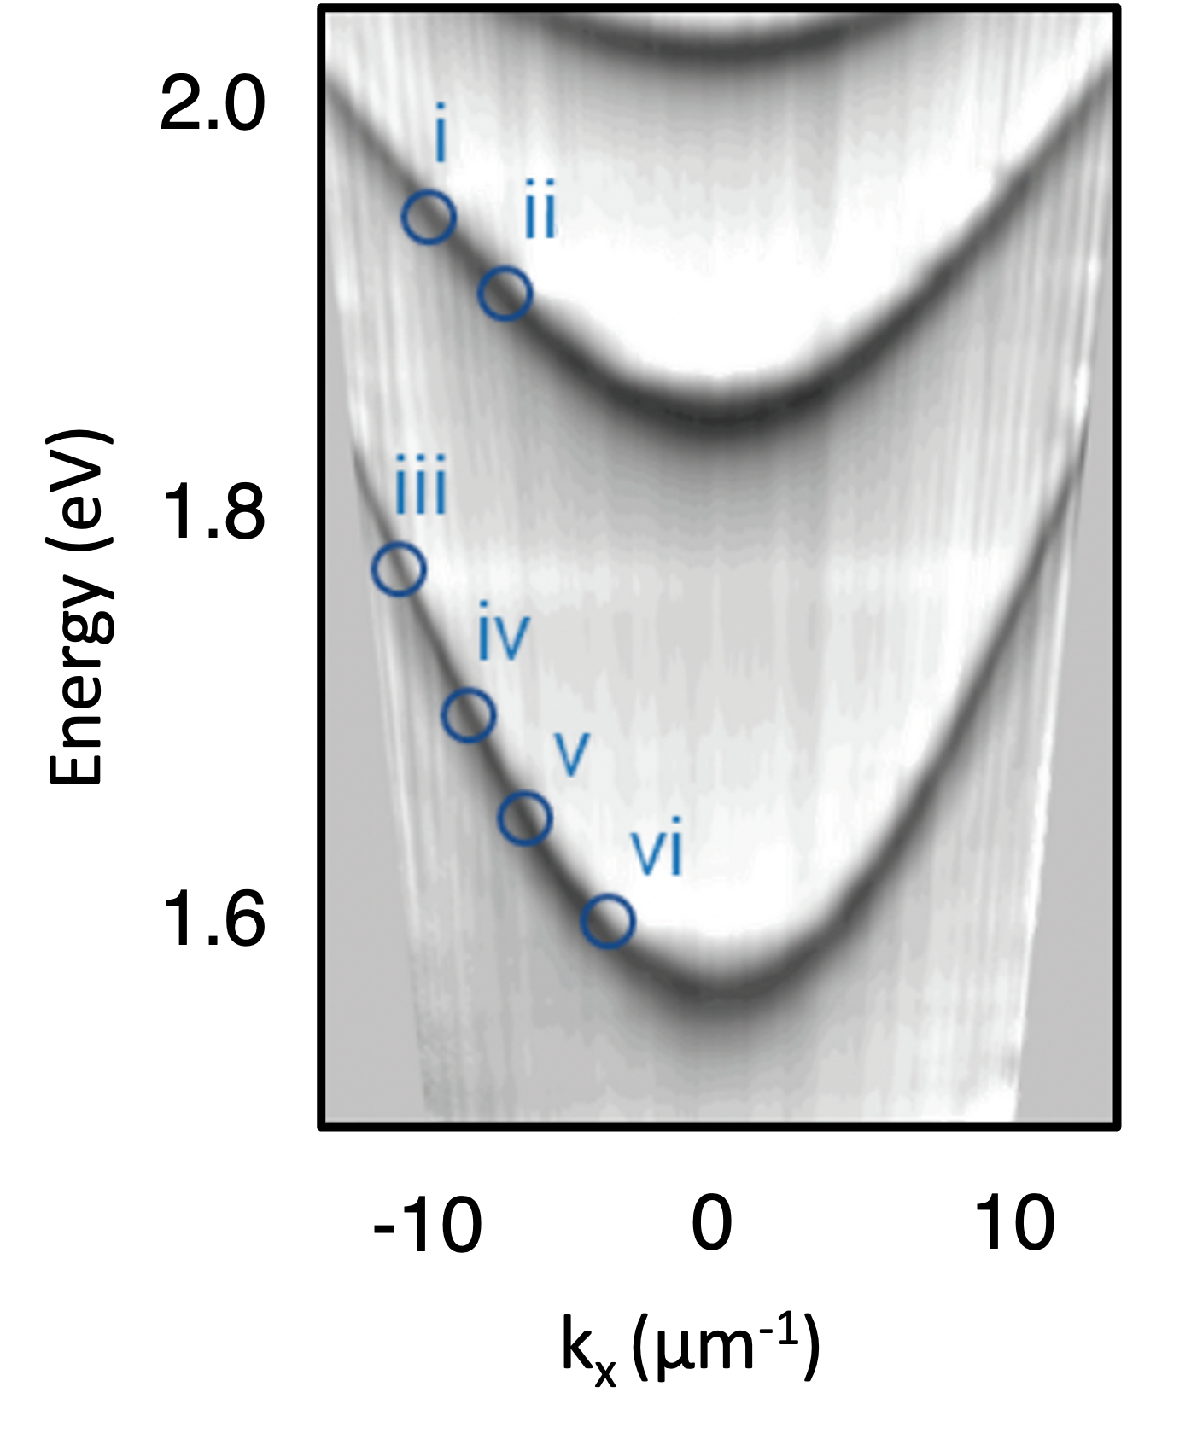



Experiment
v_{g} = dE/dk_{x}
v_{g}
Group Velocity Renormalization
1.7
1.9
2.1
Single Layer
Multilayer
Energy (eV)
2.0
$$V_{g}$$
1.8
Energy (eV)
1.7
1.9
2.1
2.0
Energy (eV)
1.6
-10
0
10
1.8
k_{x} (µm⁻¹)
Energy (eV)
1.6
Xu$†$, Mandal$†$… , Reichman, Delor Nat. Comm. (2023)
-10
0
10
Blackham$^{†}$, Manjalingal$^{†}$, Rahmanian, Mandal, Nano Letters. (2025)
$K_{x}$ ($μ$m⁻¹ )
Rahmanian, Manjalingal, Blackham, Mandal, arXiv (2025)

Slide 26
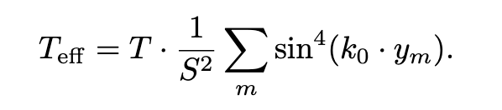

Phonon Fluctuation Synchronization Effect
Suppression of the effective classical temperature
This opens lot of unanswered Question?
Changing Cavity-Material Architecture
Relaxation Pathways
k_{y}
k_{y}
Upper
Polariton
K_{UL}
k_{x}
k_{x}
K_{UD}
Energy
Dark Bands
K_{DL}
Lower
Polariton
weak Fröhlich Scattering
(d)
$$k$$

Slide 27

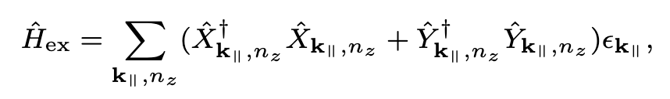
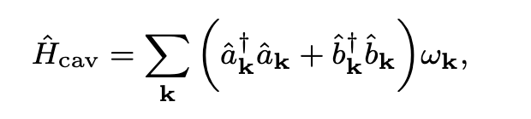
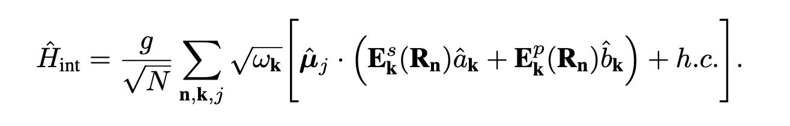
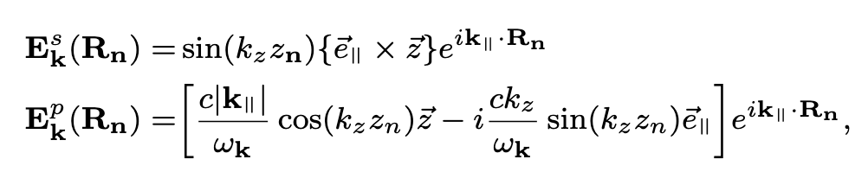
Hamiltonian
Excitonic Part
Photonic Part
Light-Matter Interaction
Where,

Slide 28
Relaxation in

Slide 29
Direct Transition

Slide 30
Suppression of Frohlich

Slide 31

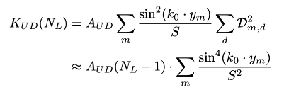
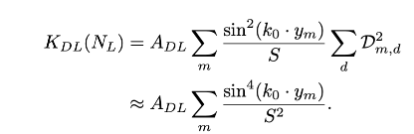
Relaxation Rates

